Slide 1
MTH376: Algebra
For
Master of Mathematics
By
Dr. M. Fazeel Anwar
Assistant Professor
Department of Mathematics, CIIT Islamabad

Slide 2
Lecture 06

Slide 3
Recap
Matrix Groups
Commutative Groups

Slide 4
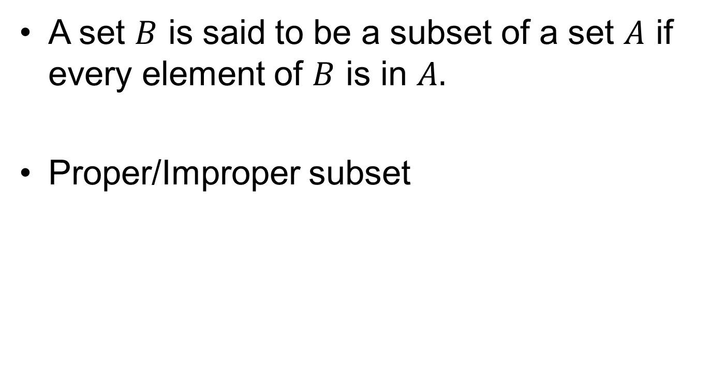
Subset
A set $B$ is said to be a subset of a set $A$ if every element of $B$ is in $A.$
Proper/Improper subset

Slide 5
Examples

Slide 6
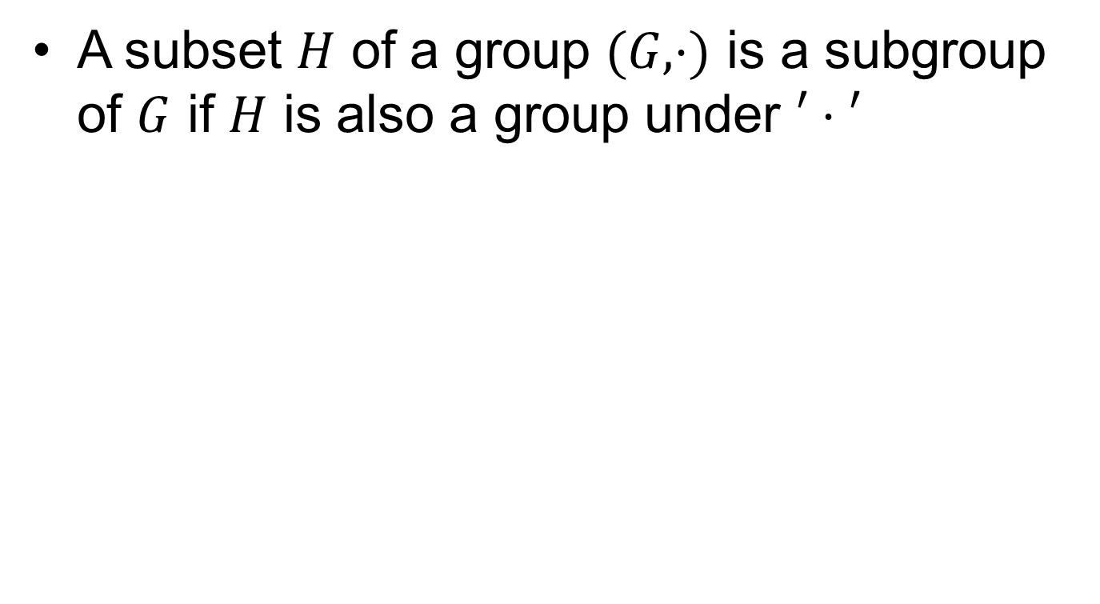
Subgroup
A subset $H$ of a group $(G, ⋅)$ is a subgroup of $G$ if $H$ is also a group under $′⋅′$

Slide 7
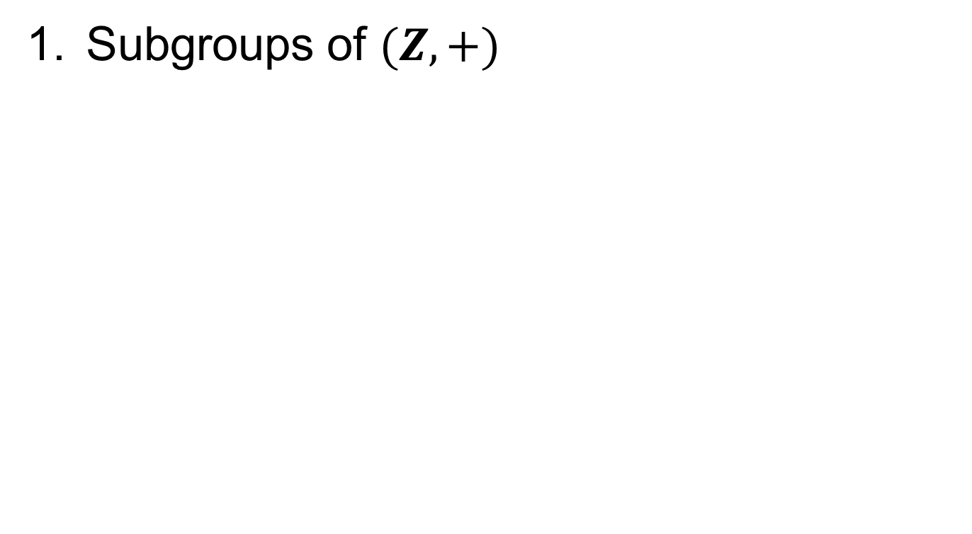
Examples
Subgroups of $(Z, +)$

Slide 8
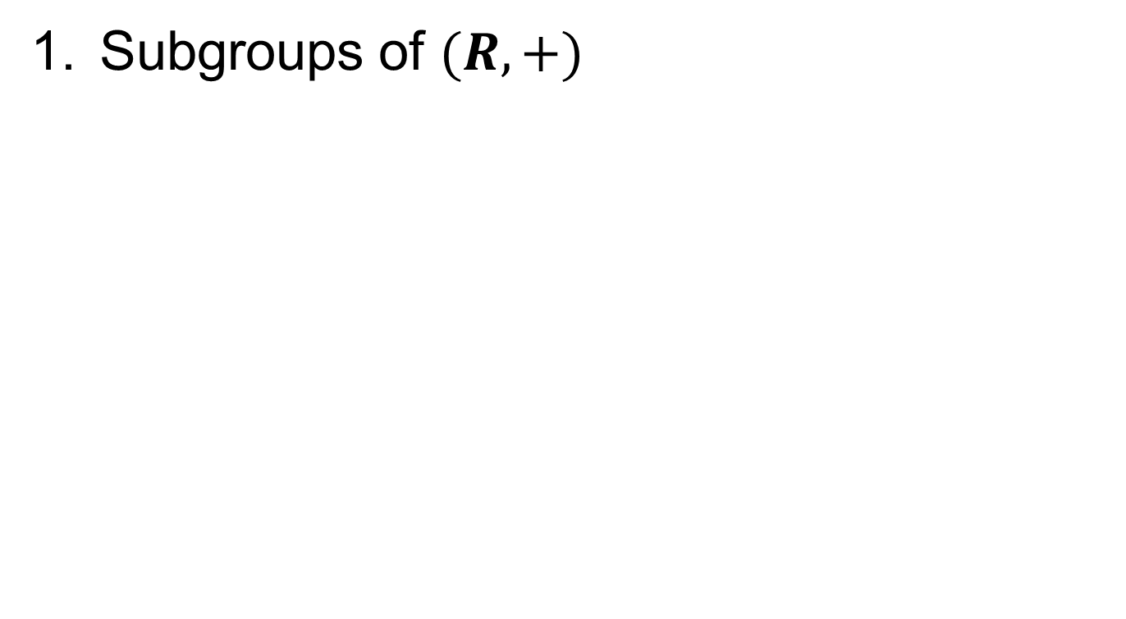
Examples.
Subgroups of $(R, +)$

Slide 9
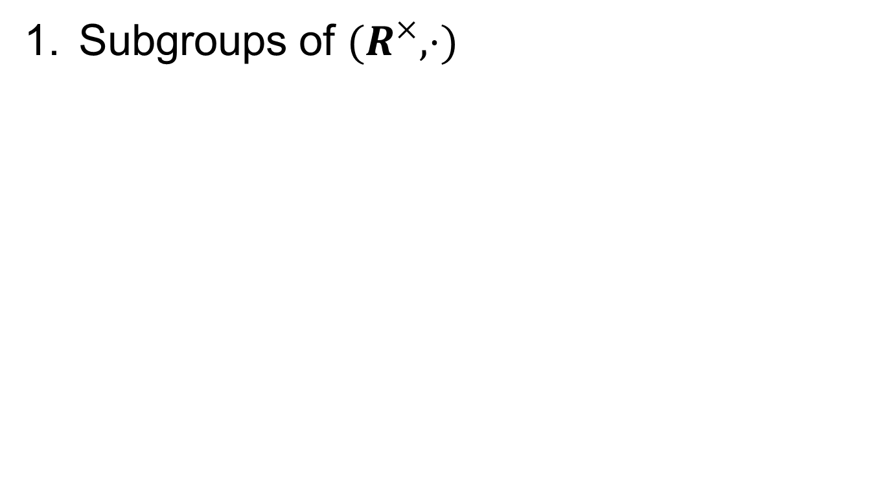
Examples..
Subgroups of $(R^{×}, ⋅)$

Slide 10
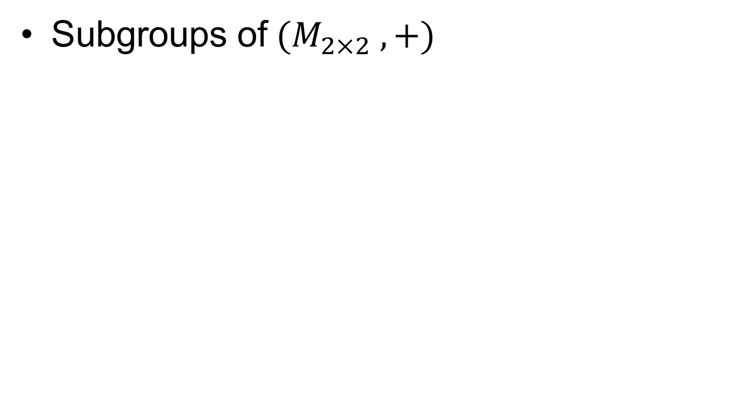
Examples...
Subgroups of $(M_{2×2} ,+)$

Slide 12
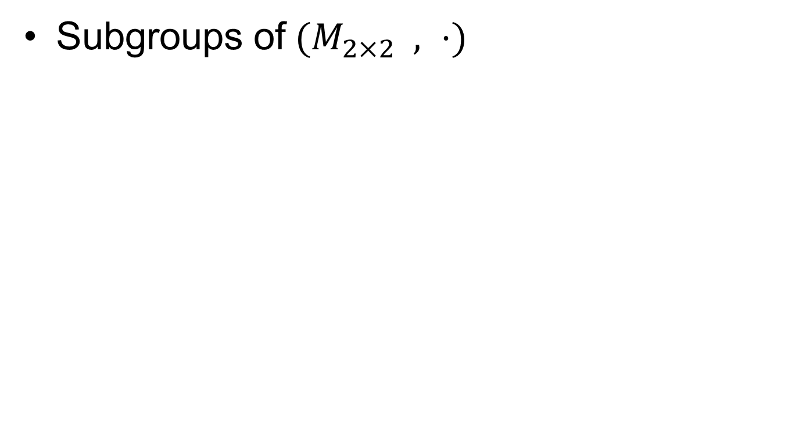
Examples....
Subgroups of $(M_{2×2} , ⋅)$

Slide 13
Summary

Slide 14
Thank You

