Slide 1
MTH376: Algebra
For
Master of Mathematics
By
Dr. M. Fazeel Anwar
Assistant Professor
Department of Mathematics, CIIT Islamabad

Slide 2
Lecture 05

Slide 3
Recap
Group (Definition)
Finite Groups
Group Tables
Rules for Group Tables
Properties of Groups

Slide 4
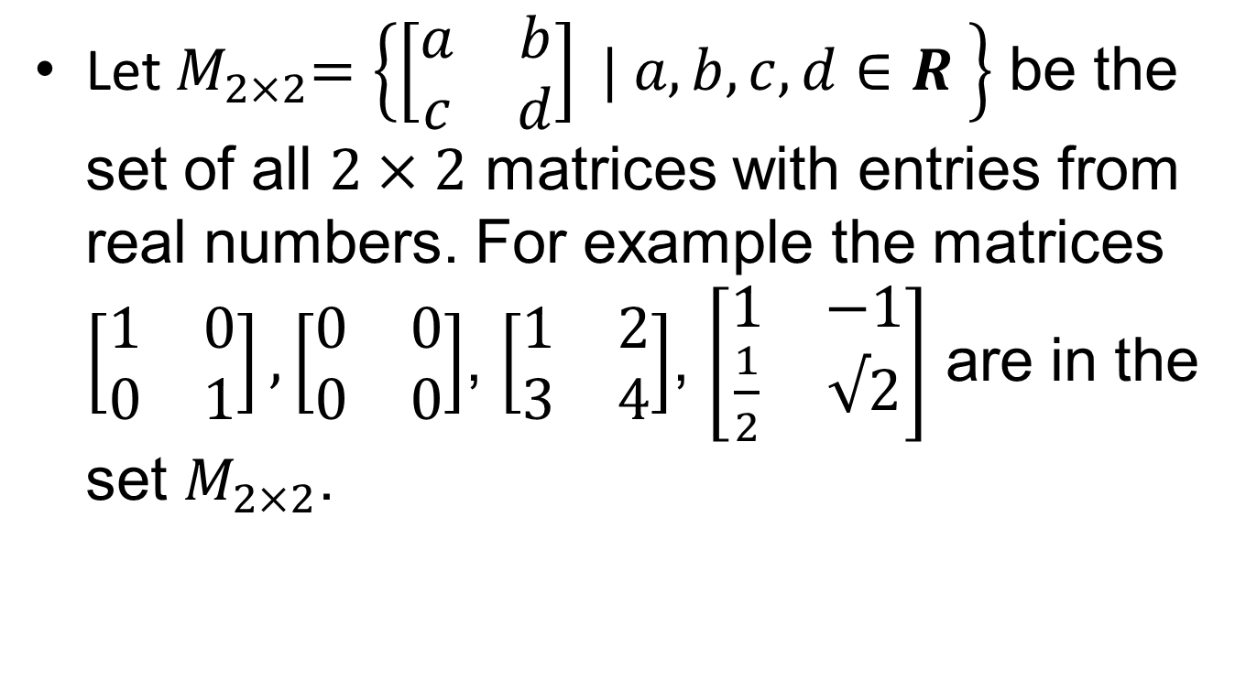
Matrix Groups
Let${ M}_{2×2}=\left\{\left[\begin{matrix}a & b \\ c & d\end{matrix}\right] | a,b,c,d∈R \right\}$ be the set of all $2×2$ matrices with entries from real numbers. For example the matrices $\left[\begin{matrix}1 & 0 \\ 0 & 1\end{matrix}\right],\left[\begin{matrix}0 & 0 \\ 0 & 0\end{matrix}\right]$, $\left[\begin{matrix}1 & 2 \\ 3 & 4\end{matrix}\right]$, $\left[\begin{matrix}1 & −1 \\ \frac{1}{2} & √2\end{matrix}\right]$ are in the set $M_{2×2}$.

Slide 5
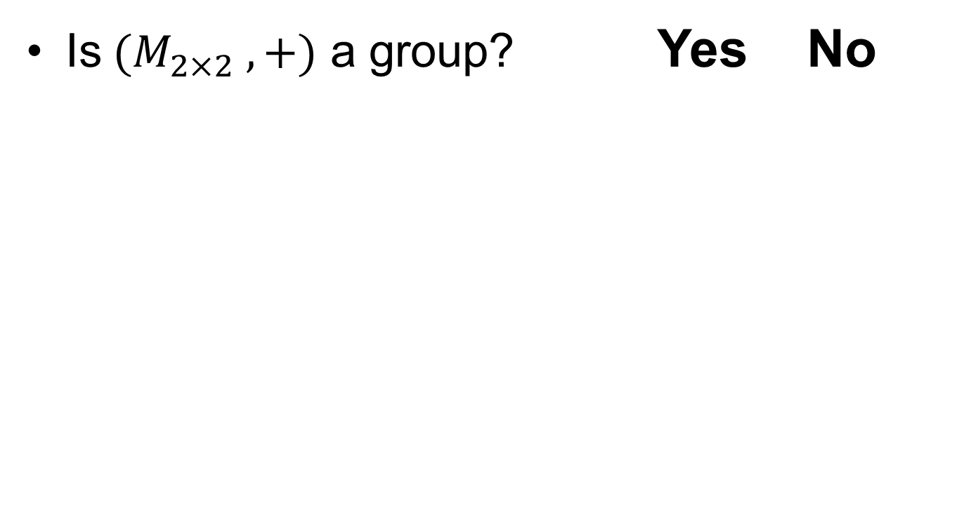
Matrix Groups.
Is $(M_{2×2} ,+)$ a group? Yes No

Slide 6
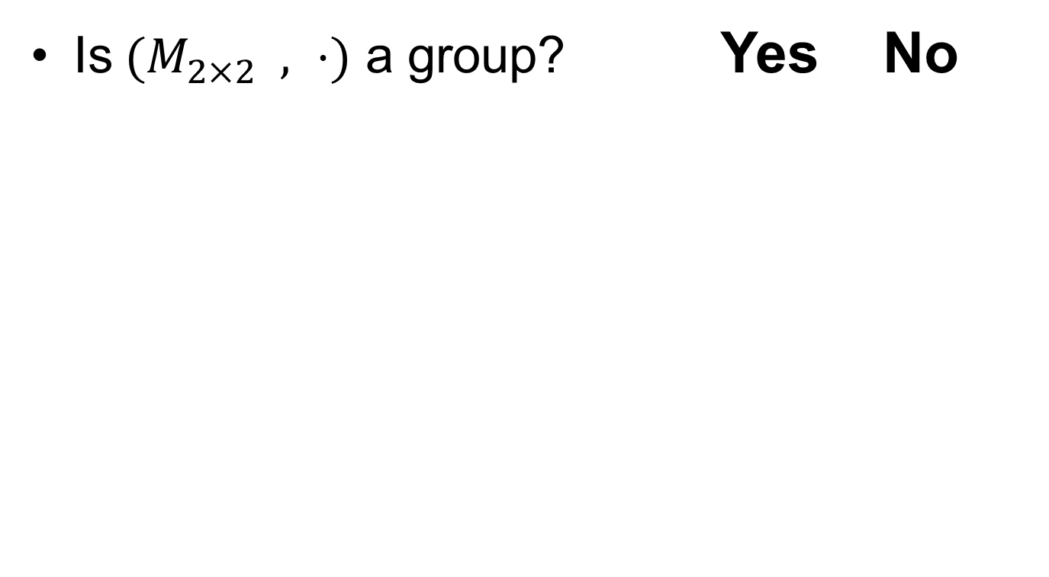
Matrix Groups..
Is $(M_{2×2} , ⋅)$ a group? Yes No

Slide 7
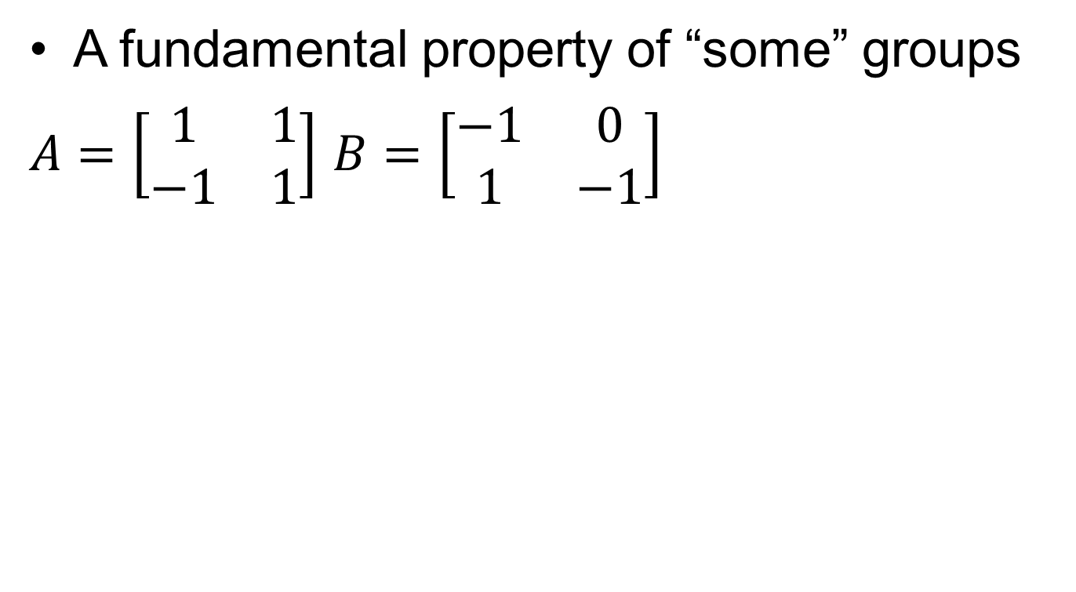
Matrix Groups…
A fundamental property of “some” groups
$A=\left[\begin{matrix}1 & 1 \\ −1 & 1\end{matrix}\right]$ $B=\left[\begin{matrix}−1 & 0 \\ 1 & −1\end{matrix}\right]$

Slide 8
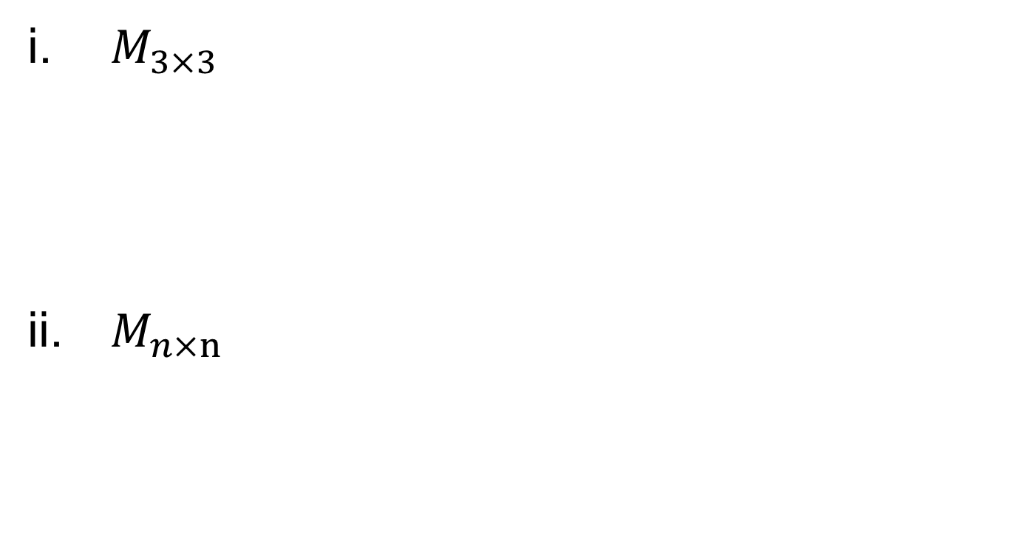
Matrix Groups….
$M_{3×3}$
$M_{n×n}$

Slide 9

Matrix Groups…..
$M_{m×n}$

Slide 10
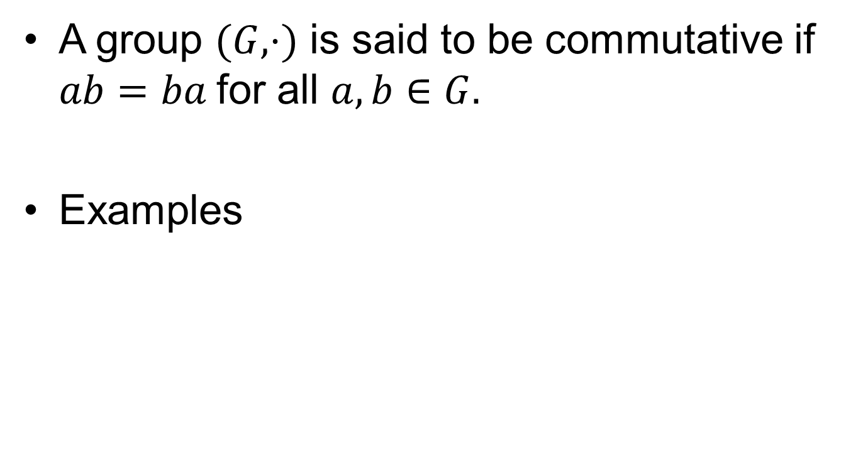
Commutative Groups
A group $(G, ⋅)$ is said to be commutative if $ab=ba$for all $a,b∈G.$
Examples

Slide 11
Summary

Slide 12
Thank You

