Slide 1
MTH376: Algebra
For
Master of Mathematics
By
Dr. M. Fazeel Anwar
Assistant Professor
Department of Mathematics, CIIT Islamabad

Slide 2
Lecture 04

Slide 3
Recap
Group (Definition)
Examples of groups

Slide 4
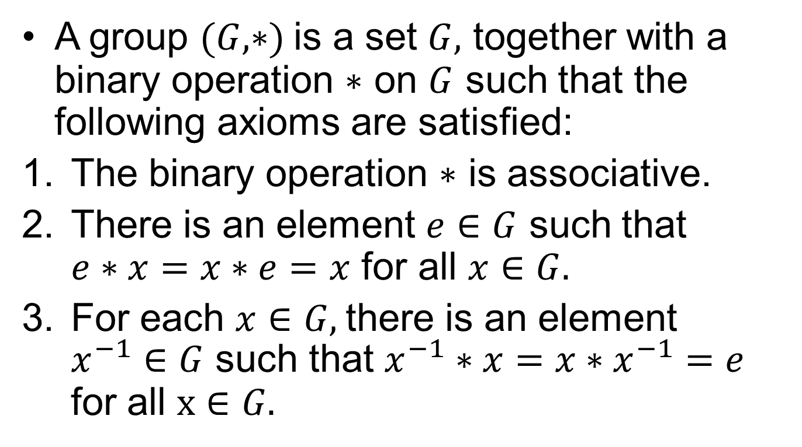
Group
A group $(G, ∗)$ is a set $G,$ together with a binary operation $∗$ on $G$ such that the following axioms are satisfied:
The binary operation $∗$ is associative.
There is an element $e∈G$ such that $e∗x=x∗e=x$ for all $x∈G.$
For each $x∈G,$there is an element $x^{−1}∈G$ such that $x^{−1}∗x=x∗x^{−1}=e$ for all $x∈G.$

Slide 5
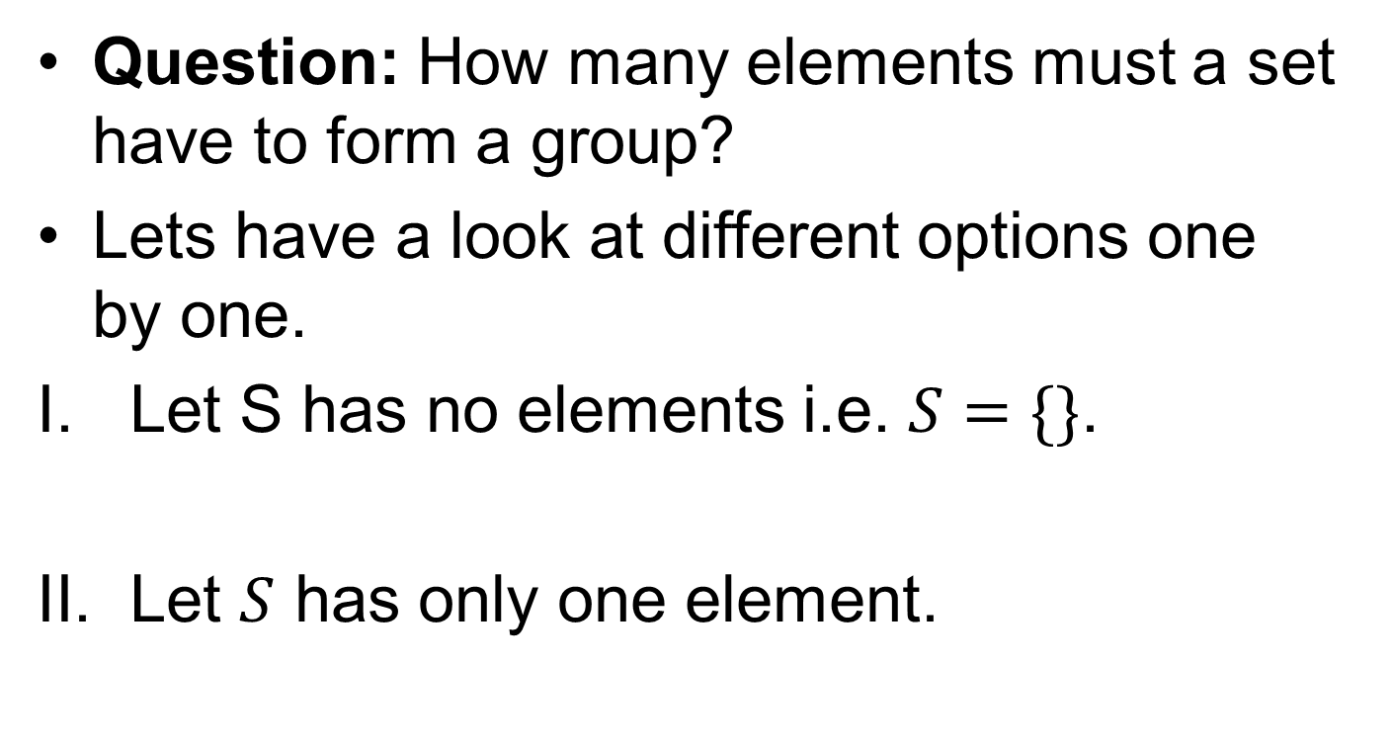
Finite Groups
Question: How many elements must a set have to form a group?
Lets have a look at different options one by one.
Let S has no elements i.e. $S=\{\}$.
Let $S$ has only one element.

Slide 6
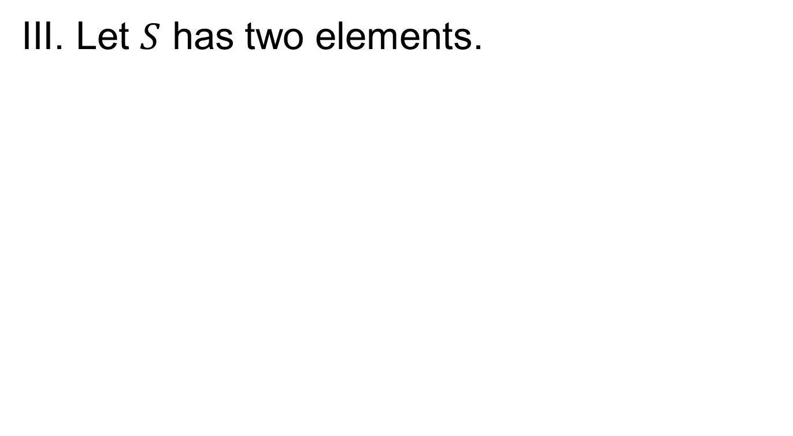
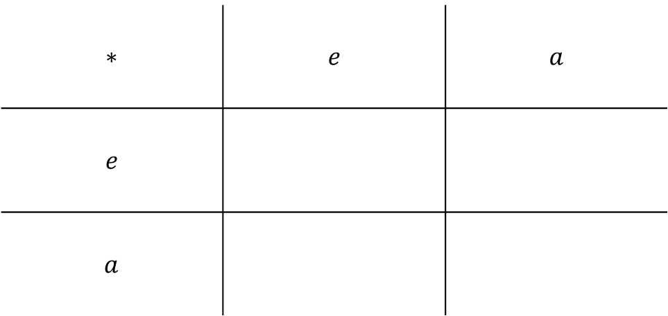
Finite Groups.
Let $S$ has two elements.
$$∗$$ | $$e$$ | $$a$$
$$e$$
$$a$$

Slide 7
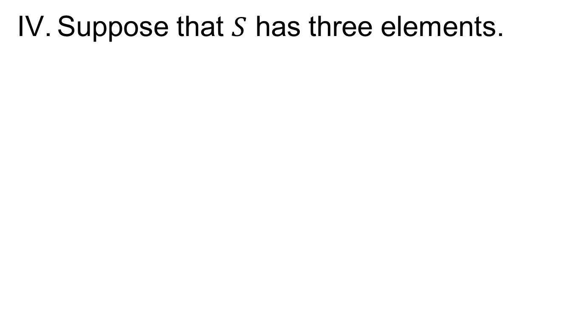
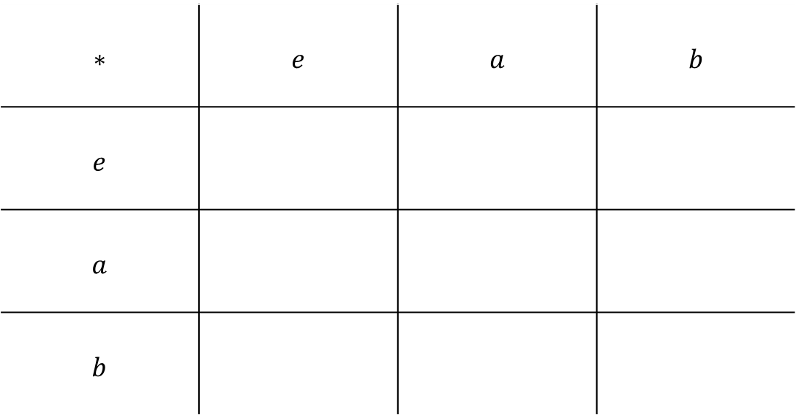
Finite Groups..
Suppose that $S$ has three elements.
$$∗$$ | $$e$$ | $$a$$ | $$b$$
$$e$$
$$a$$
$$b$$

Slide 8
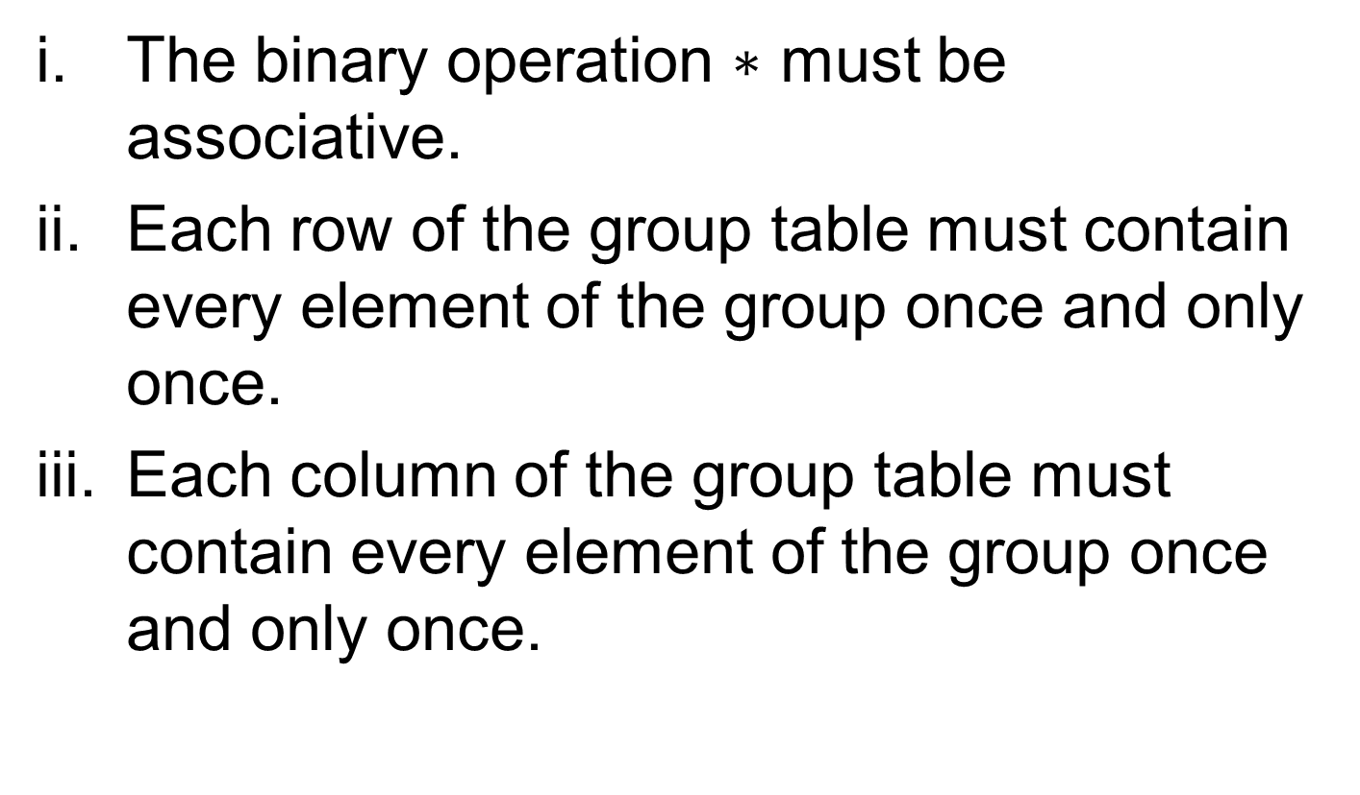
Rules for Group Tables
The binary operation $∗$ must be associative.
Each row of the group table must contain every element of the group once and only once.
Each column of the group table must contain every element of the group once and only once.

Slide 9
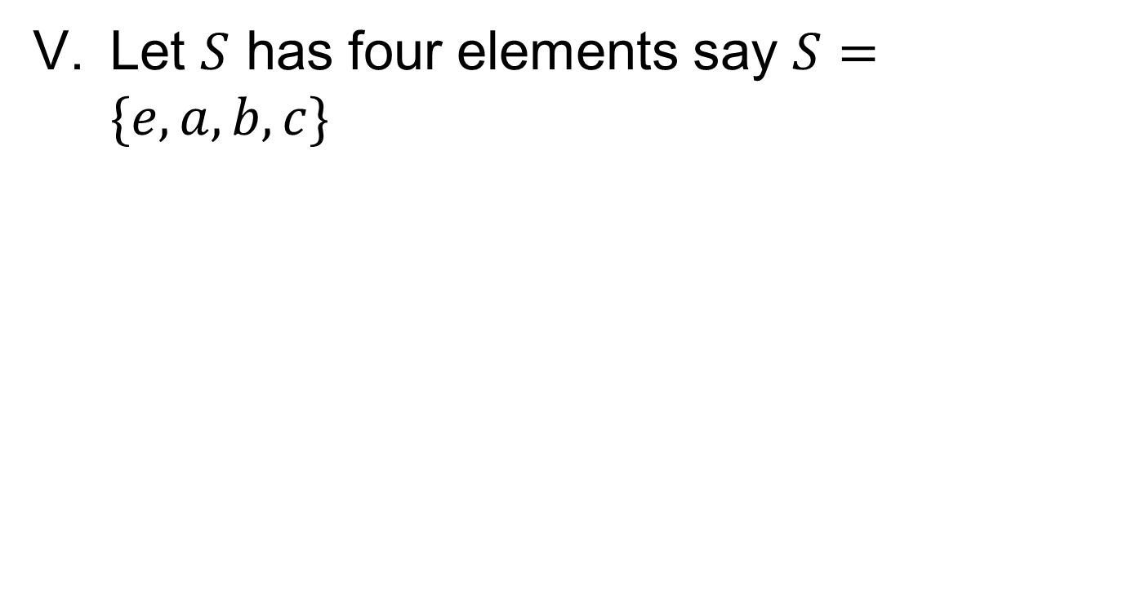
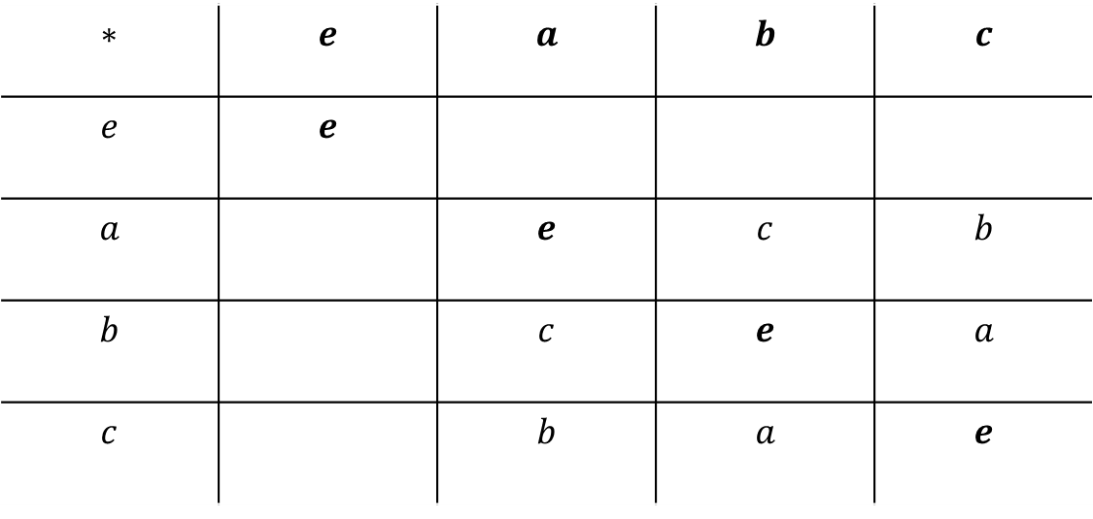
Finite Groups…
Let $S$ has four elements say $S=\{e,a,b,c\}$
$$∗$$ | $$e$$ | $$a$$ | $$b$$ | $$c$$
$$e$$ | $$e$$
$$a$$ |  | $$e$$ | $$c$$ | $$b$$
$$b$$ |  | $$c$$ | $$e$$ | $$a$$
$$c$$ |  | $$b$$ | $$a$$ | $$e$$

Slide 10
Finite Groups….
The group of four elements displayed in the last slide is known as the Klein 4-group.
Exercise: Find another group table on a set of four elements.

Slide 11
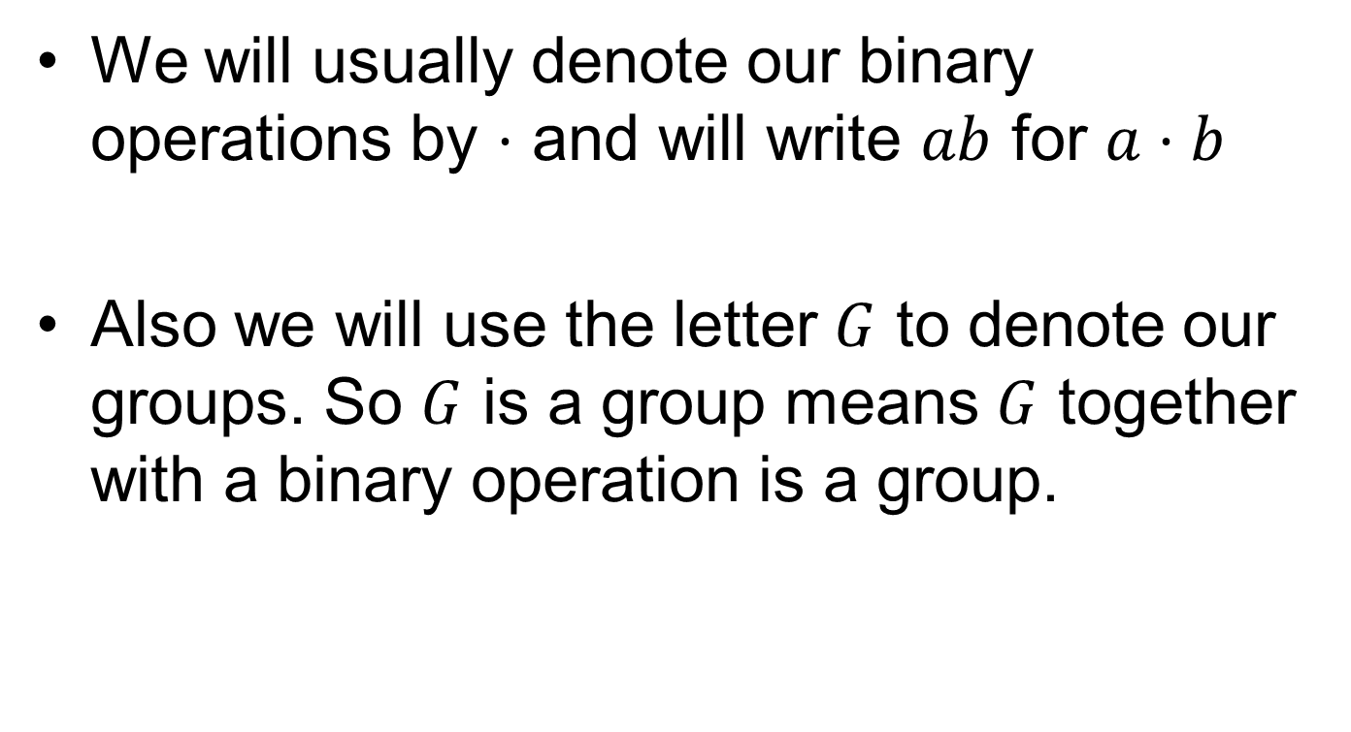
Some Conventions
We will usually denote our binary operations by $⋅$ and will write $ab$ for $a⋅b$
Also we will use the letter $G$ to denote our groups. So $G$ is a group means $G$ together with a binary operation is a group.

Slide 12
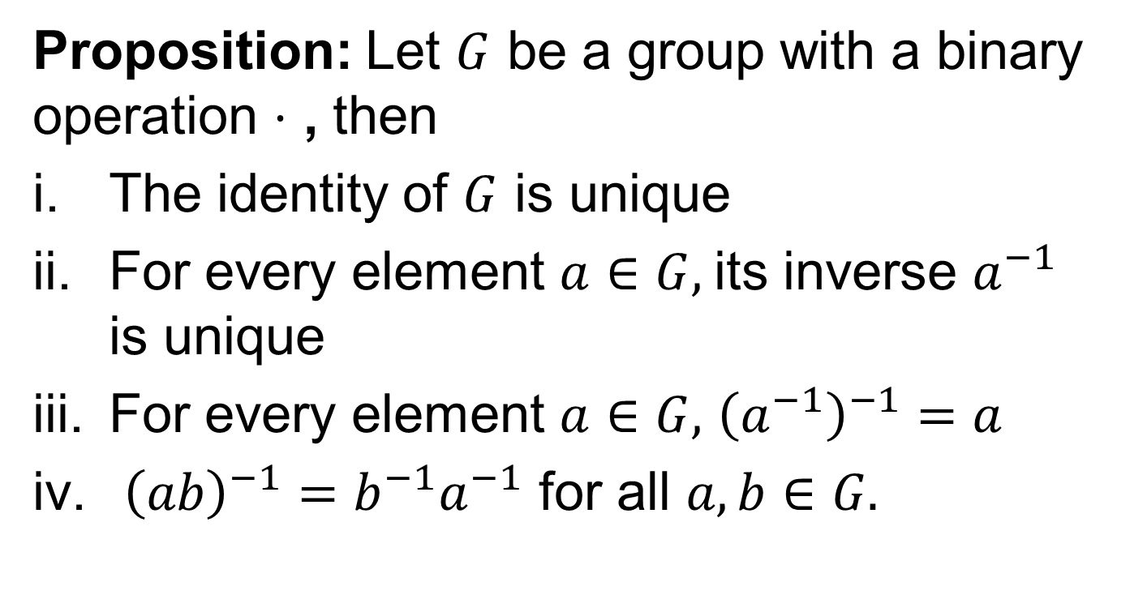
Properties of Groups
Proposition: Let $G$ be a group with a binary operation $⋅$ , then
The identity of $G$ is unique
For every element $a∈G,$its inverse $a^{−1}$ is unique
For every element $a∈G,$ ${\left(a^{−1}\right)}^{−1}=a$
${\left(ab\right)}^{−1}={b^{−1}a}^{−1}$ for all $a,b∈G.$

Slide 13
Proof

Slide 16
Summary

Slide 17
Thank You

