Slide 1
MTH376: Algebra
For
Master of Mathematics
By
Dr. M. Fazeel Anwar
Assistant Professor
Department of Mathematics, CIIT Islamabad

Slide 2
Lecture 30

Slide 3
Recap
Ring
Examples

Slide 4
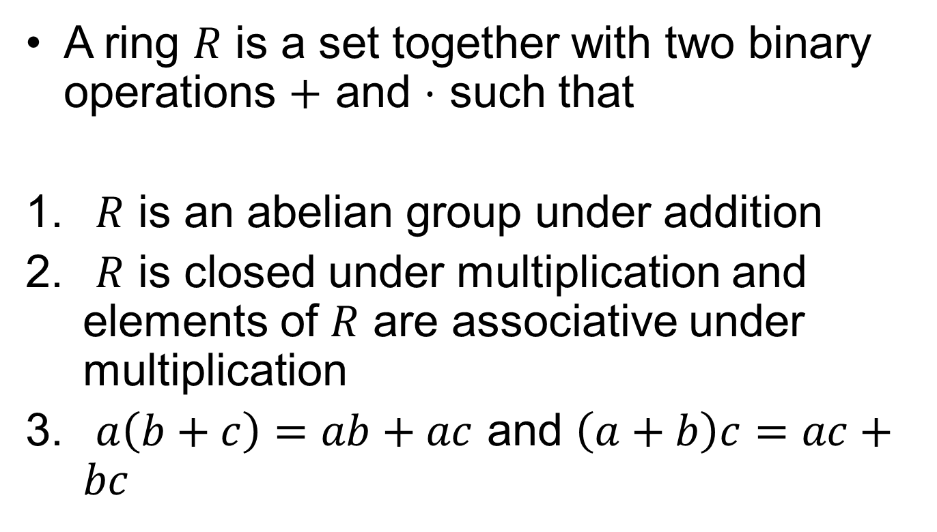
Rings
A ring $R$ is a set together with two binary operations $+$ and $⋅$ such that
$R$ is an abelian group under addition
$R$ is closed under multiplication and elements of $R$ are associative under multiplication
$a\left(b+c\right)=ab+ac$ and $\left(a+b\right)c=ac+bc$

Slide 5

Examples
$Z$

Slide 6

Examples
$Z_{n}$

Slide 7

Examples
$M_{n×n}(R)$

Slide 8

Examples
$R[X]$

Slide 10
Commutative ring

Slide 12
Zero divisors

Slide 13
Integral domain

Slide 14
Ring with unity

Slide 15
Examples of Integral Domain

Slide 16
Units

Slide 17
Subring

Slide 18
Summary

Slide 19
Thank You

