Slide 1
MTH376: Algebra
For
Master of Mathematics
By
Dr. M. Fazeel Anwar
Assistant Professor
Department of Mathematics, CIIT Islamabad

Slide 2
Lecture 03

Slide 3
Recap
Binary operation
Examples of binary operations
Motivation for defining groups
Group (Definition)

Slide 4
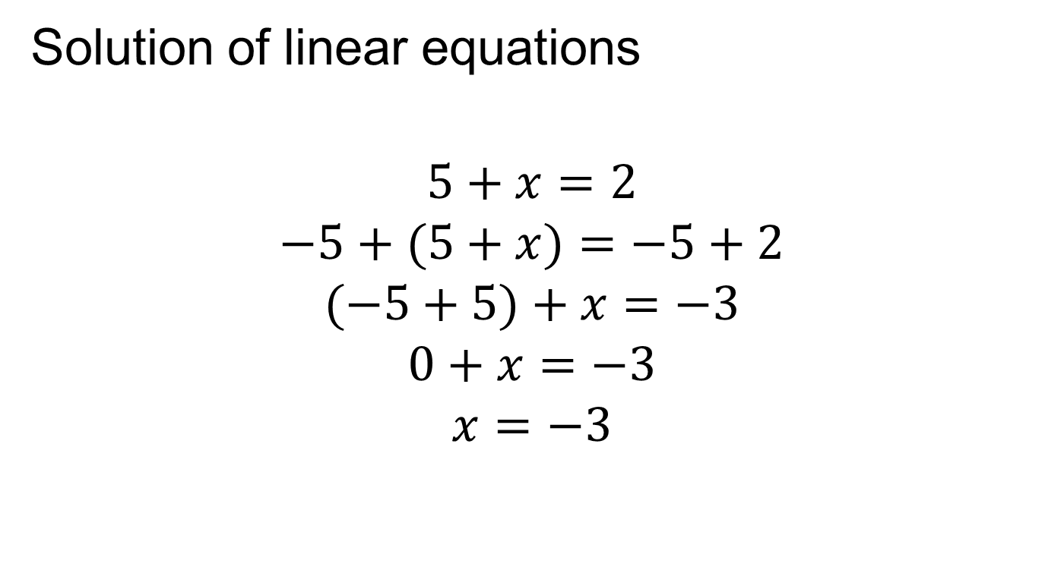
Motivation for defining groups
Solution of linear equations
$$5+x=2$$
$$−5+(5+x)=−5+2$$
$$(−5+5)+x=−3$$
$$0+x=−3$$
$$x=−3$$

Slide 5
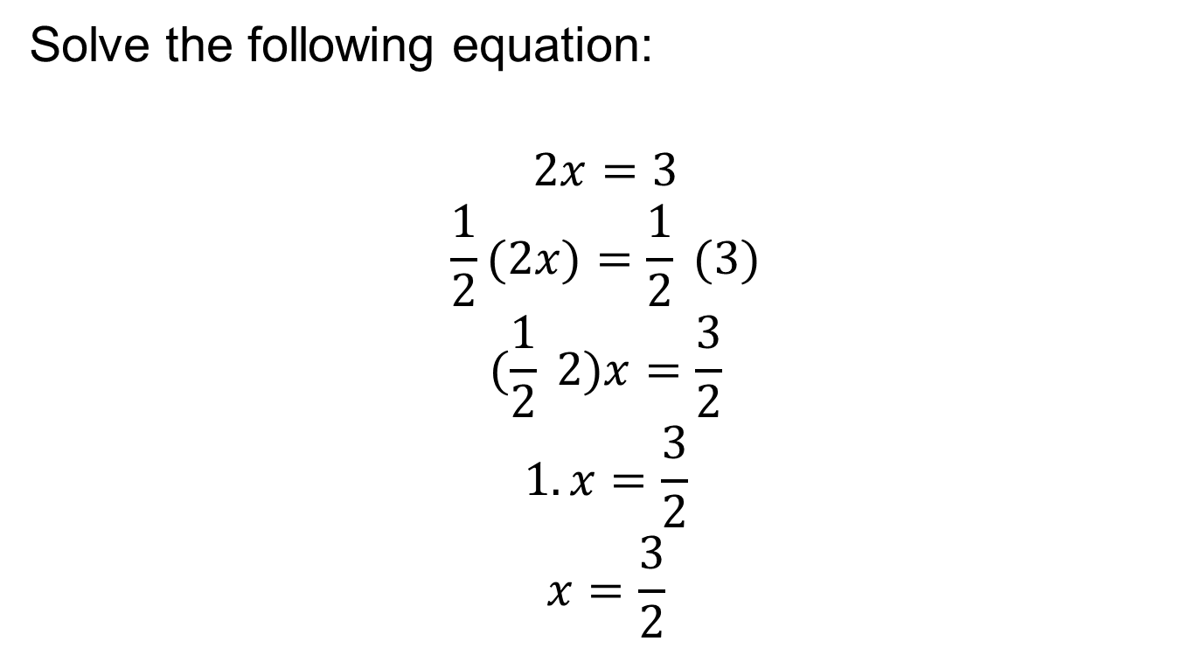
Motivation (continued…)
Solve the following equation:
$$2x=3$$
$$\frac{1}{2}(2x)=\frac{1}{2} (3)$$
$$(\frac{1}{2} 2)x=\frac{3}{2}$$
$$1.x=\frac{3}{2}$$
$$x=\frac{3}{2}$$

Slide 6
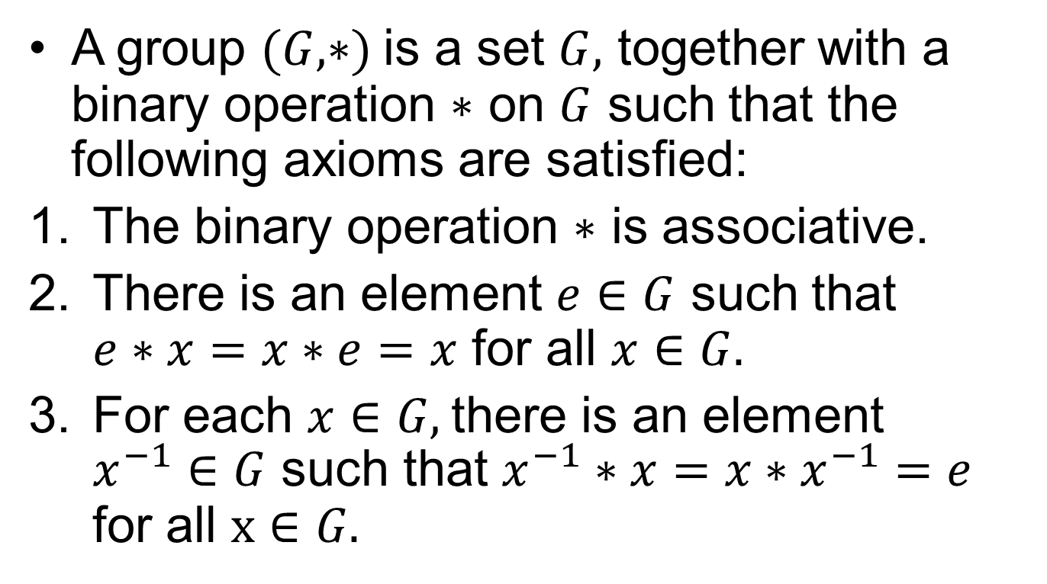
Group
A group $(G, ∗)$ is a set $G,$ together with a binary operation $∗$ on $G$ such that the following axioms are satisfied:
The binary operation $∗$ is associative.
There is an element $e∈G$ such that $e∗x=x∗e=x$ for all $x∈G.$
For each $x∈G,$there is an element $x^{−1}∈G$ such that $x^{−1}∗x=x∗x^{−1}=e$ for all $x∈G.$

Slide 7
Discussion and remarks

Slide 8
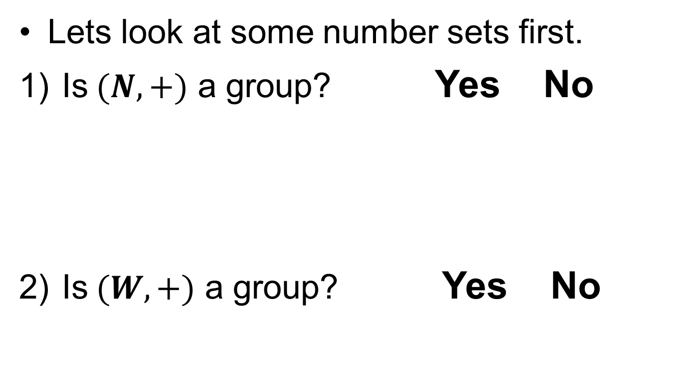
Examples
Lets look at some number sets first.
Is $(N,+)$ a group? Yes No
Is $(W,+)$ a group? Yes No

Slide 9
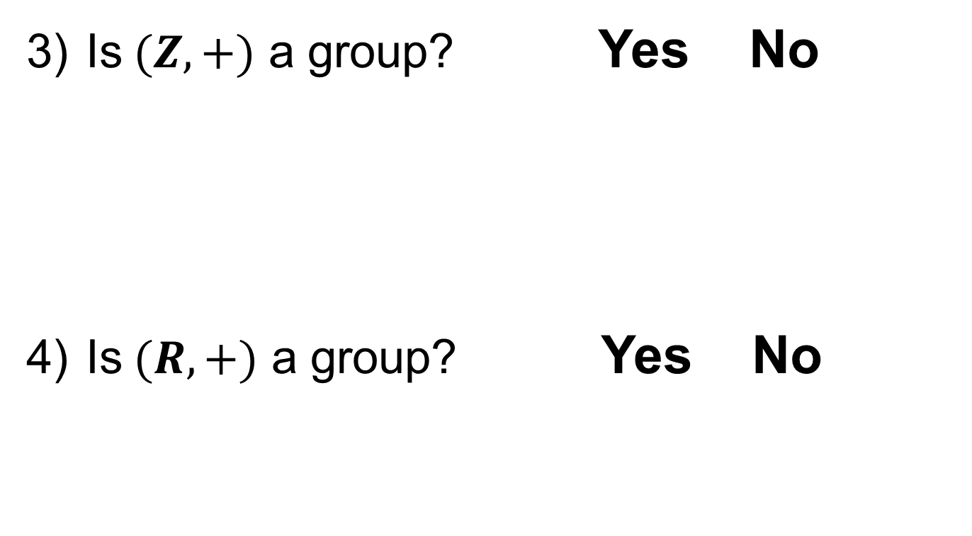
Examples.
Is $(Z,+)$ a group? Yes No
Is $(R,+)$ a group? Yes No

Slide 10
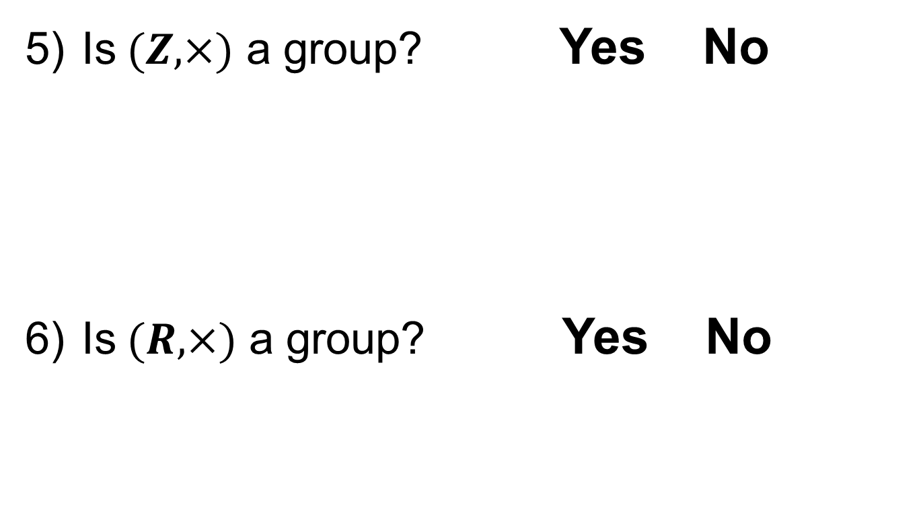
Examples..
Is $(Z,×)$ a group? Yes No
Is $(R,×)$ a group? Yes No

Slide 11
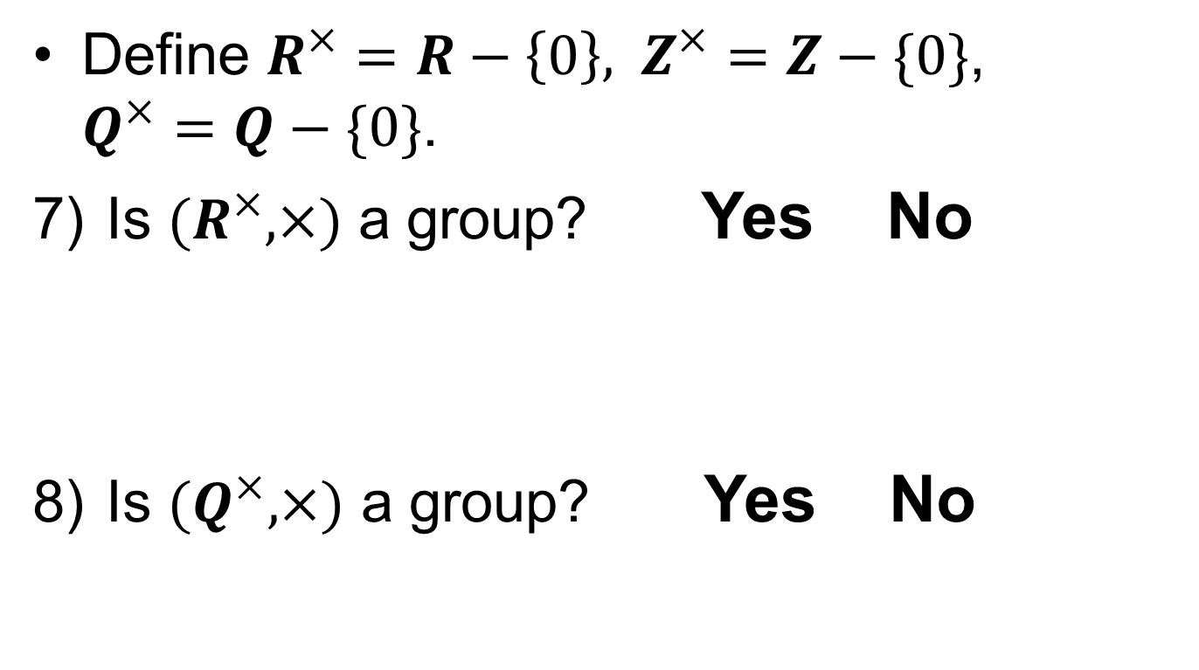
Examples…
Define $R^{×}=R−\left\{0\right\},$ $Z^{×}=Z−\{0\}$, $Q^{×}=Q−\{0\}$.
Is ${(R}^{×}, ×)$ a group? Yes No
Is ${(Q}^{×}, ×)$ a group? Yes No

Slide 12
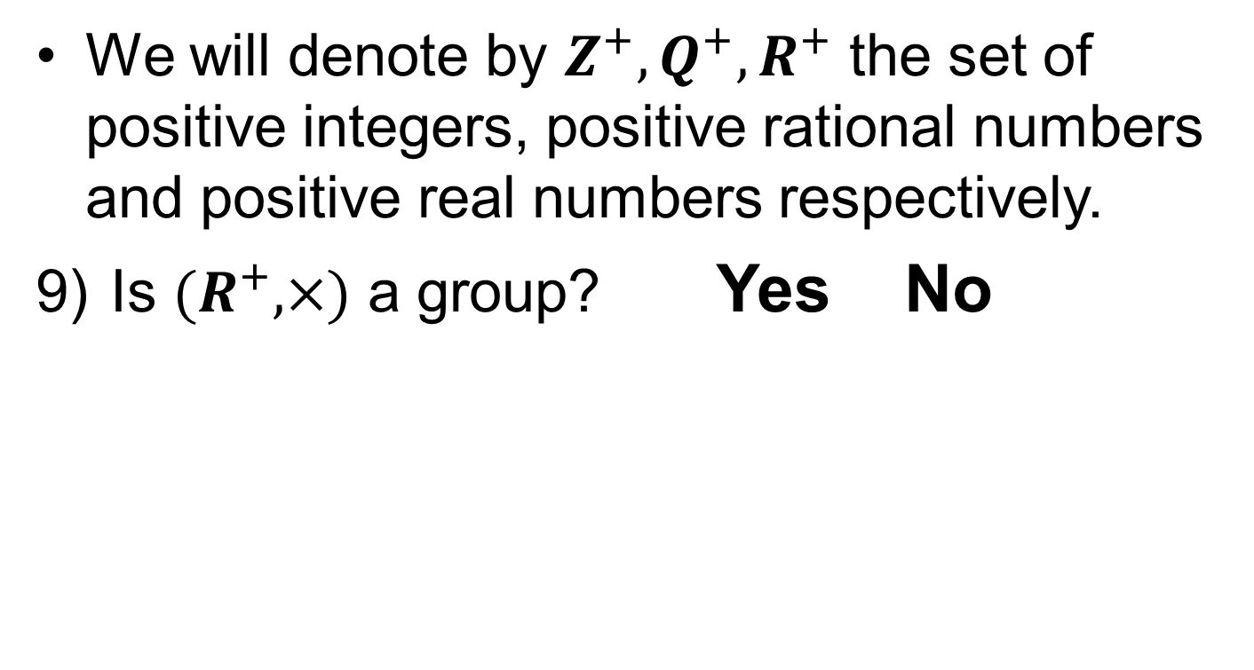
Examples….
We will denote by $Z^{+}, Q^{+}, R^{+}$ the set of positive integers, positive rational numbers and positive real numbers respectively.
Is ${(R}^{+}, ×)$ a group? Yes No

Slide 13
Summary

Slide 14
Thank You

