Slide 1
MTH376: Algebra
For
Master of Mathematics
By
Dr. M. Fazeel Anwar
Assistant Professor
Department of Mathematics, CIIT Islamabad

Slide 2
Lecture 29

Slide 3
Recap
Cayely’s Theorem

Slide 6
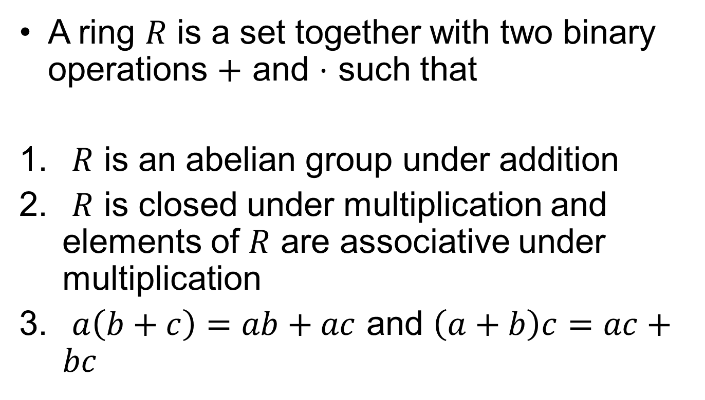
Rings
A ring $R$ is a set together with two binary operations $+$ and $⋅$ such that
$R$ is an abelian group under addition
$R$ is closed under multiplication and elements of $R$ are associative under multiplication
$a\left(b+c\right)=ab+ac$ and $\left(a+b\right)c=ac+bc$

Slide 7
Discussion

Slide 9

Examples
$Z$

Slide 10

Examples
$Z_{n}$

Slide 11
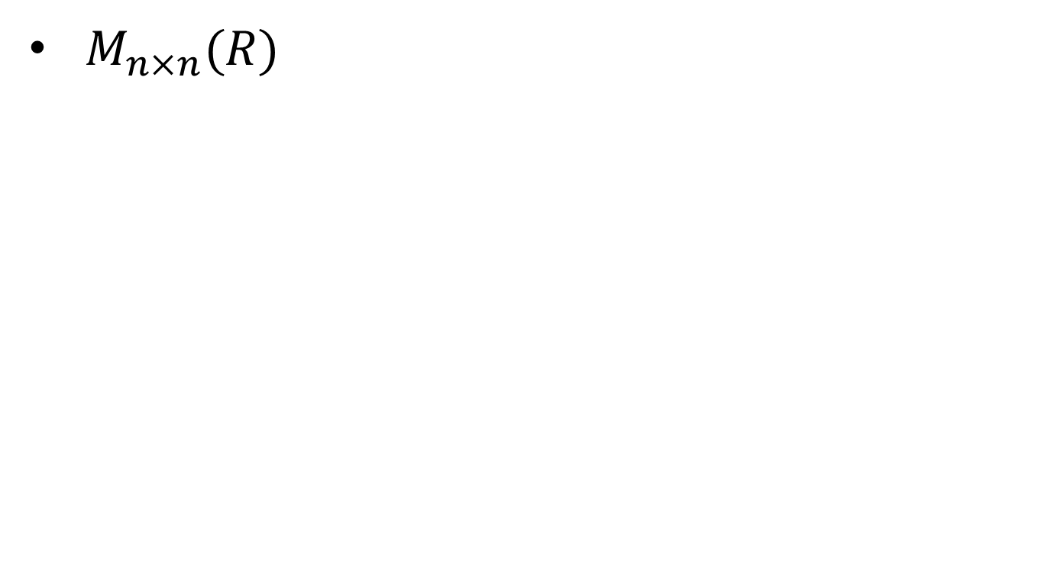
Examples
$M_{n×n}(R)$

Slide 12
Summary

Slide 13
Thank You

