Slide 1
MTH376: Algebra
For
Master of Mathematics
By
Dr. M. Fazeel Anwar
Assistant Professor
Department of Mathematics, CIIT Islamabad

Slide 2
Lecture 28

Slide 3
Recap
Quotient group
Kernel of a homomorphism
Image of a homomorphism

Slide 6
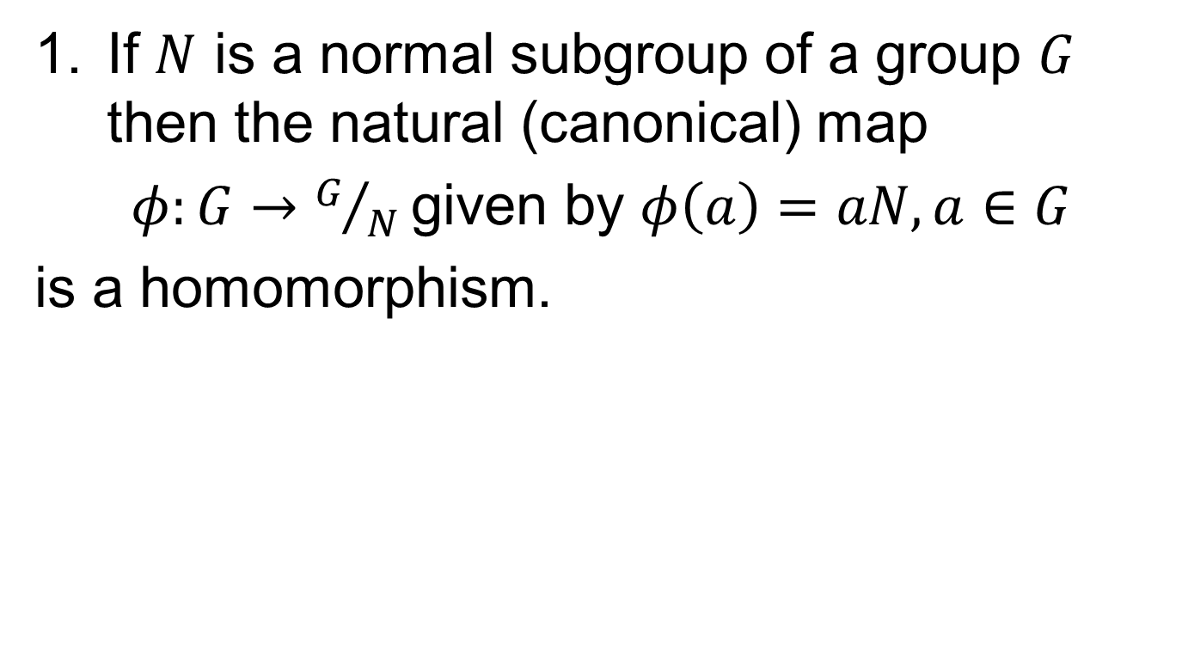
Homomorphism Theorems
If $N$ is a normal subgroup of a group $G$ then the natural (canonical) map
$φ:G→G/N$given by $φ\left(a\right)=aN, a∈G$
is a homomorphism.

Slide 8
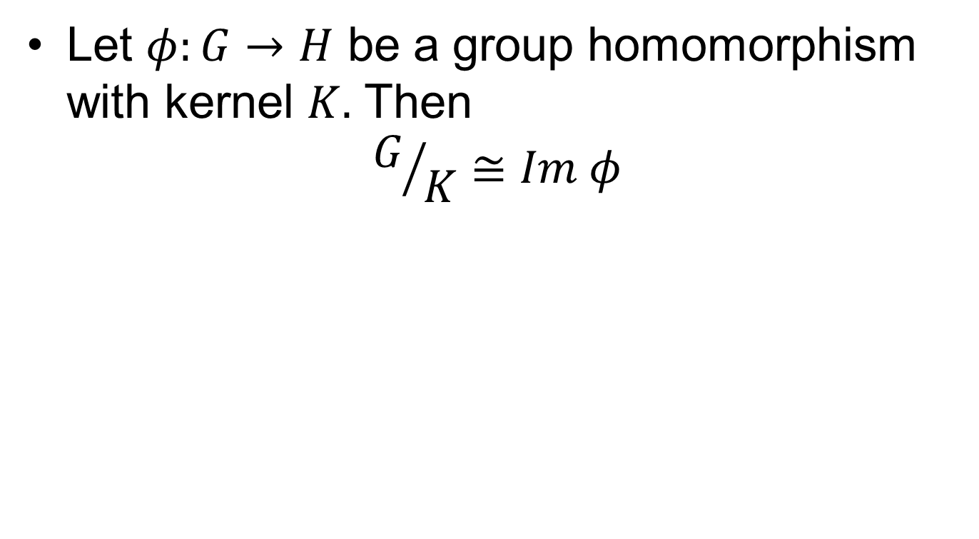
Fundamental Homomorphism Theorem
Let $φ:G→H$ be a group homomorphism with kernel $K.$ Then
$$G/K≅Im φ$$

Slide 13
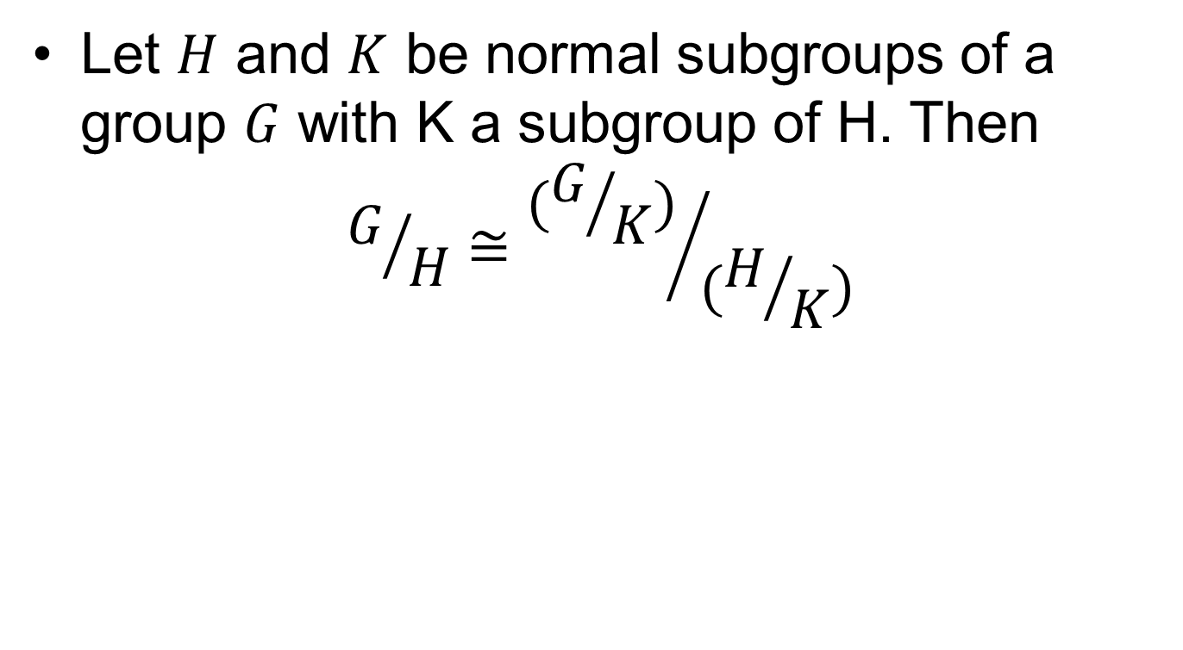
First Isomorphism Theorem
Let $H$ and $K$ be normal subgroups of a group $G$ with K a subgroup of H. Then
$$G/H≅{(G/K)}/{(H/K)}$$

Slide 14
The Main Result

Slide 15
Cayley Theorem
Every group is isomorphic to a group of permutations.

Slide 16
End of Group Theory

Slide 17
Summary

Slide 18
Thank You

