Slide 1
MTH376: Algebra
For
Master of Mathematics
By
Dr. M. Fazeel Anwar
Assistant Professor
Department of Mathematics, CIIT Islamabad

Slide 2
Lecture 26

Slide 3
Recap
Isomorphism
Isomorphic groups
Non isomorphic groups

Slide 5
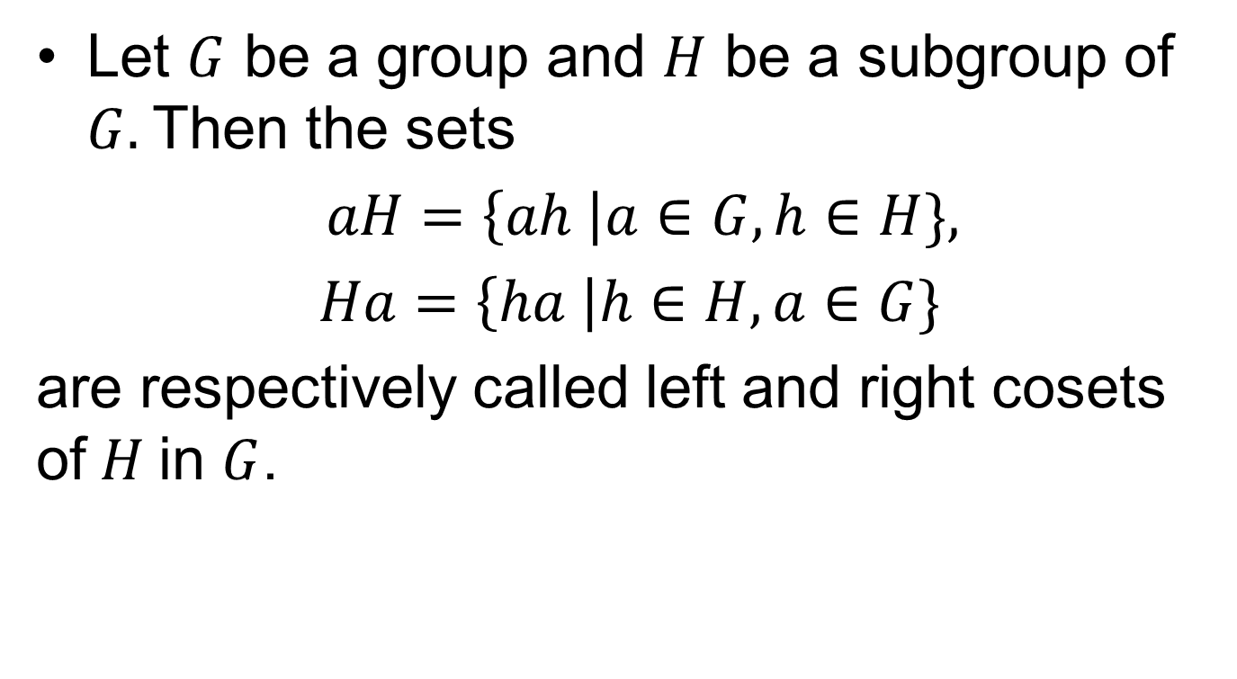
Cosets
Let $G$ be a group and $H$ be a subgroup of $G.$Then the sets
$aH=\left\{ah \right|a∈G, h∈H\},$
$Ha=\left\{ha \right|h∈H, a∈G\}$
are respectively called left and right cosets of$H$in $G$.

Slide 7
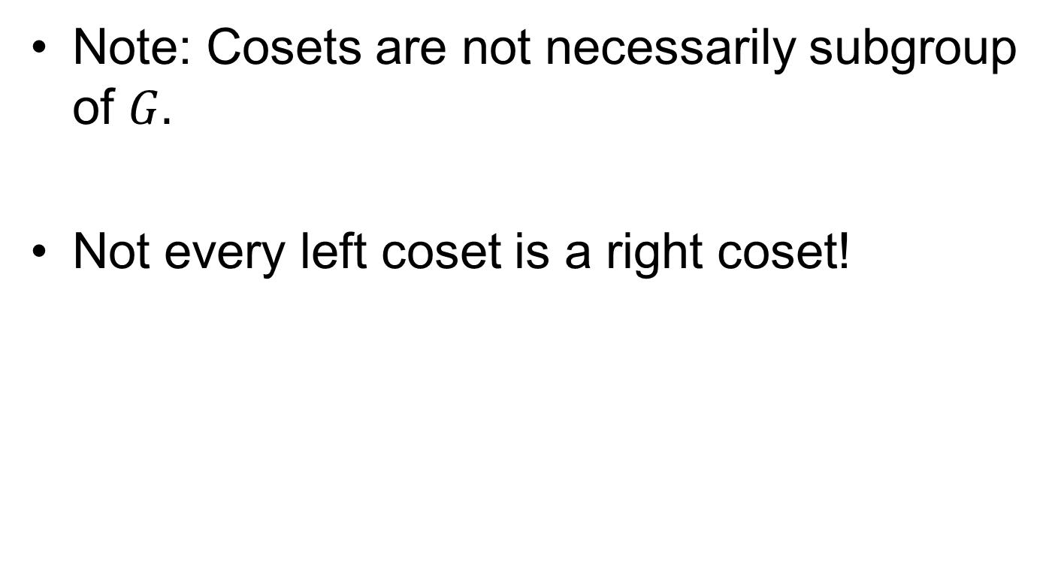
Cosets.
Note: Cosets are not necessarily subgroup of $G.$
Not every left coset is a right coset!

Slide 10
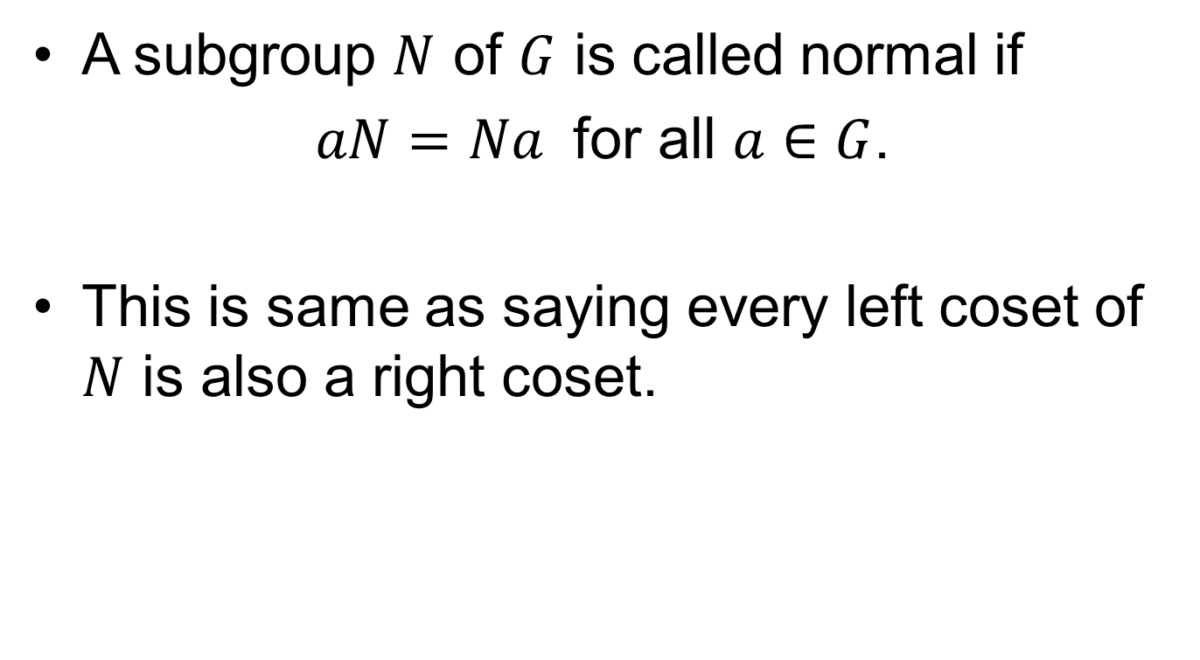
Normal subgroups
A subgroup $N$ of $G$ is called normal if
$aN=Na$ for all $a∈G$.
This is same as saying every left coset of $N$ is also a right coset.

Slide 12
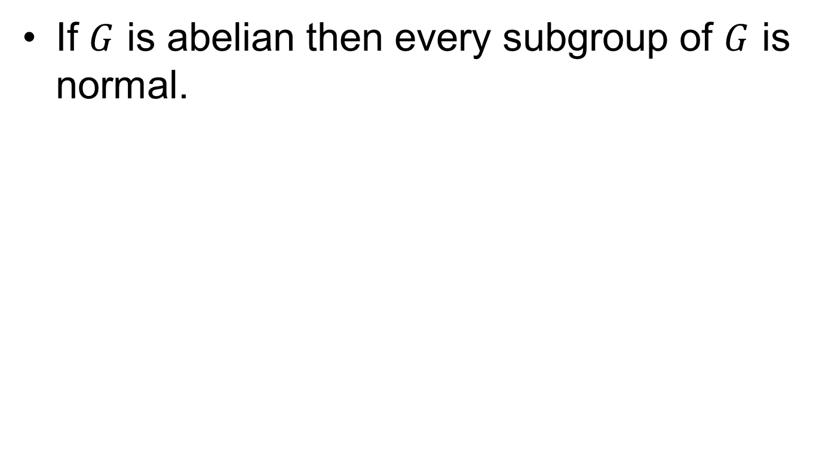
Normal Subgroups.
If $G$ is abelian then every subgroup of $G$ is normal.

Slide 13
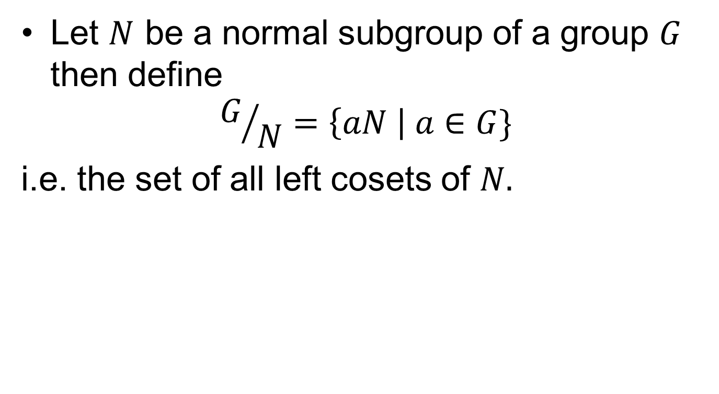
Quotient Group
Let $N$ be a normal subgroup of a group $G$ then define
$$G/N=\left\{aN \right| a∈G\}$$
i.e. the set of all left cosets of $N.$

Slide 15
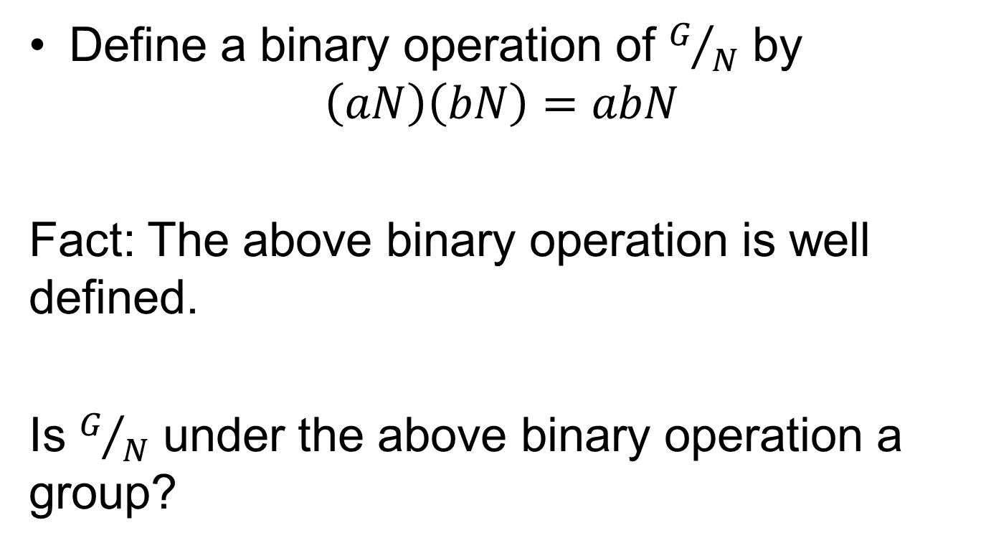
Quotient Group.
Define a binary operation of $G/N$ by
$$\left(aN\right)\left(bN\right)=abN$$
Fact: The above binary operation is well defined.
Is $G/N$ under the above binary operation a group?

Slide 16
Summary

Slide 17
Thank You

