Slide 1
MTH376: Algebra
For
Master of Mathematics
By
Dr. M. Fazeel Anwar
Assistant Professor
Department of Mathematics, CIIT Islamabad

Slide 2
Lecture 25

Slide 3
Recap
Isomorphism
Isomorphic groups
Infinite cyclic groups

Slide 4
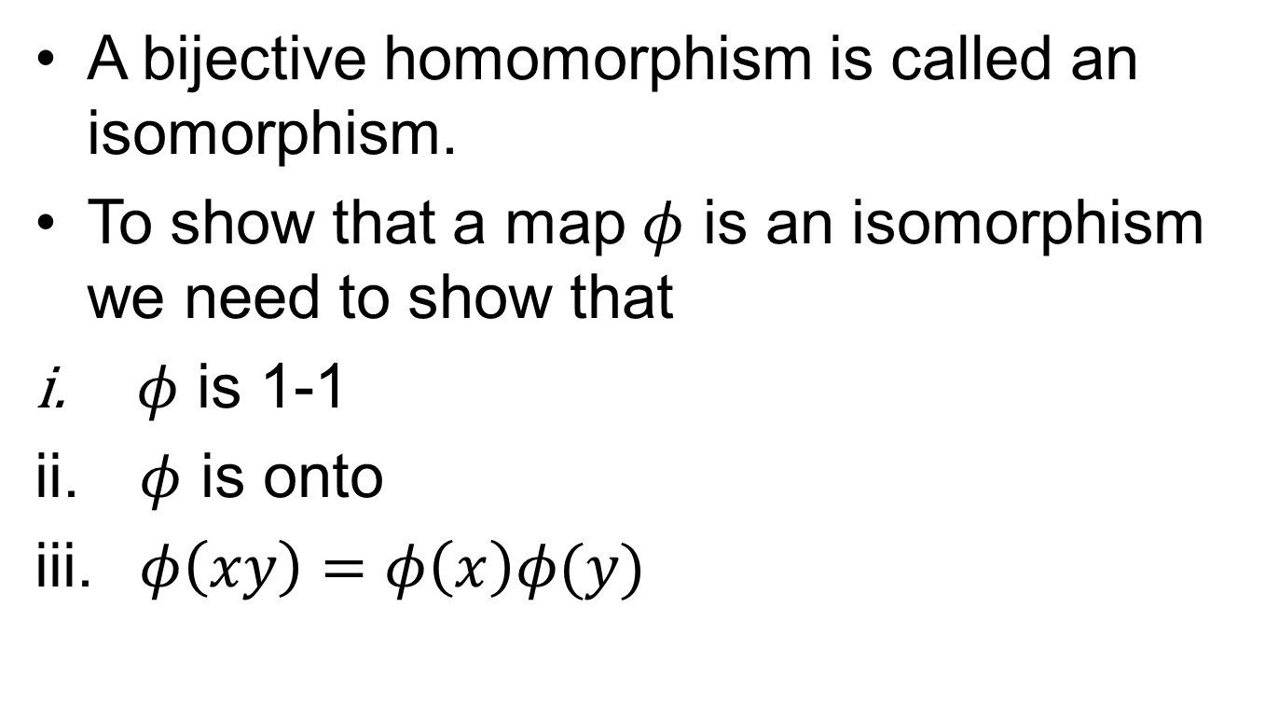
Isomorphism
A bijective homomorphism is called an isomorphism.
To show that a map $φ$ is an isomorphism we need to show that
$φ$ is 1-1
$φ$ is onto
$φ\left(xy\right)=φ\left(x\right)φ(y)$

Slide 5
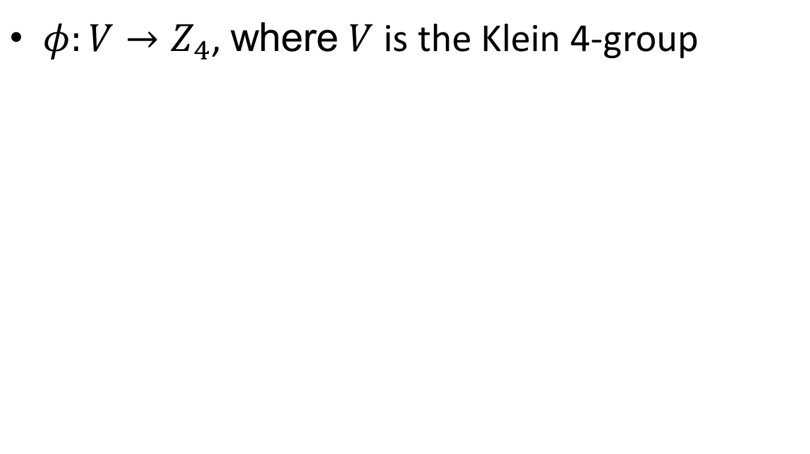
Non isomorphic groups
$φ:V→Z_{4}$, where $V$ is the Klein 4-group

Slide 7
Non isomorphic groups.
By definition it means that there is no isomorphism between the groups, so we have to rule out all the possibilities.
This is not really possibly unless there is no 1-1 map between the groups

Slide 9
Non isomorphic groups..
To show that groups are not isomorphic we can use any of the following
Show that there is no 1-1/onto map
There is a property (cyclic, order of elements, order of subgroups, solution of algebraic equations) satisfied in one group but not the other.

Slide 10
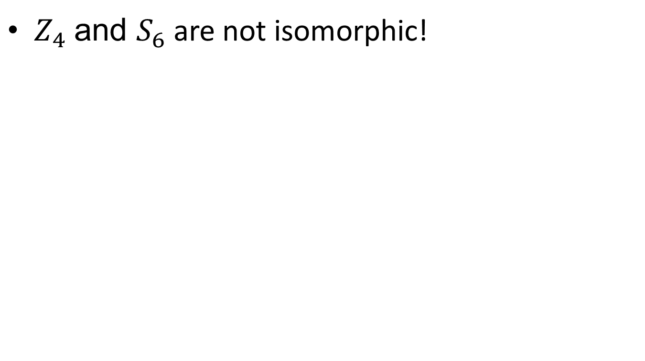
Non isomorphic groups…
$Z_{4}$ and $S_{6}$ are not isomorphic!

Slide 11
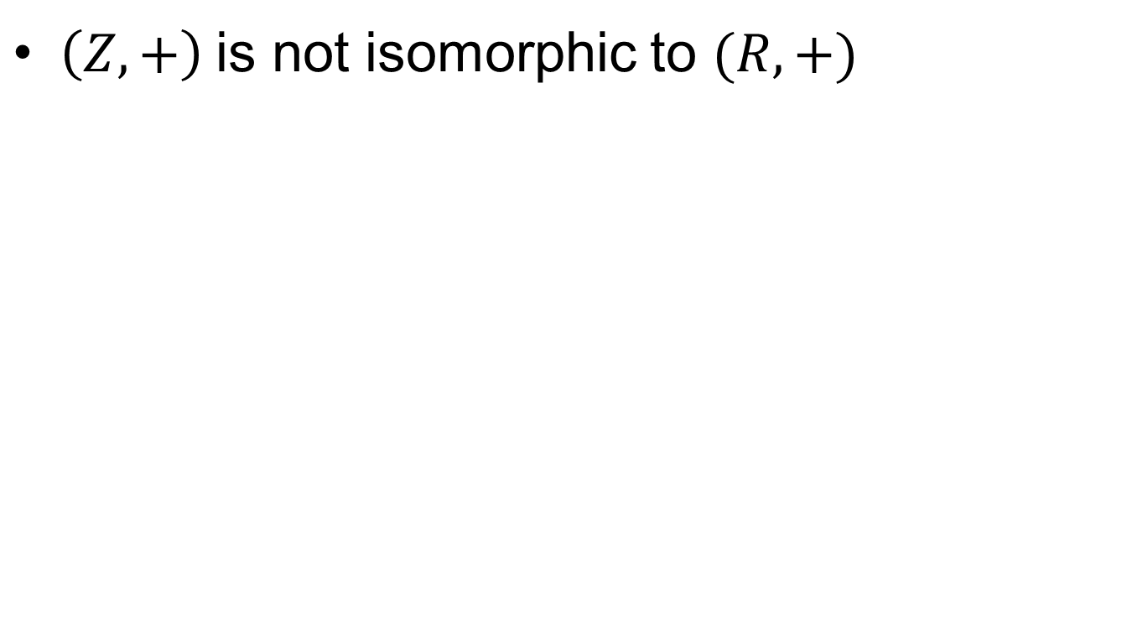
Non isomorphic groups….
$\left(Z,+\right)$ is not isomorphic to $(R, +)$

Slide 12
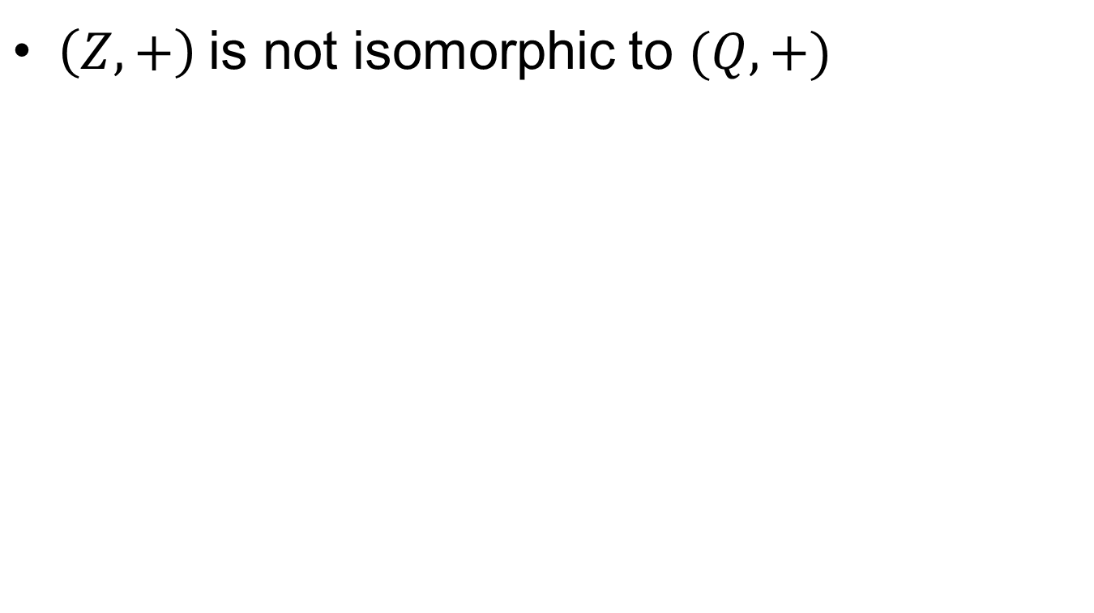
Non isomorphic groups…..
$\left(Z,+\right)$ is not isomorphic to $(Q, +)$

Slide 13
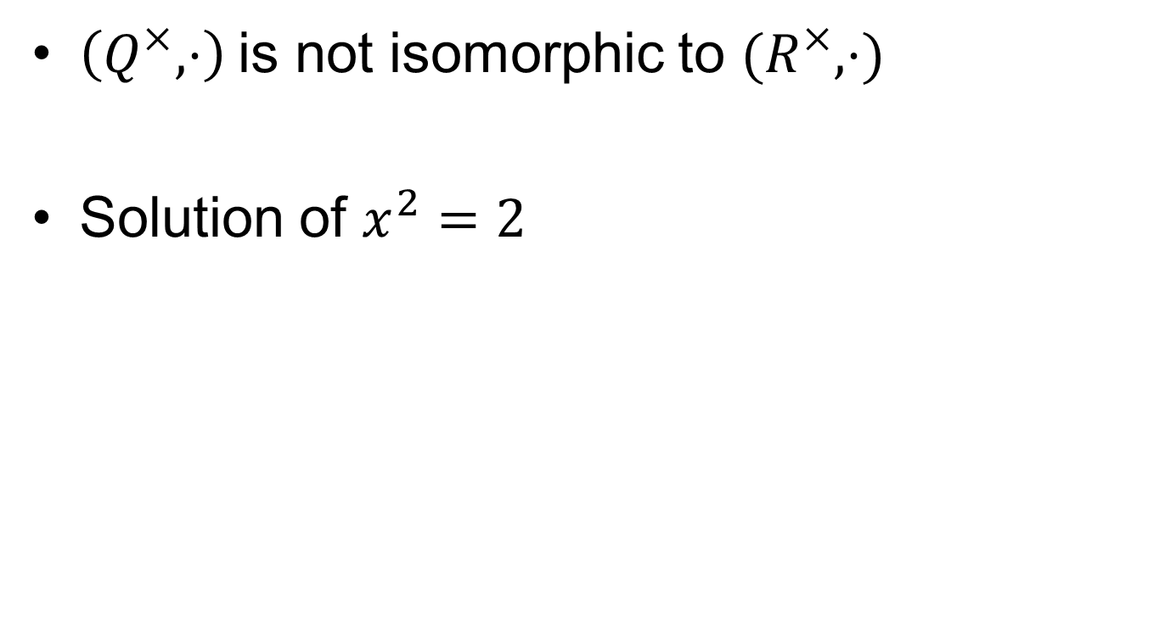
Non isomorphic groups……
$\left(Q^{×},⋅\right)$ is not isomorphic to $(R^{×}, ⋅)$
Solution of $x^{2}=2$

Slide 14
Cosets

Slide 18
Summary

Slide 19
Thank You

