Slide 1
MTH376: Algebra
For
Master of Mathematics
By
Dr. M. Fazeel Anwar
Assistant Professor
Department of Mathematics, CIIT Islamabad

Slide 2
Lecture 24

Slide 3
Recap
Group homomorphism
Isomorphism
Isomorphic groups

Slide 4
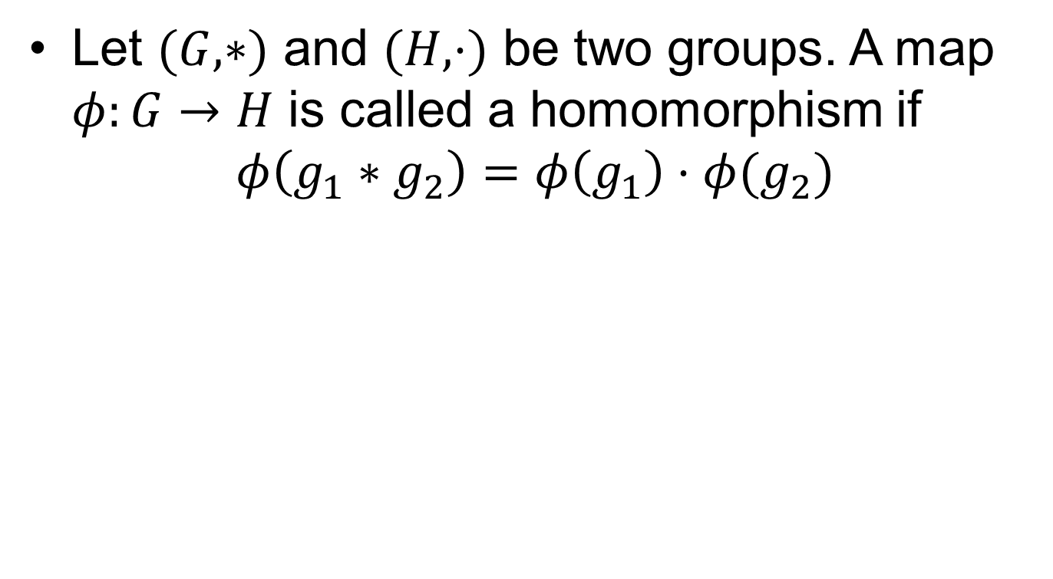
Homomorphism
Let $(G, ∗)$ and $(H, ⋅)$ be two groups. A map $φ:G→H$ is called a homomorphism if
$$φ\left(g_{1}∗g_{2}\right)=φ\left(g_{1}\right)⋅φ(g_{2})$$

Slide 5
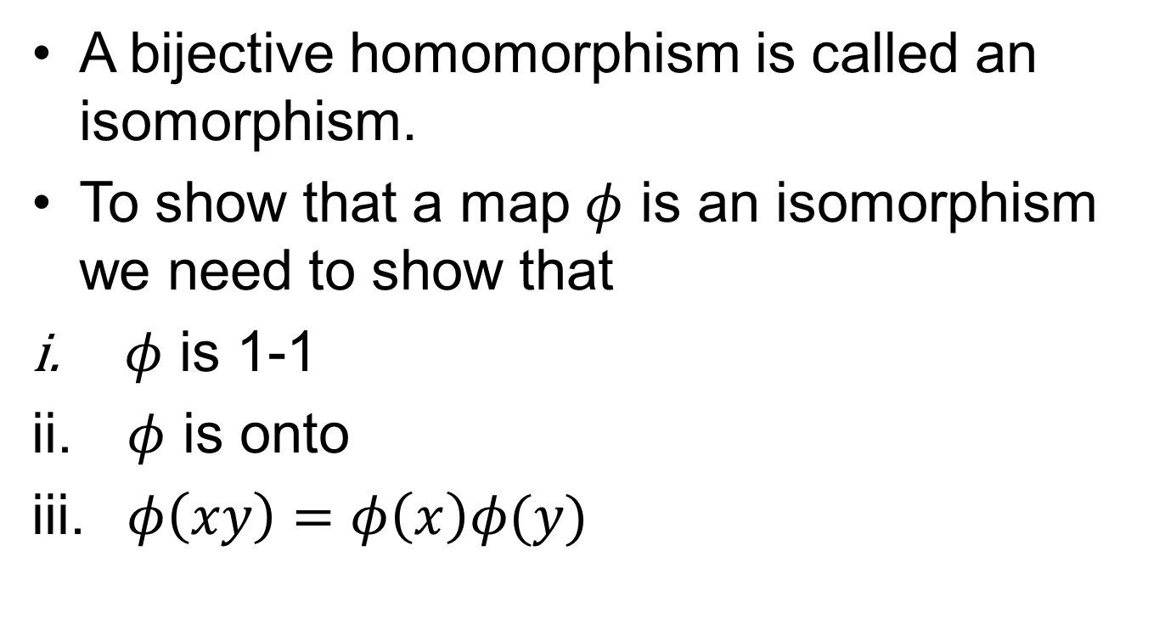
Isomorphism
A bijective homomorphism is called an isomorphism.
To show that a map $φ$ is an isomorphism we need to show that
$φ$ is 1-1
$φ$ is onto
$φ\left(xy\right)=φ\left(x\right)φ(y)$

Slide 6
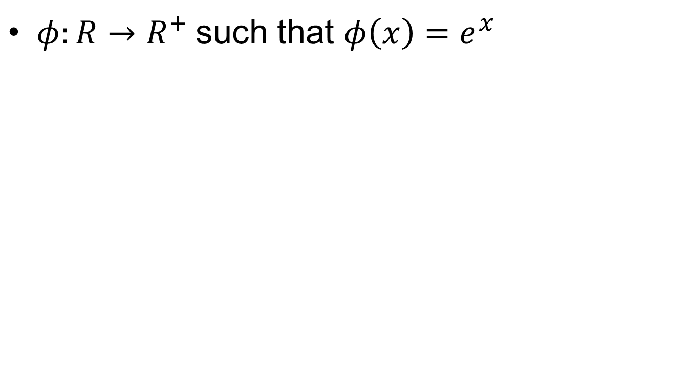
Examples
$φ:R→R^{+}$ such that $φ\left(x\right)=e^{x}$

Slide 8
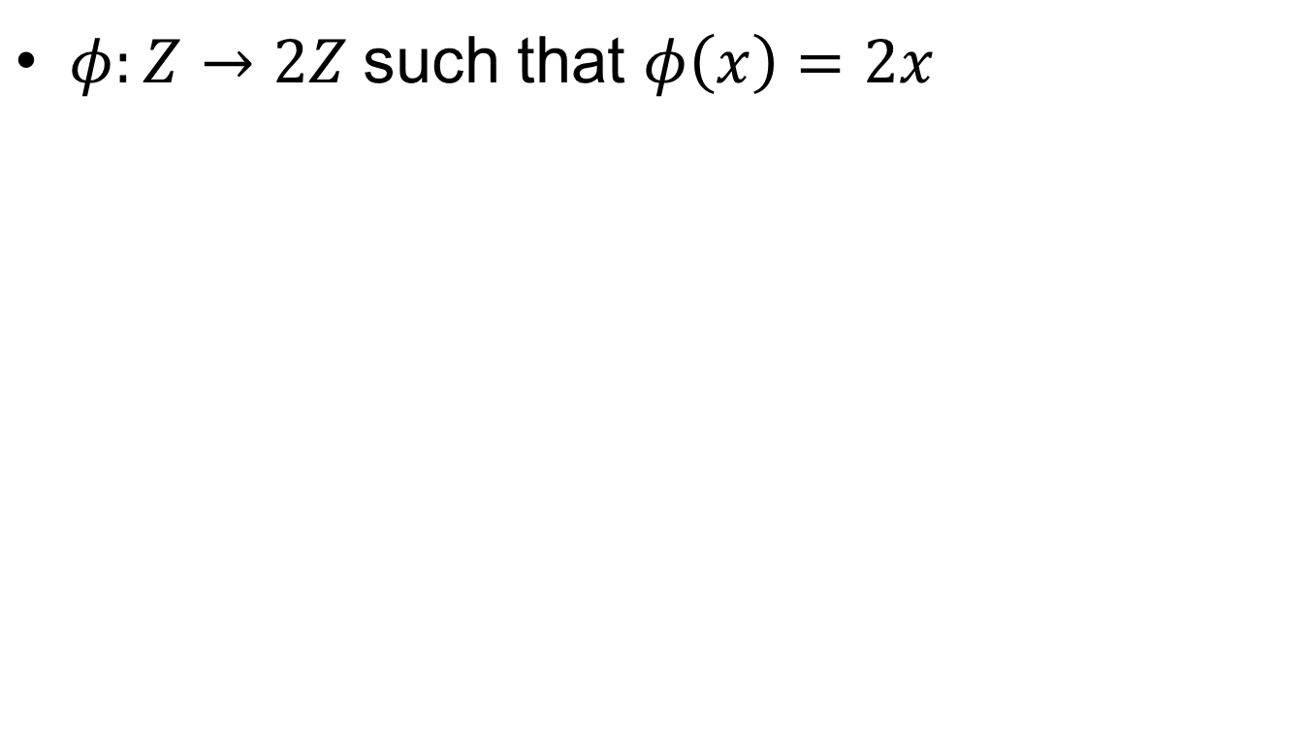
Examples.
$φ:Z→2Z$ such that $φ\left(x\right)=2x$

Slide 9

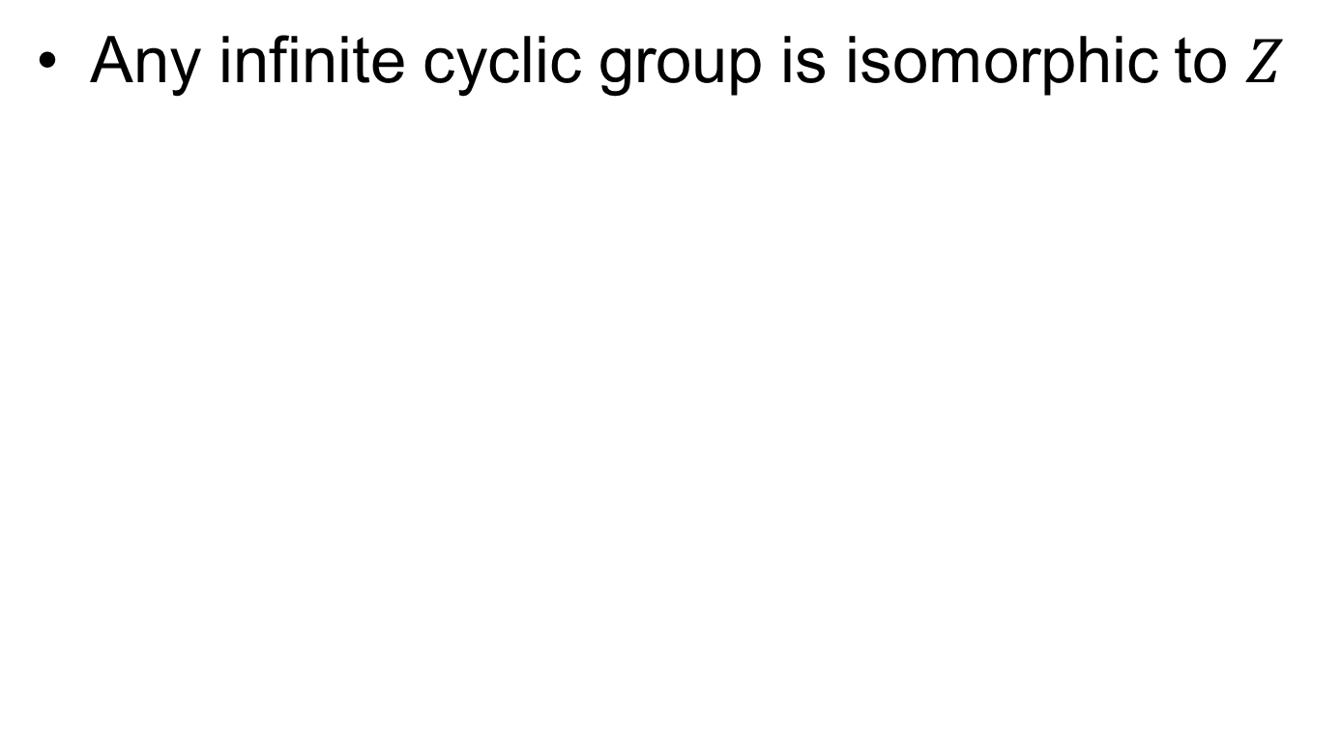
Cyclic groups and $Z$
Any infinite cyclic group is isomorphic to $Z$

Slide 13
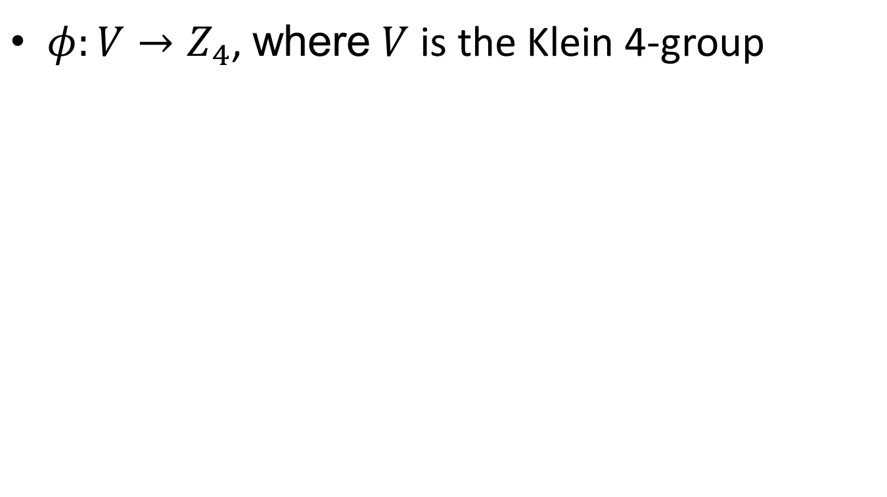
Non isomorphic groups
$φ:V→Z_{4}$, where $V$ is the Klein 4-group

Slide 15
Non isomorphic groups.
By definition it means that there is no isomorphism between the groups, so we have to rule out all the possibilities.
This is not really possibly unless there is no 1-1 map between the groups

Slide 17
Non isomorphic groups..
To show that groups are not isomorphic we can use any of the following
Show that there is no 1-1/onto map
There is a property (cyclic, order of elements, order of subgroups, solution of algebraic equations) satisfied in one group but not the other.

Slide 19
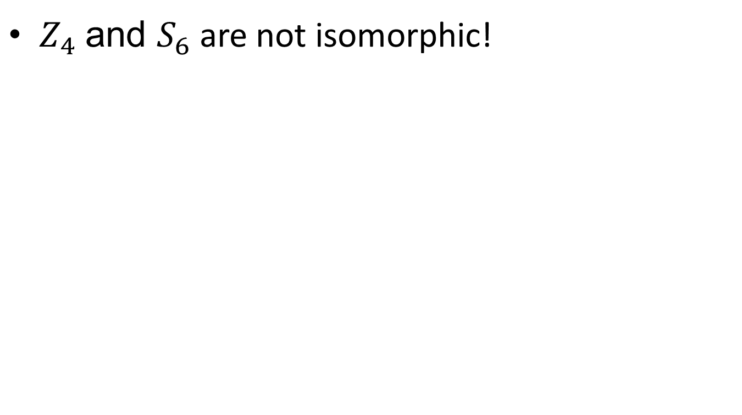
Non isomorphic groups…
$Z_{4}$ and $S_{6}$ are not isomorphic!

Slide 20
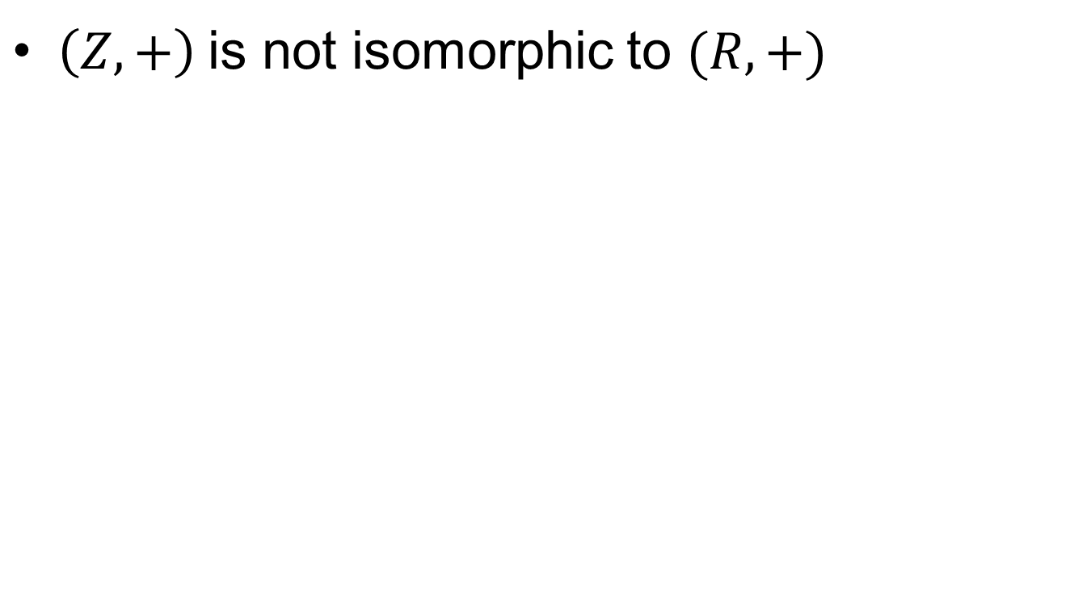
Non isomorphic groups….
$\left(Z,+\right)$ is not isomorphic to $(R, +)$

Slide 21
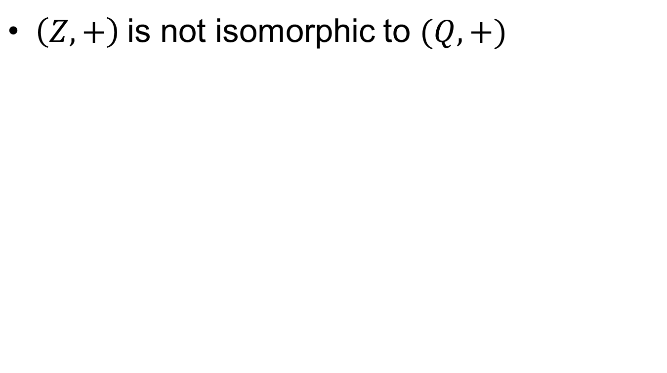
Non isomorphic groups…..
$\left(Z,+\right)$ is not isomorphic to $(Q, +)$

Slide 22
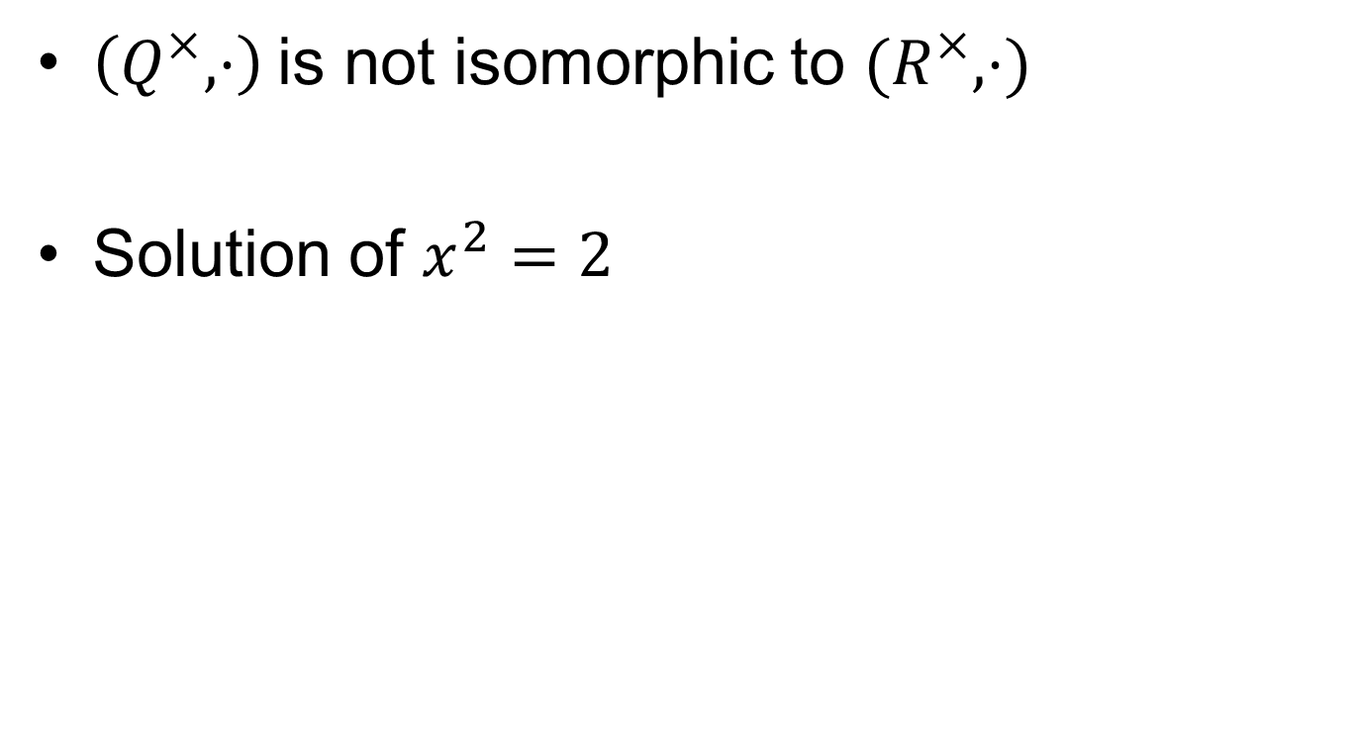
Non isomorphic groups……
$\left(Q^{×},⋅\right)$ is not isomorphic to $(R^{×}, ⋅)$
Solution of $x^{2}=2$

Slide 23

Subgroups of $Z$and Cosets

Slide 25
Summary

Slide 26
Thank You

