Slide 1
MTH376: Algebra
For
Master of Mathematics
By
Dr. M. Fazeel Anwar
Assistant Professor
Department of Mathematics, CIIT Islamabad

Slide 2
Lecture 22

Slide 3
Recap
Order of an element
Order of a group
Relation between groups

Slide 5
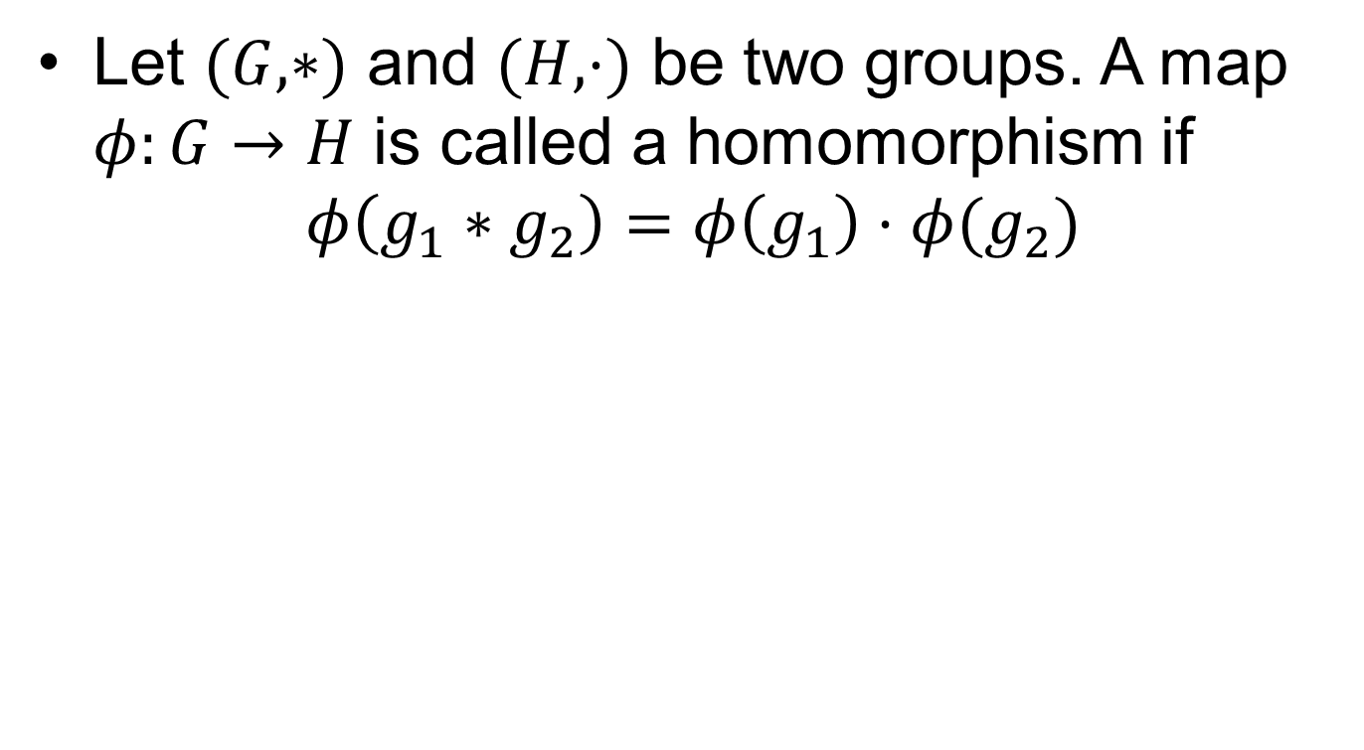
Homomorphism
Let $(G, ∗)$ and $(H, ⋅)$ be two groups. A map $φ:G→H$ is called a homomorphism if
$$φ\left(g_{1}∗g_{2}\right)=φ\left(g_{1}\right)⋅φ(g_{2})$$

Slide 6
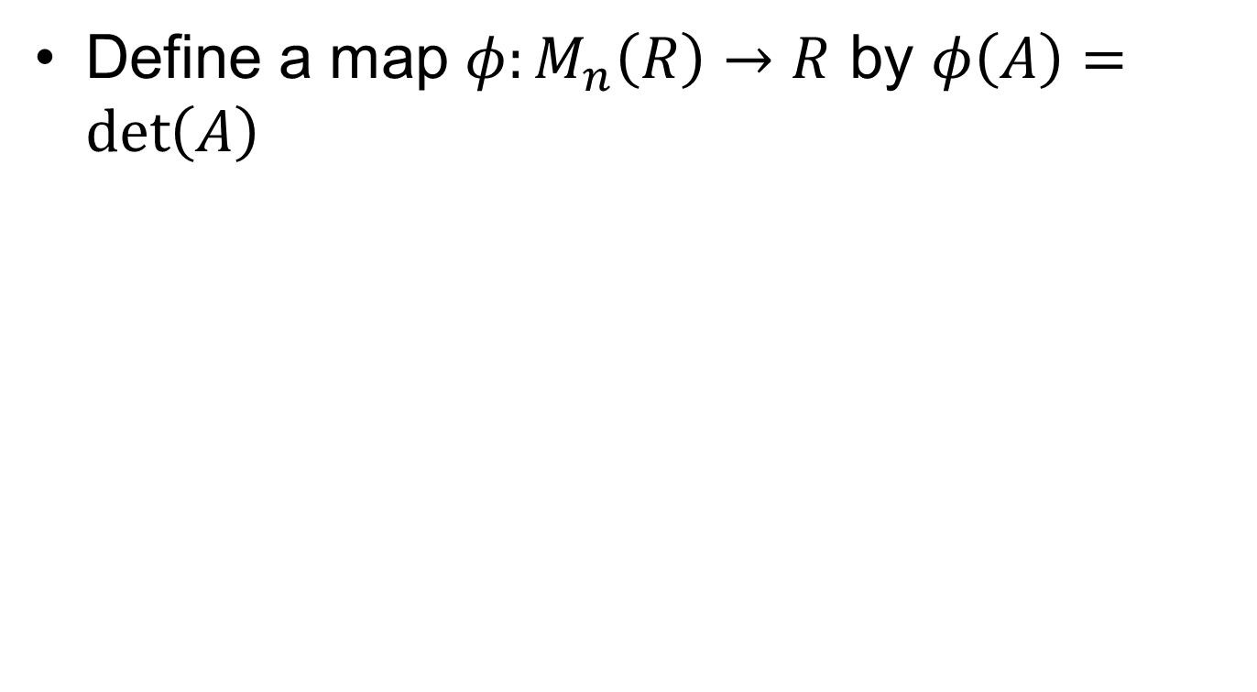
Examples
Define a map $φ:M_{n}\left(R\right)→R$ by $φ\left(A\right)=\det\left(A\right)$

Slide 8
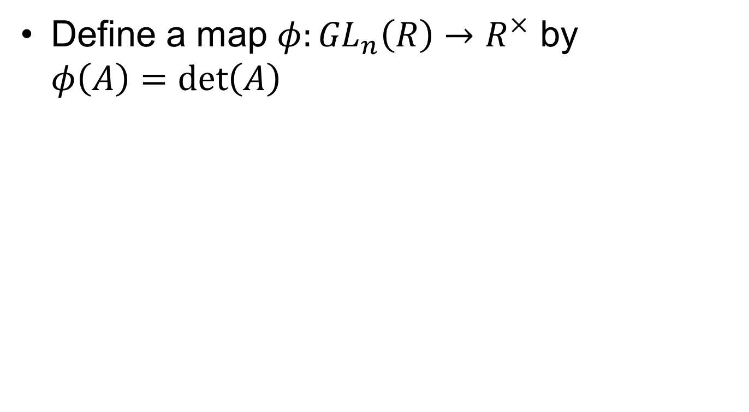
Examples.
Define a map $φ:{GL}_{n}\left(R\right)→R^{×}$ by $φ\left(A\right)=\det\left(A\right)$

Slide 10
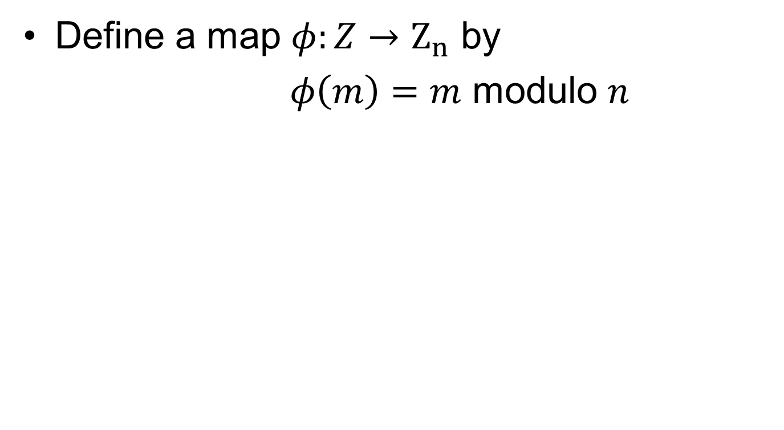
Examples..
Define a map $φ:Z→Z_{n}$ by
$φ\left(m\right)=m$ modulo $n$

Slide 13
Summary

Slide 14
Thank You

