Slide 1
MTH376: Algebra
For
Master of Mathematics
By
Dr. M. Fazeel Anwar
Assistant Professor
Department of Mathematics, CIIT Islamabad

Slide 2
Lecture 21

Slide 3
Recap
Cyclic groups and abelian groups
Subgroups of cyclic group
Examples
Subgroups of integers

Slide 6
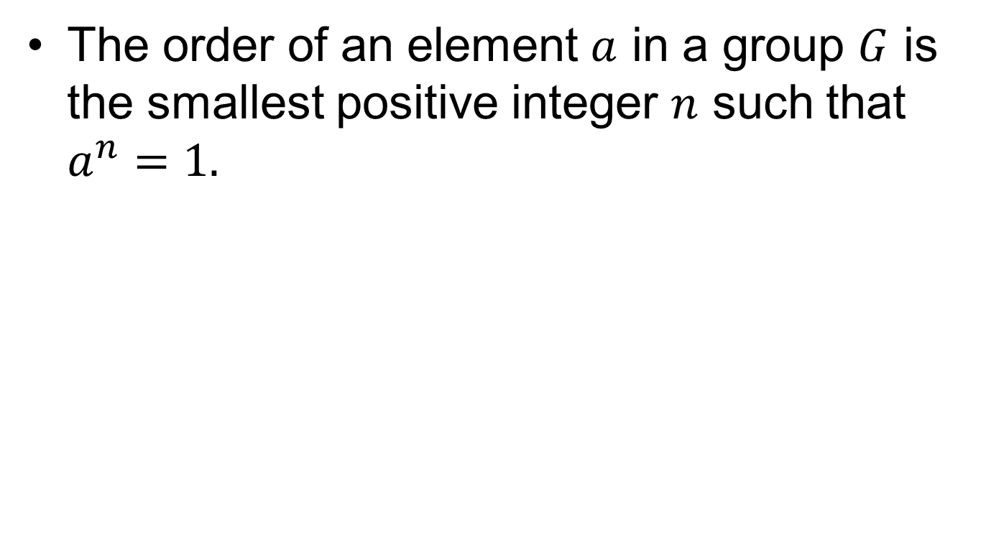
Order of an element
The order of an element $a$ in a group $G$ is the smallest positive integer $n$ such that $a^{n}=1.$

Slide 9
Order of a group

Slide 10
Order of a cyclic subgroup

Slide 12
Relation between groups

Slide 14
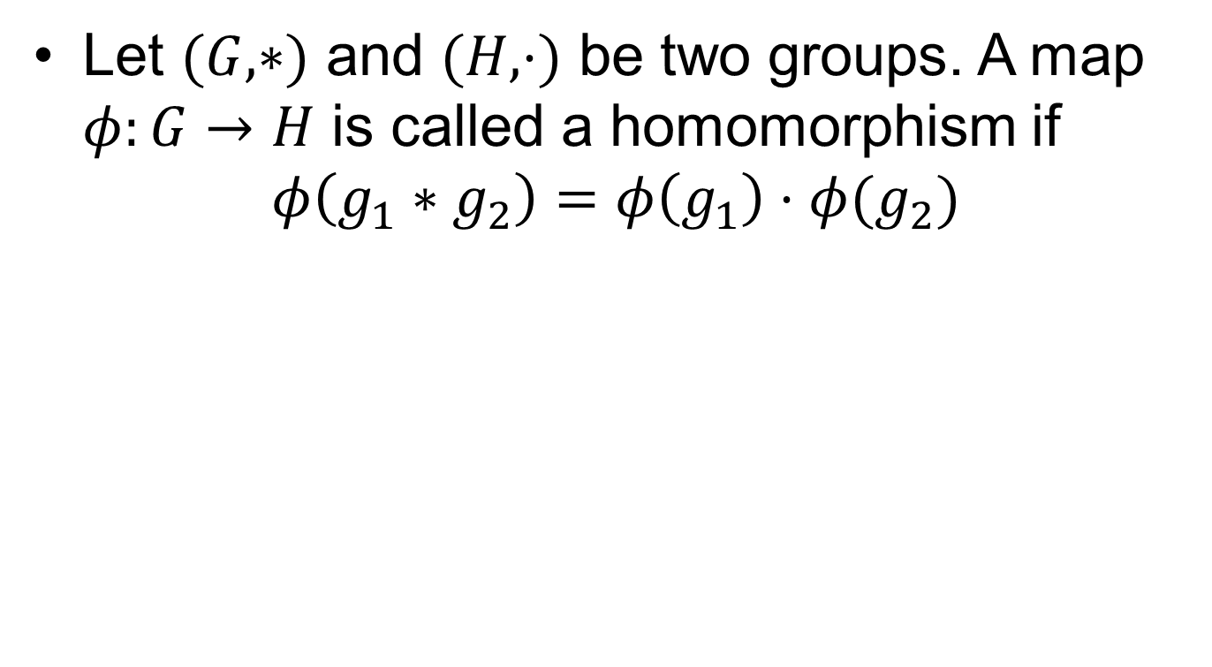
Homomorphism
Let $(G, ∗)$ and $(H, ⋅)$ be two groups. A map $φ:G→H$ is called a homomorphism if
$$φ\left(g_{1}∗g_{2}\right)=φ\left(g_{1}\right)⋅φ(g_{2})$$

Slide 15
Examples

Slide 16
Examples.

Slide 17
Examples..

Slide 18
Summary

Slide 19
Thank You

