Slide 1
MTH376: Algebra
For
Master of Mathematics
By
Dr. M. Fazeel Anwar
Assistant Professor
Department of Mathematics, CIIT Islamabad

Slide 2
Lecture 20

Slide 3
Recap
Cyclic group
Examples
Cyclic groups and abelian groups

Slide 4
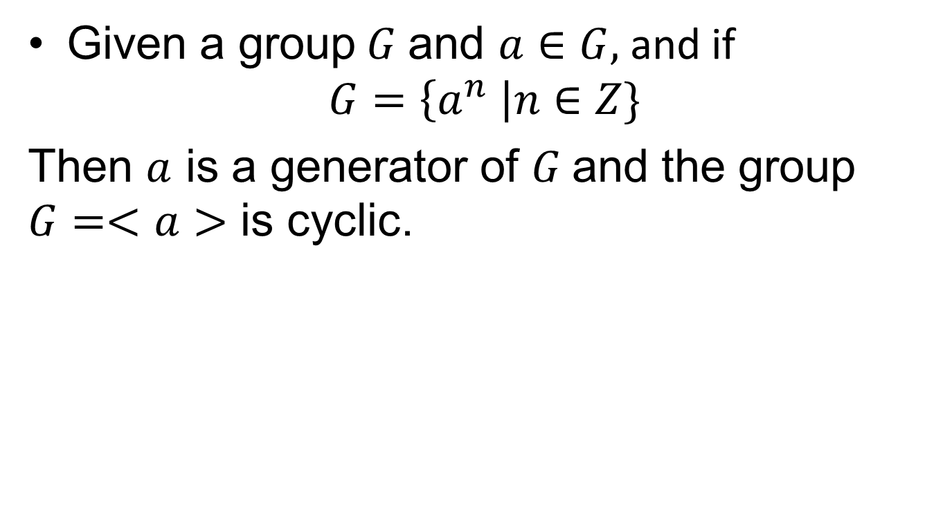
Cyclic Groups
Given a group $G$ and $a∈G,$and if
$$G=\left\{a^{n} \right|n∈Z\}$$
Then $a$ is a generator of $G$and the group $G=<a>$ is cyclic.

Slide 7
Theorem
Every cyclic group is abelian.

Slide 12
Theorem
Every subgroup of a cyclic group is cyclic.

Slide 14

Subgroups of $Z$

Slide 16
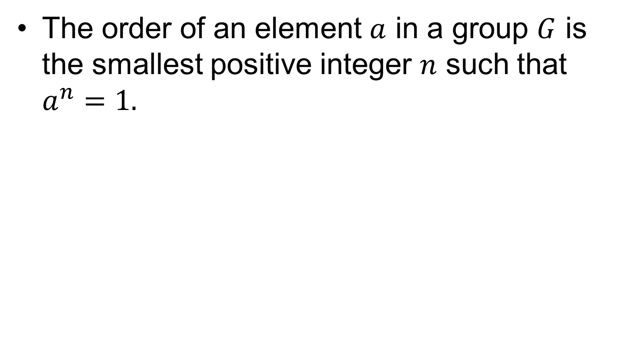
Order of an element
The order of an element $a$ in a group $G$ is the smallest positive integer $n$ such that $a^{n}=1.$

Slide 19
Summary

Slide 20
Thank You

