Slide 1
MTH376: Algebra
For
Master of Mathematics
By
Dr. M. Fazeel Anwar
Assistant Professor
Department of Mathematics, CIIT Islamabad

Slide 2
Lecture 02

Slide 3
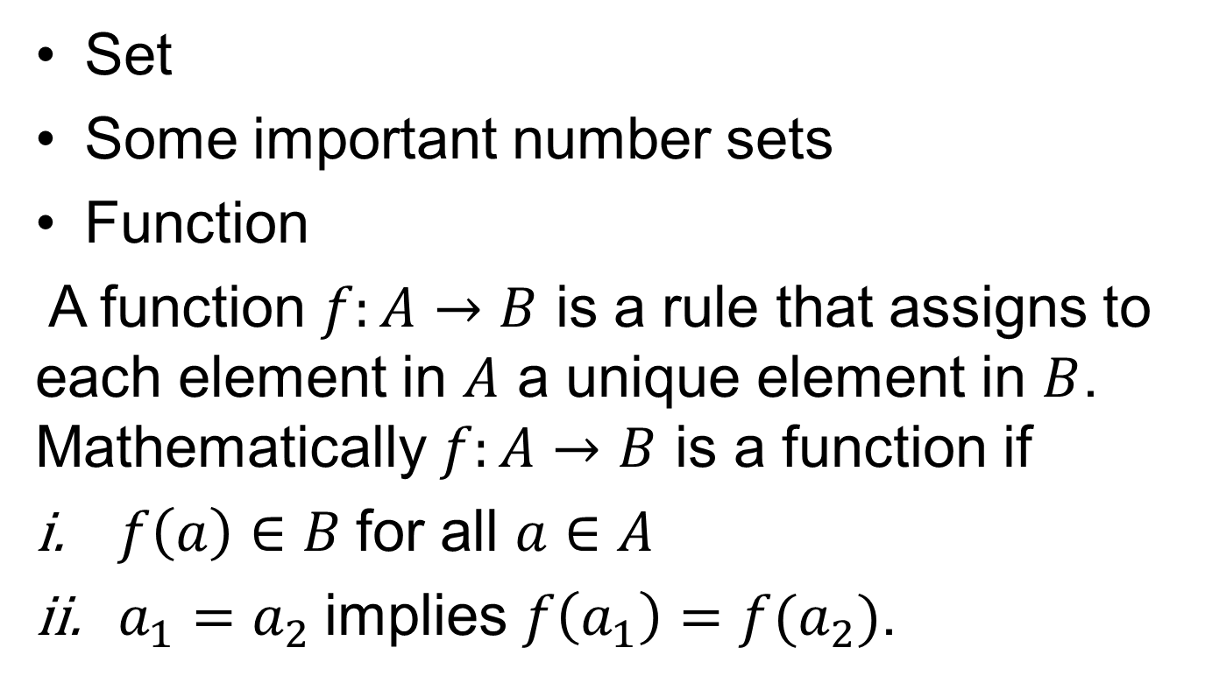
Recap
Set
Some important number sets
Function
A function $f:A→B$ is a rule that assigns to each element in $A$ a unique element in $B$. Mathematically $f:A→B$ is a function if
$f\left(a\right)∈B$for all $a∈A$
$a_{1}=a_{2}$implies $f\left(a_{1}\right)=f(a_{2})$.

Slide 4
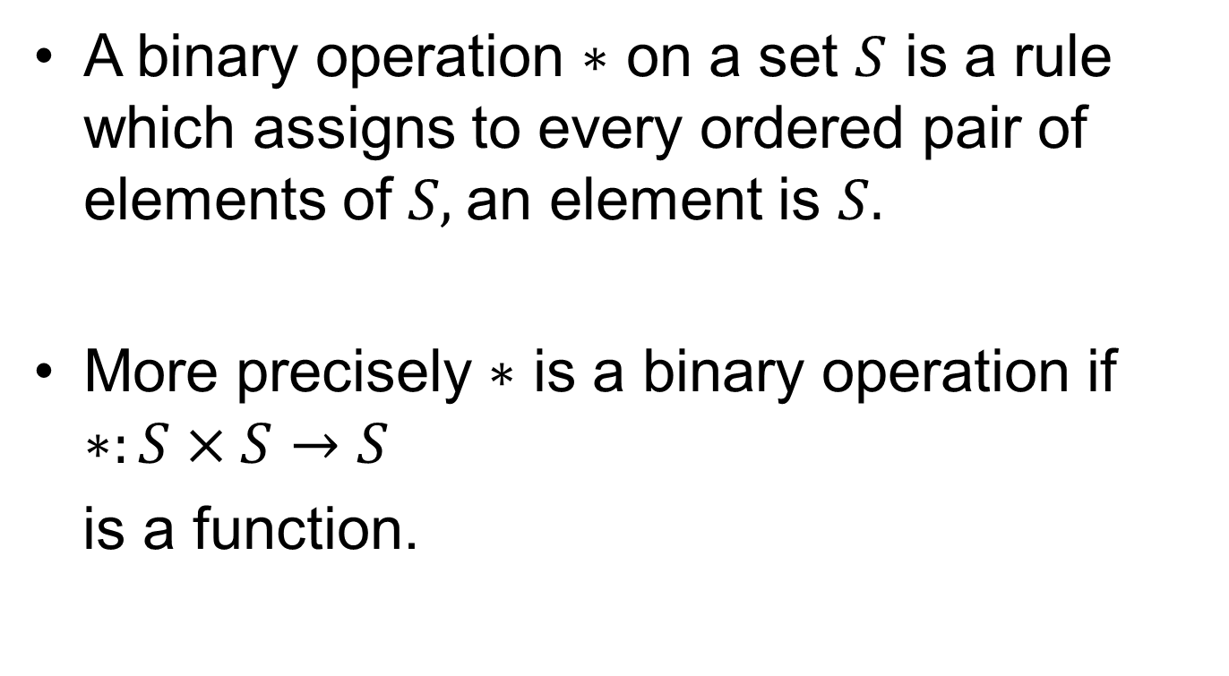
Binary Operation
A binary operation $∗$ on a set $S$ is a rule which assigns to every ordered pair of elements of $S,$an element is $S.$
More precisely $∗$ is a binary operation if $∗:S×S→S$
is a function.

Slide 5
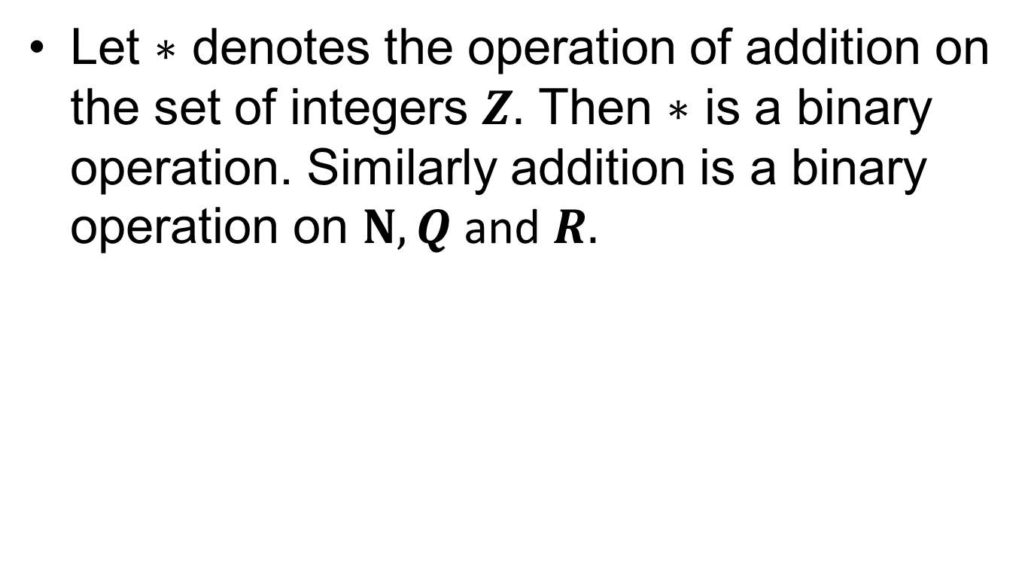
Examples
Let $∗$ denotes the operation of addition on the set of integers $Z.$ Then $∗$ is a binary operation. Similarly addition is a binary operation on $N, Q$ and $R.$

Slide 6
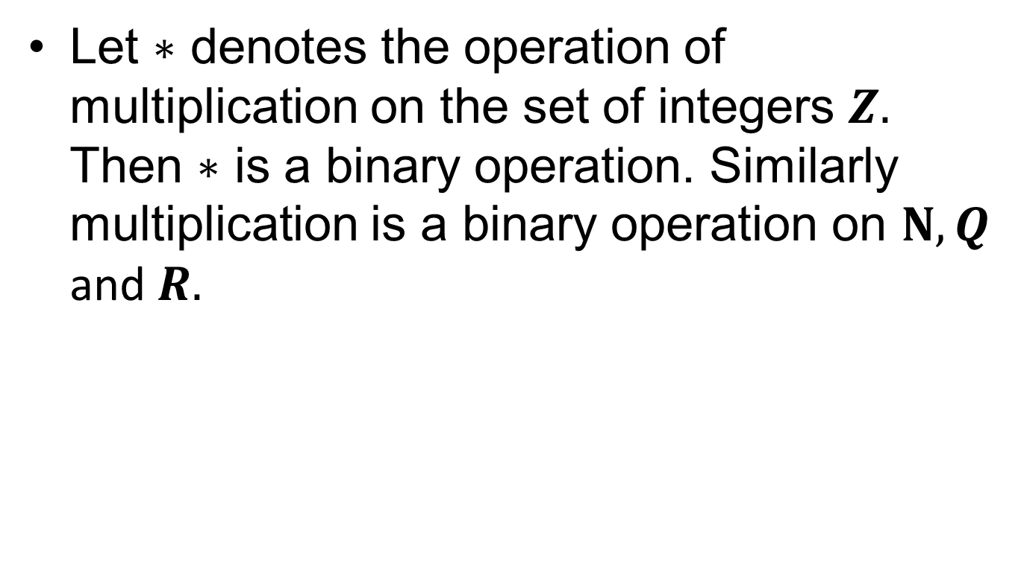
Examples(continued…)
Let $∗$ denotes the operation of multiplication on the set of integers $Z.$ Then $∗$ is a binary operation. Similarly multiplication is a binary operation on $N, Q$ and $R.$

Slide 7
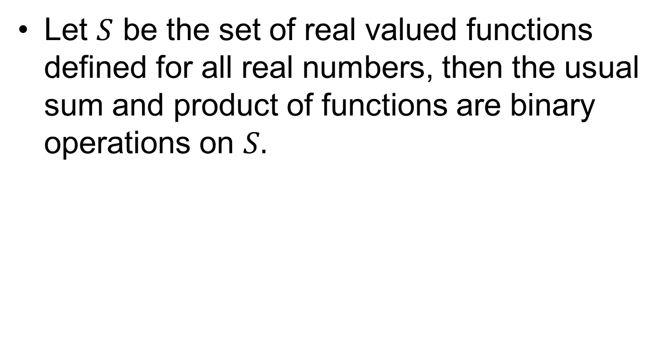
More examples
Let $S$ be the set of real valued functions defined for all real numbers, then the usual sum and product of functions are binary operations on $S.$

Slide 9
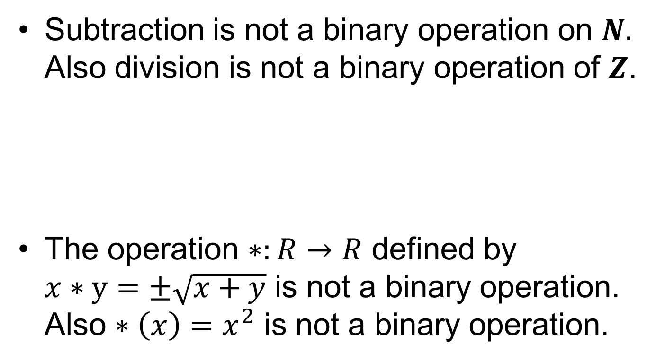
Some non examples
Subtraction is not a binary operation on $N.$ Also division is not a binary operation of $Z$.
The operation $∗:R→R$ defined by $x∗y=±\sqrt{x+y}$ is not a binary operation. Also $∗\left(x\right)=x^{2}$ is not a binary operation.

Slide 10
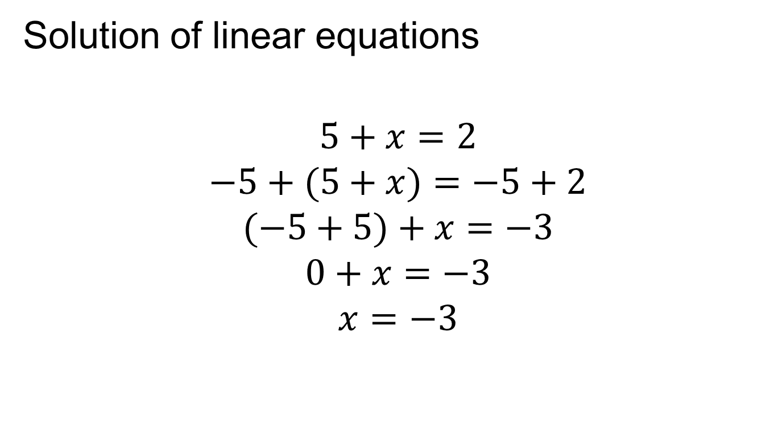
Motivation for defining groups
Solution of linear equations
$$5+x=2$$
$$−5+(5+x)=−5+2$$
$$(−5+5)+x=−3$$
$$0+x=−3$$
$$x=−3$$

Slide 11
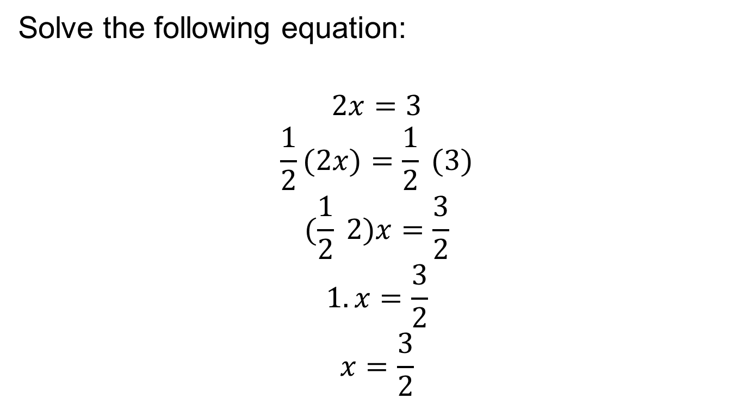
Motivation (continued…)
Solve the following equation:
$$2x=3$$
$$\frac{1}{2}(2x)=\frac{1}{2} (3)$$
$$(\frac{1}{2} 2)x=\frac{3}{2}$$
$$1.x=\frac{3}{2}$$
$$x=\frac{3}{2}$$

Slide 12
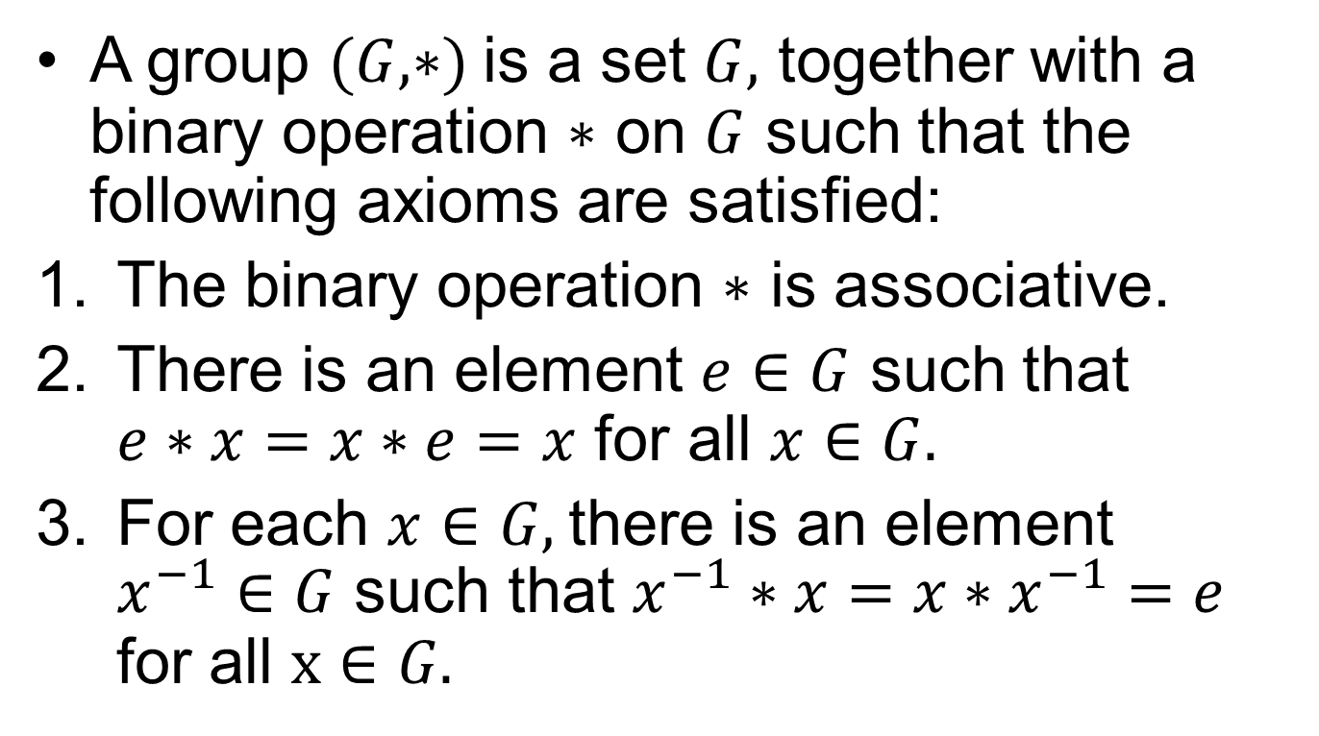
Group
A group $(G, ∗)$ is a set $G,$ together with a binary operation $∗$ on $G$ such that the following axioms are satisfied:
The binary operation $∗$ is associative.
There is an element $e∈G$ such that $e∗x=x∗e=x$ for all $x∈G.$
For each $x∈G,$there is an element $x^{−1}∈G$ such that $x^{−1}∗x=x∗x^{−1}=e$ for all $x∈G.$

Slide 13
Discussion and remarks

Slide 14
Summary

Slide 15
Thank You

