Slide 1
MTH376: Algebra
For
Master of Mathematics
By
Dr. M. Fazeel Anwar
Assistant Professor
Department of Mathematics, CIIT Islamabad

Slide 2
Lecture 19

Slide 3
Recap
Cyclic subgroup
Examples

Slide 4
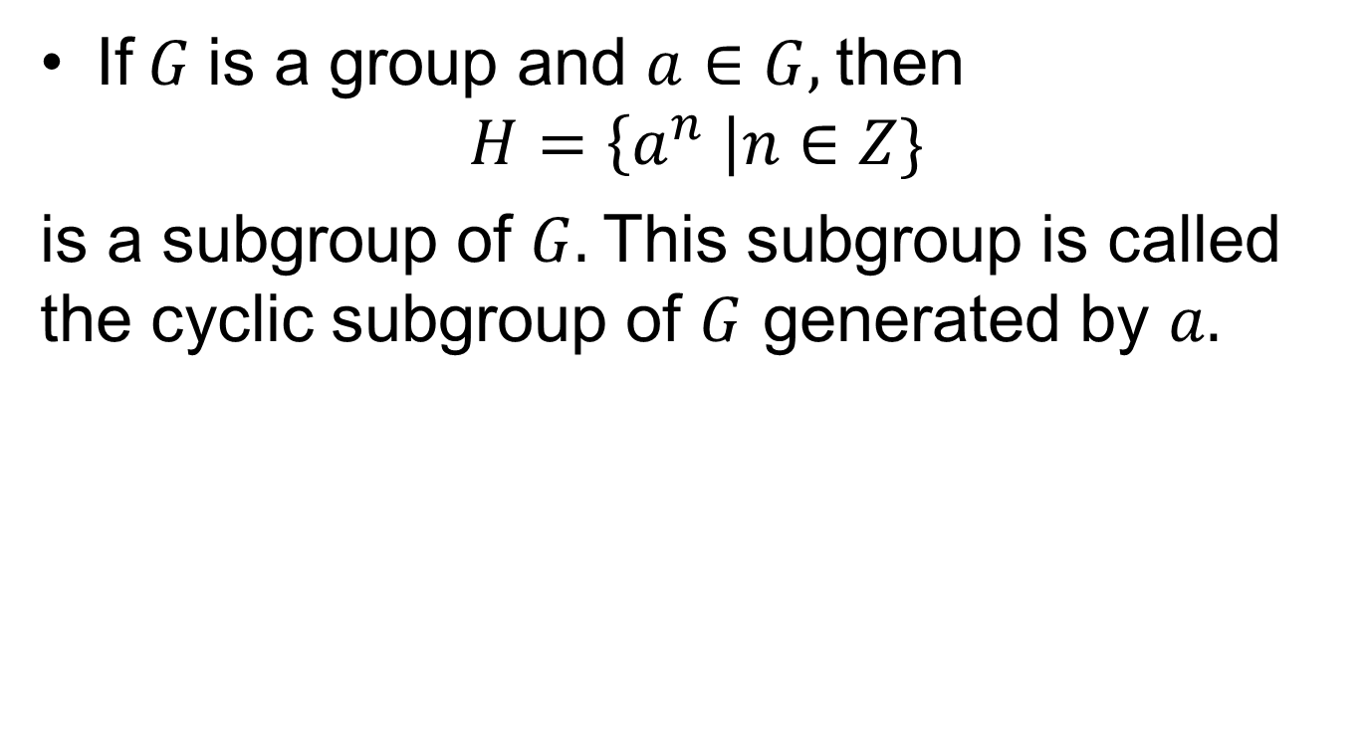
Cyclic subgroup
If$G$is a group and $a∈G,$then
$$H=\left\{a^{n} \right|n∈Z\}$$
is a subgroup of $G.$This subgroup is called the cyclic subgroup of $G$ generated by $a.$

Slide 5
Examples

Slide 6
Examples.

Slide 7
Examples..

Slide 8
Examples…

Slide 9
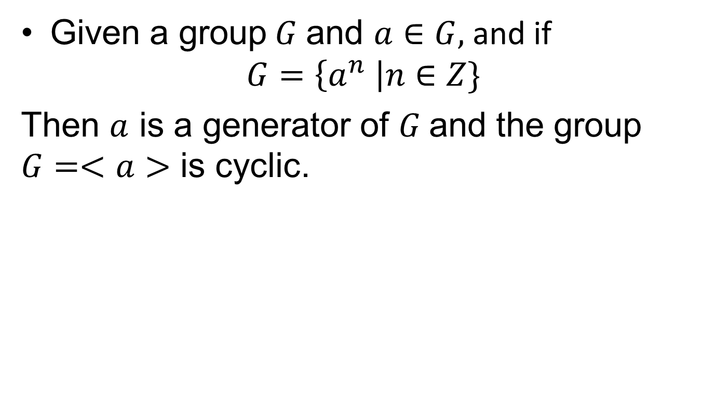
Cyclic Groups
Given a group$G$and $a∈G,$and if
$$G=\left\{a^{n} \right|n∈Z\}$$
Then $a$ is a generator of $G$and the group $G=<a>$ is cyclic.

Slide 14
Theorem
Every cyclic group is abelian.

Slide 15
Summary

Slide 16
Thank You

