Slide 1
MTH376: Algebra
For
Master of Mathematics
By
Dr. M. Fazeel Anwar
Assistant Professor
Department of Mathematics, CIIT Islamabad

Slide 2
Lecture 18

Slide 3
Recap
Revision of permutation concepts
The alternating group
Cyclic groups

Slide 5
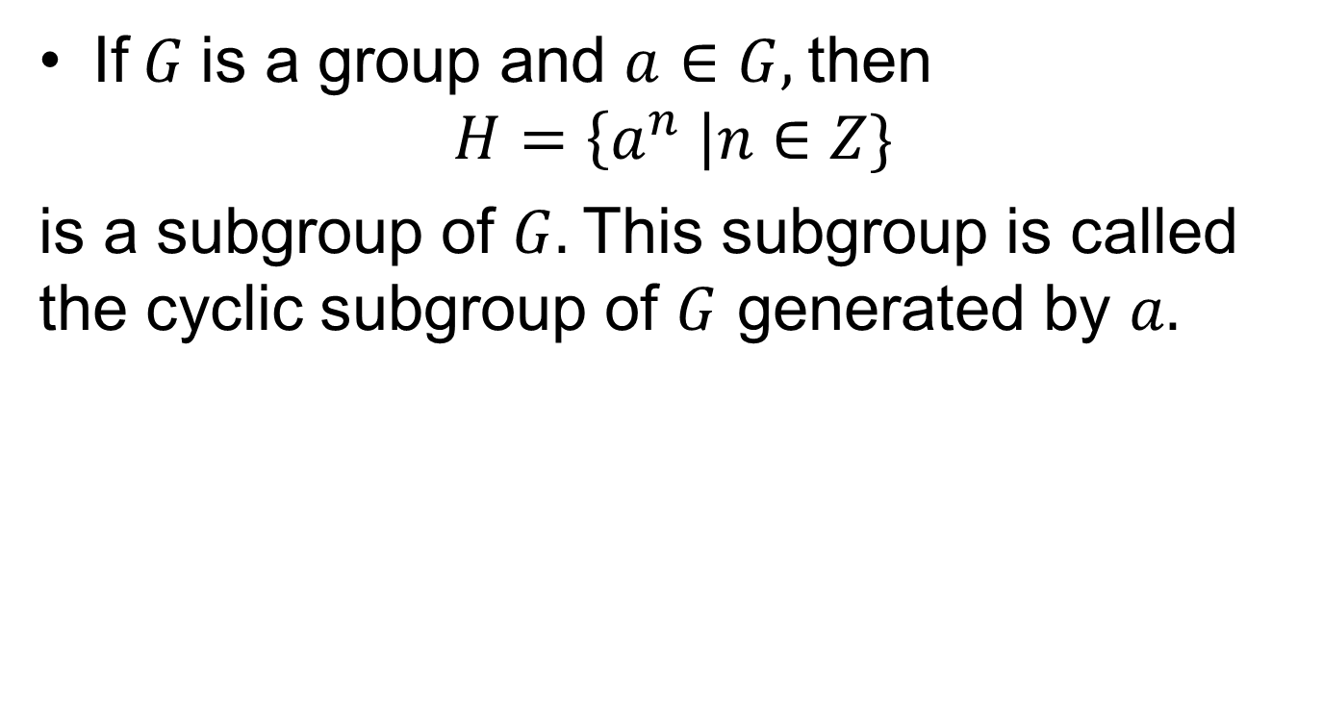
Cyclic Groups
If$G$is a group and $a∈G,$then
$$H=\left\{a^{n} \right|n∈Z\}$$
is a subgroup of $G.$This subgroup is called the cyclic subgroup of $G$ generated by $a.$

Slide 6
Examples

Slide 7
Examples.

Slide 8
Examples..

Slide 9
Examples...

Slide 10
Examples....

Slide 11
Examples.....

Slide 12
Summary

Slide 13
Thank You

