Slide 1
MTH376: Algebra
For
Master of Mathematics
By
Dr. M. Fazeel Anwar
Assistant Professor
Department of Mathematics, CIIT Islamabad

Slide 2
Lecture 17

Slide 3
Recap
Revision of permutation concepts
The alternating group

Slide 10
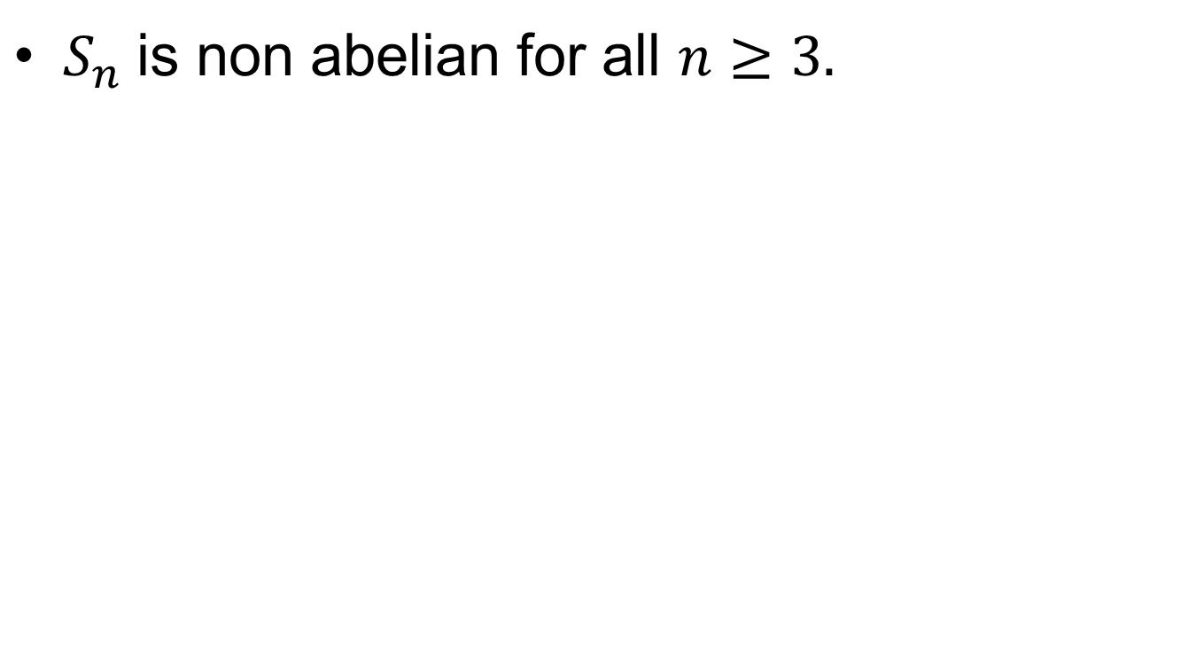
Fact
$S_{n}$ is non abelian for all $n≥3.$

Slide 12
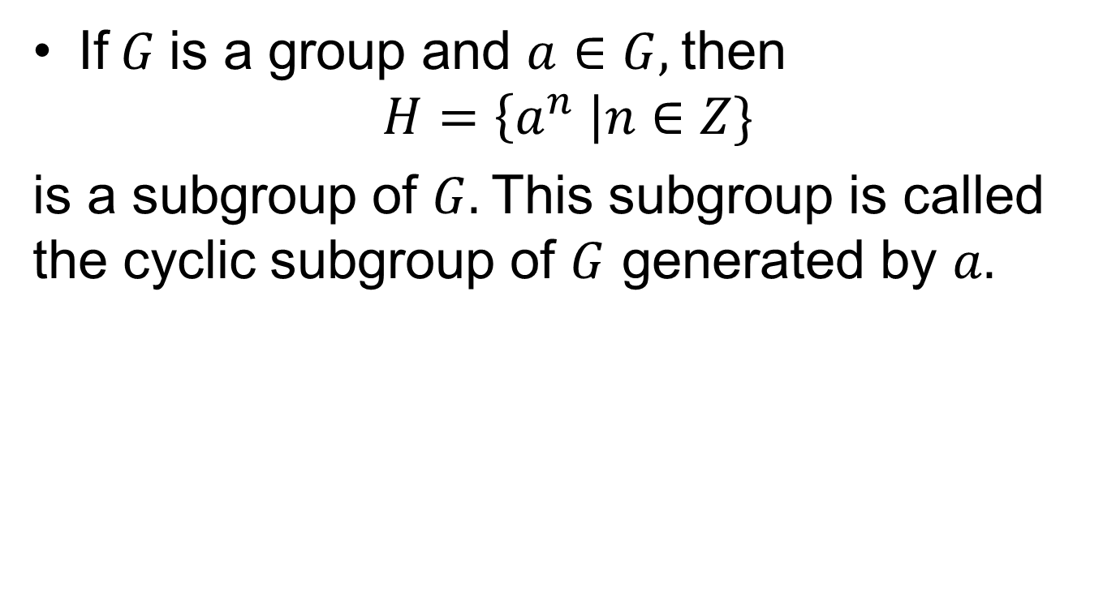
Cyclic Groups
If $G$ is a group and $a∈G,$then
$$H=\left\{a^{n} \right|n∈Z\}$$
is a subgroup of $G.$This subgroup is called the cyclic subgroup of $G$ generated by $a.$

Slide 13
Examples

Slide 14
Examples.

Slide 16
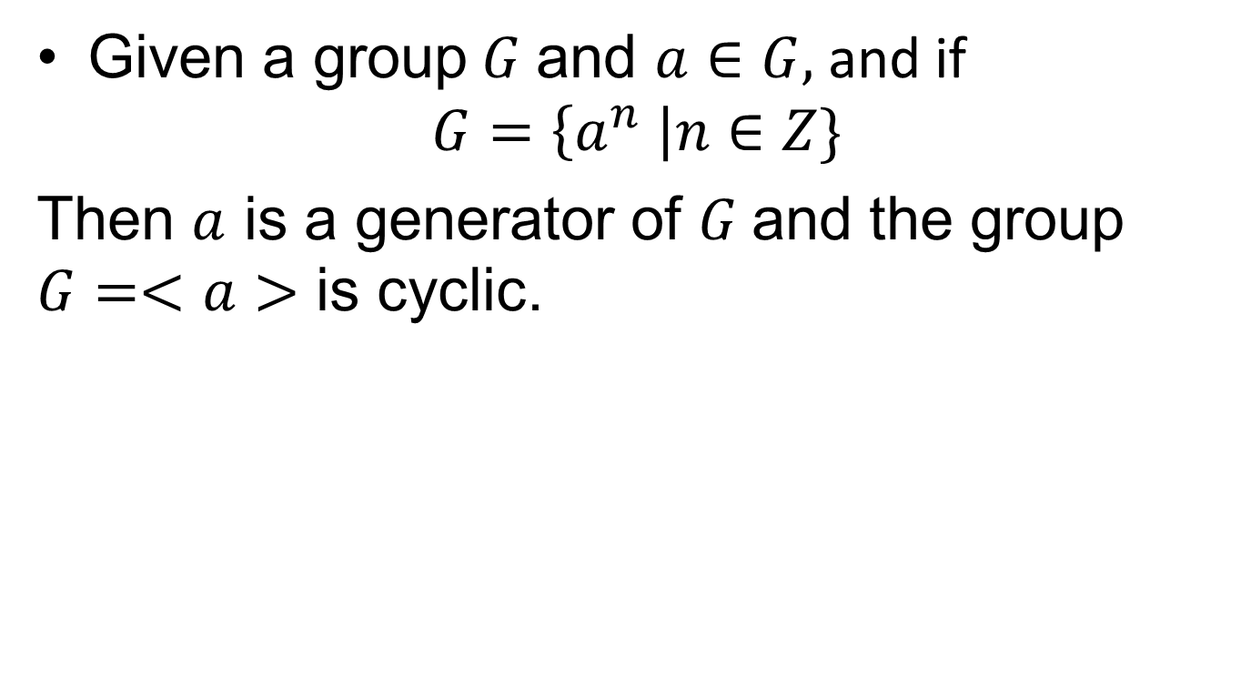
Cyclic Groups(continued)
Given a group $G$ and $a∈G,$and if
$$G=\left\{a^{n} \right|n∈Z\}$$
Then $a$ is a generator of $G$and the group $G=<a>$ is cyclic.

Slide 19
Theorem
Every cyclic group is abelian.

Slide 21
Summary

Slide 22
Thank You

