Slide 1
MTH376: Algebra
For
Master of Mathematics
By
Dr. M. Fazeel Anwar
Assistant Professor
Department of Mathematics, CIIT Islamabad

Slide 2
Lecture 16

Slide 3
Recap
Cyclic Notation
Transpositions
Even/Odd permutation

Slide 7
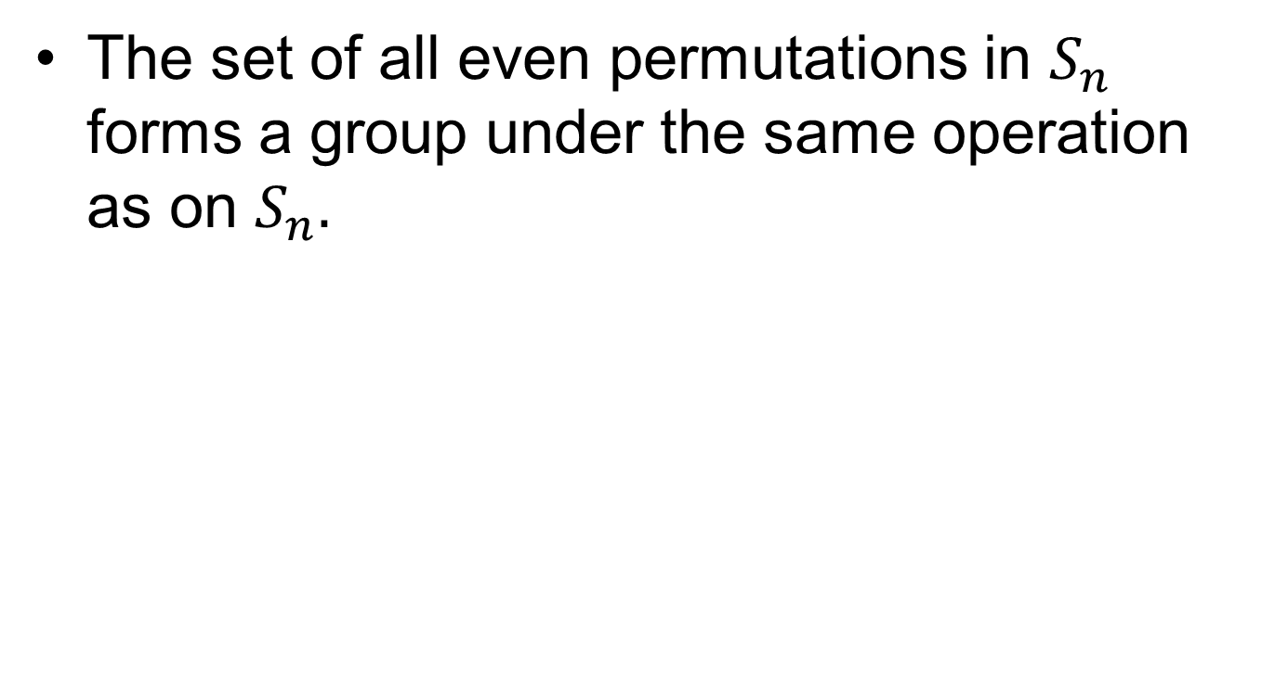
The Alternating Group
The set of all even permutations in $S_{n}$ forms a group under the same operation as on $S_{n}.$

Slide 9

$$A_{3}$$

Slide 11

$$A_{4}$$

Slide 13
Summary

Slide 14
Thank You

