Slide 1
MTH376: Algebra
For
Master of Mathematics
By
Dr. M. Fazeel Anwar
Assistant Professor
Department of Mathematics, CIIT Islamabad

Slide 2
Lecture 14

Slide 3
Recap
Permutation Groups
Symmetric Groups
Dihedral Groups

Slide 6
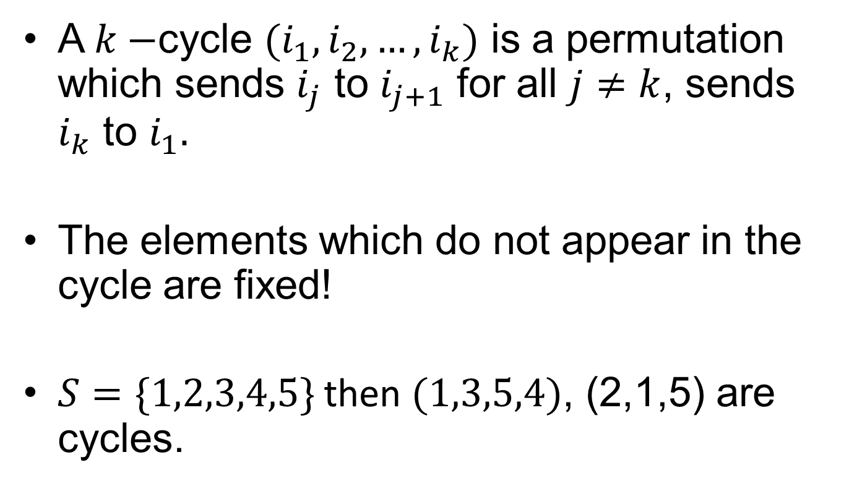
Cycle
A $k−$cycle $(i_{1}, i_{2}, …, i_{k})$ is a permutation which sends $i_{j}$ to $i_{j+1}$ for all $j≠k$, sends $i_{k}$ to $i_{1}.$
The elements which do not appear in the cycle are fixed!
$S=\{1,2,3,4,5\}$ then $(1,3,5,4)$, (2,1,5) are cycles.

Slide 9
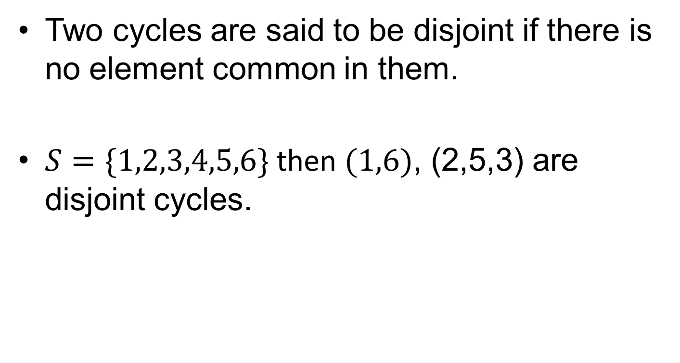
Cycle (continued…)
Two cycles are said to be disjoint if there is no element common in them.
$S=\{1,2,3,4,5,6\}$ then $(1,6)$, (2,5,3) are disjoint cycles.

Slide 10
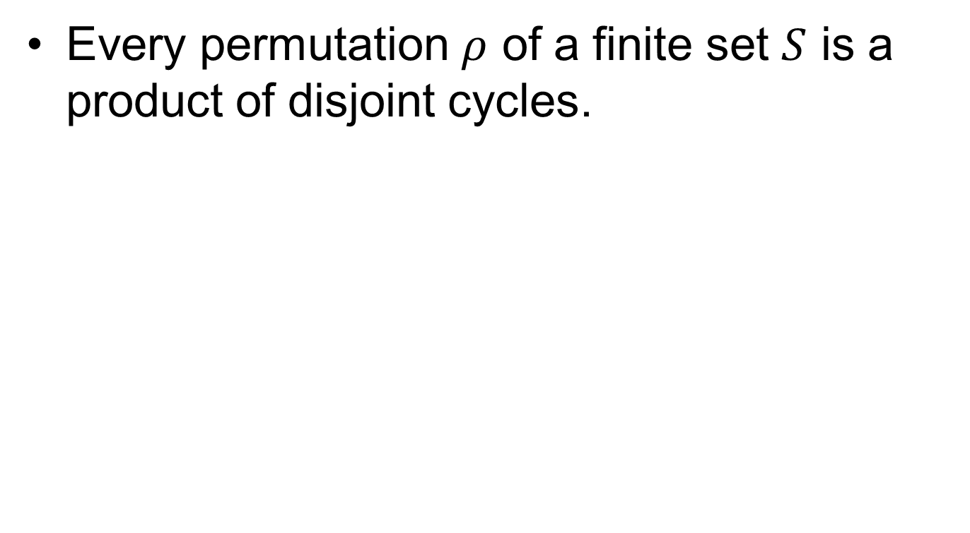
Theorem
Every permutation $ρ$ of a finite set $S$ is a product of disjoint cycles.

Slide 11
Examples

Slide 12
Summary

Slide 13
Thank You

