Slide 1
MTH376: Algebra
For
Master of Mathematics
By
Dr. M. Fazeel Anwar
Assistant Professor
Department of Mathematics, CIIT Islamabad

Slide 2
Lecture 13

Slide 3
Recap
Permutation Groups
Symmetric Groups
Symmetries of a triangle

Slide 4
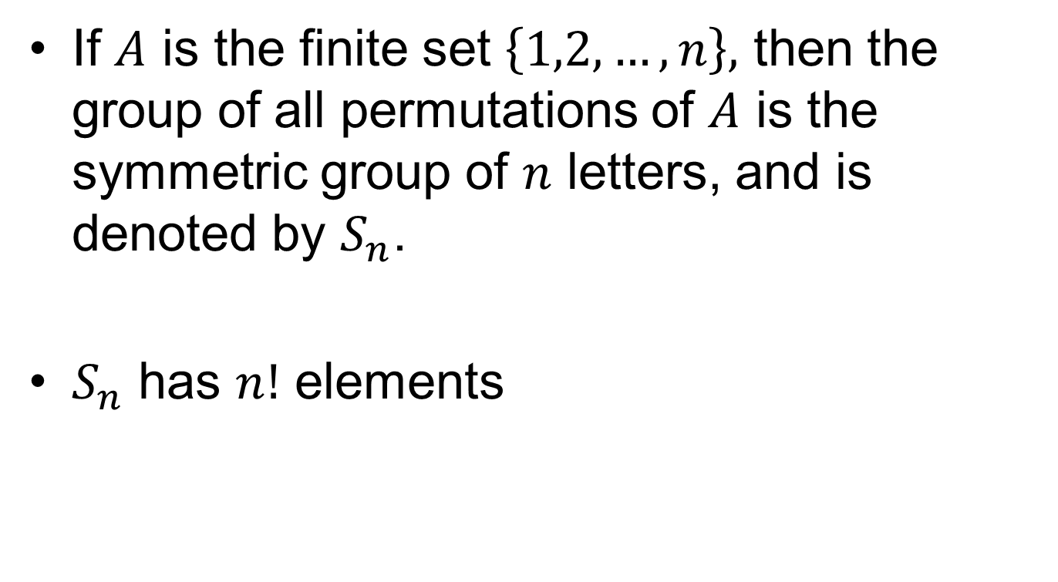
Symmetric Group
If $A$ is the finite set $\left\{1,2,…,n\right\},$ then the group of all permutations of $A$ is the symmetric group of $n$ letters, and is denoted by $S_{n}$.
$S_{n}$ has $n!$ elements

Slide 5

$$S_{3}$$

Slide 6
Symmetries of a square

Slide 10
Dihedral Group
Symmetries of a regular n-gon

Slide 12
Dihedral Group.

Slide 14
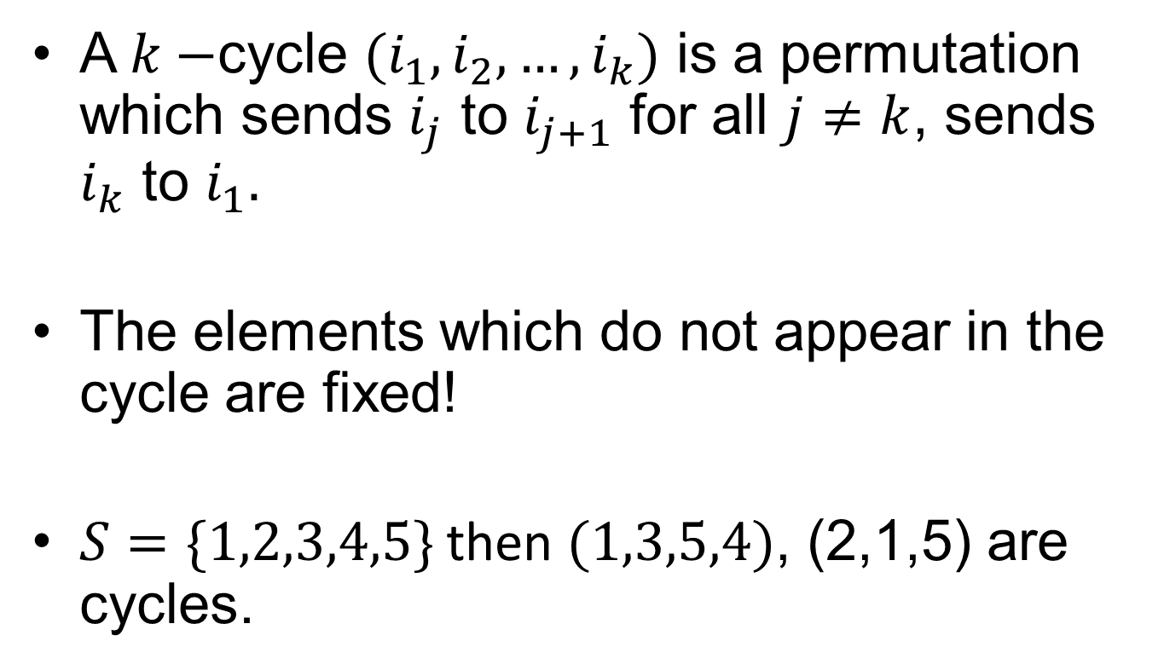
Cycle
A $k−$cycle $(i_{1}, i_{2}, …, i_{k})$ is a permutation which sends $i_{j}$ to $i_{j+1}$ for all $j≠k$, sends $i_{k}$ to $i_{1}.$
The elements which do not appear in the cycle are fixed!
$S=\{1,2,3,4,5\}$then $(1,3,5,4)$, (2,1,5) are cycles.

Slide 15
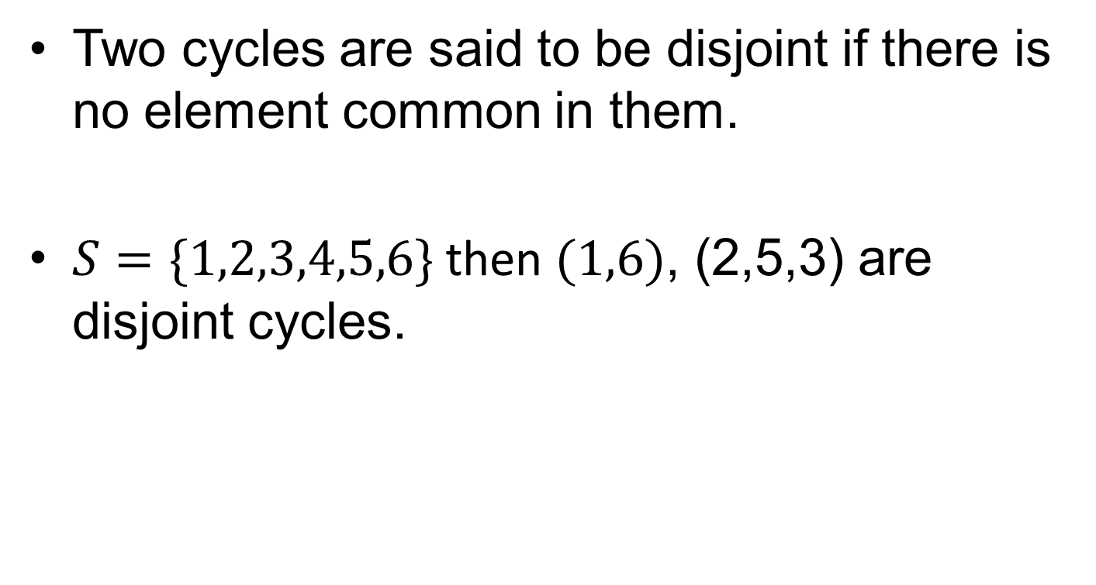
Cycle (continued…)
Two cycles are said to be disjoint if there is no element common in them.
$S=\{1,2,3,4,5,6\}$ then $(1,6)$, (2,5,3) are disjoint cycles.

Slide 16
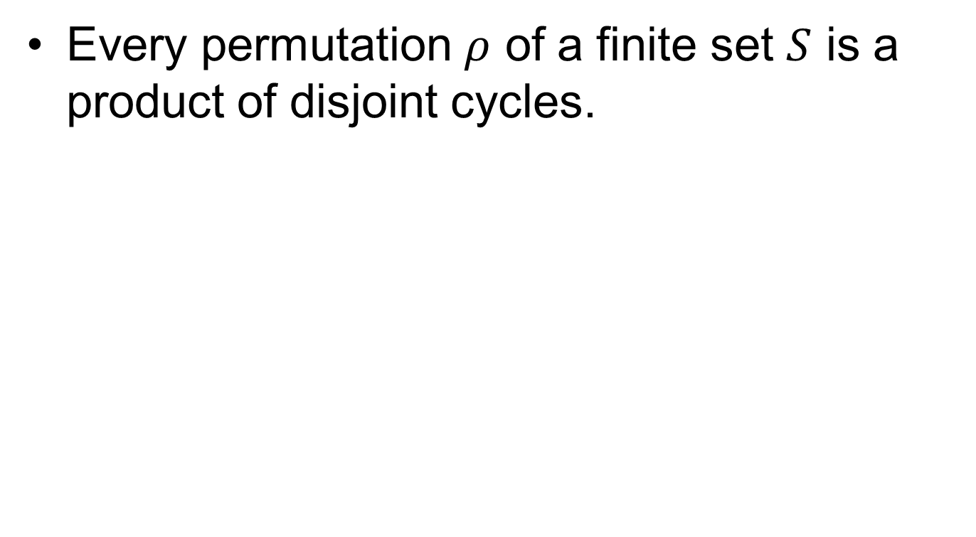
Theorem
Every permutation $ρ$ of a finite set $S$ is a product of disjoint cycles.

Slide 17
Examples

Slide 18
More Examples

Slide 19
Summary

Slide 20
Thank You

