Slide 1
MTH376: Algebra
For
Master of Mathematics
By
Dr. M. Fazeel Anwar
Assistant Professor
Department of Mathematics, CIIT Islamabad

Slide 2
Lecture 12

Slide 3
Recap
Permutations
Permutation Groups

Slide 4
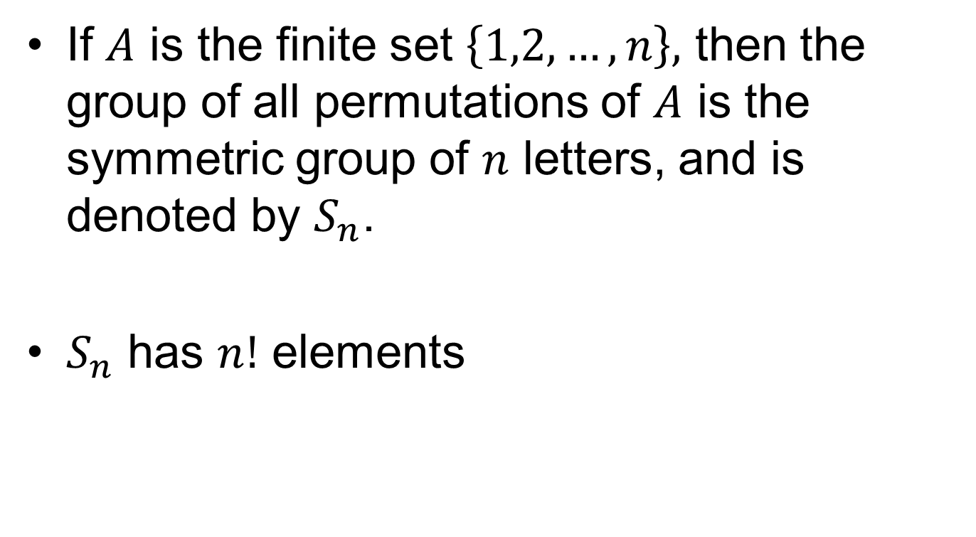
Symmetric Group
If $A$ is the finite set $\left\{1,2,…,n\right\},$ then the group of all permutations of $A$ is the symmetric group of $n$ letters, and is denoted by $S_{n}$.
$S_{n}$ has $n!$ elements

Slide 5

$$S_{3}$$

Slide 6

$S_{3}$(continued)

Slide 9
Symmetries of a triangle

Slide 10
Symmetries of a square

Slide 11
Summary

Slide 12
Thank You

