Slide 1
MTH376: Algebra
For
Master of Mathematics
By
Dr. M. Fazeel Anwar
Assistant Professor
Department of Mathematics, CIIT Islamabad

Slide 2
Lecture 10

Slide 3

Recap
Integers Modulo $n$
Modulo Groups

Slide 4

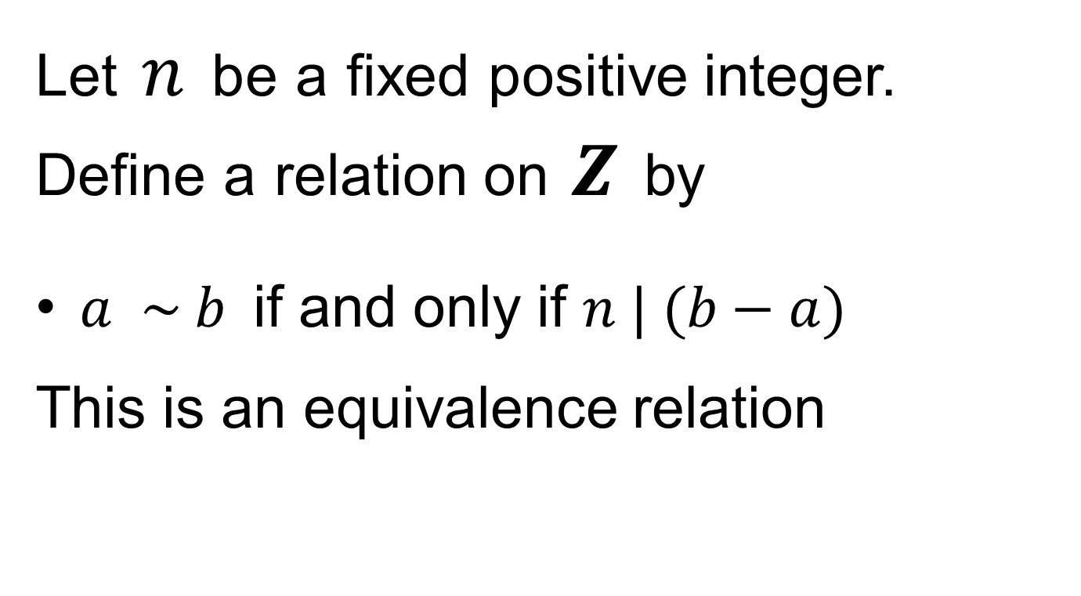
Integers modulo $n$ …
Let $n$ be a fixed positive integer. Define a relation on $Z$ by
$a \sim b$ if and only if $n | (b−a)$
This is an equivalence relation

Slide 5
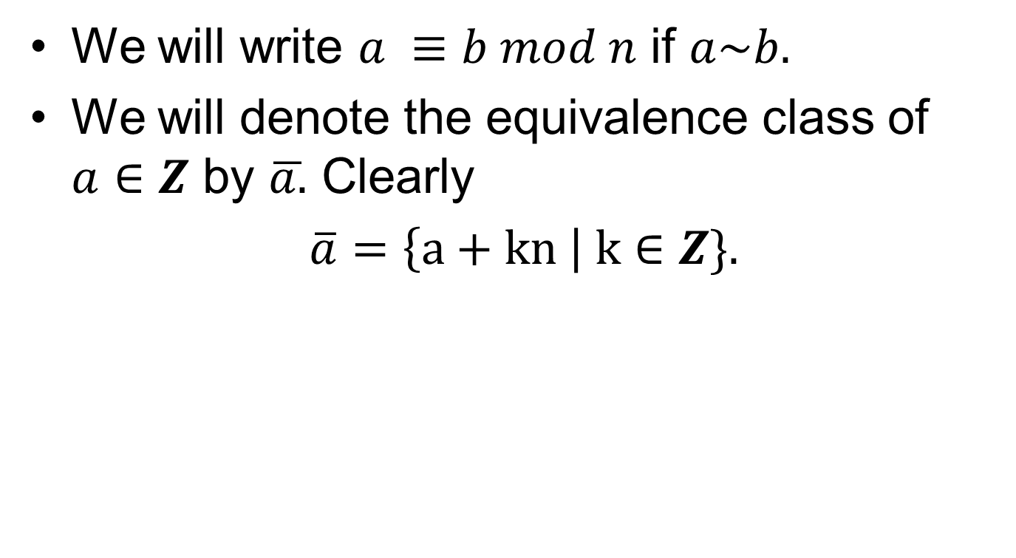
Integers modulo $n$ …
We will write $a ≡b mod n$ if $a\sim b.$
We will denote the equivalence class of $a∈Z$ by $\overline{a.}$ Clearly
$\overline{a}=\left\{a+kn \right| k∈Z\}.$

Slide 6
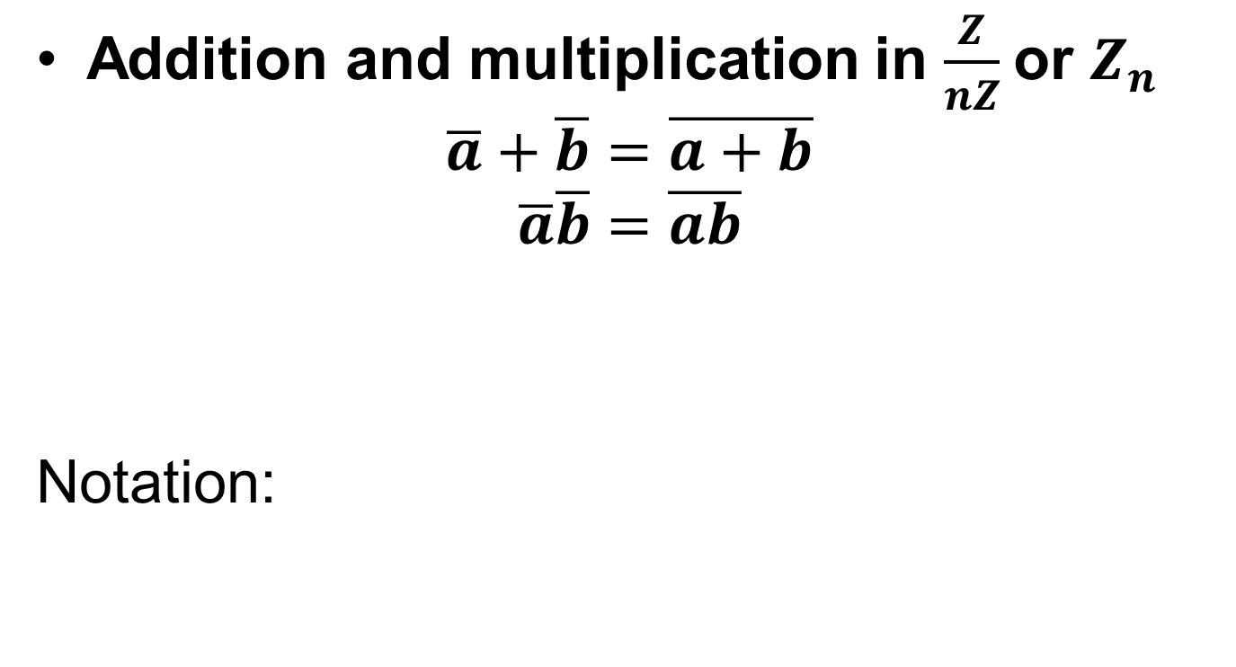
Integers modulo $n$ …
Addition and multiplication in $\frac{Z}{nZ}$or $Z_{n}$
$$\overline{a}+\overline{b}=\overline{a+b}$$
$$\overline{a}\overline{b}=\overline{ab}$$
Notation:

Slide 7
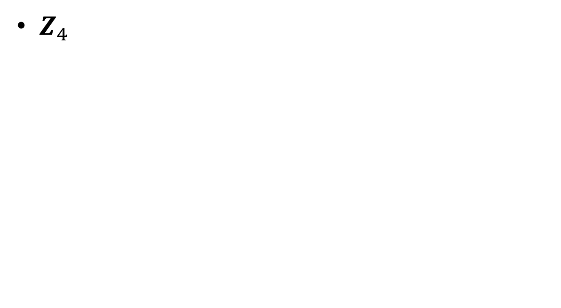
Modulo Groups
$Z_{4}$

Slide 9

Modulo Groups.
$Z_{n}$

Slide 11
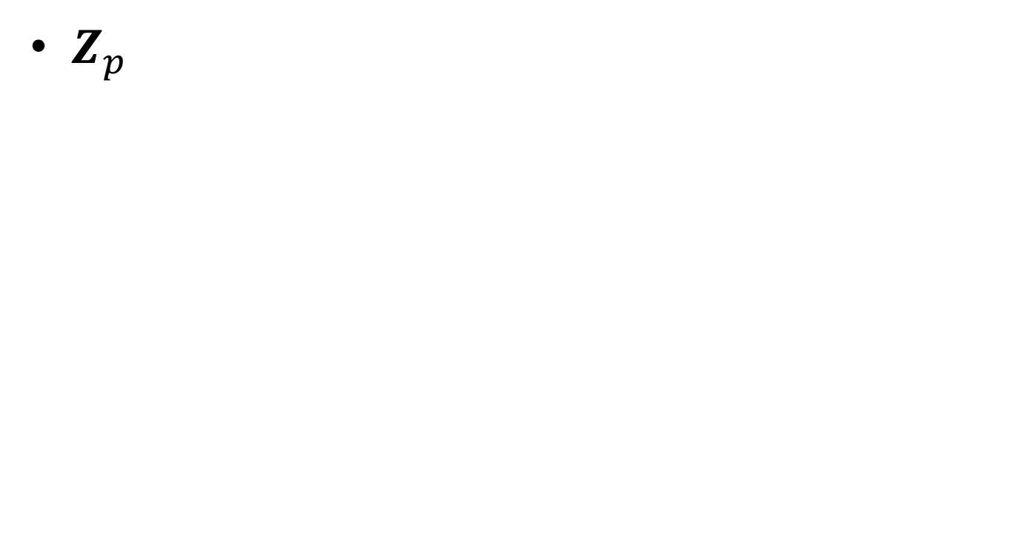
Modulo Groups.
$Z_{p}$

Slide 13
Permutation Group

Slide 14
Permutation Group.

Slide 15
Permutation Group..

Slide 16
Permutation Group…

Slide 17
Summary

Slide 18
Thank You

