Slide 1
MTH374: Optimization
For
Master of Mathematics
By
Dr. M. Fazeel Anwar
Assistant Professor
Department of Mathematics, CIIT Islamabad

Slide 2
Lecture 09

Slide 3
Recap
More examples of multivariable optimization problems
Constrained optimization

Slide 4
Today’s Topics
Constrained optimization
Lagrange Multiplier

Slide 5
Constrained Optimization
In the real world, often restrictions or constraints are placed upon values of the independent variables.
These problems are referred to as constrained optima or constrained optimization.
We usually have very few resources and we want to allocate them to maximize our objectives.
We also have very specific requirements attached to our objectives.
In a nutshell restrictions are a key ingredient to any real life problem

Slide 6
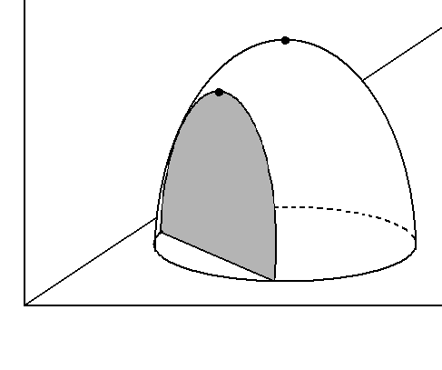
Constrained Optimization
Free
maximum
Constrained
maximum
constraint

Slide 7
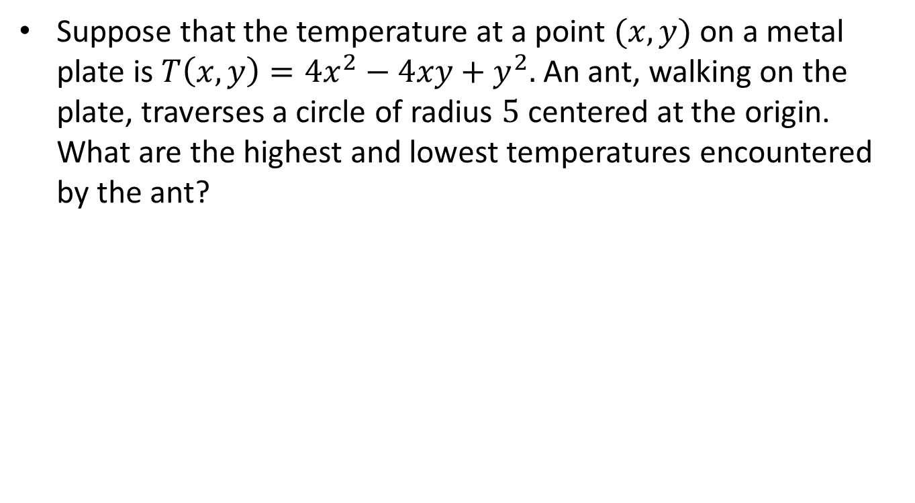
Example-I
Suppose that the temperature at a point $(x,y)$ on a metal plate is $T\left(x,y\right)=4x^{2}−4xy+y^{2}.$ An ant, walking on the plate, traverses a circle of radius $5$ centered at the origin. What are the highest and lowest temperatures encountered by the ant?

Slide 8
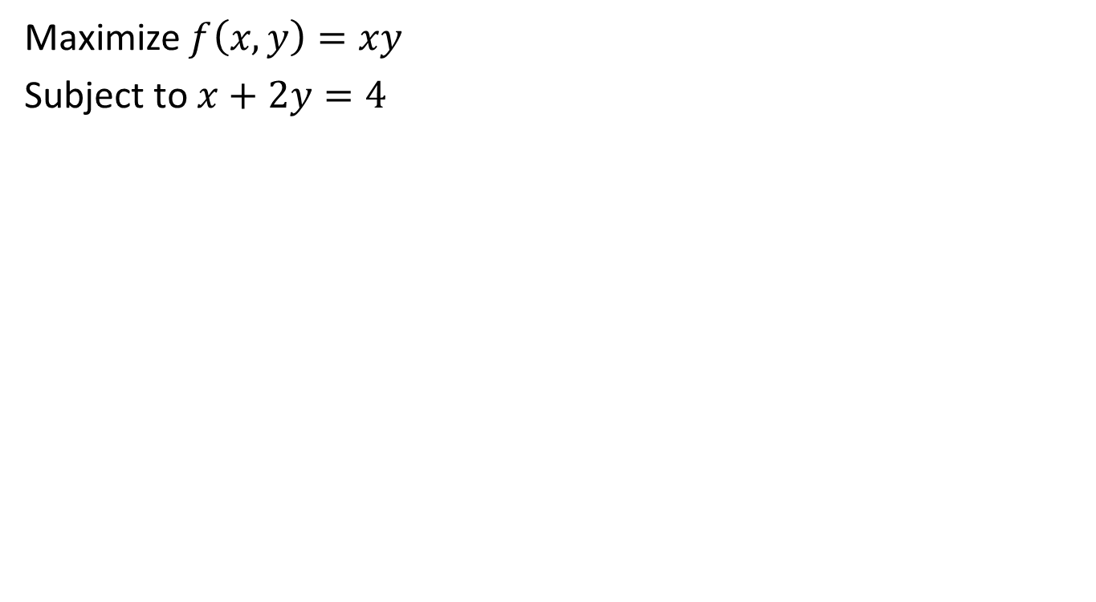
Example-II
Maximize $f\left(x,y\right)=xy$
Subject to $x+2y=4$

Slide 9
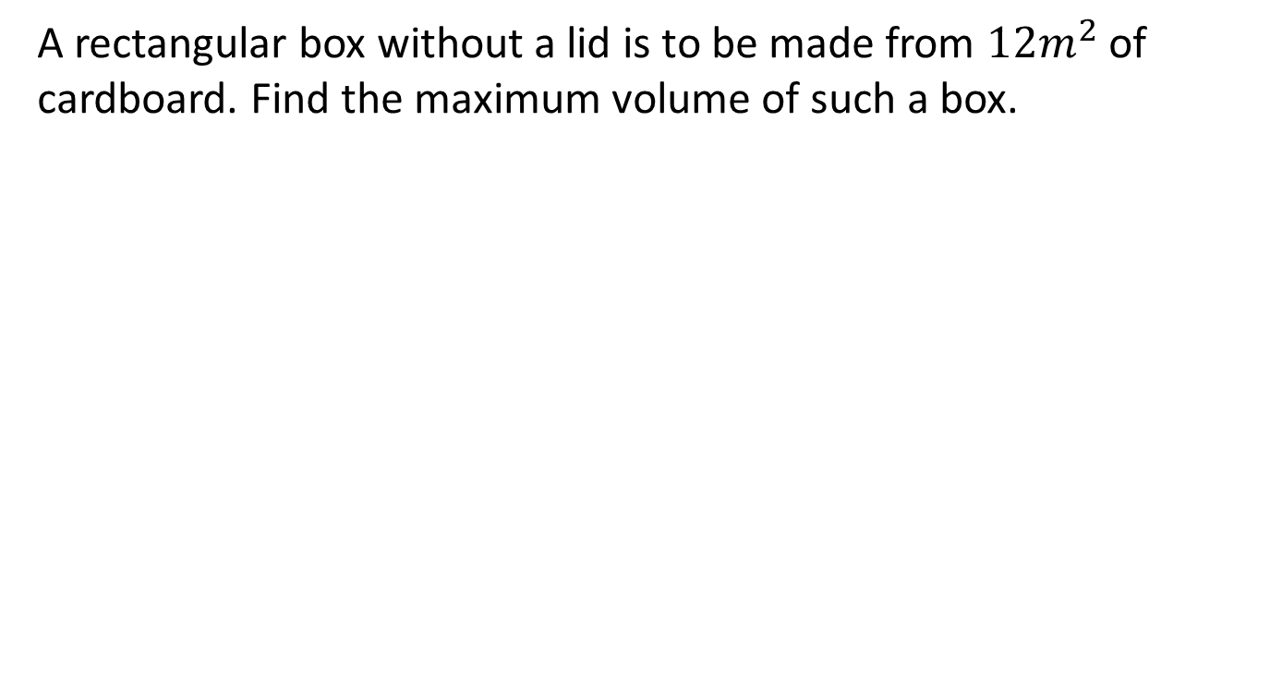
Example-III
A rectangular box without a lid is to be made from $12m^{2}$ of cardboard. Find the maximum volume of such a box.

Slide 10
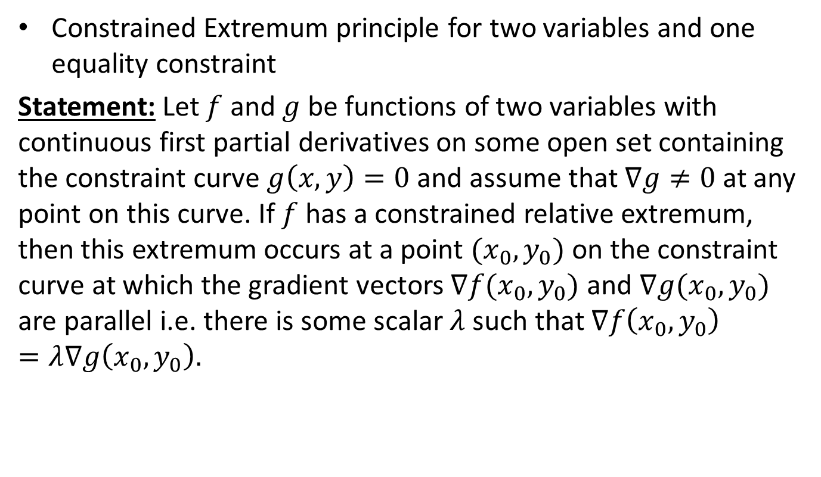
Lagrange Multipliers-I
Constrained Extremum principle for two variables and one equality constraint
Statement: Let $f$ and $g$ be functions of two variables with continuous first partial derivatives on some open set containing the constraint curve $g\left(x,y\right)=0$ and assume that $∇g≠0$ at any point on this curve. If $f$ has a constrained relative extremum, then this extremum occurs at a point $(x_{0},y_{0})$ on the constraint curve at which the gradient vectors $∇f(x_{0},y_{0})$ and $∇g(x_{0},y_{0})$ are parallel i.e. there is some scalar $λ$ such that $∇f\left(x_{0},y_{0}\right)=λ∇g\left(x_{0},y_{0}\right).$

Slide 12
Example-I
Suppose that the temperature at a point $(x,y)$ on a metal plate is $T\left(x,y\right)=4x^{2}−4xy+y^{2}.$ An ant, walking on the plate, traverses a circle of radius $5$ centered at the origin. What are the highest and lowest temperatures encountered by the ant?

Slide 17
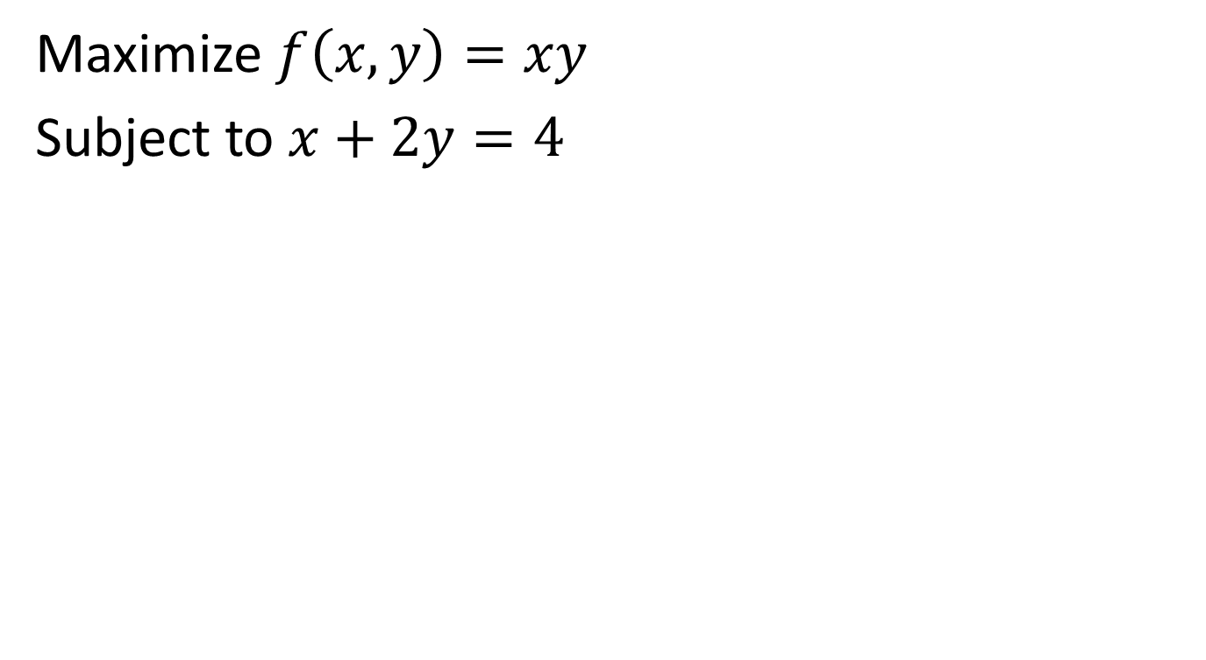
Example-II
Maximize $f\left(x,y\right)=xy$
Subject to $x+2y=4$

Slide 20
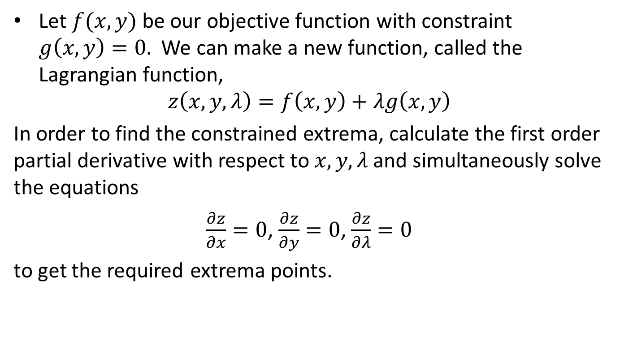
Lagrange Multipliers-I
Alternate Approach
Let $f(x,y)$ be our objective function with constraint $g\left(x,y\right)=0.$ We can make a new function, called the Lagrangian function,
$$z\left(x,y,λ\right)=f\left(x,y\right)+λg\left(x,y\right)$$
In order to find the constrained extrema, calculate the first order partial derivative with respect to $x,y,λ$ and simultaneously solve the equations
$\frac{∂z}{∂x}=0$, $\frac{∂z}{∂y}=0$, $\frac{∂z}{∂λ}=0$
to get the required extrema points.

Slide 21
Example-III
A rectangular box without a lid is to be made from $12m^{2}$ of cardboard. Find the maximum volume of such a box.

Slide 22
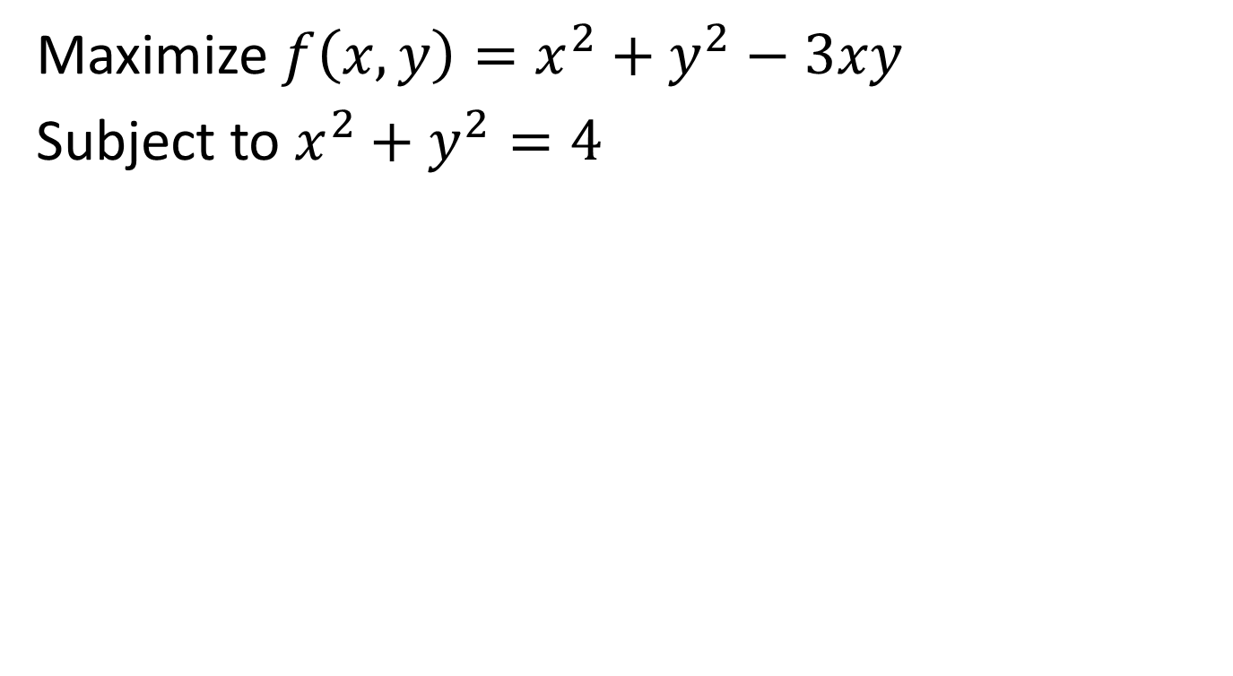
Example-IV
Maximize $f\left(x,y\right)=x^{2}+y^{2}−3xy$
Subject to $x^{2}+y^{2}=4$

Slide 25
Summary

Slide 26
Thank You

