Slide 1
MTH374: Optimization
For
Master of Mathematics
By
Dr. M. Fazeel Anwar
Assistant Professor
Department of Mathematics, CIIT Islamabad

Slide 2
Lecture 08

Slide 3
Recap
Multivariable optimization
Unconstrained problems

Slide 4
Today’s Topics
More examples of multivariable optimization problems
Constrained optimization
Lagrange Multiplier

Slide 5
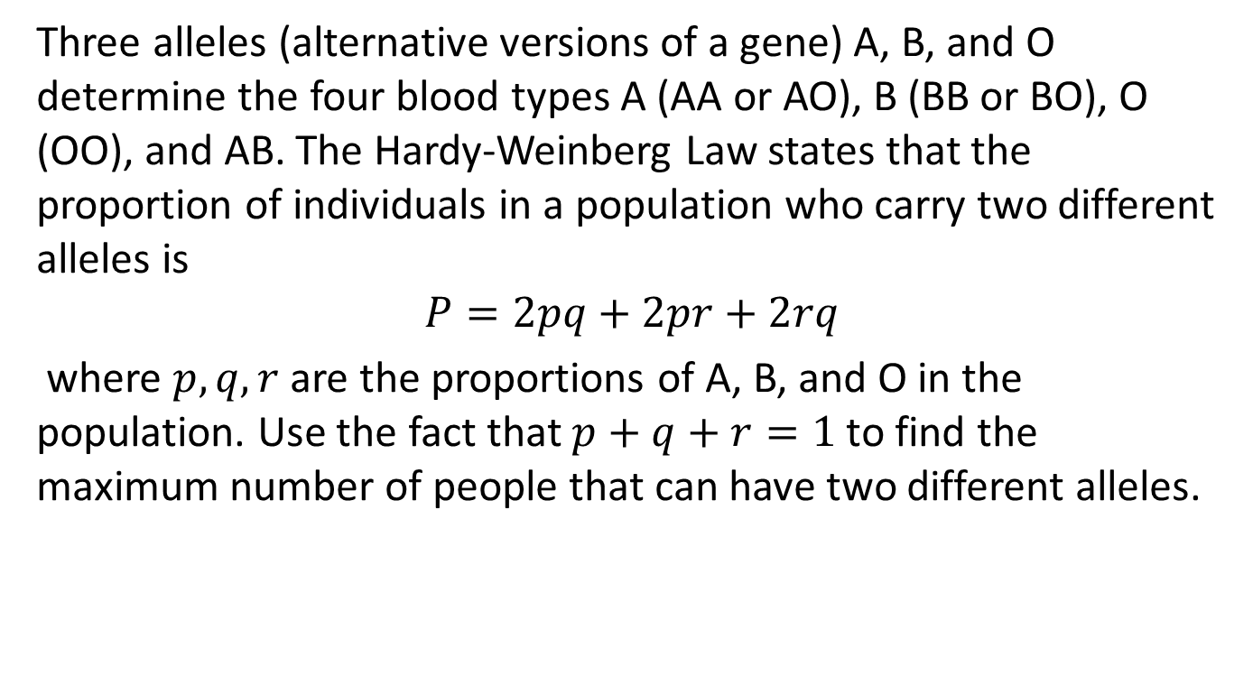
Example
Three alleles (alternative versions of a gene) A, B, and O determine the four blood types A (AA or AO), B (BB or BO), O (OO), and AB. The Hardy-Weinberg Law states that the proportion of individuals in a population who carry two different alleles is
$$P=2pq+2pr+2rq$$
where $p,q,r$ are the proportions of A, B, and O in the population. Use the fact that $p+q+r=1$ to find the maximum number of people that can have two different alleles.

Slide 7
Constrained Optimization
In the real world, often restrictions or constraints are placed upon values of the independent variables.
These problems are referred to as constrained optima or constrained optimization.
We usually have very few resources and we want to allocate them to maximize our objectives.
We also have very specific requirements attached to our objectives.
In a nutshell restrictions are a key ingredient to any real life problem

Slide 8
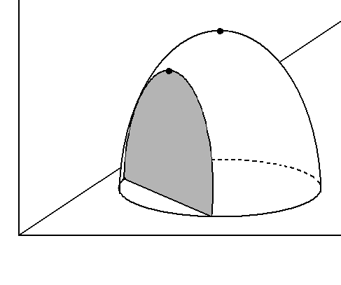
Constrained Optimization
Free
maximum
Constrained
maximum
constraint

Slide 9
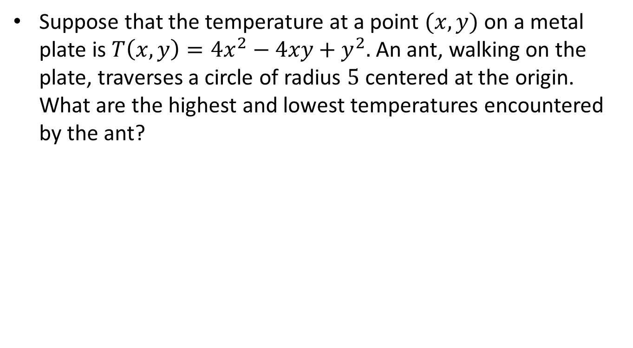
Example-I
Suppose that the temperature at a point $(x,y)$ on a metal plate is $T\left(x,y\right)=4x^{2}−4xy+y^{2}.$ An ant, walking on the plate, traverses a circle of radius $5$ centered at the origin. What are the highest and lowest temperatures encountered by the ant?

Slide 10
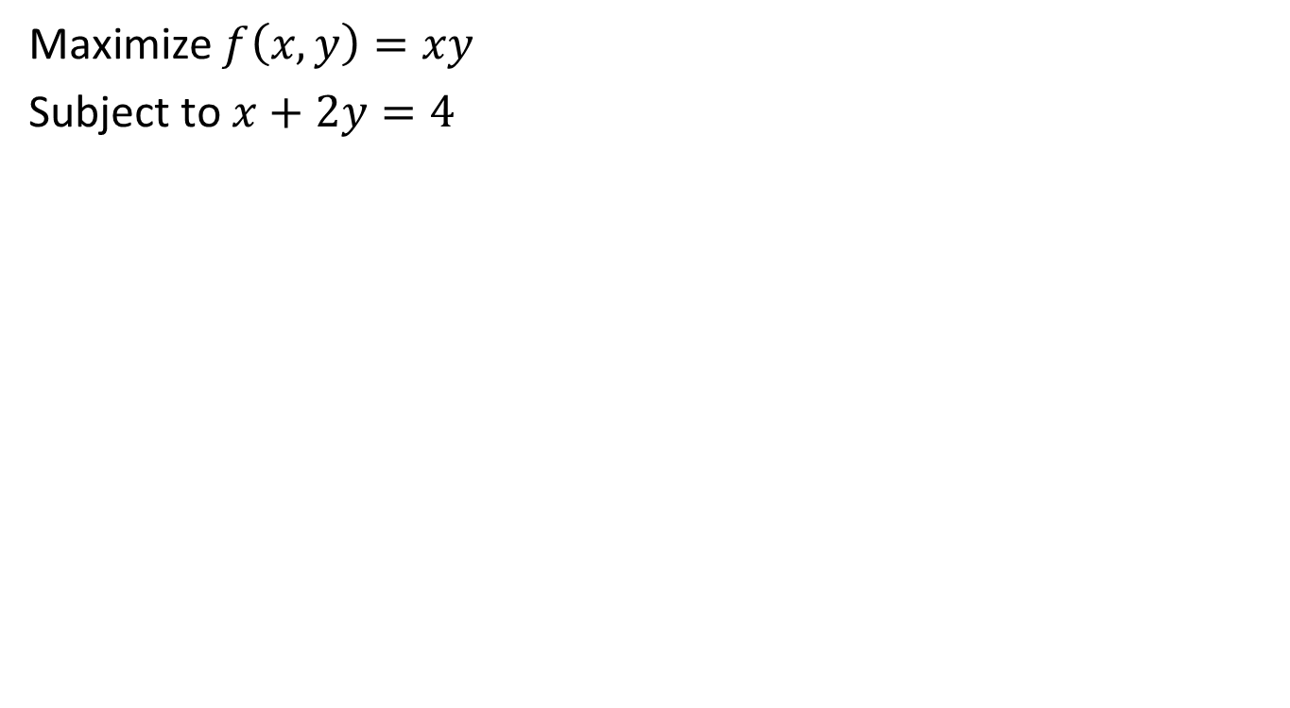
Example-II
Maximize $f\left(x,y\right)=xy$
Subject to $x+2y=4$

Slide 11
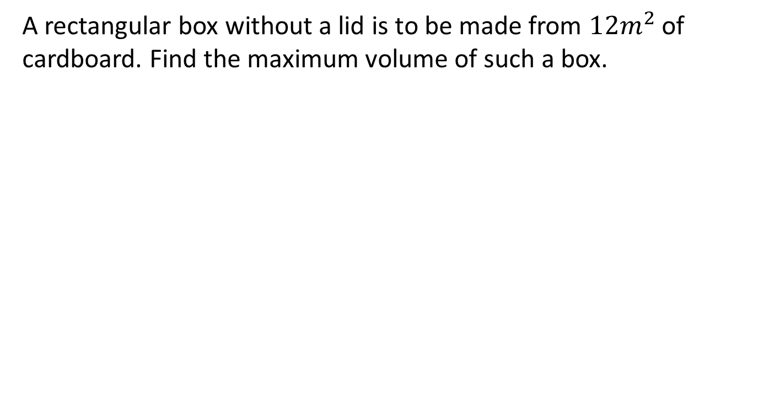
Example-III
A rectangular box without a lid is to be made from $12m^{2}$ of cardboard. Find the maximum volume of such a box.

Slide 12
Summary

Slide 13
Thank You

