Slide 1
MTH374: Optimization
For
Master of Mathematics
By
Dr. M. Fazeel Anwar
Assistant Professor
Department of Mathematics, CIIT Islamabad

Slide 2
Lecture 07

Slide 3
Recap
Multivariable optimization

Slide 4
Today’s Topics
Examples of multi variable optimization
Constrained optimization
Lagrange Multiplier

Slide 5
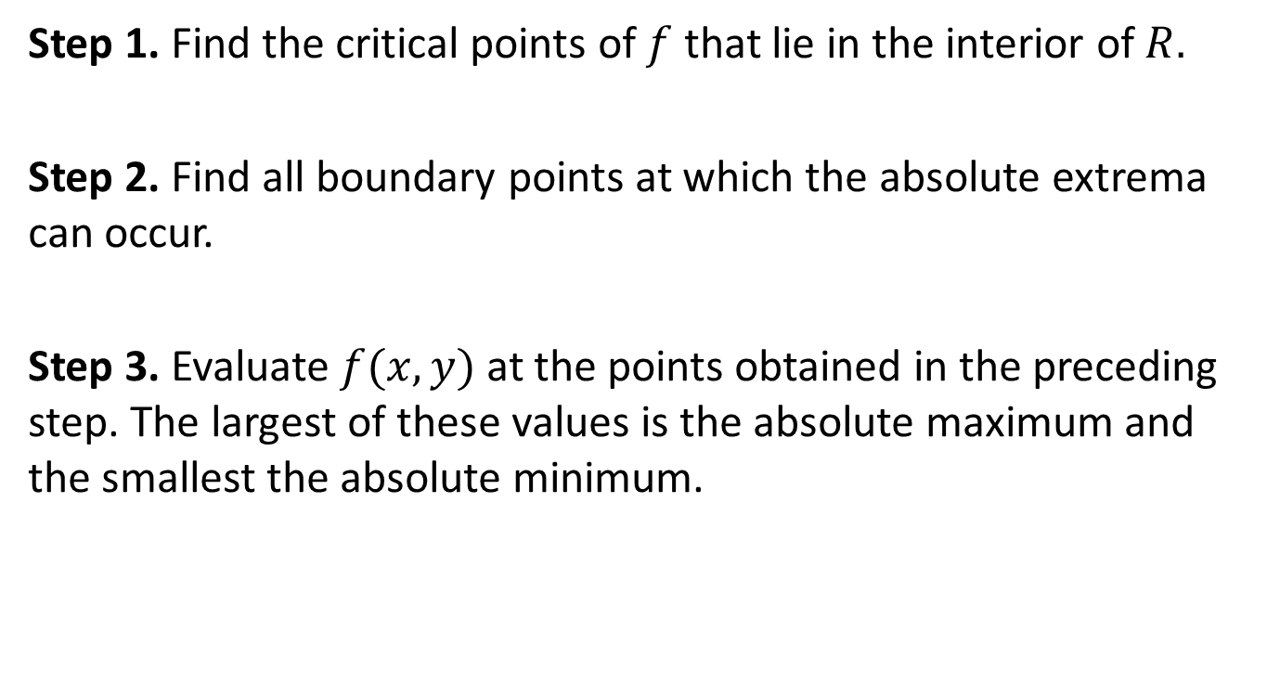
Finding Absolute Maxima/Minima
Step 1. Find the critical points of $f$ that lie in the interior of $R.$
Step 2. Find all boundary points at which the absolute extrema can occur.
Step 3. Evaluate $f(x,y)$ at the points obtained in the preceding step. The largest of these values is the absolute maximum and the smallest the absolute minimum.

Slide 6
Example

Slide 10
Example.

Slide 13
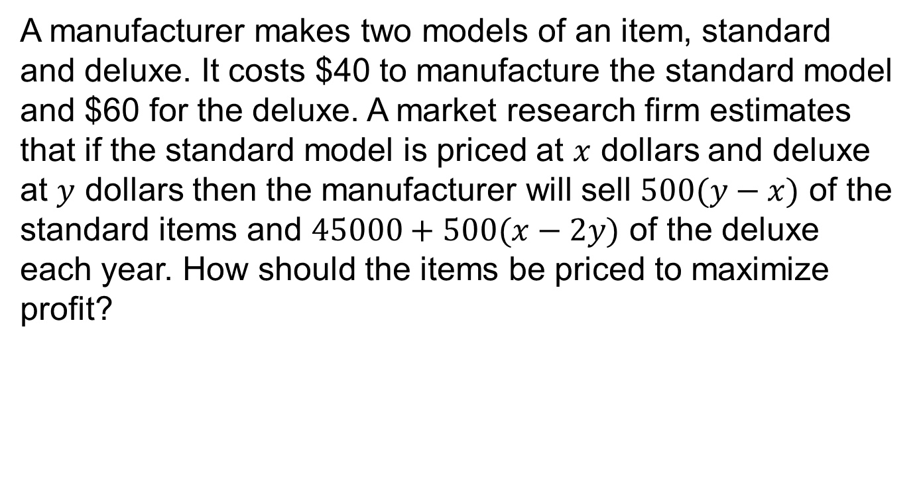
Example
A manufacturer makes two models of an item, standard and deluxe. It costs $40 to manufacture the standard model and $60 for the deluxe. A market research firm estimates that if the standard model is priced at $x$ dollars and deluxe at $y$ dollars then the manufacturer will sell $500(y−x)$ of the standard items and $45000+500(x−2y)$ of the deluxe each year. How should the items be priced to maximize profit?

Slide 16
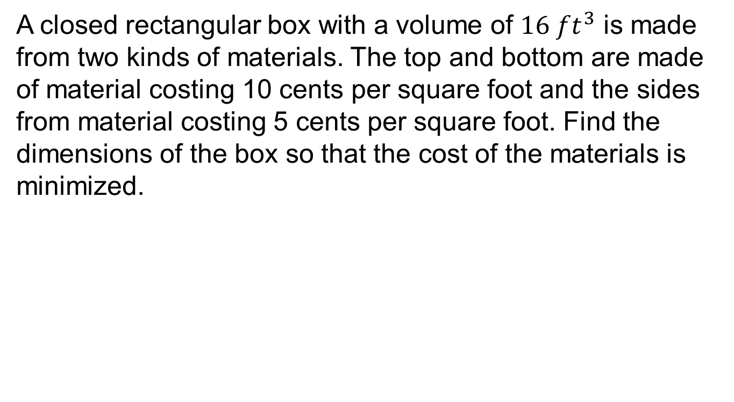
Example.
A closed rectangular box with a volume of $16 ft^{3}$ is made from two kinds of materials. The top and bottom are made of material costing 10 cents per square foot and the sides from material costing 5 cents per square foot. Find the dimensions of the box so that the cost of the materials is minimized.

Slide 20
Summary

Slide 21
Thank You

