Slide 1
MTH374: Optimization
For
Master of Mathematics
By
Dr. M. Fazeel Anwar
Assistant Professor
Department of Mathematics, CIIT Islamabad

Slide 2
Lecture 06

Slide 3
Recap
Examples of one variable optimization
Multivariable optimization

Slide 4
Today’s Topics
Multivariable optimization

Slide 5
Optimization problems in multiple variables

Slide 6
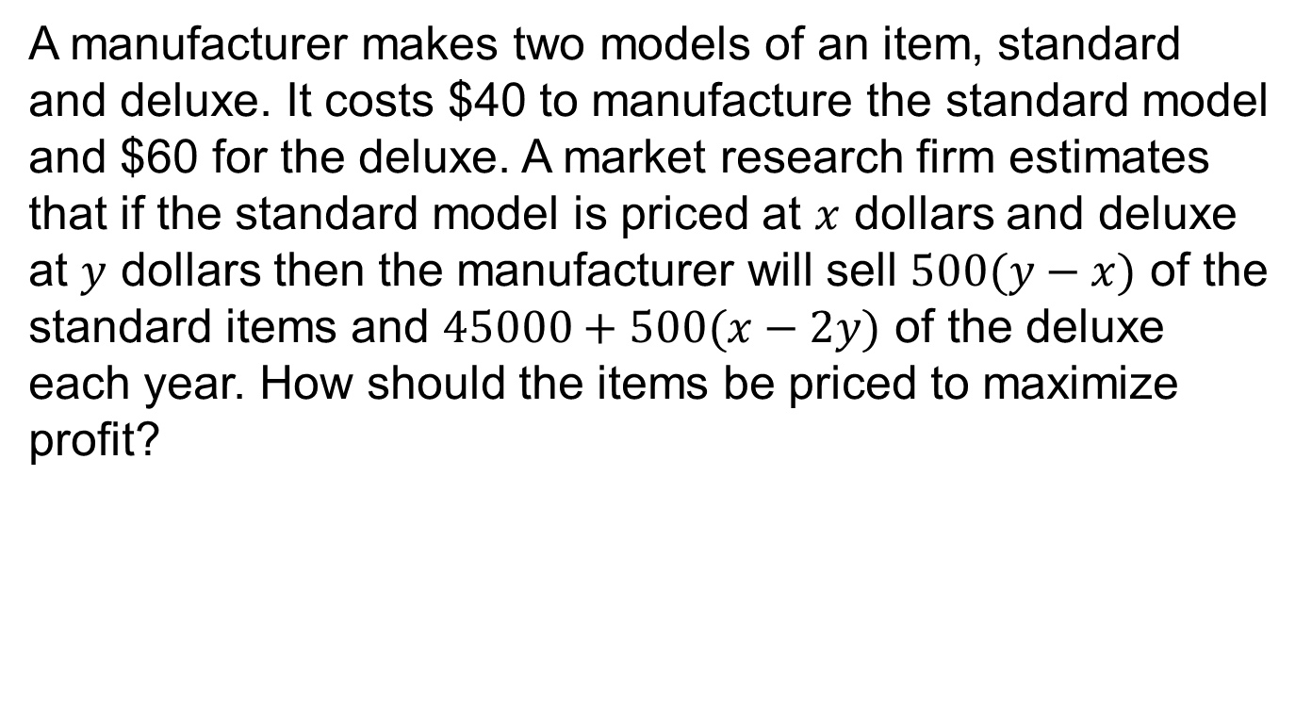
Example
A manufacturer makes two models of an item, standard and deluxe. It costs $40 to manufacture the standard model and $60 for the deluxe. A market research firm estimates that if the standard model is priced at $x$ dollars and deluxe at $y$ dollars then the manufacturer will sell $500(y−x)$ of the standard items and $45000+500(x−2y)$ of the deluxe each year. How should the items be priced to maximize profit?

Slide 7
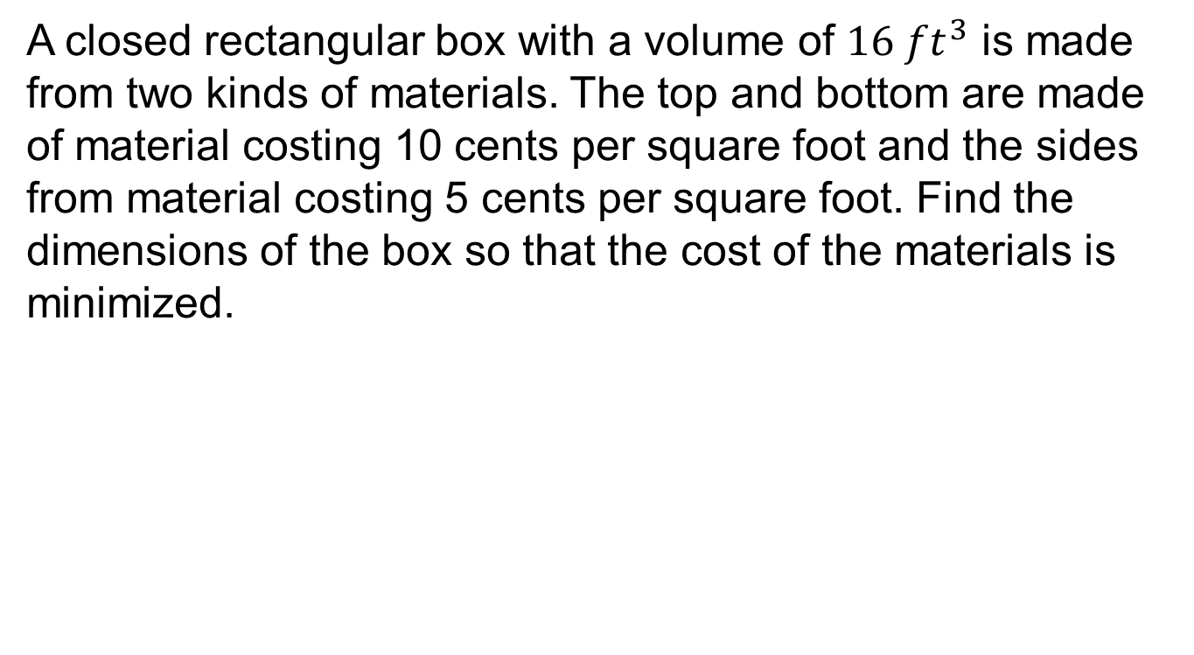
Example.
A closed rectangular box with a volume of $16 ft^{3}$ is made from two kinds of materials. The top and bottom are made of material costing 10 cents per square foot and the sides from material costing 5 cents per square foot. Find the dimensions of the box so that the cost of the materials is minimized.

Slide 8
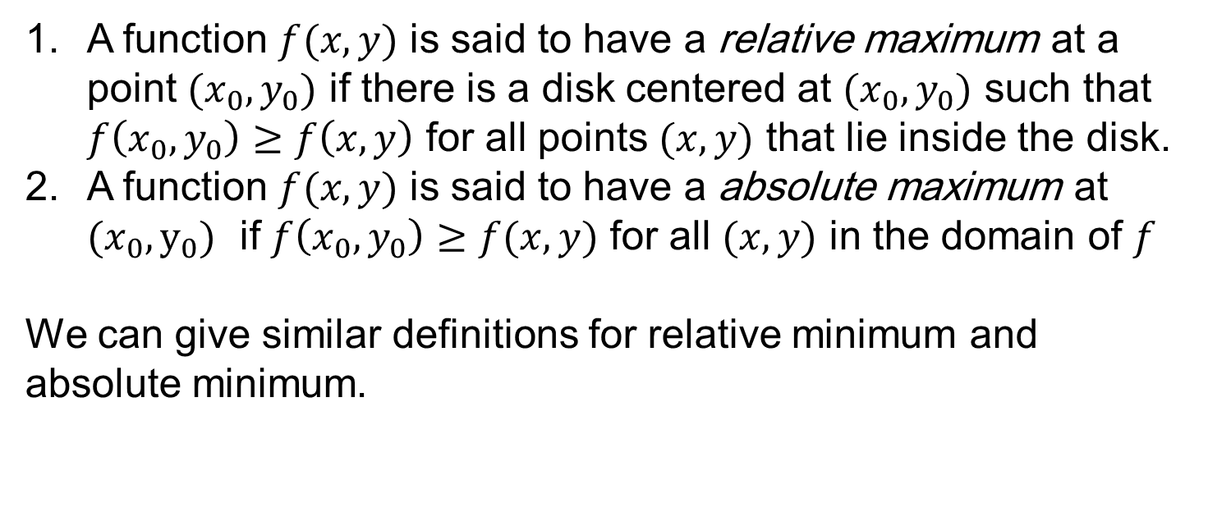
Relative Maxima and Minima (two variables)
A function $f(x,y)$ is said to have a relative maximum at a point $(x_{0}, y_{0})$ if there is a disk centered at ${(x}_{0},y_{0})$ such that $f\left(x_{0},y_{0}\right)≥f\left(x,y\right)$ for all points $(x,y)$ that lie inside the disk.
A function $f(x,y)$ is said to have a absolute maximum at ${(x}_{0},y_{0})$ if $f\left(x_{0},y_{0}\right)≥f(x,y)$ for all $(x,y)$ in the domain of $f$
We can give similar definitions for relative minimum and absolute minimum.

Slide 10
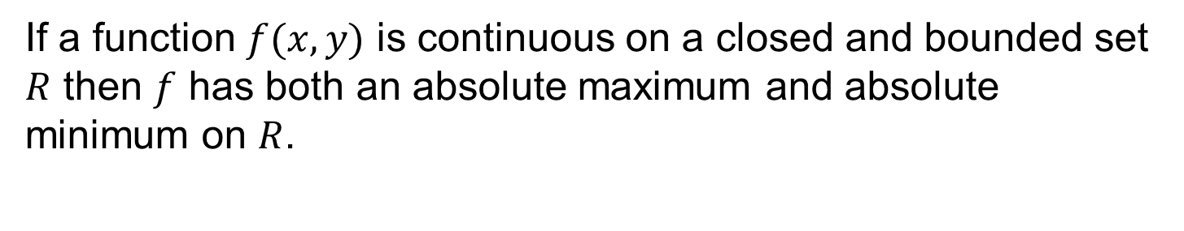
The Extreme Value Theorem
If a function $f(x,y)$ is continuous on a closed and bounded set $R$ then $f$ has both an absolute maximum and absolute minimum on $R$.

Slide 11
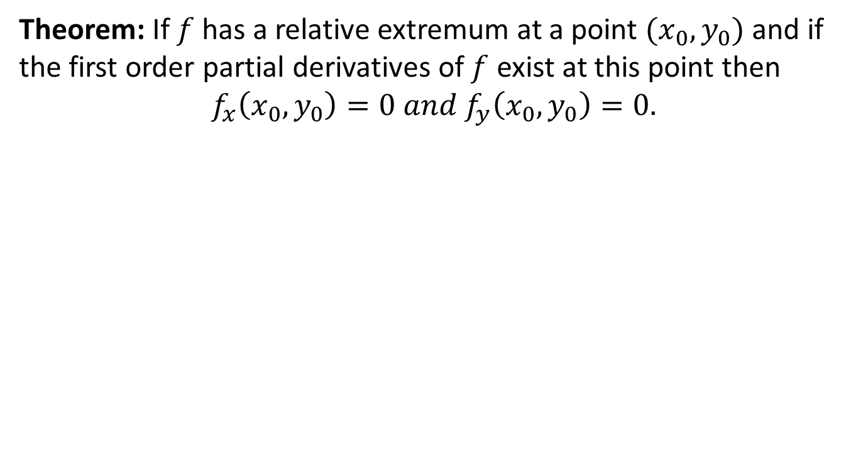
Finding relative maxima/minima
Theorem: If $f$ has a relative extremum at a point $(x_{0},y_{0})$ and if the first order partial derivatives of $f$ exist at this point then
$$f_{x}\left(x_{0},y_{0}\right)=0 and f_{y}\left(x_{0},y_{0}\right)=0.$$

Slide 12
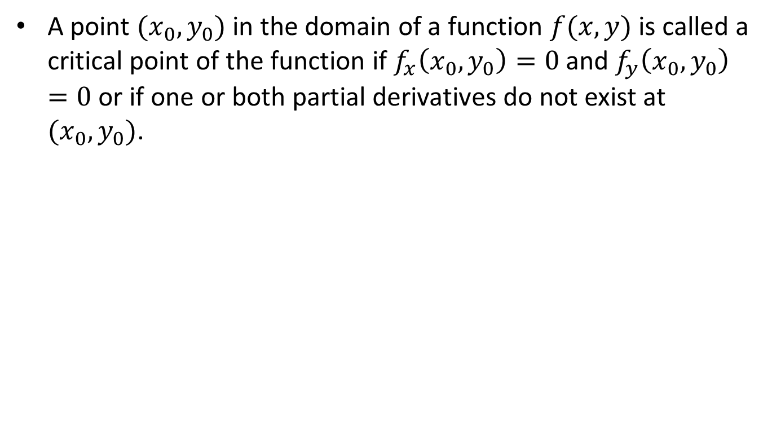
Critical Points
A point $(x_{0},y_{0})$ in the domain of a function $f(x,y)$ is called a critical point of the function if $f_{x}\left(x_{0},y_{0}\right)=0$ and $f_{y}\left(x_{0},y_{0}\right)=0$ or if one or both partial derivatives do not exist at ${(x}_{0}, y_{0})$.

Slide 13
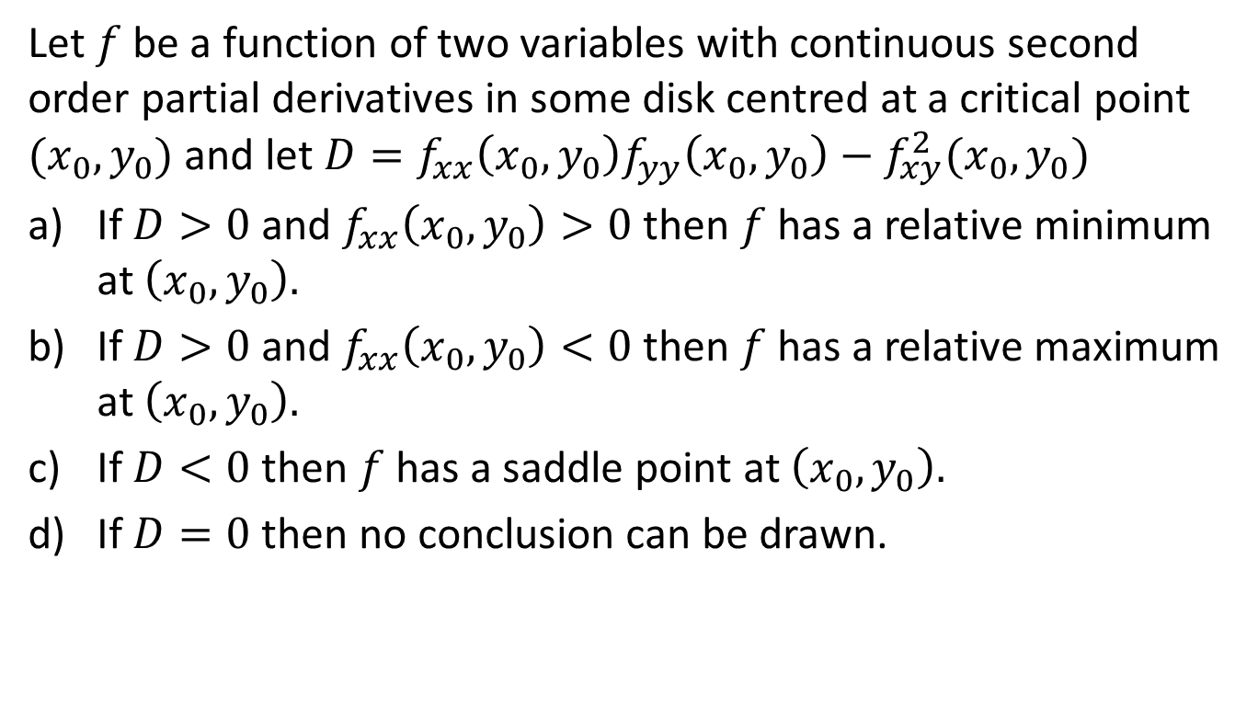
The Second Partials Test
Let $f$ be a function of two variables with continuous second order partial derivatives in some disk centred at a critical point $(x_{0},y_{0})$ and let $D=f_{xx}\left(x_{0},y_{0}\right)f_{yy}\left(x_{0},y_{0}\right)−f_{xy}^{2}(x_{0},y_{0})$
If $D>0$ and $f_{xx}\left(x_{0},y_{0}\right)>0$ then $f$ has a relative minimum at $\left(x_{0},y_{0}\right).$
If $D>0$ and $f_{xx}\left(x_{0},y_{0}\right)<0$ then $f$ has a relative maximum at $\left(x_{0},y_{0}\right).$
If $D<0$ then $f$ has a saddle point at $\left(x_{0},y_{0}\right).$
If $D=0$ then no conclusion can be drawn.

Slide 14
Example

Slide 16
Example.

Slide 19
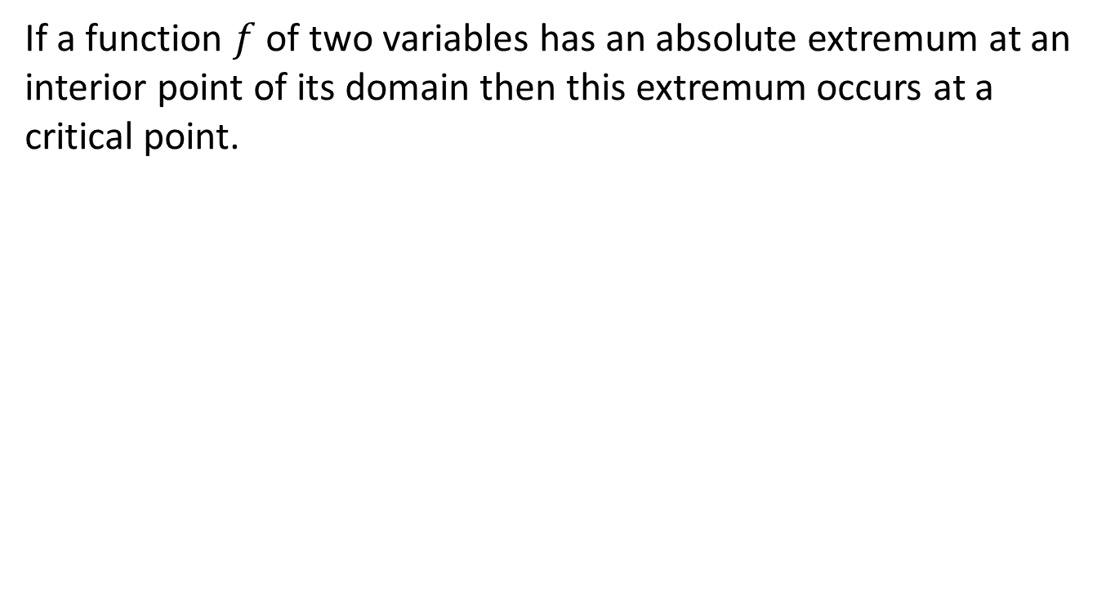
Absolute maxima/minima
If a function $f$ of two variables has an absolute extremum at an interior point of its domain then this extremum occurs at a critical point.

Slide 20
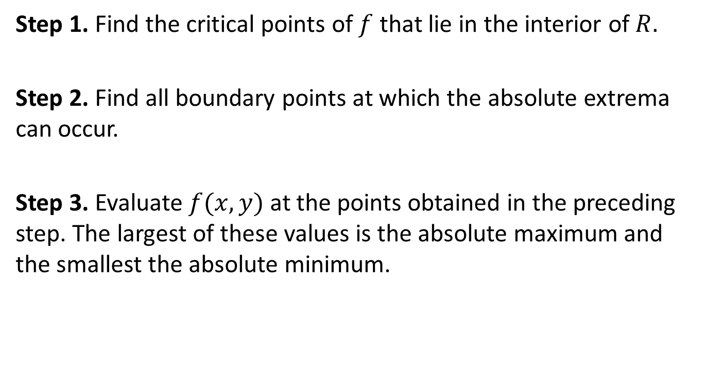
Finding Absolute Maxima/Minima
Step 1. Find the critical points of $f$ that lie in the interior of $R.$
Step 2. Find all boundary points at which the absolute extrema can occur.
Step 3. Evaluate $f(x,y)$ at the points obtained in the preceding step. The largest of these values is the absolute maximum and the smallest the absolute minimum.

Slide 21
Summary

Slide 22
Thank You

