Slide 1
MTH374: Optimization
For
Master of Mathematics
By
Dr. M. Fazeel Anwar
Assistant Professor
Department of Mathematics, CIIT Islamabad

Slide 2
Lecture 05

Slide 3
Recap
Some optimization from calculus
One variable optimization

Slide 4
Today’s Topics
Examples of one variable optimization
Multivariable optimization

Slide 5
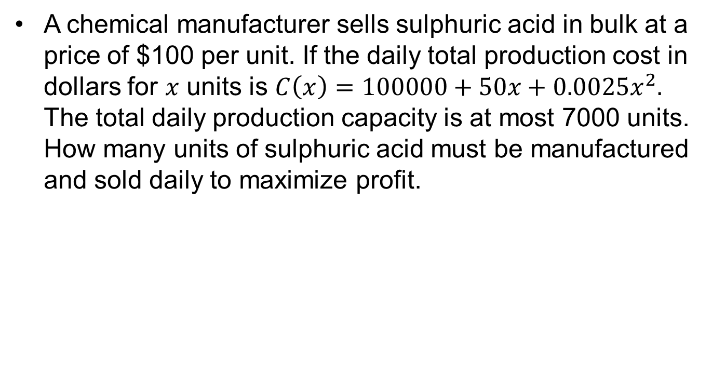
Example.. (Solution)
A chemical manufacturer sells sulphuric acid in bulk at a price of $100 per unit. If the daily total production cost in dollars for $x$ units is $C\left(x\right)=100000+50x+0.0025x^{2}.$ The total daily production capacity is at most 7000 units. How many units of sulphuric acid must be manufactured and sold daily to maximize profit.

Slide 8
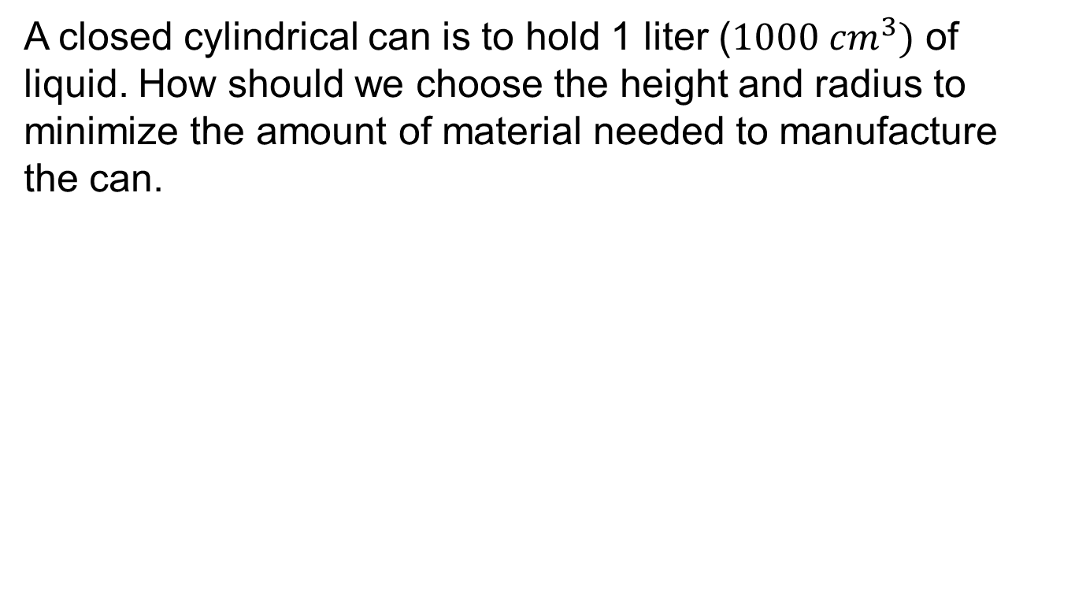
Example…
A closed cylindrical can is to hold 1 liter ($1000 cm^{3})$ of liquid. How should we choose the height and radius to minimize the amount of material needed to manufacture the can.

Slide 12
Optimization problems in multiple variables

Slide 13
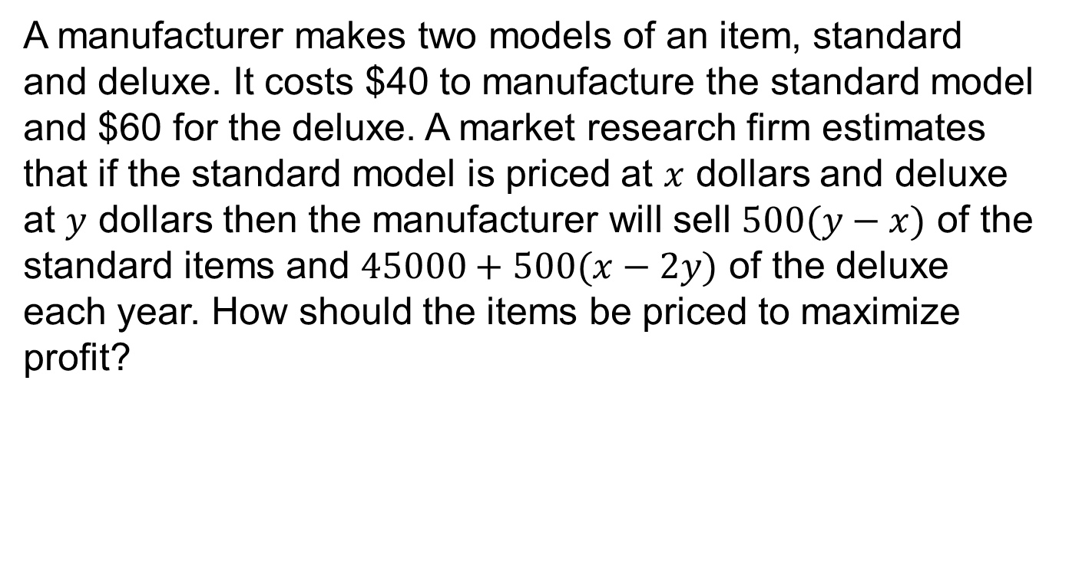
Example
A manufacturer makes two models of an item, standard and deluxe. It costs $40 to manufacture the standard model and $60 for the deluxe. A market research firm estimates that if the standard model is priced at $x$ dollars and deluxe at $y$ dollars then the manufacturer will sell $500(y−x)$ of the standard items and $45000+500(x−2y)$ of the deluxe each year. How should the items be priced to maximize profit?

Slide 15
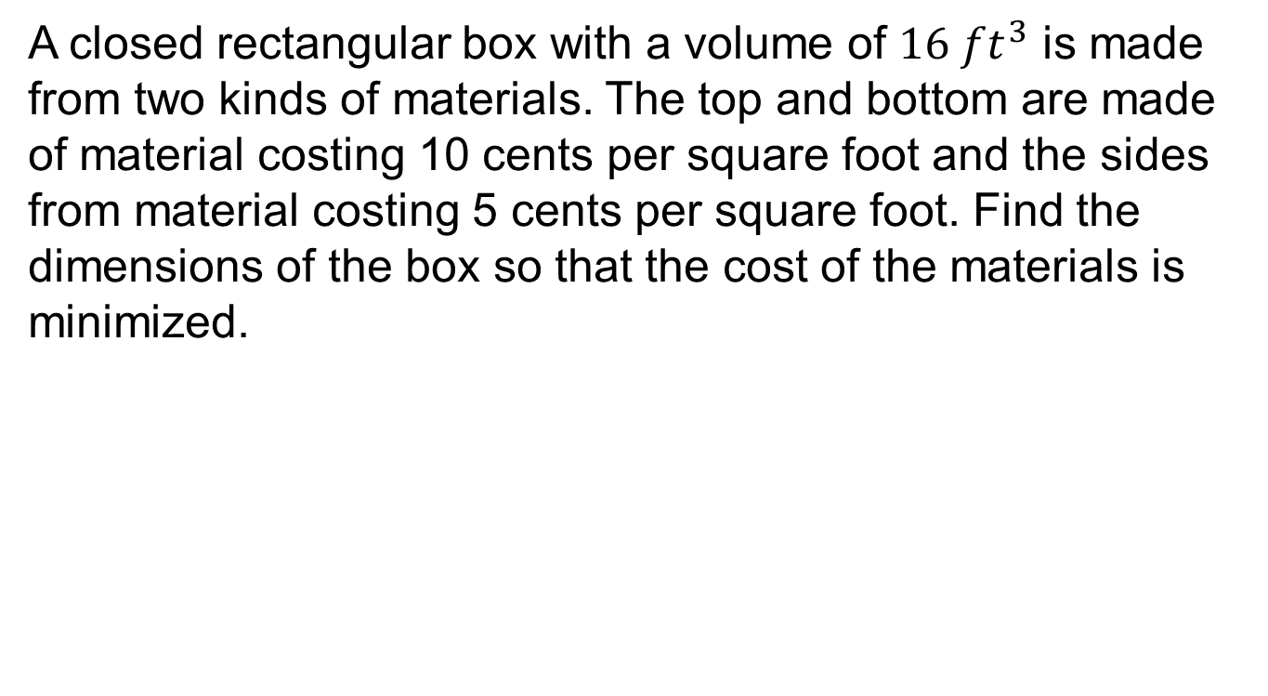
Example.
A closed rectangular box with a volume of $16 ft^{3}$ is made from two kinds of materials. The top and bottom are made of material costing 10 cents per square foot and the sides from material costing 5 cents per square foot. Find the dimensions of the box so that the cost of the materials is minimized.

Slide 17
Summary

Slide 18
Thank You

