Slide 1
MTH374: Optimization
For
Master of Mathematics
By
Dr. M. Fazeel Anwar
Assistant Professor
Department of Mathematics, CIIT Islamabad

Slide 2
Lecture 04

Slide 3
Recap
Optimization problem
Variables and objective functions
Some optimization from calculus

Slide 4
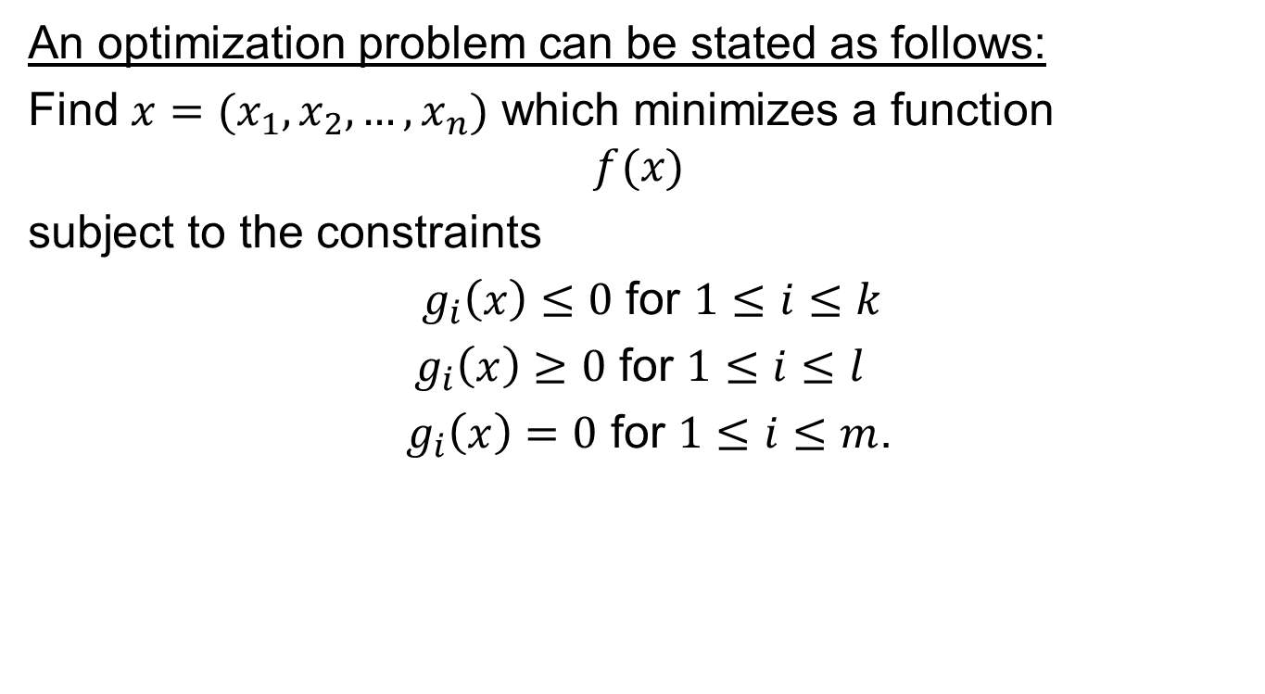
A general optimization problem
An optimization problem can be stated as follows:
Find $x=(x_{1}, x_{2}, …, x_{n})$ which minimizes a function
$$f(x)$$
subject to the constraints
$g_{i}\left(x\right)≤0$ for $1≤i≤k$
$g_{i}\left(x\right)≥0$ for $1≤i≤l$
${ g}_{i}\left(x\right)=0$ for $1≤i≤m$.

Slide 5
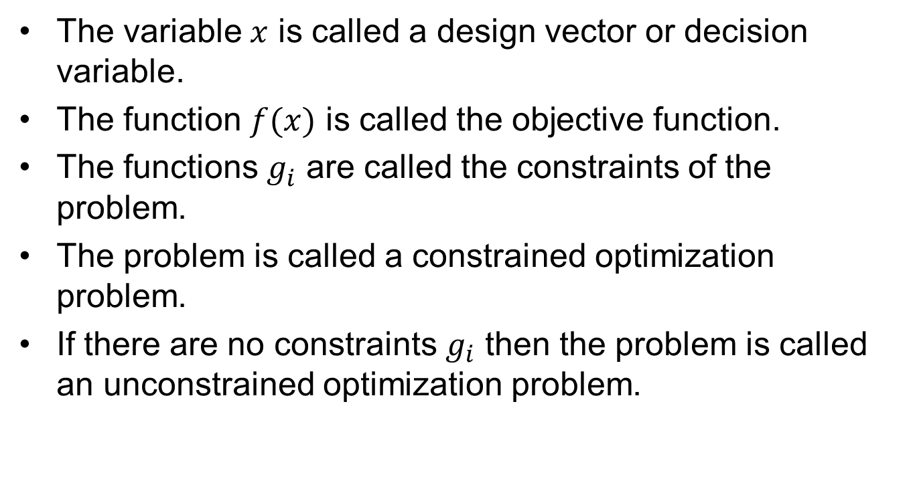
Some notations
The variable $x$ is called a design vector or decision variable.
The function $f(x)$ is called the objective function.
The functions $g_{i}^{}$ are called the constraints of the problem.
The problem is called a constrained optimization problem.
If there are no constraints $g_{i}$ then the problem is called an unconstrained optimization problem.

Slide 6
Today’s Topics
Some optimization from calculus
One variable optimization
Multivariable optimization

Slide 7
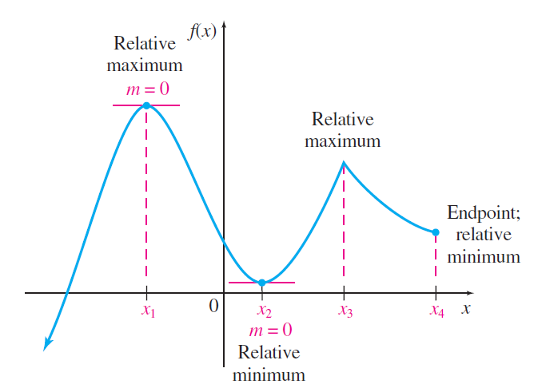
Relative Maxima and Minima

Slide 8
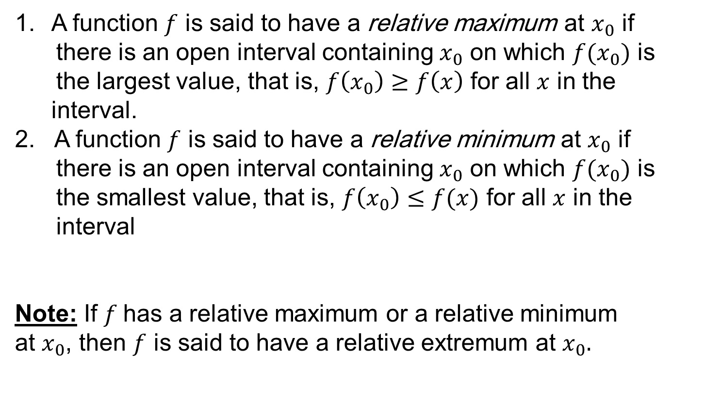
Relative Maxima and Minima
A function $f$ is said to have a relative maximum at $x_{0}$ if there is an open interval containing $x_{0}$ on which $f(x_{0})$ is the largest value, that is, $f\left(x_{0}\right)≥f\left(x\right)$ for all $x$ in the interval.
A function $f$ is said to have a relative minimum at $x_{0}$ if there is an open interval containing $x_{0}$ on which $f(x_{0})$ is the smallest value, that is, $f\left(x_{0}\right)≤f(x)$ for all $x$ in the interval
Note: If $f$has a relative maximum or a relative minimum
at $x_{0}$, then $f$ is said to have a relative extremum at $x_{0}.$

Slide 9




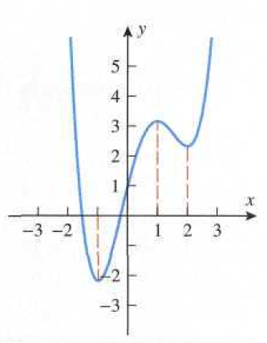
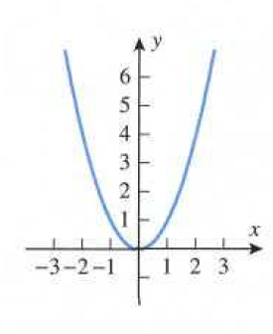
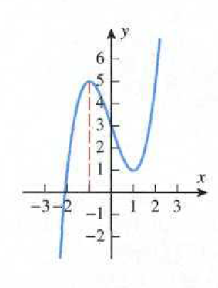
Example

Slide 10
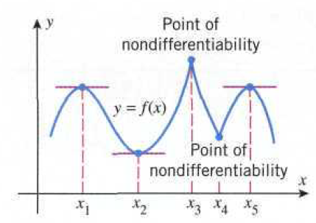
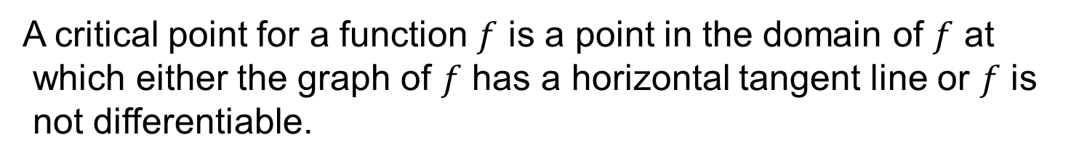
Critical Points
A critical point for a function $f$ is a point in the domain of $f$ at
which either the graph of $f$ has a horizontal tangent line or $f$ is
not differentiable.
A critical point $x$ is called a stationary point of $f$ if $f^{′}\left(x\right)=0.$

Slide 11
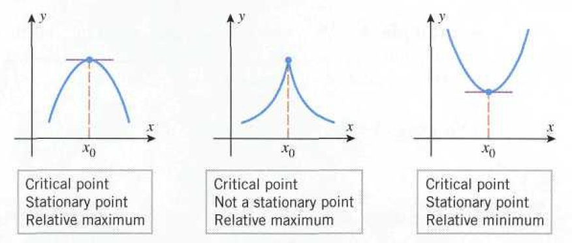
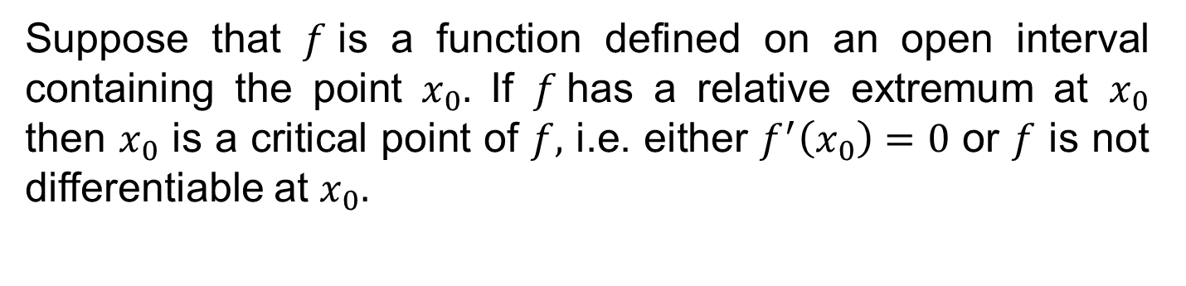
Relative extrema and critical points
Suppose that $f$is a function defined on an open interval containing the point $x_{0}.$ If $f$has a relative extremum at $x_{0}$ then $x_{0}$ is a critical point of $f,$ i.e. either $f^{′}\left(x_{0}\right)=0$ or $f$ is not differentiable at $x_{0}.$

Slide 12
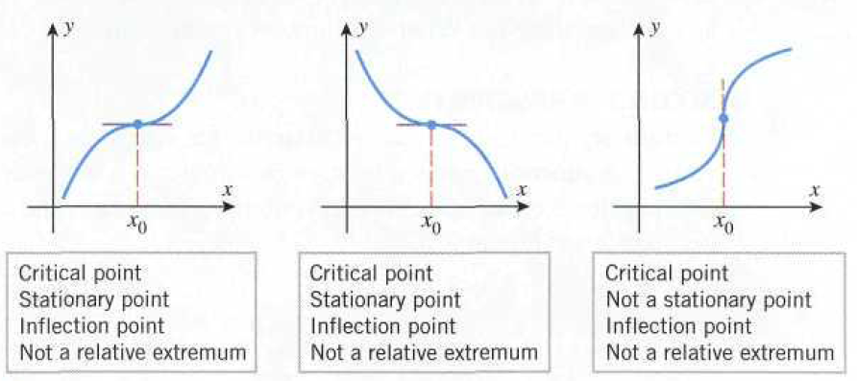

Slide 13
Example
Find all the relative extrema of $f\left(x\right)=x^{3}−6x^{2}+1$
Critical points
Relative min.
Relative max.

Slide 14
First Derivative Test
Suppose that
is continuous at a critical point
1. If
on an open interval extending left from
and
on an open interval extending right from
then
has a relative maximum at
2. If
on an open interval extending left from
and
on an open interval extending right from
then
has a relative minimum at
3. If
has same sign on an open interval extending left
from
as it does on an open interval extending right from
then
does not have a relative extrema

Slide 16
Example
Use the first derivative test to show that
has a relative minimum at x=1
Solution
f has relative minima at x=1
x=1 is a critical point as
Interval
Test Value
Sing of | - | +
Conclusion | is decreasing on | is decreasing on

Slide 17
Second Derivative Test
Suppose that f is twice differentiable at the
(a) If
and
then
has relative minimum at
(b) If
and
then
has relative minimum at
(c) If
and
then the test is inconclusive;
that is, f may have a relative maximum, a relative minimum,
or neither at
Example
Find the relative extrema of
Solution

Slide 18
Critical Points
Setting
are critical points

Slide 19
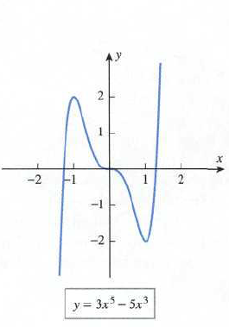
Stationary Point |  |  | Second Derivative Test
 | -30 | - | has a relative maximum
 | 0 | 0 | Inconclusive
 | 30 | + | has a relative minimum

Slide 20
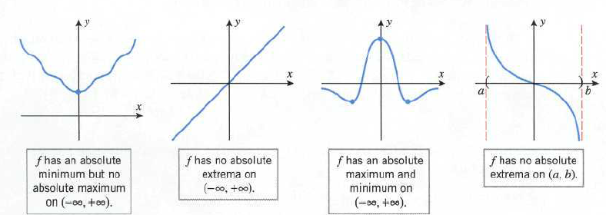
Absolute Extrema
Let I be an interval in the domain of a function f. We say that f
has an absolute maximum at a point in I if
for all x in I, and we say that f has an absolute minimum at
if for all x in I.

Slide 21
Extreme value Theorem
If a function f is continuous on a finite closed interval [a, b] then f has both an absolute maximum and an absolute minimum on [a, b].
Procedure for finding the absolute extrema of a continuous function f on a finite closed interval [a, b]
Step 1. Find the critical points of f in (a, b).
Step 2. Evaluate f at all the critical points and at the end points
a and b.
Step 3. The largest of the value in step 2 is the absolute maximum value of f on [a, b] and the smallest value is the absolute minimum

Slide 22
Example
Find the absolute maximum and minimum values of the function
on the interval [1, 5], and determine where these values occur.
solution
at x=2 and x=3
So x=2 and x=3 are stationary points
Evaluating f at the end points, at x=2 and at x=3 and at the ends
points of the interval.

Slide 23
Absolute minimum is 23 at x=1
Absolute minimum is 55 at x=5

Slide 24
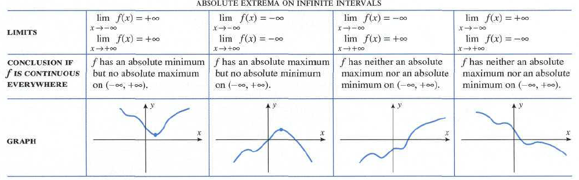
Absolute extrema on infinite intervals

Slide 25
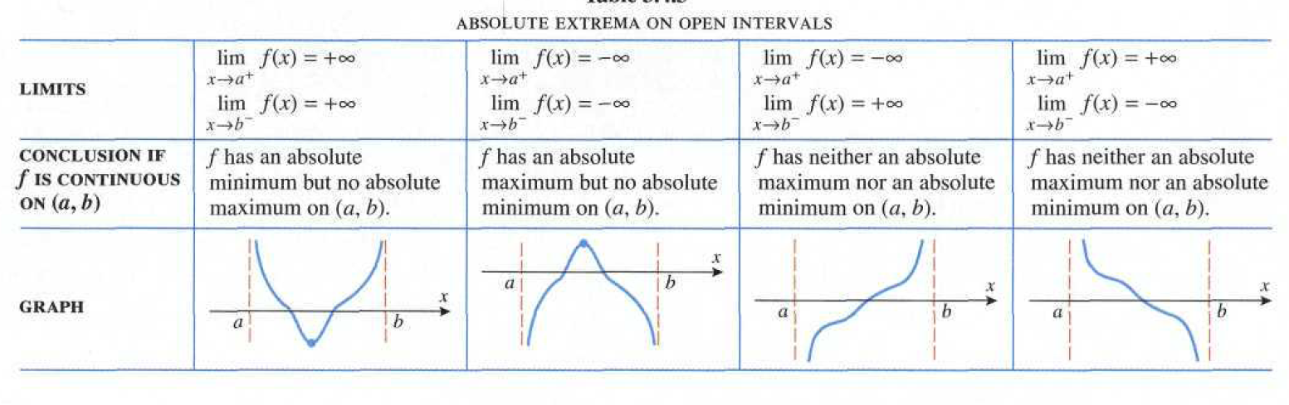
Absolute extrema on infinite intervals

Slide 26
Example (Solution)
A rectangular plot of land is to be fenced in using two kinds of fencing. Two opposite sides will use heavy duty fencing selling for $3 a foot, while the remaining two sides will use standard fencing selling for $2 a foot. What are the dimensions of the rectangular plot of greatest area that can be fenced in at a cost of $6000?

Slide 29
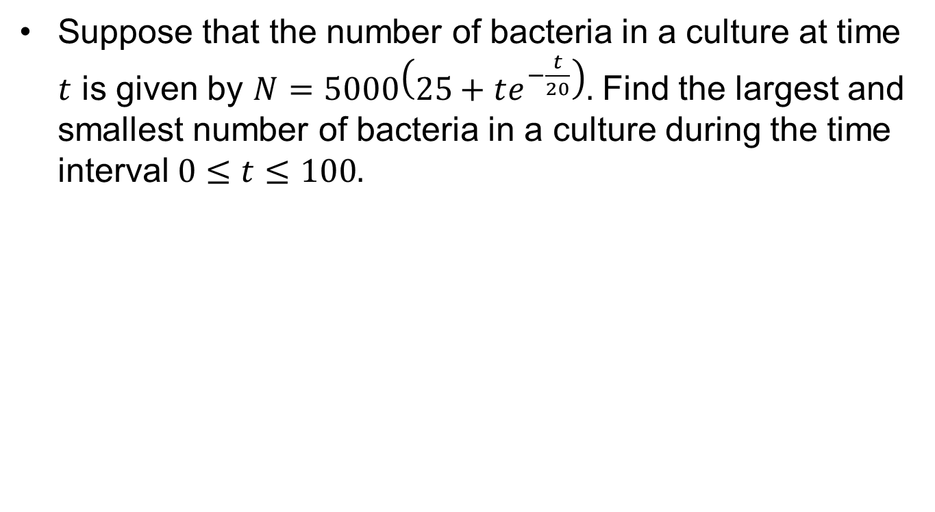
Example. (Solution)
Suppose that the number of bacteria in a culture at time $t$ is given by $N=5000\left(25+te^{−\frac{t}{20}}\right).$ Find the largest and smallest number of bacteria in a culture during the time interval $0≤t≤100.$

Slide 32
Summary

Slide 33
Thank You

