Slide 1
MTH374: Optimization
For
Master of Mathematics
By
Dr. M. Fazeel Anwar
Assistant Professor
Department of Mathematics, CIIT Islamabad

Slide 2
Lecture 31

Slide 3
Recap
Changes affecting optimality
Transportation models

Slide 4
Today’s Topics
Transportation problems
The transportation algorithm

Slide 5
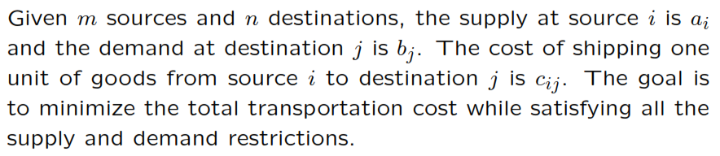
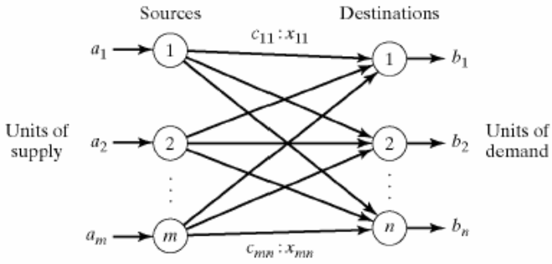
Transportation Model

Slide 6
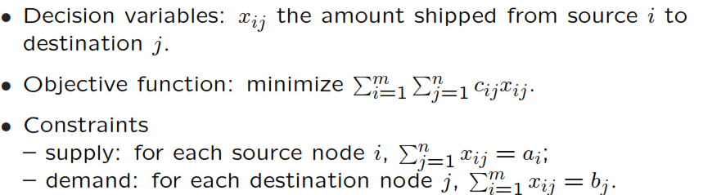
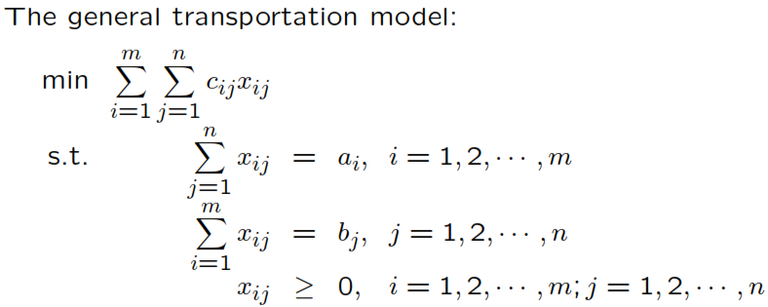
Transportation Model

Slide 7
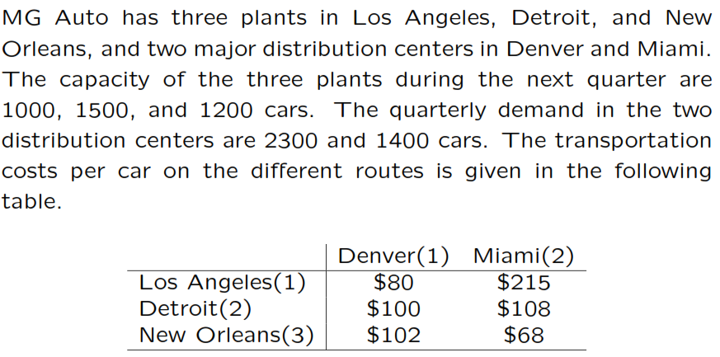
Example

Slide 8
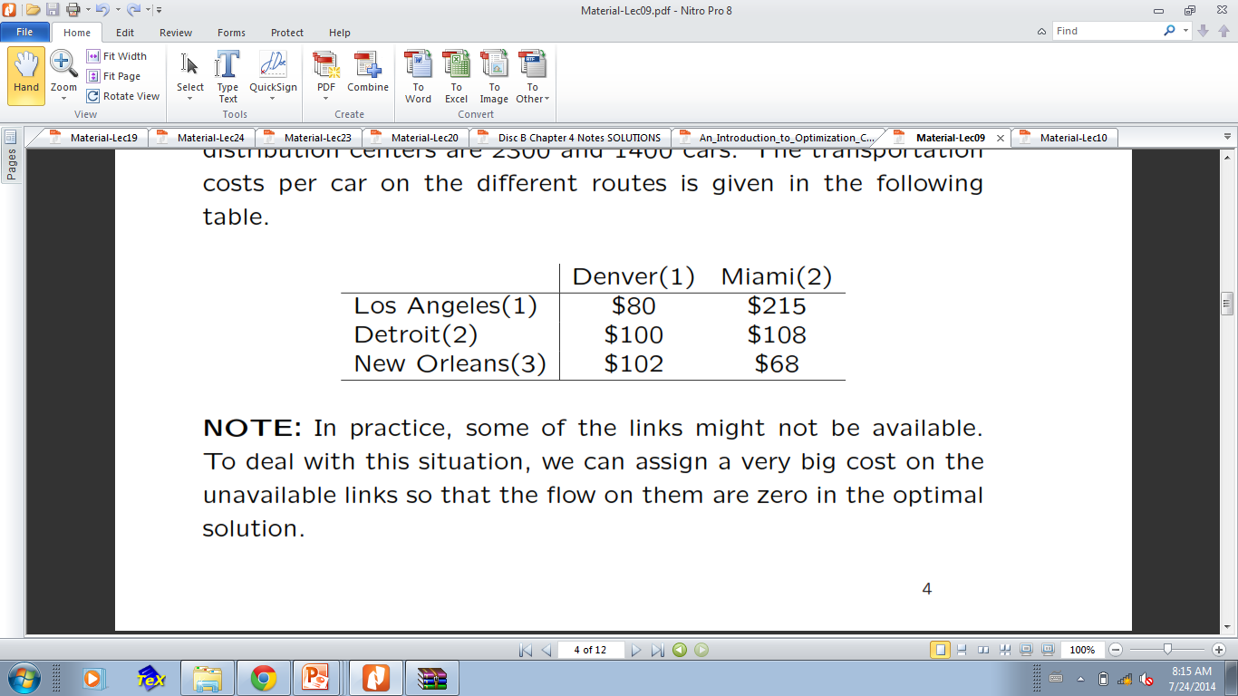

Slide 9
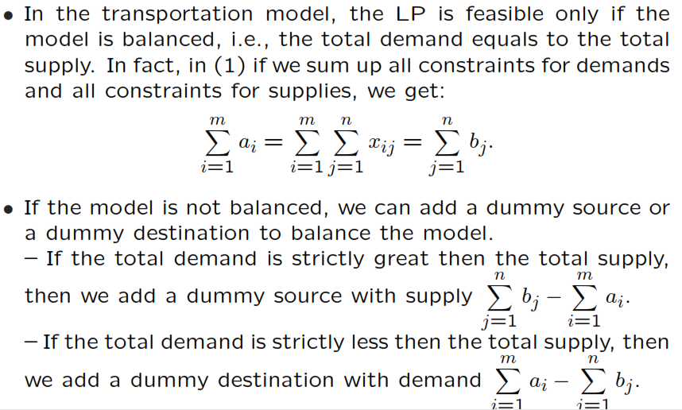
Balancing a Model

Slide 10
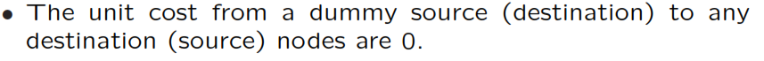
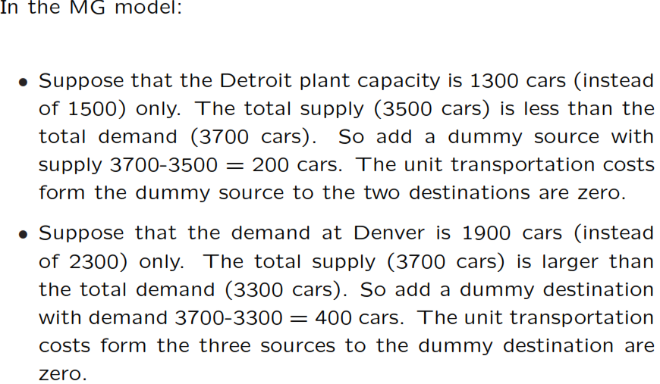

Slide 11
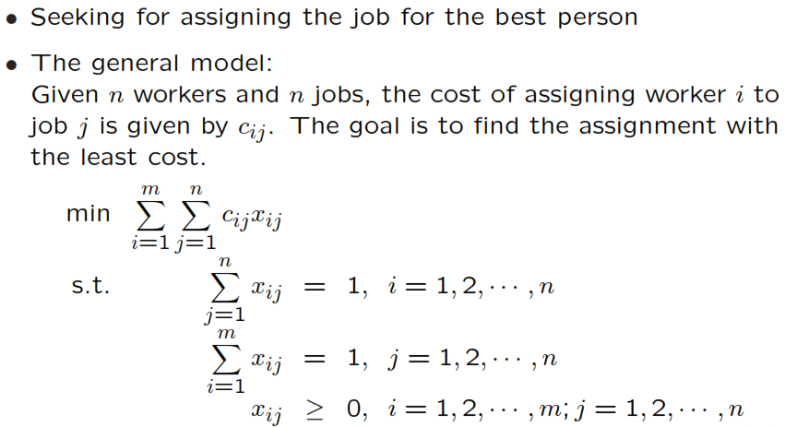
The assignment problem

Slide 12
The transportation algorithm

Slide 13
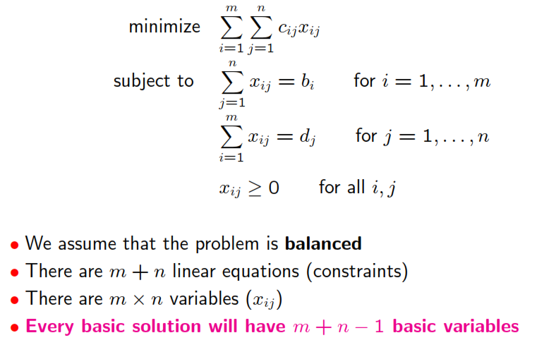
Transportation problem

Slide 14
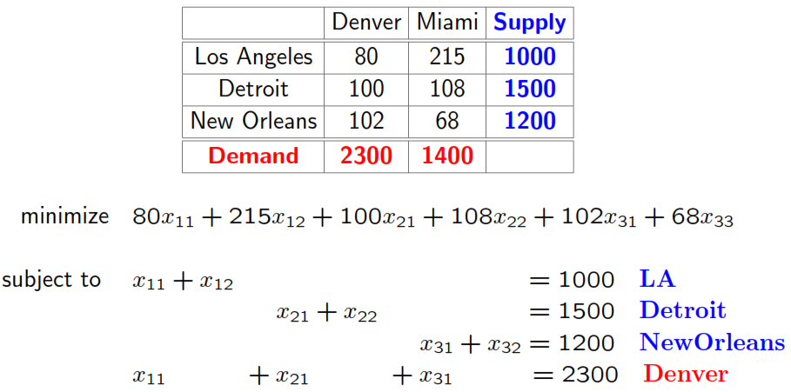
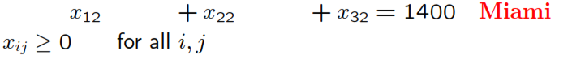
MG Auto Model

Slide 15
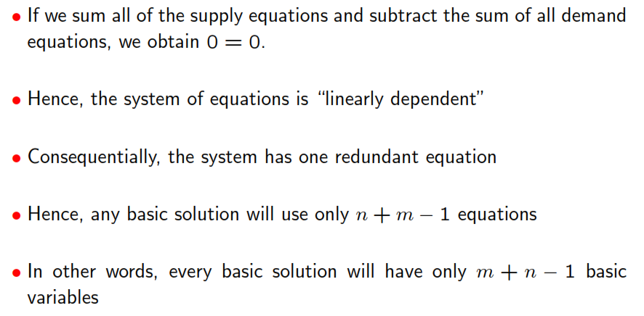

Slide 16
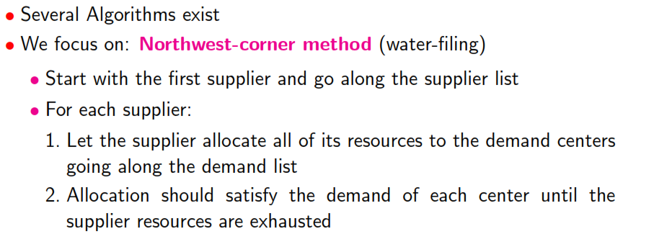
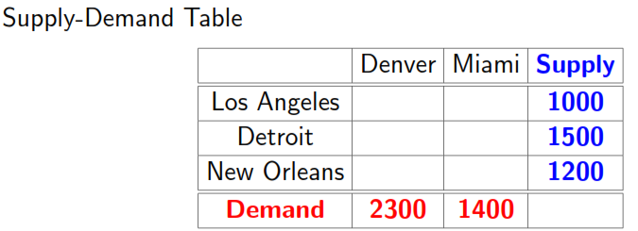

Slide 17
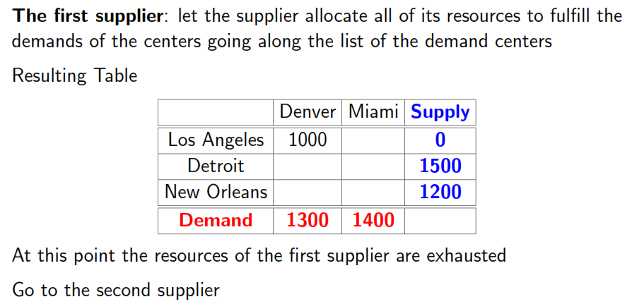
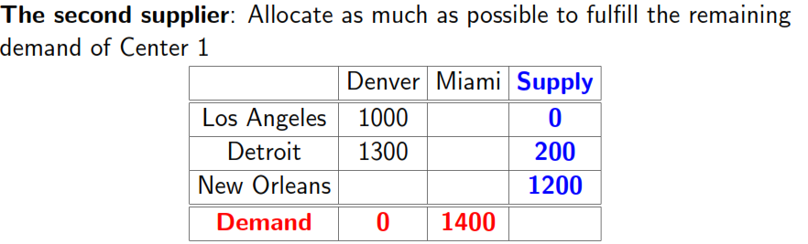

Slide 18
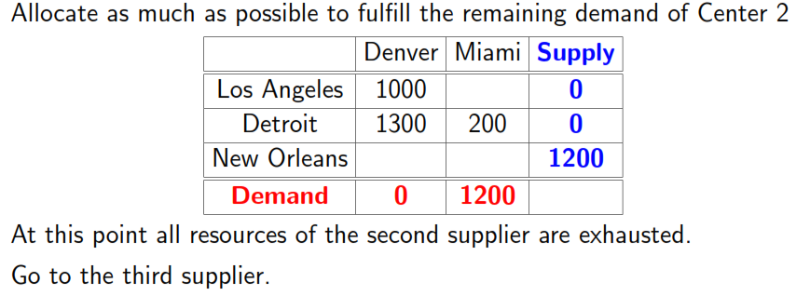
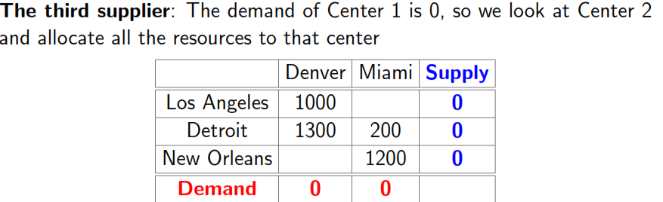

Slide 19
The resulting basic feasible solution

Slide 20
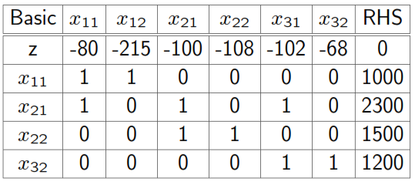
Initial data table

Slide 22
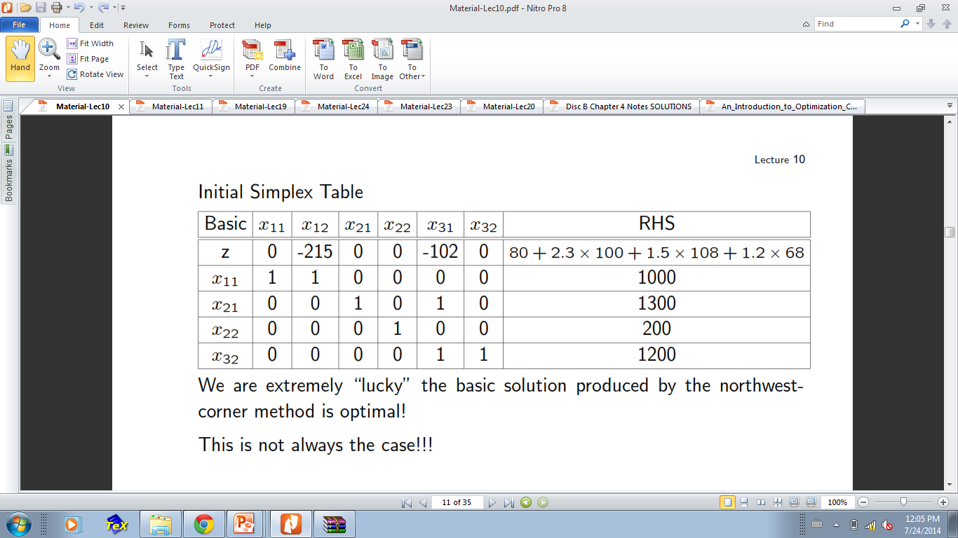
Simplex table

Slide 23
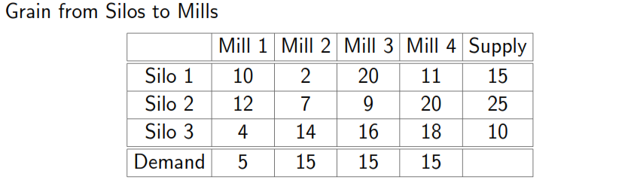
Sun-Ray transportation model

Slide 24
Initial feasible solution

Slide 25
Constraints of original problem

Slide 26
Constraints of dual problem

Slide 27
Solve constraint equations for dual problem

Slide 28
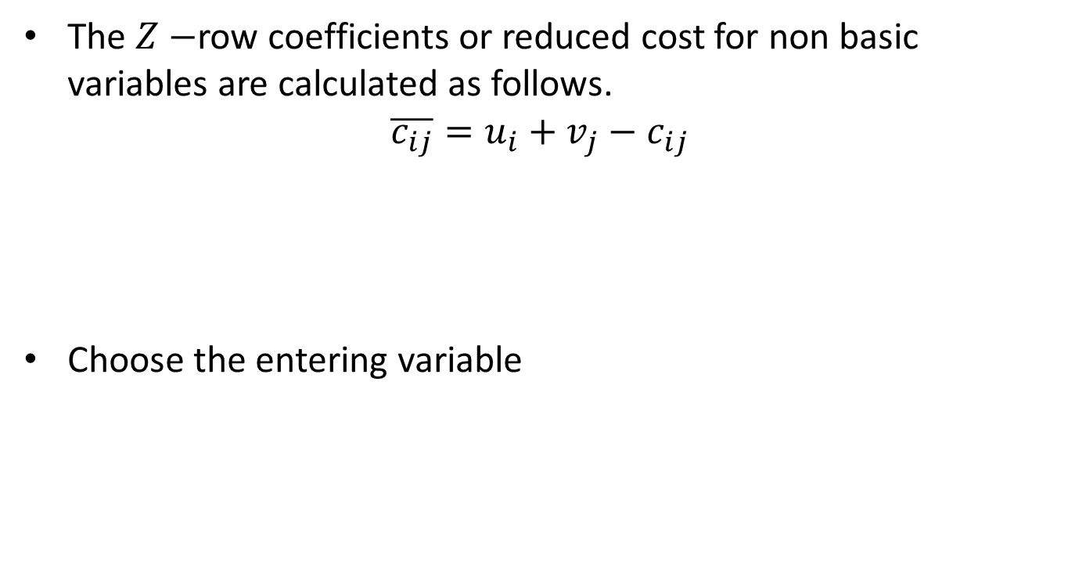
Reduced cost for non basic variables
The $Z−$row coefficients or reduced cost for non basic variables are calculated as follows.
$$\overline{c_{ij}}=u_{i}+v_{j}−c_{ij}$$
Choose the entering variable

Slide 34
Summary

Slide 35
Thank You

