Slide 1
MTH374: Optimization
For
Master of Mathematics
By
Dr. M. Fazeel Anwar
Assistant Professor
Department of Mathematics, CIIT Islamabad

Slide 2
Lecture 30

Slide 3
Recap
Post optimal analysis
Changes affecting optimality

Slide 4
Today’s Topics
New economic activity
Transportation problems
The transportation algorithm

Slide 5
Example
TOYCO assembles three types of toys: trains, trucks and cars using three operations. Available assembly time for the three operations are 430, 460 and 420 minutes per day respectively and the revenues per toy train, truck and car are $3, $2, and $5 respectively. The assembly times per train for the three operations are 1, 3 and 1 minutes respectively. The corresponding times per truck and car are (2,0,4) and (1,2,0) minutes. Maximize revenues…

Slide 6
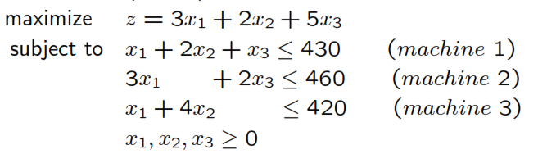

Slide 7
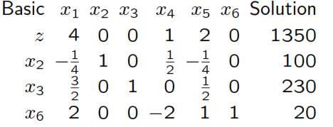

Slide 8
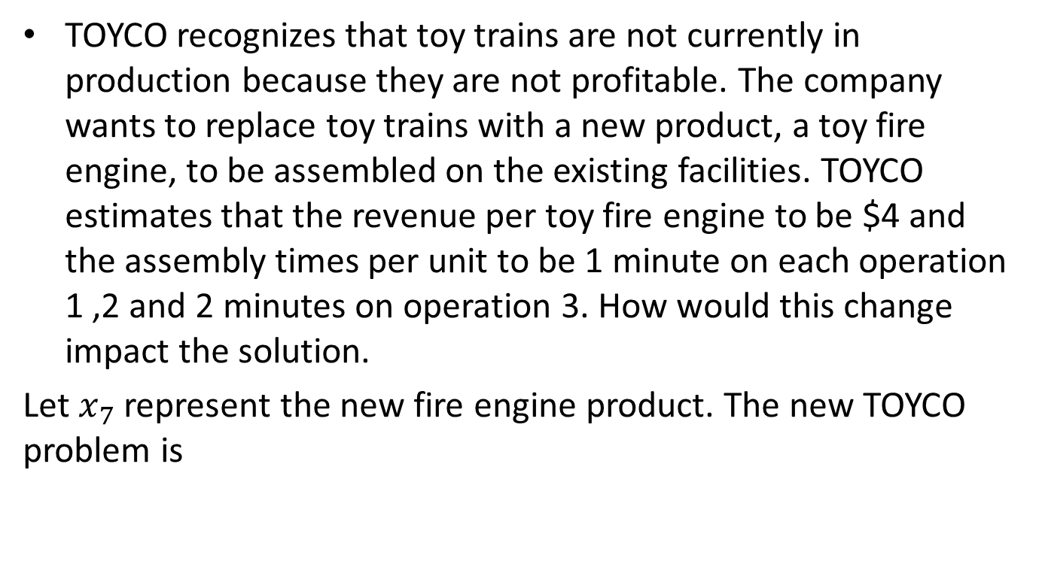
Addition of a new activity
TOYCO recognizes that toy trains are not currently in production because they are not profitable. The company wants to replace toy trains with a new product, a toy fire engine, to be assembled on the existing facilities. TOYCO estimates that the revenue per toy fire engine to be $4 and the assembly times per unit to be 1 minute on each operation 1 ,2 and 2 minutes on operation 3. How would this change impact the solution.
Let $x_{7}$ represent the new fire engine product. The new TOYCO problem is

Slide 9
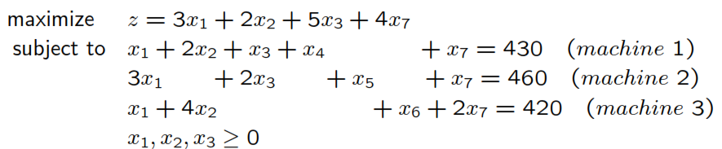
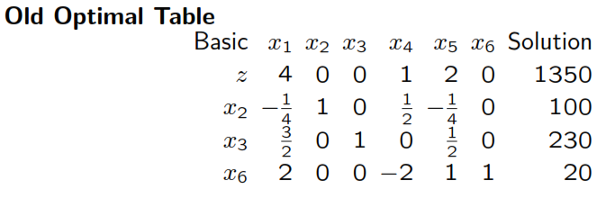

Slide 10
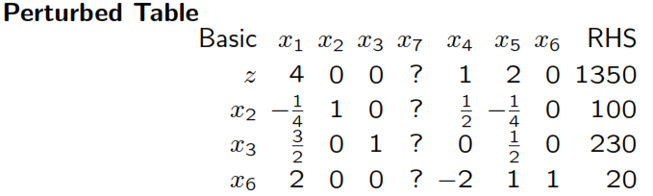

Slide 11
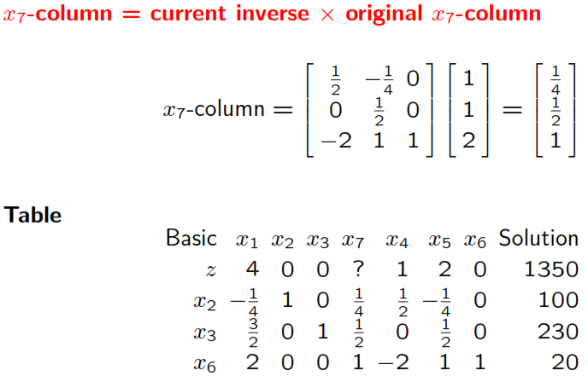

Slide 12
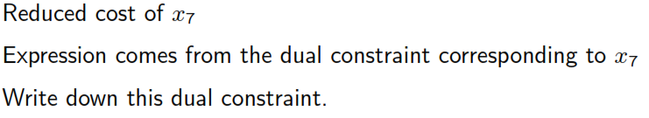
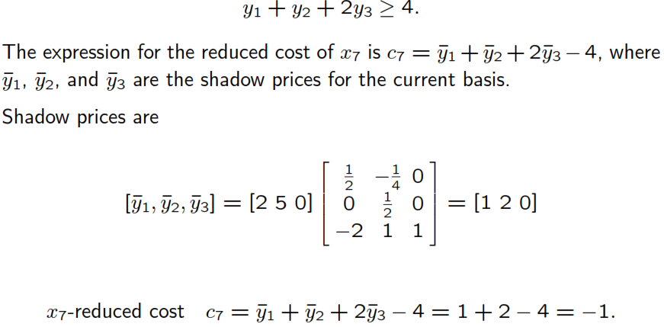

Slide 13
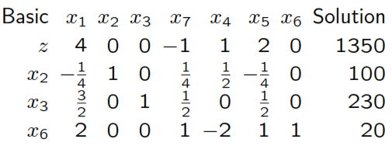

Slide 15
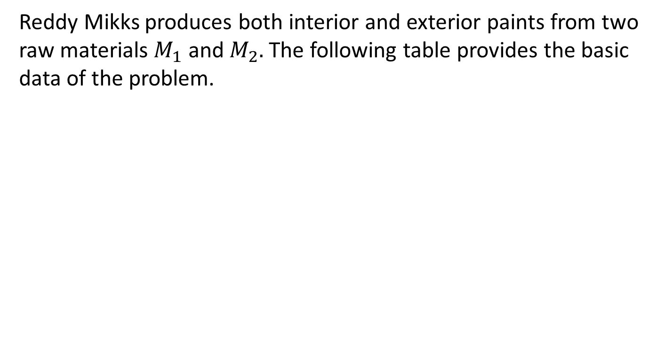
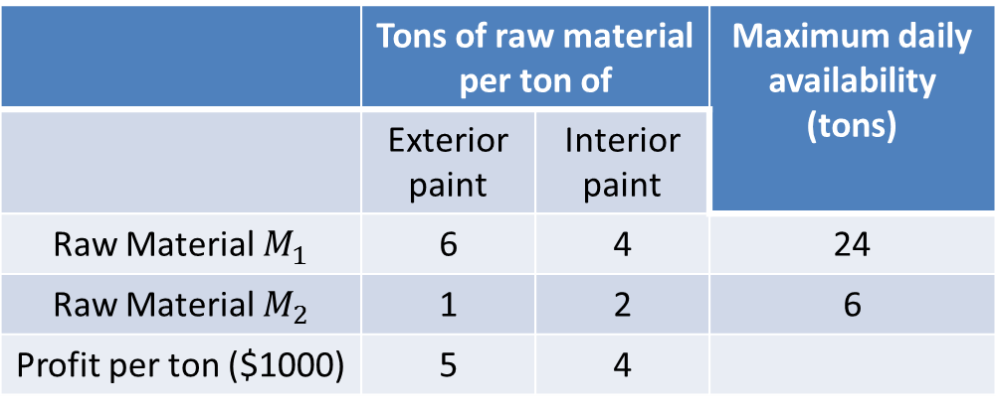
Example-II
Reddy Mikks produces both interior and exterior paints from two raw materials $M_{1}$ and $M_{2}.$The following table provides the basic data of the problem.
 | Tons of raw material per ton of |  | Maximum daily availability (tons)
 | Exterior paint | Interior paint
Raw Material $M_{1}$ | 6 | 4 | 24
Raw Material $M_{2}$ | 1 | 2 | 6
Profit per ton ($1000) | 5 | 4

Slide 16
A market survey indicates that the daily demand for interior paint can not exceed that for exterior paint by more than one ton. Also the maximum daily demand for interior paint is 2 tons. Determine the best product mix that maximizes the daily profit.

Slide 18
The company is considering the production of a cheaper brand of exterior paint whose input requirements per ton include 0.75 ton of each raw material. The profit per ton of new exterior paint is $3500. Determine the new optimal solution.

Slide 19
Practical Problems

Slide 20
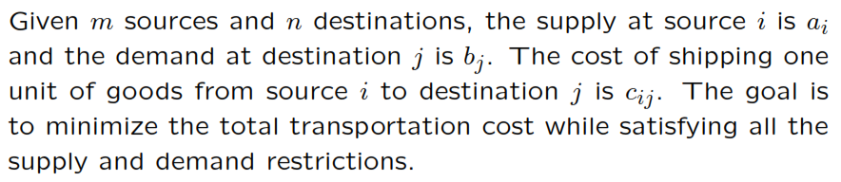
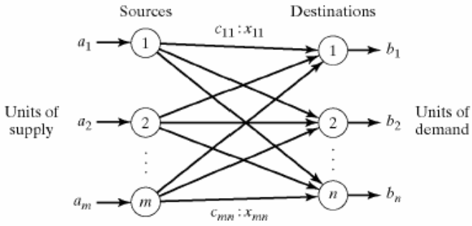
Transportation Model

Slide 21
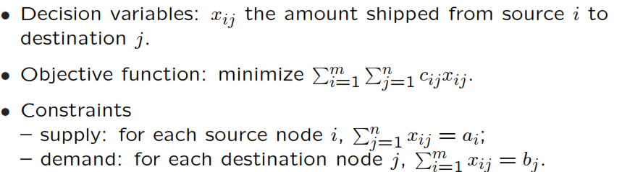
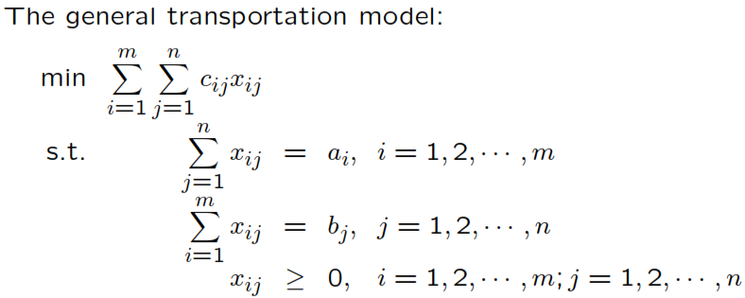
Transportation Model

Slide 22
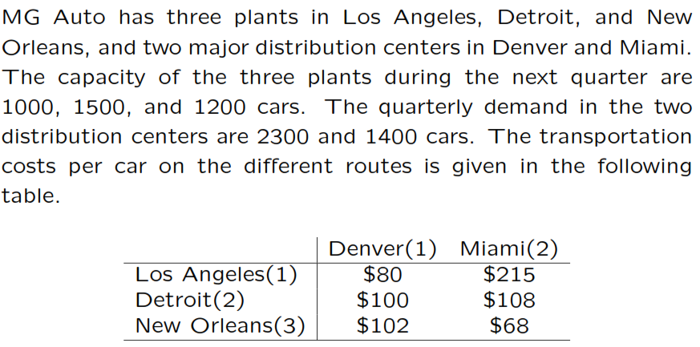
Example

Slide 23
Summary

Slide 24
Thank You

