Slide 1
MTH374: Algebra
For
Master of Mathematics
By
Dr. M. Fazeel Anwar
Assistant Professor
Department of Mathematics, CIIT Islamabad

Slide 2
Lecture 03

Slide 3
Recap
Introduction
Mathematical model

Slide 4
Example
A rectangular plot of land is to be fenced in using two kinds of fencing. Two opposite sides will use heavy duty fencing selling for $3 a foot, while the remaining two sides will use standard fencing selling for $2 a foot. What are the dimensions of the rectangular plot of greatest area that can be fenced in at a cost of $6000?

Slide 6
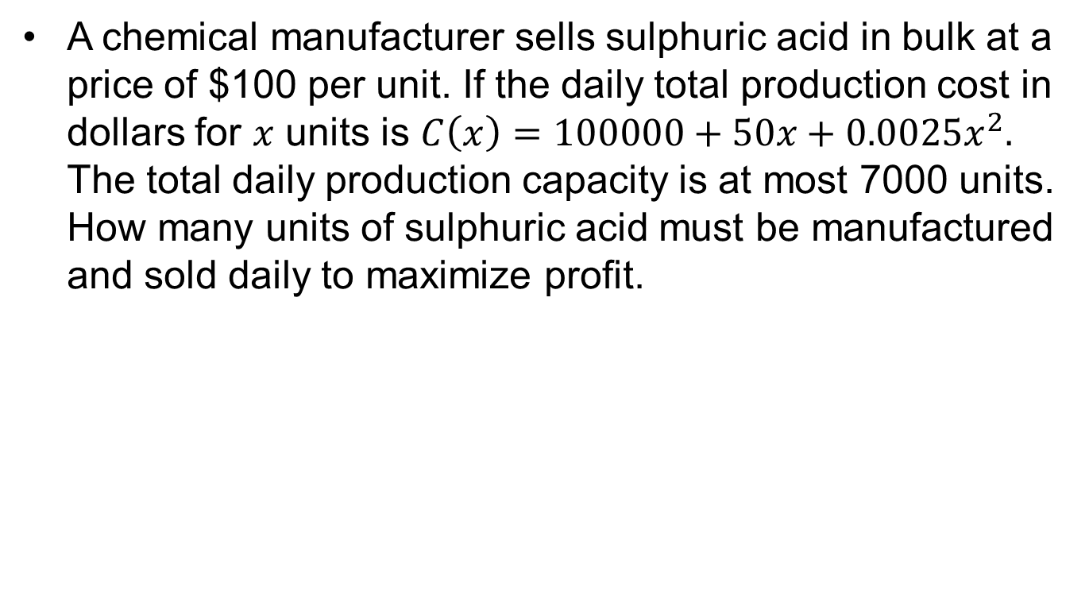
Example..
A chemical manufacturer sells sulphuric acid in bulk at a price of $100 per unit. If the daily total production cost in dollars for $x$ units is $C\left(x\right)=100000+50x+0.0025x^{2}.$ The total daily production capacity is at most 7000 units. How many units of sulphuric acid must be manufactured and sold daily to maximize profit.

Slide 8
Today’s Topics
Optimization problem
Variables and objective functions
Some optimization from calculus

Slide 9
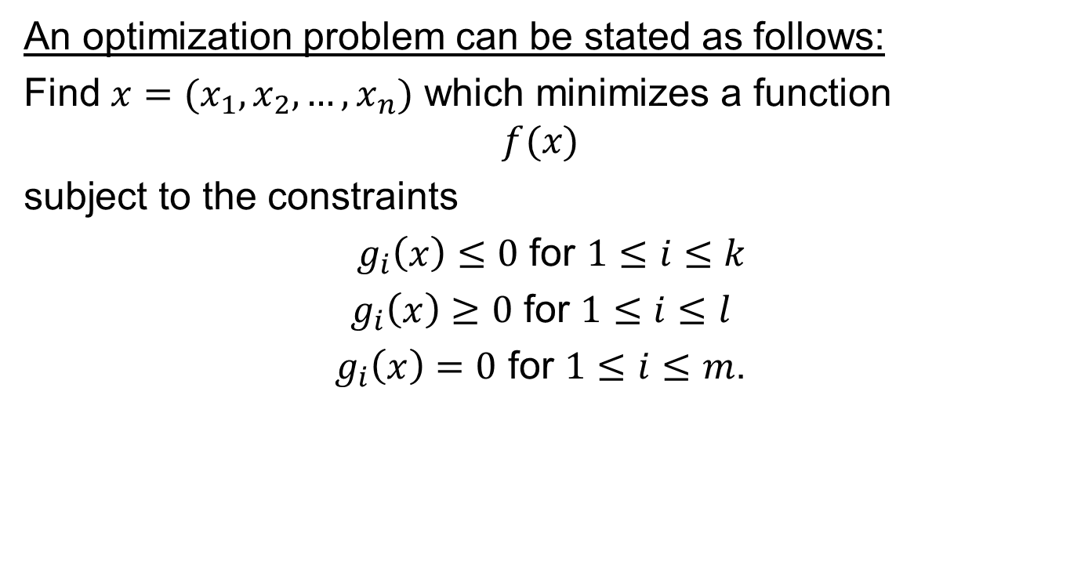
A general optimization problem
An optimization problem can be stated as follows:
Find $x=(x_{1}, x_{2}, …, x_{n})$ which minimizes a function
$$f(x)$$
subject to the constraints
$g_{i}\left(x\right)≤0$ for $1≤i≤k$
$g_{i}\left(x\right)≥0$ for $1≤i≤l$
$g_{i}\left(x\right)=0$ for $1≤i≤m$.

Slide 10
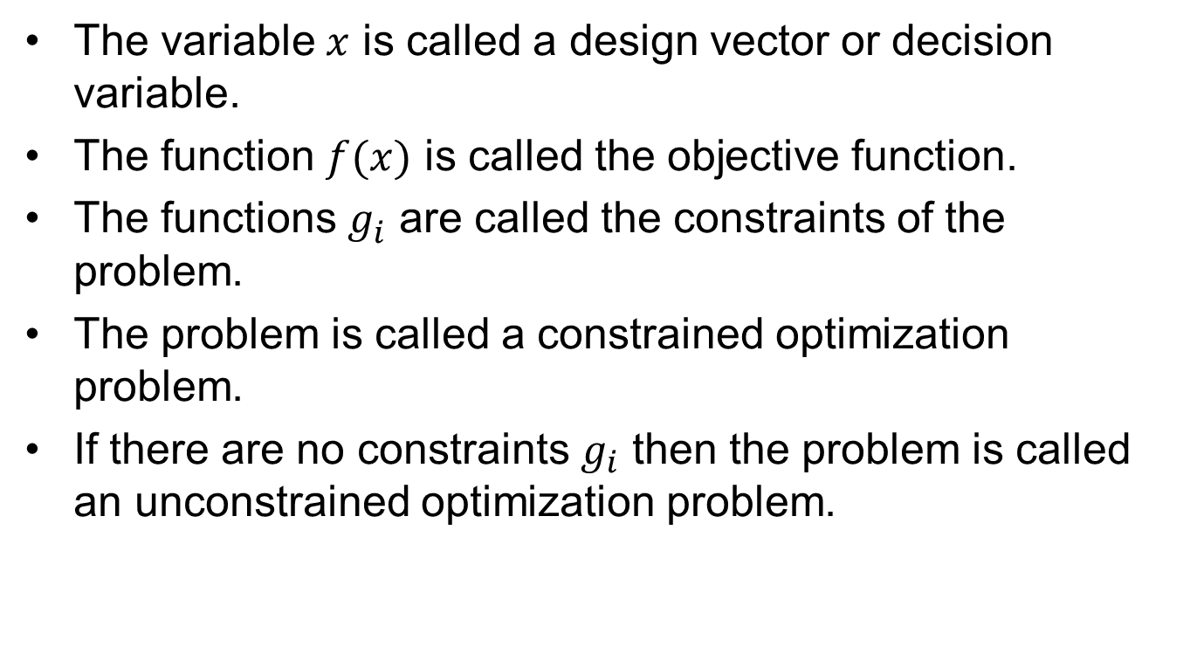
Some notations
The variable $x$ is called a design vector or decision variable.
The function $f(x)$ is called the objective function.
The functions $g_{i}^{}$ are called the constraints of the problem.
The problem is called a constrained optimization problem.
If there are no constraints $g_{i}$ then the problem is called an unconstrained optimization problem.

Slide 11
Optimization in one variable

Slide 12
Example (Revisited)
A rectangular plot of land is to be fenced in using two kinds of fencing. Two opposite sides will use heavy duty fencing selling for $3 a foot, while the remaining two sides will use standard fencing selling for $2 a foot. What are the dimensions of the rectangular plot of greatest area that can be fenced in at a cost of $6000?

Slide 13
Some optimization tools from Calculus

Slide 14
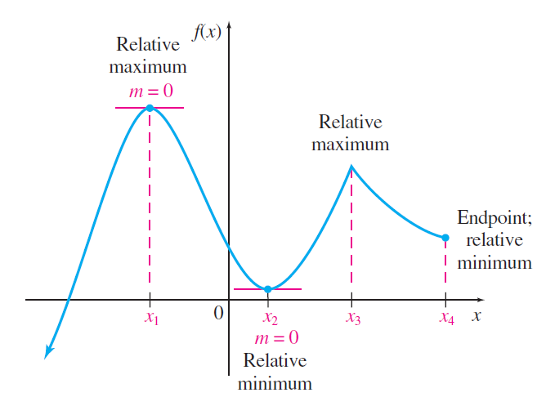
Relative Maxima and Minima

Slide 15
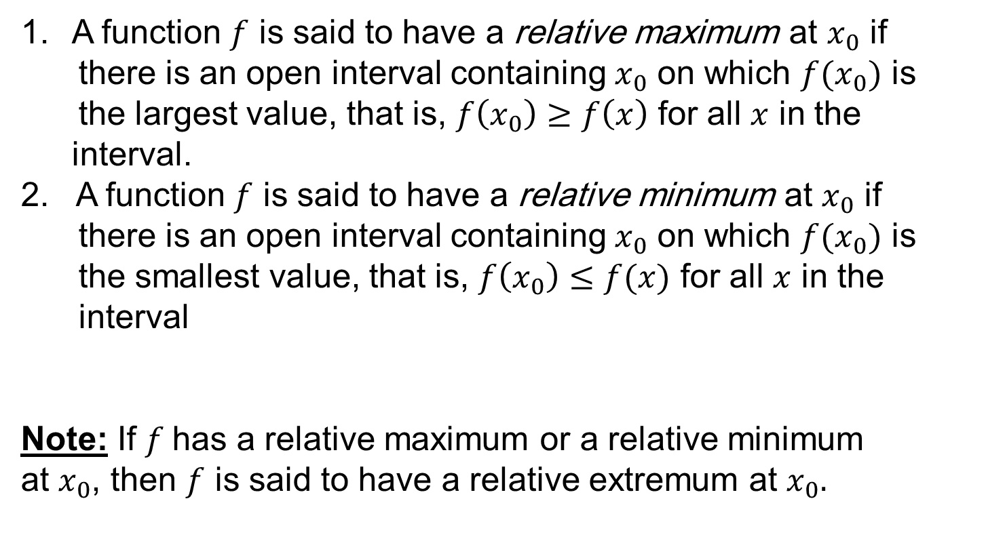
Relative Maxima and Minima
A function $f$ is said to have a relative maximum at $x_{0}$ if there is an open interval containing $x_{0}$ on which $f(x_{0})$ is the largest value, that is, $f\left(x_{0}\right)≥f\left(x\right)$ for all $x$ in the interval.
A function $f$ is said to have a relative minimum at $x_{0}$ if there is an open interval containing $x_{0}$ on which $f(x_{0})$ is the smallest value, that is, $f\left(x_{0}\right)≤f(x)$ for all $x$ in the interval
Note: If $f$has a relative maximum or a relative minimum
at $x_{0}$, then $f$ is said to have a relative extremum at $x_{0}.$

Slide 16




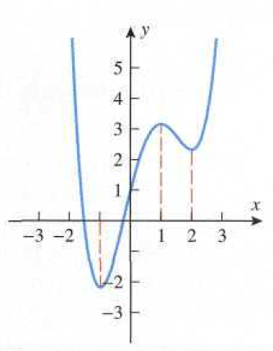
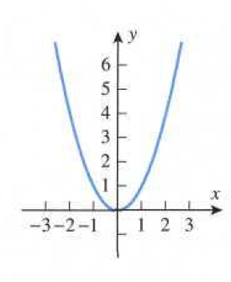
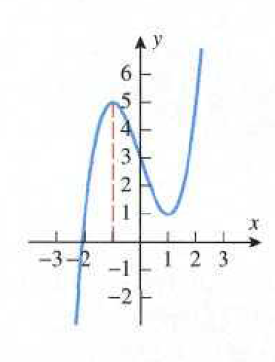
Example

Slide 17
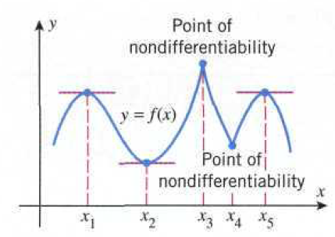
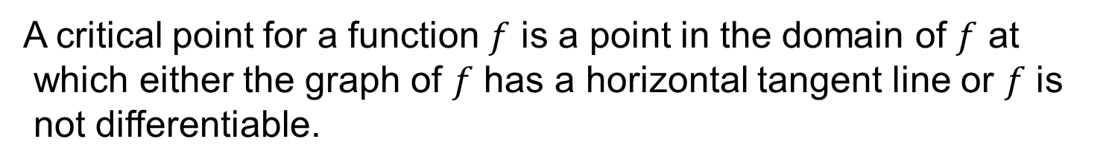
Critical Points
A critical point for a function $f$ is a point in the domain of $f$ at
which either the graph of $f$ has a horizontal tangent line or $f$ is
not differentiable.
A critical point $x$ is called a stationary point of $f$ if $f^{′}\left(x\right)=0.$

Slide 18
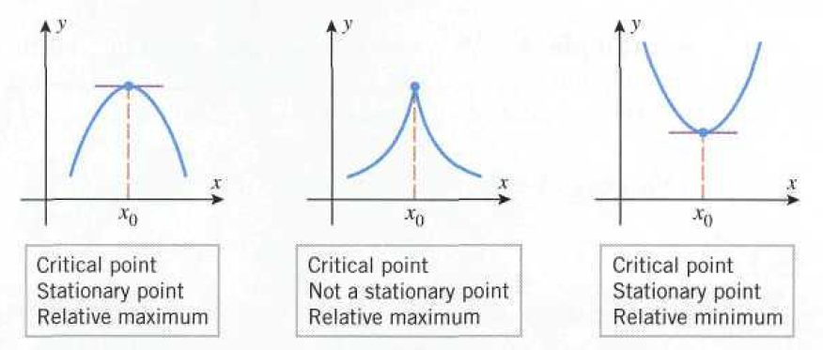
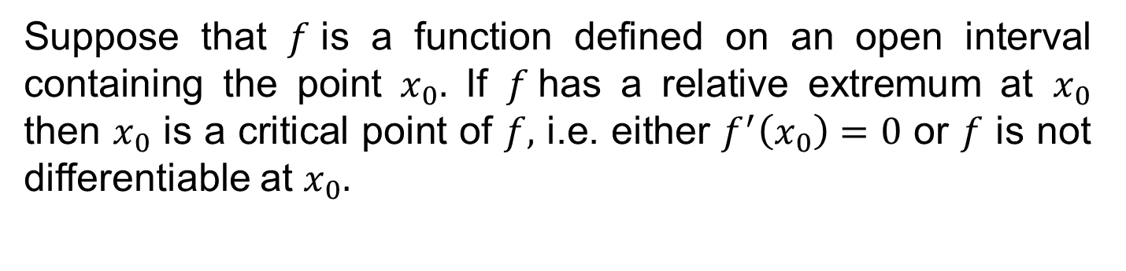
Relative extrema and critical points
Suppose that $f$is a function defined on an open interval containing the point $x_{0}.$ If $f$has a relative extremum at $x_{0}$ then $x_{0}$ is a critical point of $f,$ i.e. either $f^{′}\left(x_{0}\right)=0$ or $f$ is not differentiable at $x_{0}.$

Slide 19
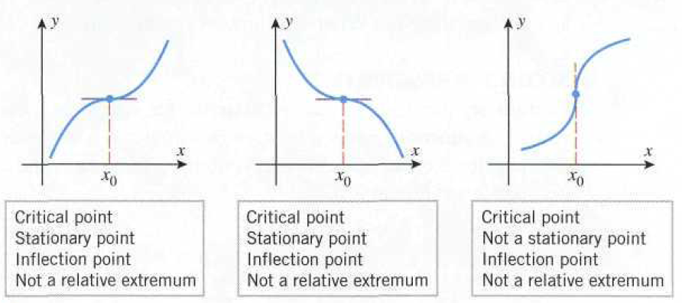

Slide 20
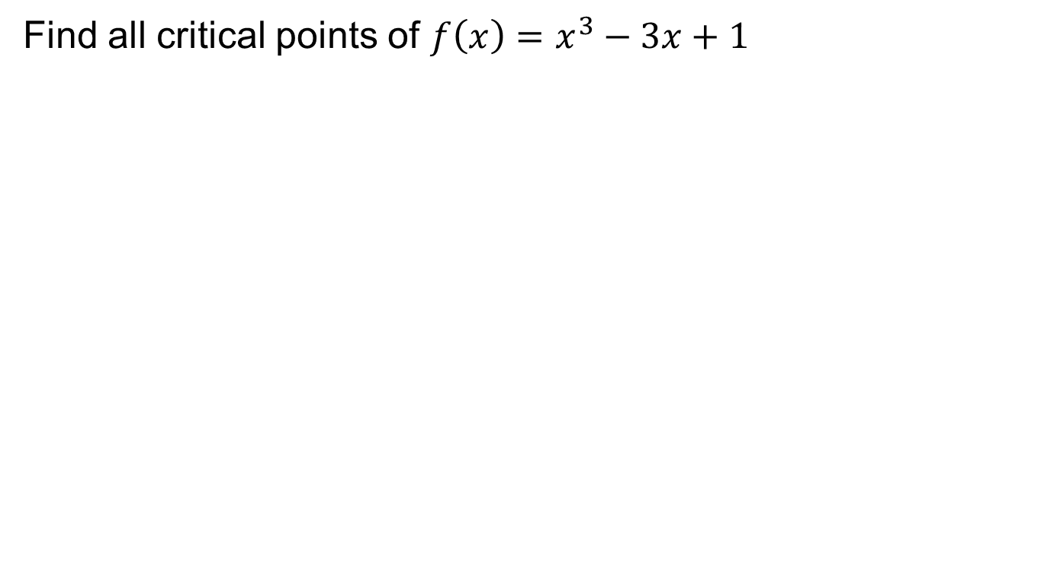
Example
Find all critical points of $f\left(x\right)=x^{3}−3x+1$

Slide 21
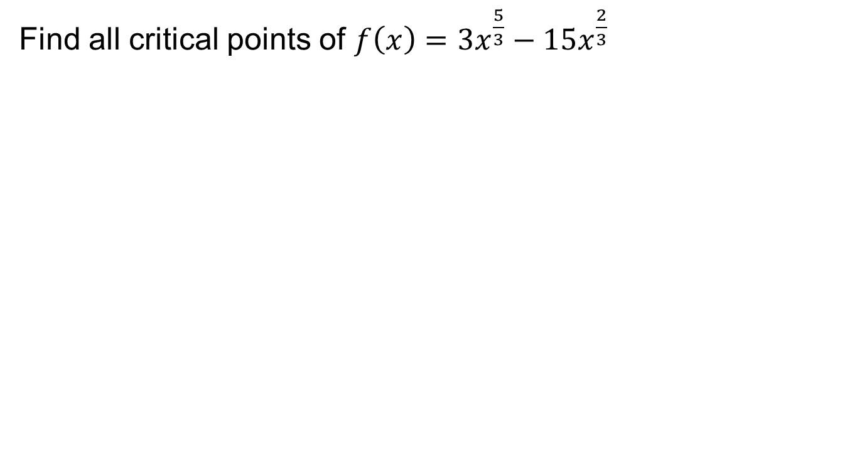
Example
Find all critical points of $f\left(x\right)=3x^{\frac{5}{3}}−15x^{\frac{2}{3}}$

Slide 23
Example
Find all the relative extrema of $f\left(x\right)=x^{3}−6x^{2}+1$
Critical points
Relative min.
Relative max.

Slide 24
Summary

Slide 25
Thank You

