Slide 1
MTH374: Optimization
For
Master of Mathematics
By
Dr. M. Fazeel Anwar
Assistant Professor
Department of Mathematics, CIIT Islamabad

Slide 2
Lecture 29

Slide 3
Recap
Post optimal analysis
Changes affecting feasibility

Slide 4
Today’s Topics
Post optimal analysis
Changes affecting optimality

Slide 5
Example
TOYCO assembles three types of toys: trains, trucks and cars using three operations. Available assembly time for the three operations are 430, 460 and 420 minutes per day respectively and the revenues per toy train, truck and car are $3, $2, and $5 respectively. The assembly times per train for the three operations are 1, 3 and 1 minutes respectively. The corresponding times per truck and car are (2,0,4) and (1,2,0) minutes. Maximize revenues…

Slide 6
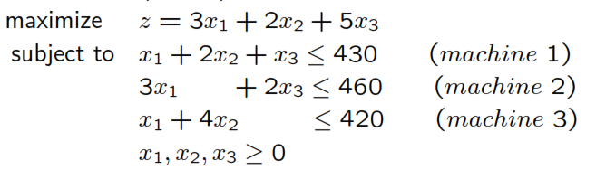

Slide 7
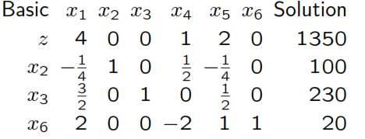

Slide 8
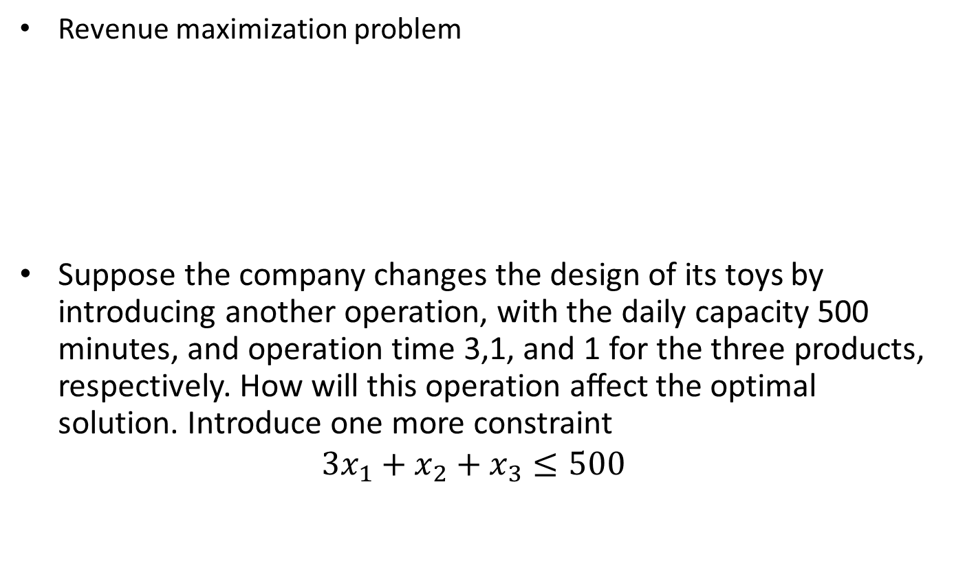
Addition of a constraint
Revenue maximization problem
Suppose the company changes the design of its toys by introducing another operation, with the daily capacity 500 minutes, and operation time 3,1, and 1 for the three products, respectively. How will this operation aﬀect the optimal solution. Introduce one more constraint
$$3x_{1}+x_{2}+x_{3}≤500$$

Slide 9
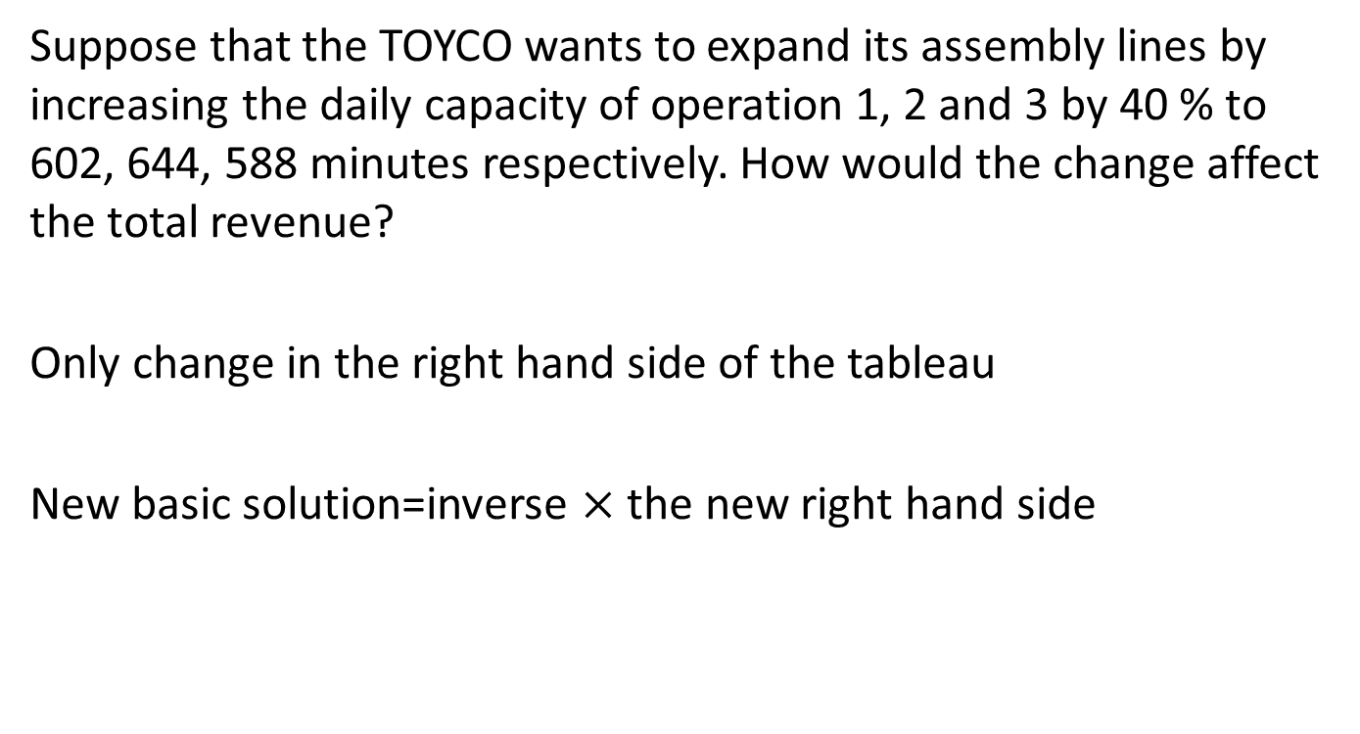
Changes in the right hand side
Suppose that the TOYCO wants to expand its assembly lines by increasing the daily capacity of operation 1, 2 and 3 by 40 % to 602, 644, 588 minutes respectively. How would the change affect the total revenue?
Only change in the right hand side of the tableau
New basic solution=inverse $×$ the new right hand side

Slide 10
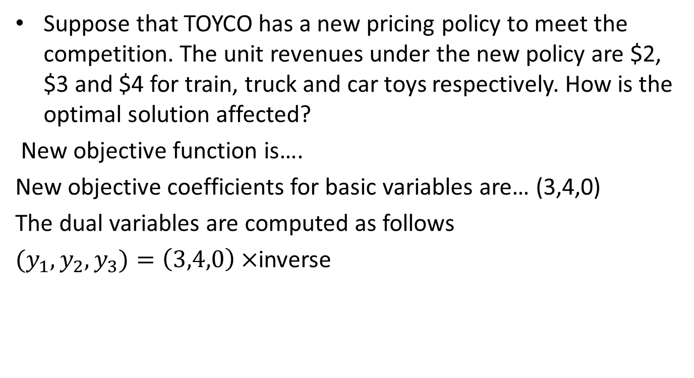
Changes in objective function coefficients
Suppose that TOYCO has a new pricing policy to meet the competition. The unit revenues under the new policy are $2, $3 and $4 for train, truck and car toys respectively. How is the optimal solution affected?
New objective function is….
New objective coefficients for basic variables are… (3,4,0)
The dual variables are computed as follows
${(y}_{1}, y_{2},y_{3})=\left(3,4,0\right)×$inverse

Slide 11
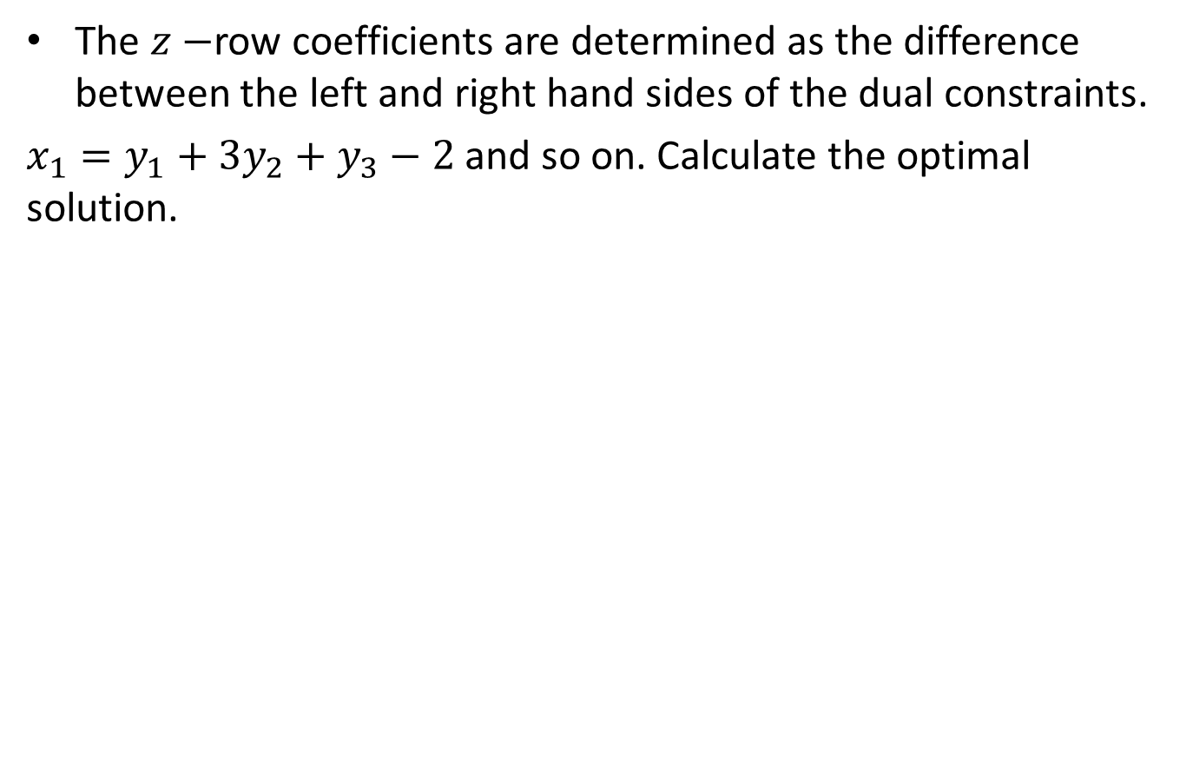
The $z−$row coefficients are determined as the difference between the left and right hand sides of the dual constraints.
$x_{1}=y_{1}+3y_{2}+y_{3}−2$ and so on. Calculate the optimal solution.

Slide 13
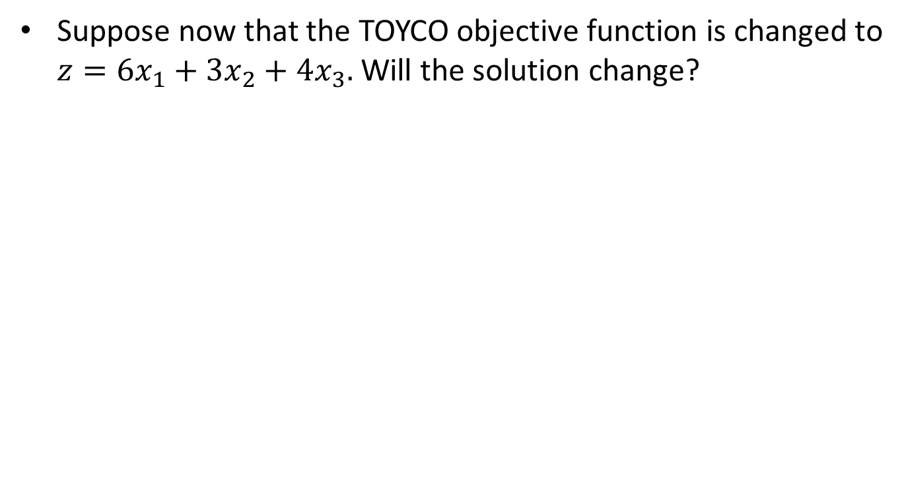
Scenario-II
Suppose now that the TOYCO objective function is changed to $z=6x_{1}+3x_{2}+4x_{3}.$ Will the solution change?

Slide 17
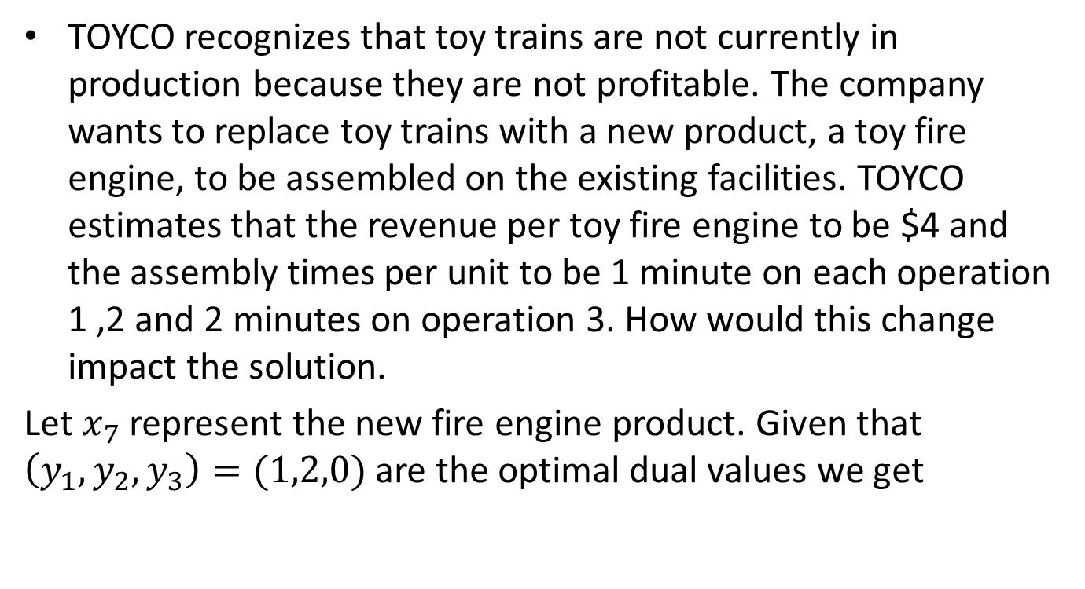
Addition of a new activity
TOYCO recognizes that toy trains are not currently in production because they are not profitable. The company wants to replace toy trains with a new product, a toy fire engine, to be assembled on the existing facilities. TOYCO estimates that the revenue per toy fire engine to be $4 and the assembly times per unit to be 1 minute on each operation 1 ,2 and 2 minutes on operation 3. How would this change impact the solution.
Let $x_{7}$ represent the new fire engine product. Given that $\left(y_{1},y_{2},y_{3}\right)=(1,2,0)$ are the optimal dual values we get

Slide 21
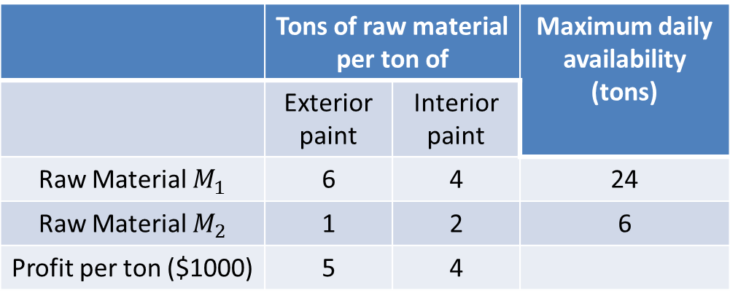
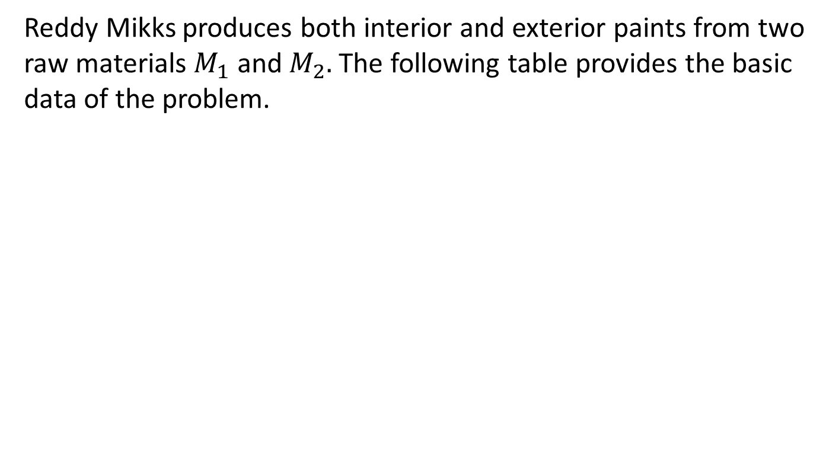
Example-II
Reddy Mikks produces both interior and exterior paints from two raw materials $M_{1}$ and $M_{2}.$The following table provides the basic data of the problem.
 | Tons of raw material per ton of |  | Maximum daily availability (tons)
 | Exterior paint | Interior paint
Raw Material $M_{1}$ | 6 | 4 | 24
Raw Material $M_{2}$ | 1 | 2 | 6
Profit per ton ($1000) | 5 | 4

Slide 22
A market survey indicates that the daily demand for interior paint can not exceed that for exterior paint by more than one ton. Also the maximum daily demand for interior paint is 2 tons. Determine the best product mix that maximizes the daily profit.

Slide 24
The company is considering the production of a cheaper brand of exterior paint whose input requirements per ton include 0.75 ton of each raw material. The profit per ton of new exterior paint is $3500. Determine the new optimal solution.

Slide 28
Example
Maximize
Z = 3X₁+ 5X₂
Subject to
X₁ ≤ 4
2 X₂ ≤ 12
3X₁ +2X₂ ≤ 18
X₁ , X₂ ≥ 0

Slide 29
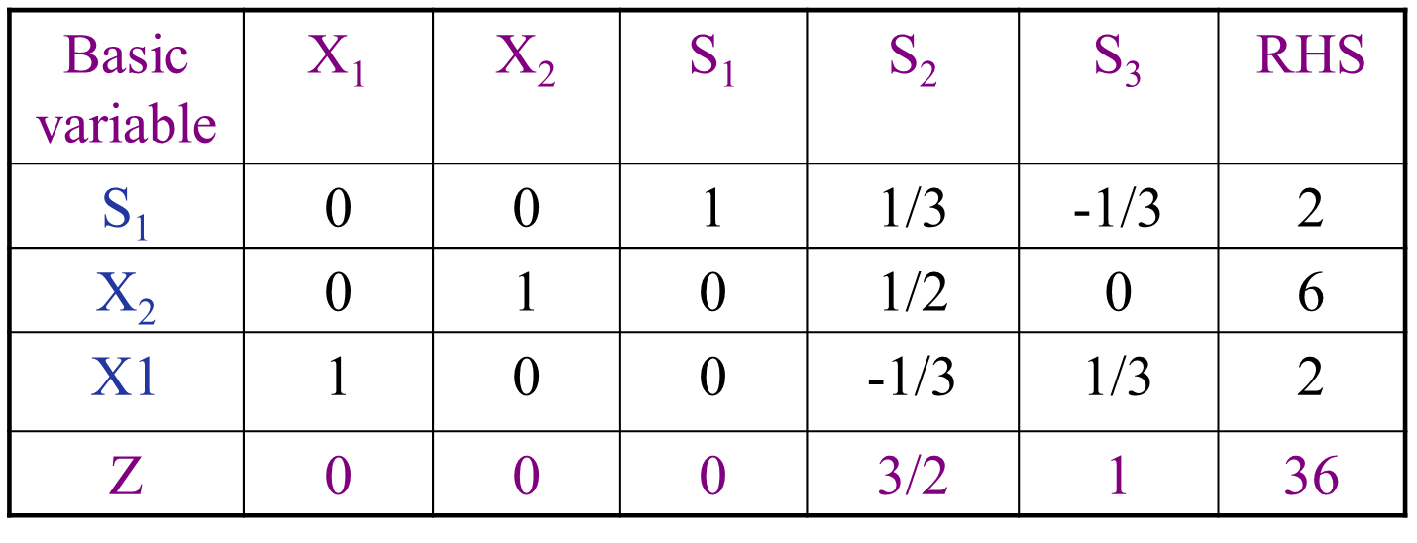

Slide 34
Summary

Slide 35
Thank You

