Slide 1
MTH374: Optimization
For
Master of Mathematics
By
Dr. M. Fazeel Anwar
Assistant Professor
Department of Mathematics, CIIT Islamabad

Slide 2
Lecture 28

Slide 3
Recap
Post optimal analysis
Changes affecting optimality
Changes affecting feasibility

Slide 4
Today’s Topics
Post optimal analysis
Changes affecting optimality
Changes affecting feasibility

Slide 5
Post Optimal Analysis
Changes aﬀecting feasibility
LP Model: right-hand side change or a new constraint
How to recover optimal if the perturbation causes the change in basic optimal solution?
Changes aﬀecting optimality
LP Model: objective coeﬃcient or new variable
How to ﬁnd new optimal?

Slide 6
Changes aﬀecting feasibility
Increasing/decreasing amount of resources (RHS)
Introducing new resources (new constraint in LP)

Slide 7
Changes Aﬀecting Optimality
Objective cost changes
Adding new economic activity

Slide 8
Example
TOYCO assembles three types of toys: trains, trucks and cars using three operations. Available assembly time for the three operations are 430, 460 and 420 minutes per day respectively and the revenues per toy train, truck and car are $3, $2, and $5 respectively. The assembly times per train for the three operations are 1, 3 and 1 minutes respectively. The corresponding times per truck and car are (2,0,4) and (1,2,0) minutes. Maximize revenues…

Slide 9
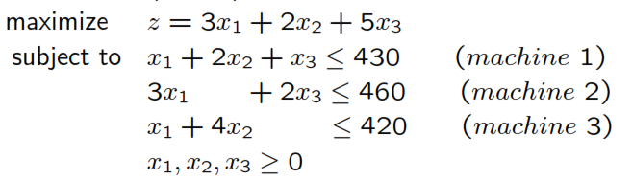

Slide 10
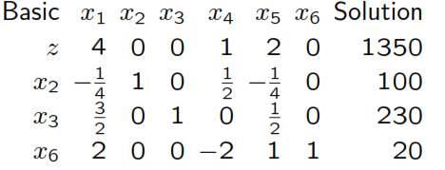

Slide 11
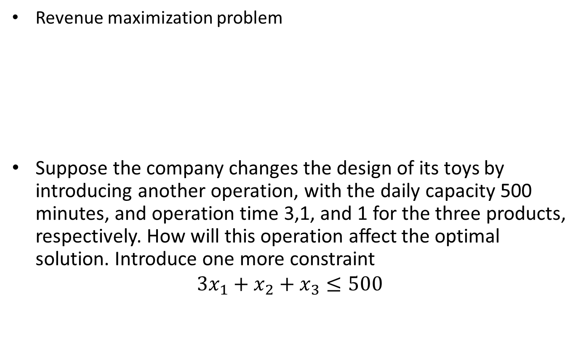
Addition of a constraint
Revenue maximization problem
Suppose the company changes the design of its toys by introducing another operation, with the daily capacity 500 minutes, and operation time 3,1, and 1 for the three products, respectively. How will this operation aﬀect the optimal solution. Introduce one more constraint
$$3x_{1}+x_{2}+x_{3}≤500$$

Slide 12
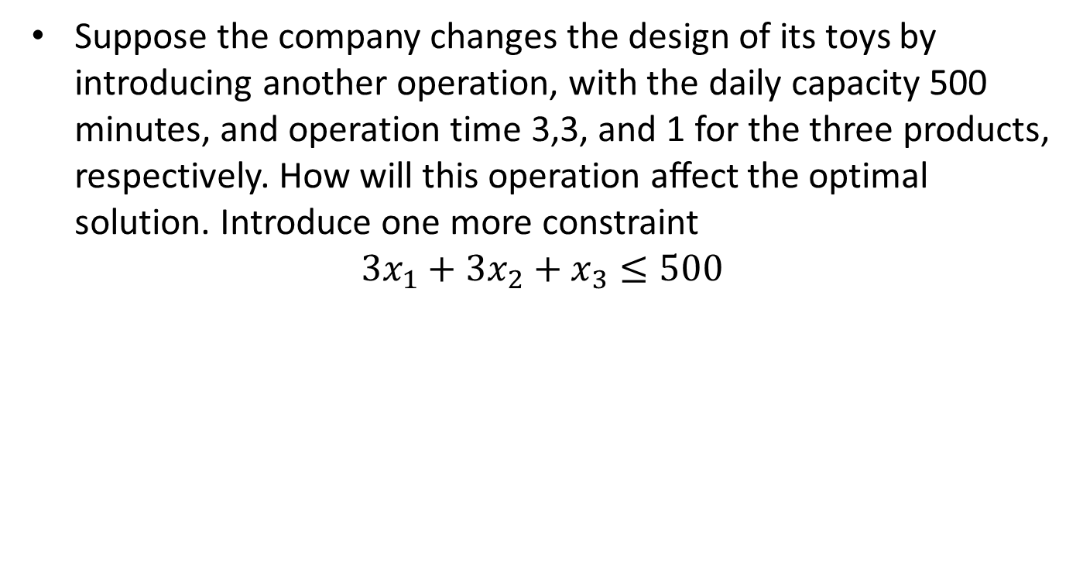
Second Scenario
Suppose the company changes the design of its toys by introducing another operation, with the daily capacity 500 minutes, and operation time 3,3, and 1 for the three products, respectively. How will this operation aﬀect the optimal solution. Introduce one more constraint
$$3x_{1}+{3x}_{2}+x_{3}≤500$$

Slide 13
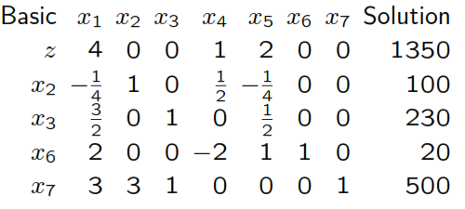
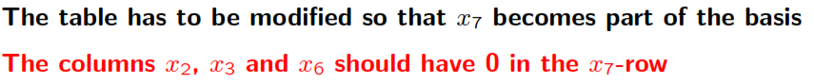
In the optimal table add a new slack (for the new constraint) and the new row (bring the new slack into the basis):

Slide 15
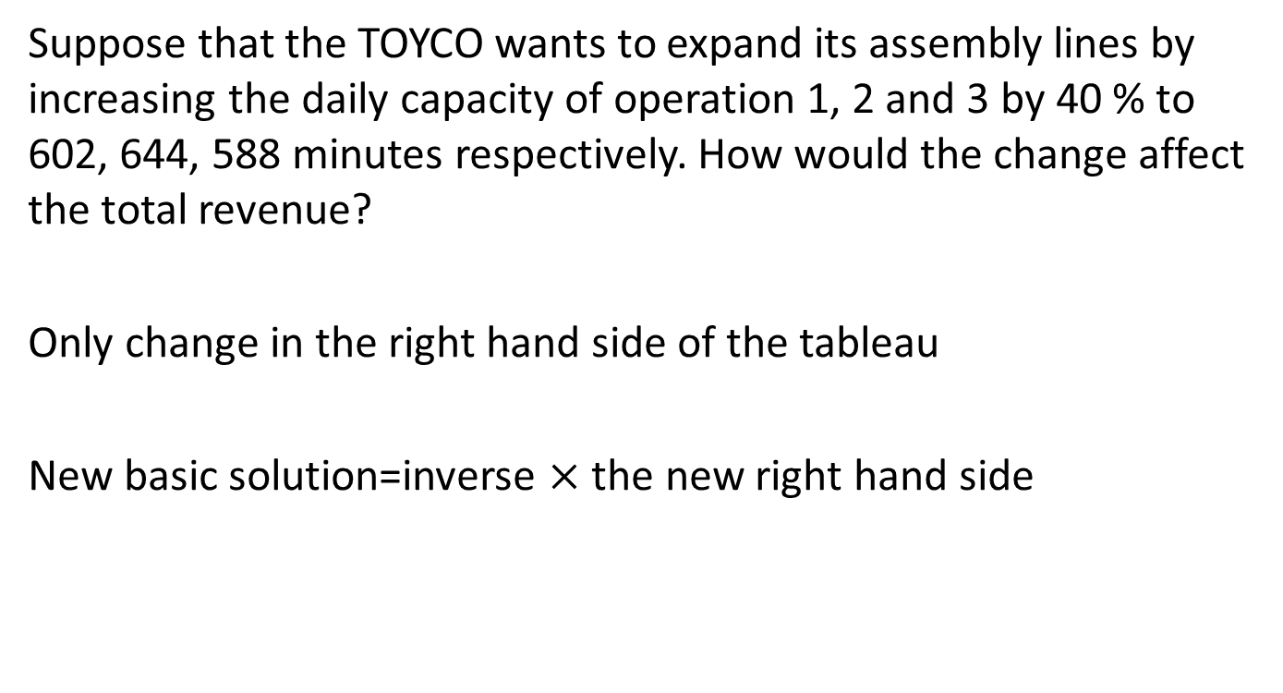
Changes in the right hand side
Suppose that the TOYCO wants to expand its assembly lines by increasing the daily capacity of operation 1, 2 and 3 by 40 % to 602, 644, 588 minutes respectively. How would the change affect the total revenue?
Only change in the right hand side of the tableau
New basic solution=inverse $×$ the new right hand side

Slide 18
Situation-II
TOYCO wants to shift the slack capacity of operation 2 to the capacity of operation 1. How would this change affect the optimal solution?
Look at the following optimal table

Slide 19
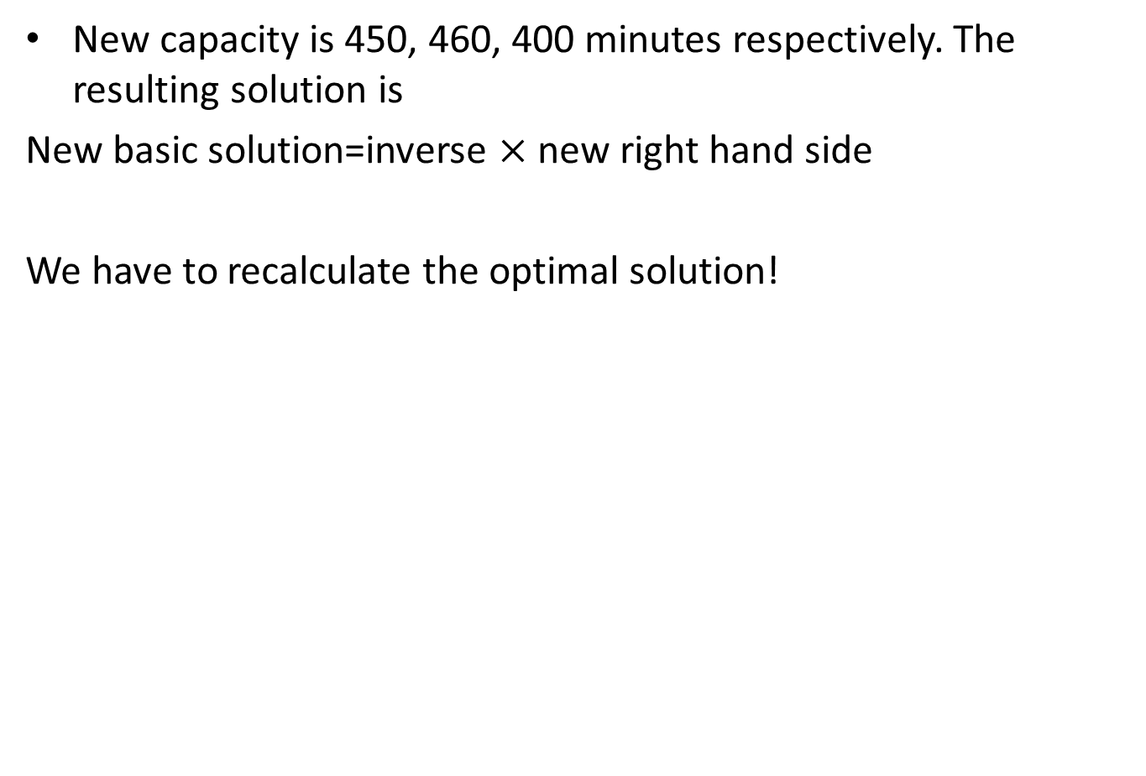
New capacity is 450, 460, 400 minutes respectively. The resulting solution is
New basic solution=inverse $×$ new right hand side
We have to recalculate the optimal solution!

Slide 21
Summary

Slide 22
Thank You

