Slide 1
MTH374: Optimization
For
Master of Mathematics
By
Dr. M. Fazeel Anwar
Assistant Professor
Department of Mathematics, CIIT Islamabad

Slide 2
Lecture 27

Slide 3
Recap
Big M method
Examples

Slide 4
Today’s Topics
Post optimal analysis
Changes affecting optimality
Changes affecting feasibility

Slide 5
Post Optimal Analysis
Changes aﬀecting feasibility
LP Model: right-hand side change or a new constraint
How to recover optimal if the perturbation causes the change in basic optimal solution?
Changes aﬀecting optimality
LP Model: objective coeﬃcient or new variable
How to ﬁnd new optimal?

Slide 6
Changes aﬀecting feasibility
Increasing/decreasing amount of resources (RHS)
Introducing new resources (new constraint in LP)

Slide 7
Changes Aﬀecting Optimality
Objective cost changes
Adding new economic activity

Slide 9
Example
TOYCO assembles three types of toys: trains, trucks and cars using three operations. Available assembly time for the three operations are 430, 460 and 420 minutes per day respectively and the revenues per toy train, truck and car are $3, $2, and $5 respectively. The assembly times per train for the three operations are 1, 3 and 1 minutes respectively. The corresponding times per truck and car are (2,0,4) and (1,2,0) minutes. Maximize revenues…

Slide 12
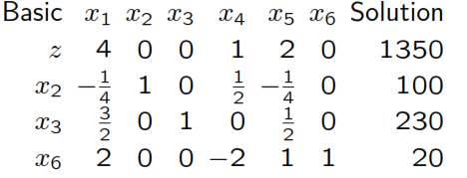

Slide 13
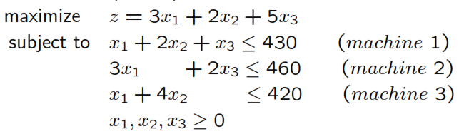
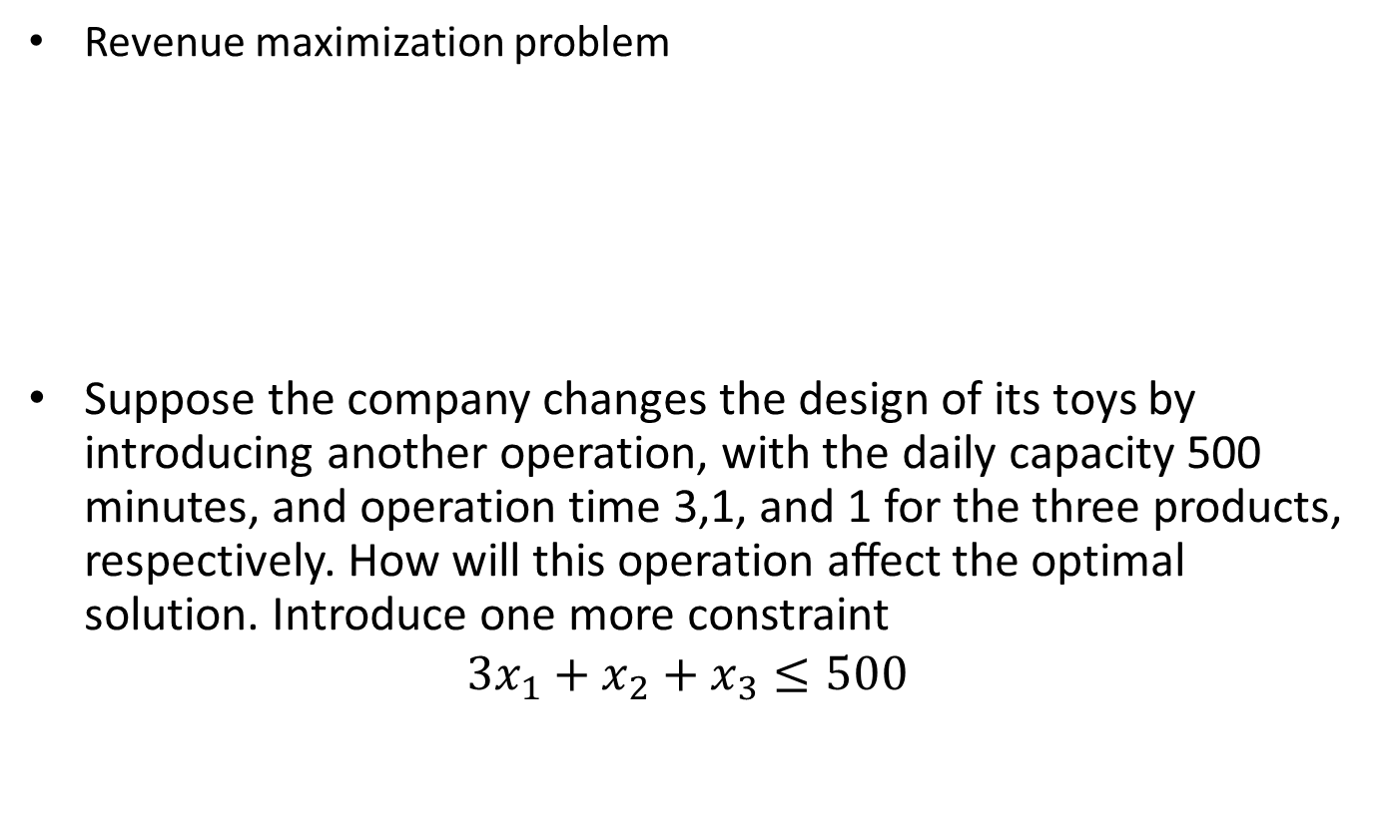
Addition of a constraint
Revenue maximization problem
Suppose the company changes the design of its toys by introducing another operation, with the daily capacity 500 minutes, and operation time 3,1, and 1 for the three products, respectively. How will this operation aﬀect the optimal solution. Introduce one more constraint
$$3x_{1}+x_{2}+x_{3}≤500$$

Slide 15
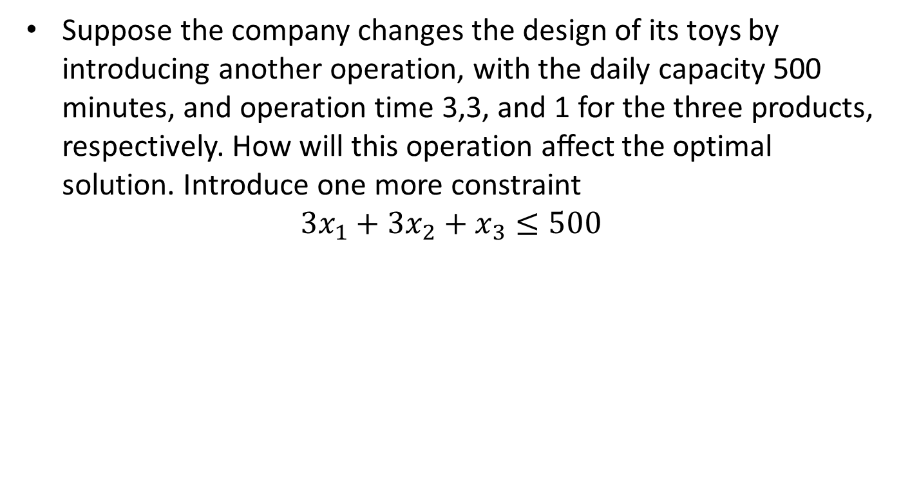
Second Scenario
Suppose the company changes the design of its toys by introducing another operation, with the daily capacity 500 minutes, and operation time 3,3, and 1 for the three products, respectively. How will this operation aﬀect the optimal solution. Introduce one more constraint
$$3x_{1}+{3x}_{2}+x_{3}≤500$$

Slide 16
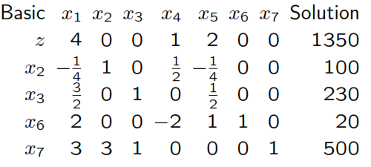
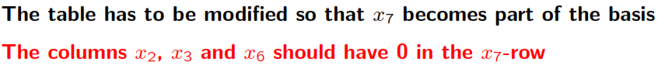
In the optimal table add a new slack (for the new constraint) and the new row (bring the new slack into the basis):

Slide 18
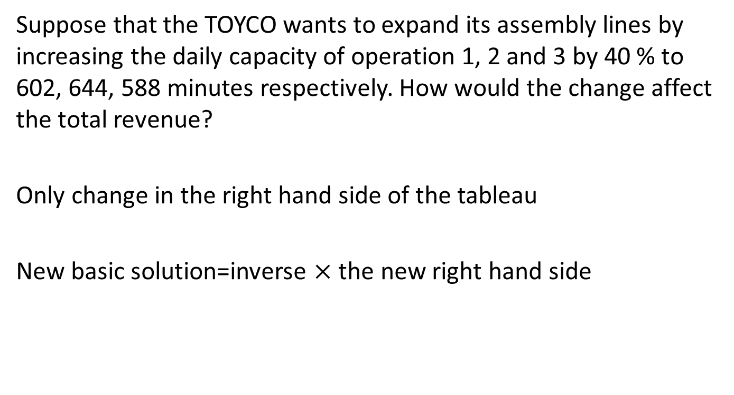
Changes in the right hand side
Suppose that the TOYCO wants to expand its assembly lines by increasing the daily capacity of operation 1, 2 and 3 by 40 % to 602, 644, 588 minutes respectively. How would the change affect the total revenue?
Only change in the right hand side of the tableau
New basic solution=inverse $×$ the new right hand side

Slide 21
Situation-II
TOYCO wants to shift the slack capacity of operation 2 to the capacity of operation 1. How would this change affect the optimal solution?
Look at the following optimal table

Slide 22
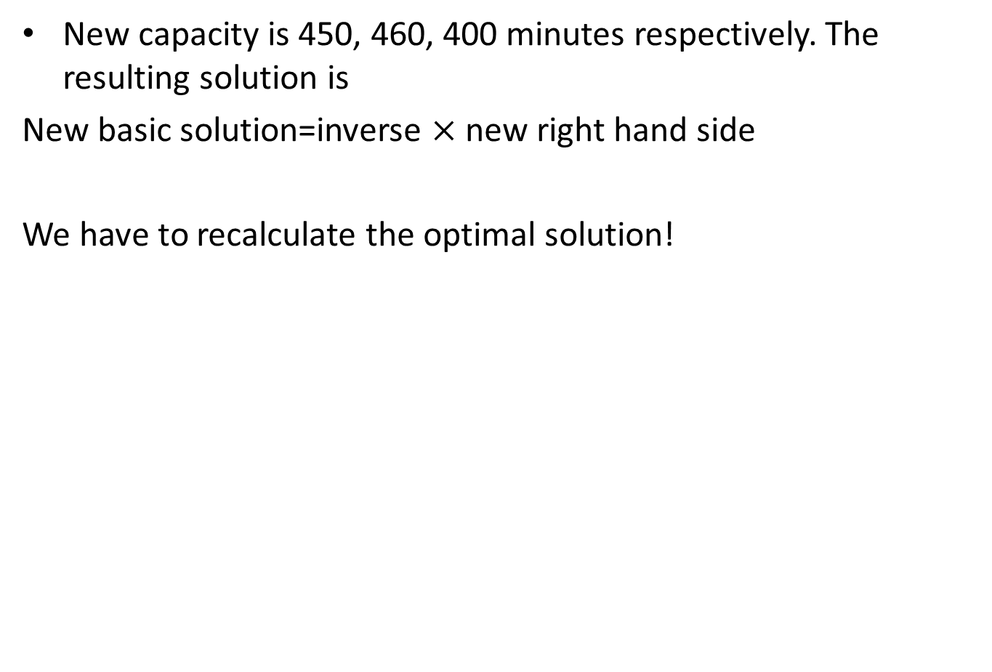
New capacity is 450, 460, 400 minutes respectively. The resulting solution is
New basic solution=inverse $×$ new right hand side
We have to recalculate the optimal solution!

Slide 25
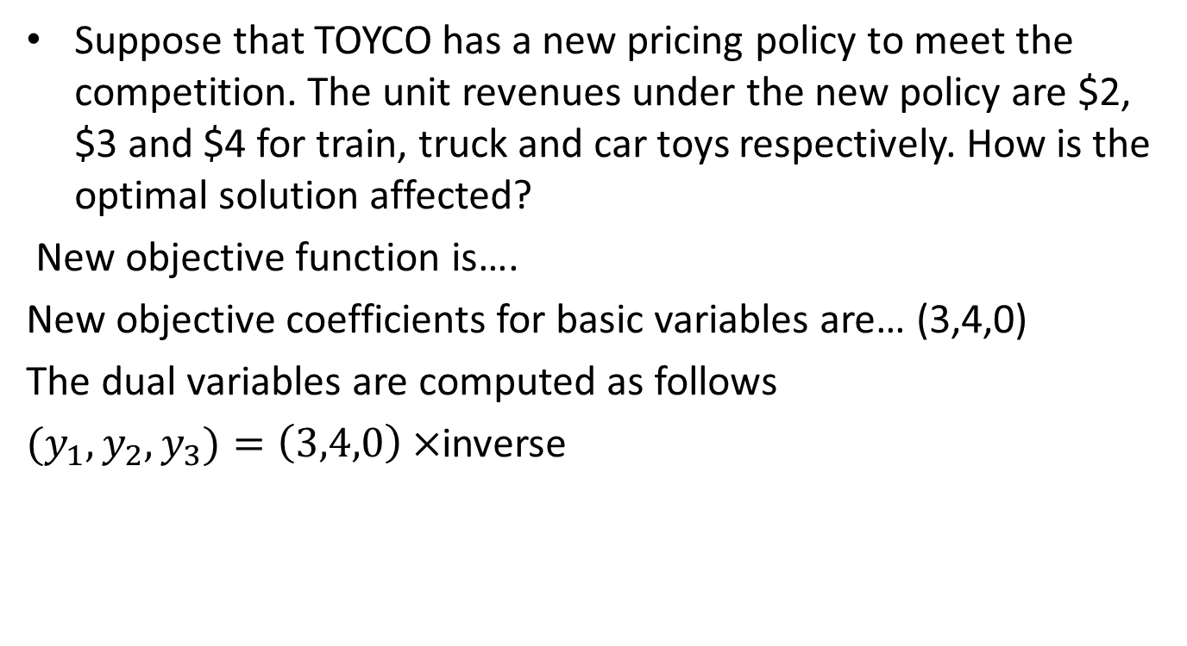
Changes in objective function coefficients
Suppose that TOYCO has a new pricing policy to meet the competition. The unit revenues under the new policy are $2, $3 and $4 for train, truck and car toys respectively. How is the optimal solution affected?
New objective function is….
New objective coefficients for basic variables are… (3,4,0)
The dual variables are computed as follows
${(y}_{1}, y_{2},y_{3})=\left(3,4,0\right)×$inverse

Slide 26
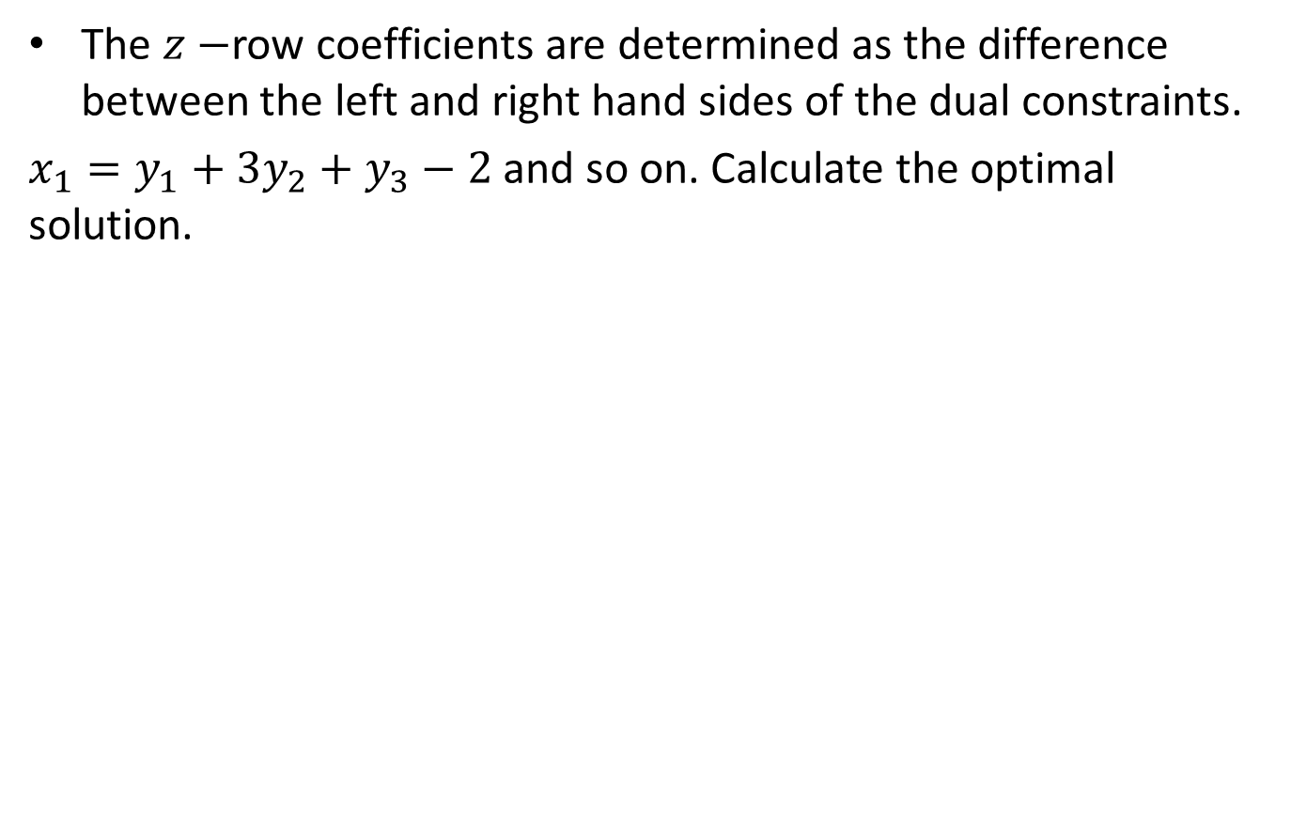
The $z−$row coefficients are determined as the difference between the left and right hand sides of the dual constraints.
$x_{1}=y_{1}+3y_{2}+y_{3}−2$ and so on. Calculate the optimal solution.

Slide 28
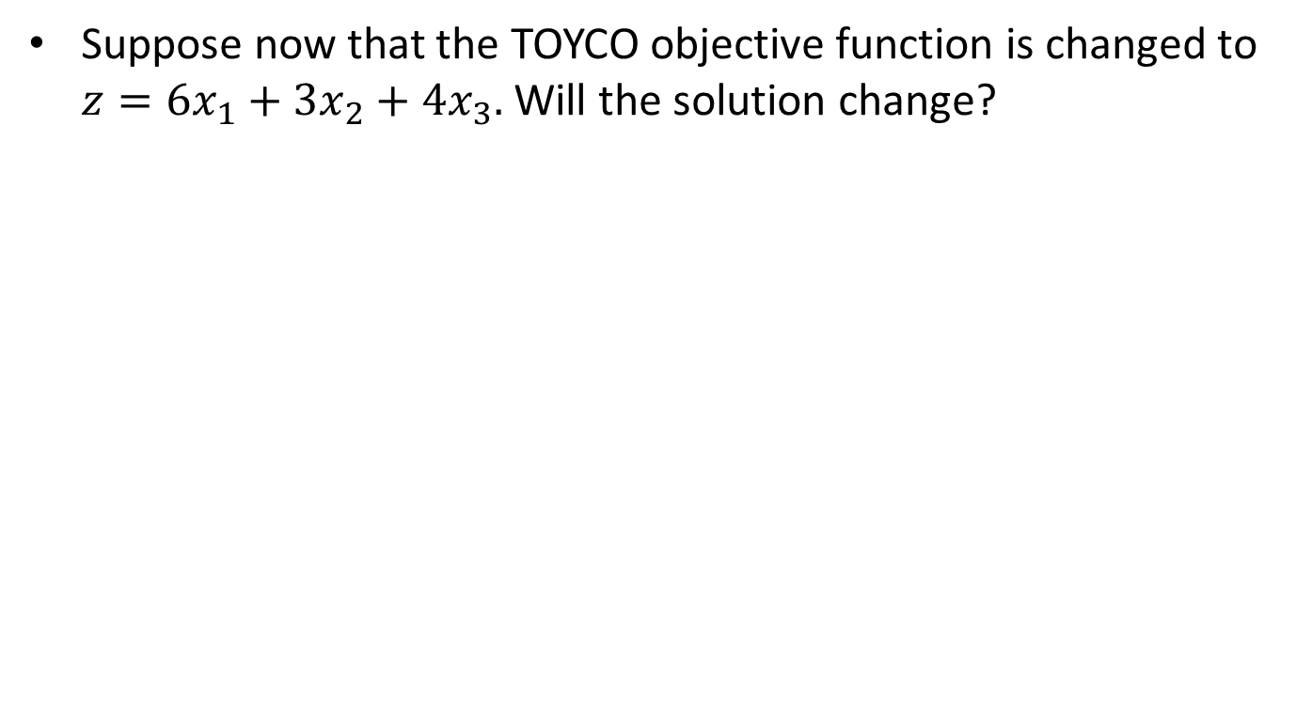
Scenario-II
Suppose now that the TOYCO objective function is changed to $z=6x_{1}+3x_{2}+4x_{3}.$ Will the solution change?

Slide 31
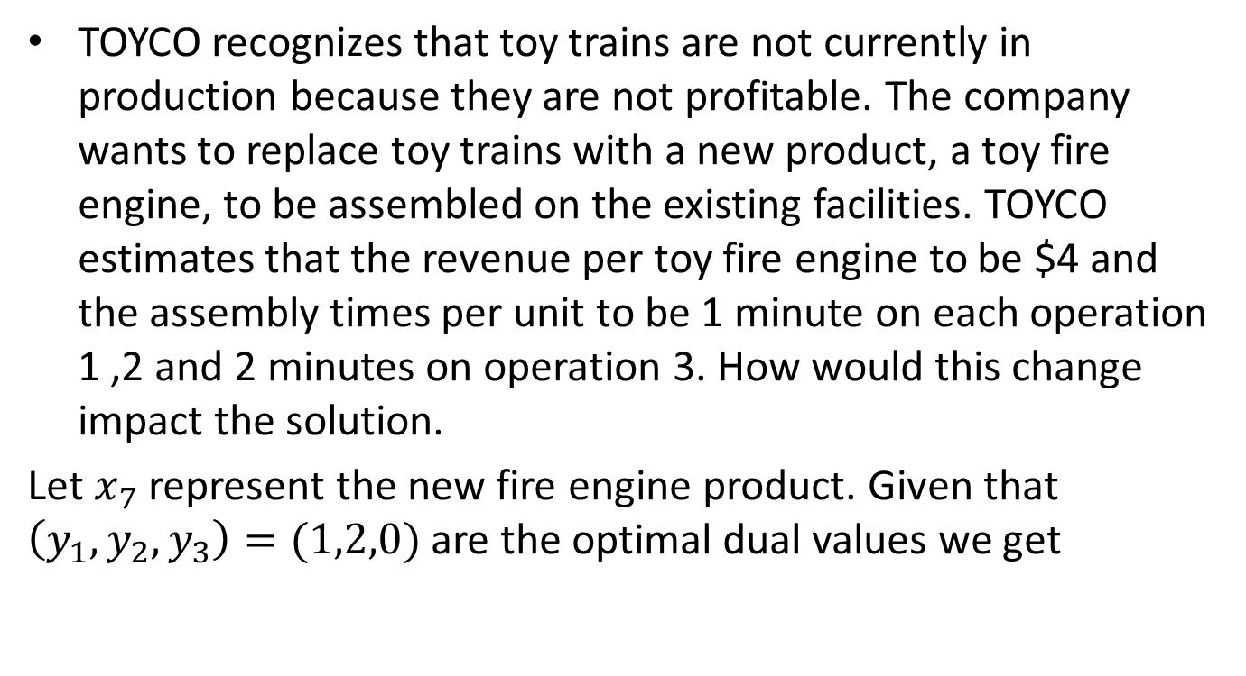
Addition of a new activity
TOYCO recognizes that toy trains are not currently in production because they are not profitable. The company wants to replace toy trains with a new product, a toy fire engine, to be assembled on the existing facilities. TOYCO estimates that the revenue per toy fire engine to be $4 and the assembly times per unit to be 1 minute on each operation 1 ,2 and 2 minutes on operation 3. How would this change impact the solution.
Let $x_{7}$ represent the new fire engine product. Given that $\left(y_{1},y_{2},y_{3}\right)=(1,2,0)$ are the optimal dual values we get

Slide 33
Example
Maximize
Z = 3X₁+ 5X₂
Subject to
X₁ ≤ 4
2 X₂ ≤ 12
3X₁ +2X₂ ≤ 18
X₁ , X₂ ≥ 0

Slide 34
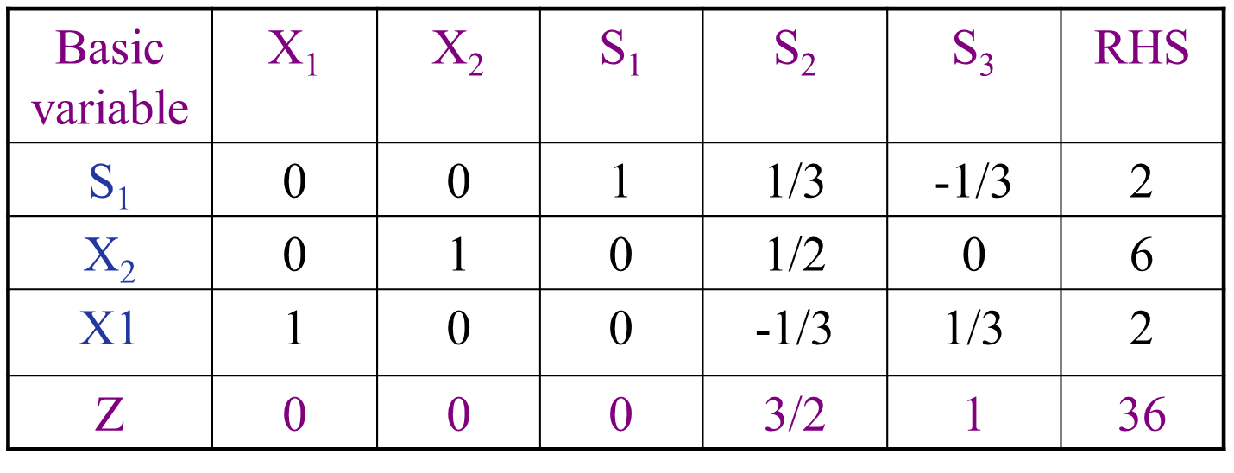

Slide 39
Summary

Slide 40
Thank You

