Slide 1
MTH374: Optimization
For
Master of Mathematics
By
Dr. M. Fazeel Anwar
Assistant Professor
Department of Mathematics, CIIT Islamabad

Slide 2
Lecture 26

Slide 3
Recap
Simplex method for minimum
Simplex method with mixed constraints

Slide 4
Today’s Topics
Big M method
Examples

Slide 5
Simplex method incase of Artificial variables
“Big M method”
Solve the following linear programming problem by using the simplex method:
Min Z =2 X₁ + 3 X₂
S.t.
½ X₁ + ¼ X₂ ≤ 4
X₁ + 3X₂ ≥ 20
X₁ + X₂ = 10
X₁, X₂ ≥ 0

Slide 6
Big M method
Solution
Step 1: standard form
Min Z,
s.t.
Z – 2 X₁ – 3 X₂ - M A₁ -M A₂ = 0
½ X₁ + ¼ X₂ + S₁ = 4
X₁ + 3X₂ - S₂ + A₁ = 20
X₁ + X₂ + A₂ = 10
X₁, X₂ ,S₁, S₂, A₁, A₂ ≥ 0
Where: M is a very large number

Slide 7
Big M method
Notes
M, a very large number, is used to ensure that the values of A₁ and A₂, …, and A_{n} will be zero in the final (optimal) tableau as follows:
1. If the objective function is Minimization, then A₁, A₂, …, and A_{n} must be added to the RHS of the objective function multiplied by a very large number (M).
Example: if the objective function is Min Z = X₁+2X₂, then the obj. function should be Min Z = X₁ + X₂+ MA₁ + MA₂+ …+ MA_{n}
OR
Z – X₁ - X₂- MA₁ - MA₂- …- MA_{n} = 0

Slide 8
2. If the objective function is Maximization, then A₁, A₂, …, and A_{n} must be subtracted from the RHS of the objective function multiplied by a very large number (M).
Example: if the objective function is Max Z = X₁+2X₂, then the obj. function should be Max Z = X₁ + X₂- MA₁ - MA₂- …- MA_{n}
OR
Z - X₁ - X₂+ MA₁ + MA₂+ …+ MA_{n} = 0
N.B.: When the Z is transformed to a zero equation, the signs are changed

Slide 9
Big M method
Step 2: Initial tableau
Basic variables | X₁ ₂ | X₂ ₃ | S₁ ₀ | S₂ ₀ | A₁ _{M} | A₂ _{M} | RHS
S₁ | ½ | ¼ | 1 | 0 | 0 | 0 | 4
A₁ | 1 | 3 | 0 | -1 | 1 | 0 | 20
A₂ | 1 | 1 | 0 | 0 | 0 | 1 | 10
Z | -2 | -3 | 0 | 0 | -M | -M | 0
Note that one of the simplex rules is violated, which is the basic variables A₁, and A₂ have a non zero value in the z row; therefore, this violation must be corrected before proceeding in the simplex algorithm as follows.

Slide 10
Big M method
To correct this violation before starting the simplex algorithm, the elementary row operations are used as follows:
New (Z row) = old (z row) ± M (A₁ row) ± M (A₂ row)
In our case, it will be positive since M is negative in the Z row, as following:
Old (Z row): -2 -3 0 0 -M -M 0
M (A1 row): M 3M 0 -M M o 20M
M (A2 row): M M 0 0 0 M 10M
New (Z row):2M-2 4M-3 0 -M 0 0 30M
It becomes zero

Slide 11
Big M method
The initial tableau will be:
Basic variables | X₁ ₂ | X₂ ₃ | S₁ ₀ | S₂ ₀ | A₁ _{M} | A₂ _{M} | RHS
S₁ | 1/2 | 1/4 | 1 | 0 | 0 | 0 | 4
A₁ | 1 | 3 | 0 | -1 | 1 | 0 | 20
A₂ | 1 | 1 | 0 | 0 | 0 | 1 | 10
Z | 2M-2 | 4M-3 | 0 | -M | 0 | 0 | 30M
Since there is a positive value in the last row, this solution is not optimal
The entering variable is X₂ (it has the most positive value in the last row)
The leaving variable is A₁ (it has the smallest ratio)

Slide 12
Big M method
First iteration
Basic variables | X₁ ₂ | X₂ ₃ | S₁ ₀ | S₂ ₀ | A₁ _{M} | A₂ _{M} | RHS
S₁ | 5/12 | 0 | 1 | 1/12 | -1/12 | 0 | 7/3
X₂ | 1/3 | 1 | 0 | -1/3 | 1/3 | 0 | 20/3
A₂ | 2/3 | 0 | 0 | 1/3 | -1/3 | 1 | 10/3
Z | 2/3M-1 | 0 | 0 | 1/3M-1 | 1-4/3M | 0 | 20+10/3M
Since there is a positive value in the last row, this solution is not optimal
The entering variable is X₁ (it has the most positive value in the last row)
The leaving variable is A₂ (it has the smallest ratio)

Slide 13
Big M method
Second iteration
Basic variables | X₁ | X₂ | S₁ | S₂ | A₁ | A₂ | RHS
S₁ | 0 | 0 | 1 | -1/8 | 1/8 | -5/8 | 1/4
X₂ | 0 | 1 | 0 | -1/2 | 1/2 | -1/2 | 5
X₁ | 1 | 0 | 0 | 1/2 | -1/2 | 3/2 | 5
Z | 0 | 0 | 0 | -1/2 | ½-M | 3/2-M | 25
This solution is optimal, since there is no positive value in the last row. The optimal solution is:
X₁ = 5, X₂ = 5, S₁ = ¼
A₁ = A₂ = 0 and Z = 25

Slide 14
Note for the Big M method
In the final tableau, if one or more artificial variables (A₁, A₂, …) still basic and has a nonzero value, then the problem has an infeasible solution.
All other notes are still valid in the Big M method.

Slide 15
Special cases
In the final tableau, if one or more artificial variables (A₁, A₂, …) still basic and has a nonzero value, then the problem has an infeasible solution
If there is a zero under one or more nonbasic variables in the last tableau (optimal solution tableau), then there is a multiple optimal solution.
When determining the leaving variable of any tableau, if there is no positive ratio (all the entries in the pivot column are negative and zeroes), then the solution is unbounded.

Slide 16
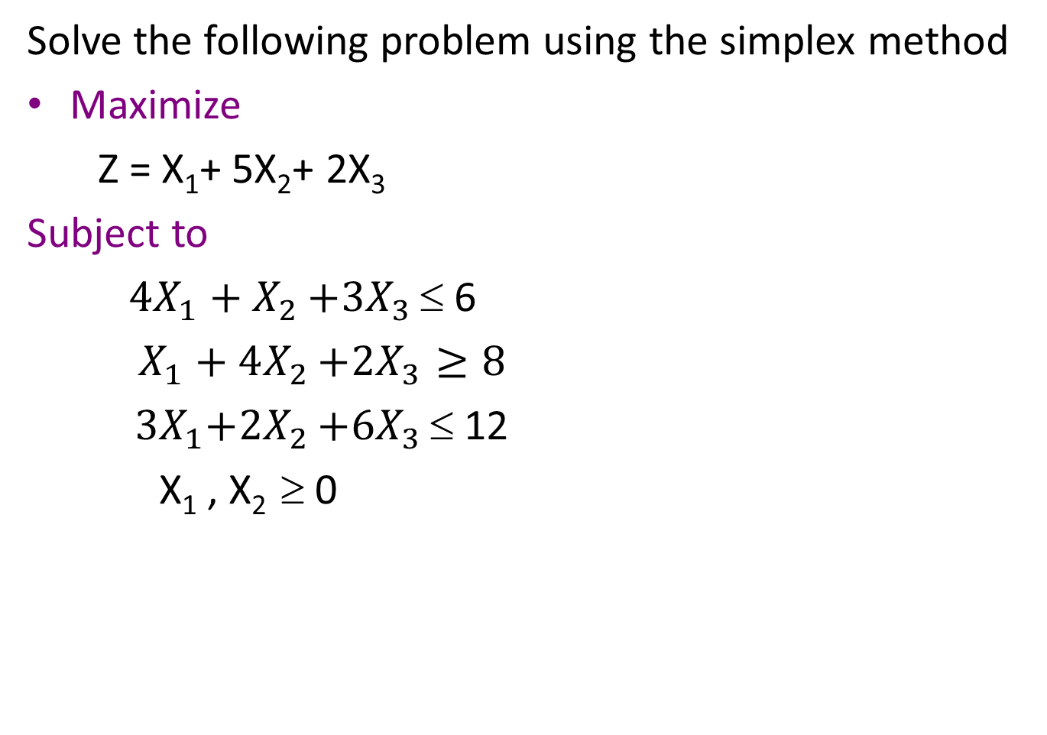
Example
Solve the following problem using the simplex method
Maximize
Z = X₁+ 5X₂+ 2X₃
Subject to
${4X}_{1}+X_{2}$ $+{3X}_{3}$ ≤ 6
$X_{1}+4X_{2}$ $+{2X}_{3}≥8$
${ 3X}_{1}+{2X}_{2}$ $+{6X}_{3}$ ≤ 12
X₁ , X₂ ≥ 0

Slide 20
Minimize Z=4x₁+ x₂
Subject to:
3x₁+ x₂ = 3
4x₁+ 3x_{2 ≥}6
x₁+ 2x_{2 ≤}4
x_{1,} x_{2 ≥} 0

Slide 22
Summary

Slide 23
Thank You

