Slide 1
MTH374: Optimization
For
Master of Mathematics
By
Dr. M. Fazeel Anwar
Assistant Professor
Department of Mathematics, CIIT Islamabad

Slide 2
Lecture 25

Slide 3
Recap
Simplex method for minimum

Slide 4
Today’s Topics
Examples
Simplex method with mixed constraints

Slide 5
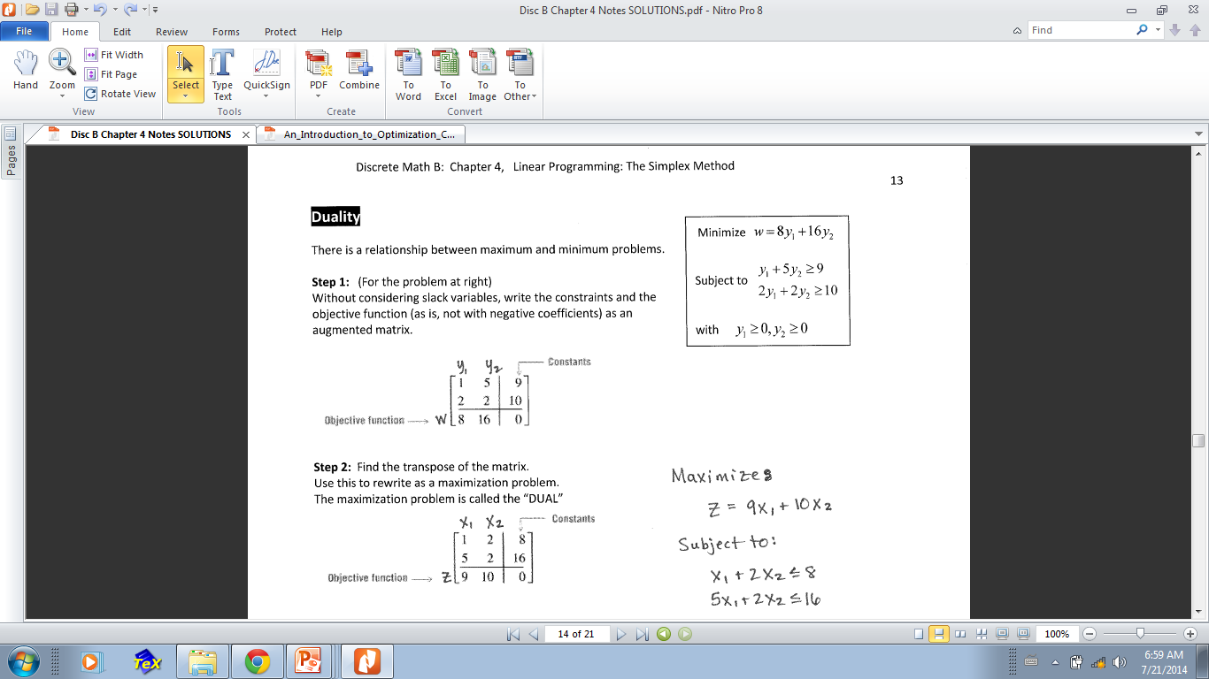
Duality and minimum problem

Slide 6
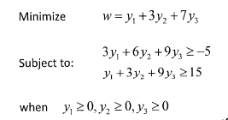
Example

Slide 11
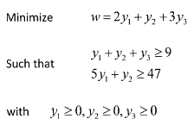
Example-II

Slide 17
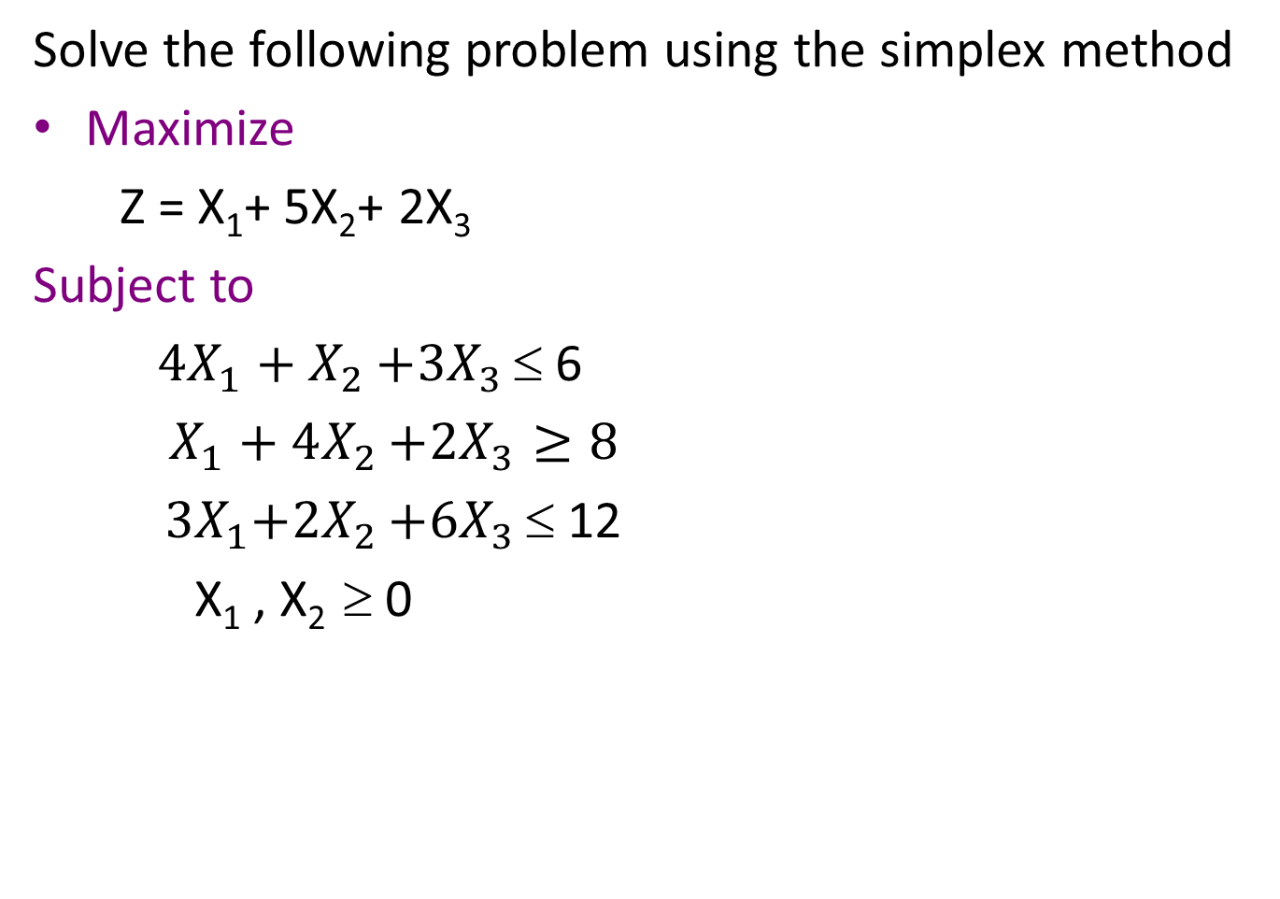
Example
Solve the following problem using the simplex method
Maximize
Z = X₁+ 5X₂+ 2X₃
Subject to
${4X}_{1}+X_{2}$ $+{3X}_{3}$ ≤ 6
$X_{1}+4X_{2}$ $+{2X}_{3}≥8$
${ 3X}_{1}+{2X}_{2}$ $+{6X}_{3}$ ≤ 12
X₁ , X₂ ≥ 0

Slide 20
Simplex method incase of Artificial variables
“Big M method”
Solve the following linear programming problem by using the simplex method:
Min Z =2 X₁ + 3 X₂
S.t.
½ X₁ + ¼ X₂ ≤ 4
X₁ + 3X₂ ≥ 20
X₁ + X₂ = 10
X₁, X₂ ≥ 0

Slide 21
Big M method
Solution
Step 1: standard form
Min Z,
s.t.
Z – 2 X₁ – 3 X₂ - M A₁ -M A₂ = 0
½ X₁ + ¼ X₂ + S₁ = 4
X₁ + 3X₂ - S₂ + A₁ = 20
X₁ + X₂ + A₂ = 10
X₁, X₂ ,S₁, S₂, A₁, A₂ ≥ 0
Where: M is a very large number

Slide 22
Big M method
Notes
M, a very large number, is used to ensure that the values of A₁ and A₂, …, and A_{n} will be zero in the final (optimal) tableau as follows:
1. If the objective function is Minimization, then A₁, A₂, …, and A_{n} must be added to the RHS of the objective function multiplied by a very large number (M).
Example: if the objective function is Min Z = X₁+2X₂, then the obj. function should be Min Z = X₁ + X₂+ MA₁ + MA₂+ …+ MA_{n}
OR
Z – X₁ - X₂- MA₁ - MA₂- …- MA_{n} = 0

Slide 23
2. If the objective function is Maximization, then A₁, A₂, …, and A_{n} must be subtracted from the RHS of the objective function multiplied by a very large number (M).
Example: if the objective function is Max Z = X₁+2X₂, then the obj. function should be Max Z = X₁ + X₂- MA₁ - MA₂- …- MA_{n}
OR
Z - X₁ - X₂+ MA₁ + MA₂+ …+ MA_{n} = 0
N.B.: When the Z is transformed to a zero equation, the signs are changed

Slide 24
Big M method
Step 2: Initial tableau
Basic variables | X₁ ₂ | X₂ ₃ | S₁ ₀ | S₂ ₀ | A₁ _{M} | A₂ _{M} | RHS
S₁ | ½ | ¼ | 1 | 0 | 0 | 0 | 4
A₁ | 1 | 3 | 0 | -1 | 1 | 0 | 20
A₂ | 1 | 1 | 0 | 0 | 0 | 1 | 10
Z | -2 | -3 | 0 | 0 | -M | -M | 0
Note that one of the simplex rules is violated, which is the basic variables A₁, and A₂ have a non zero value in the z row; therefore, this violation must be corrected before proceeding in the simplex algorithm as follows.

Slide 25
Summary

Slide 26
Thank You

