Slide 1
MTH374: Optimization
For
Master of Mathematics
By
Dr. M. Fazeel Anwar
Assistant Professor
Department of Mathematics, CIIT Islamabad

Slide 2
Lecture 24

Slide 3
Recap
Simplex method

Slide 4
Today’s Topics
Example
Simplex method for minimum
Simplex method with mixed constraints

Slide 5
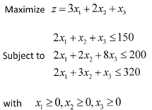
Example

Slide 10
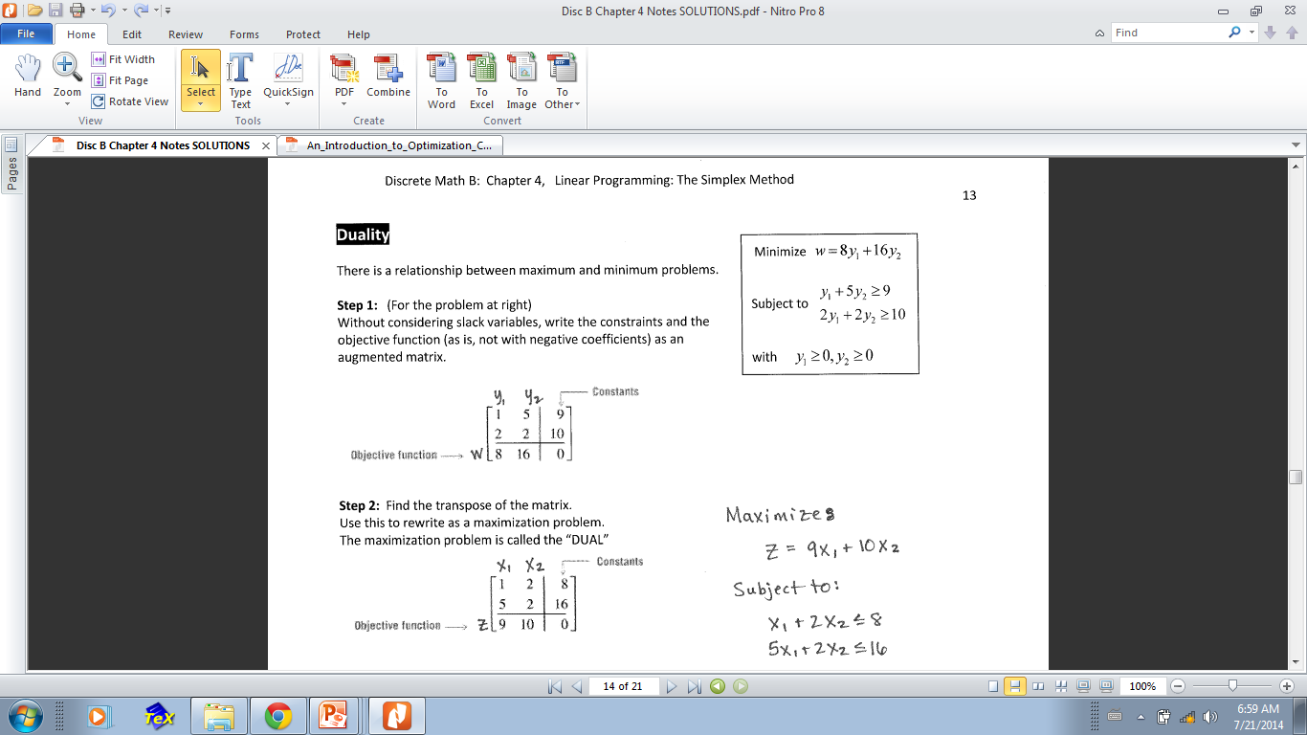
Duality and minimum problem

Slide 12
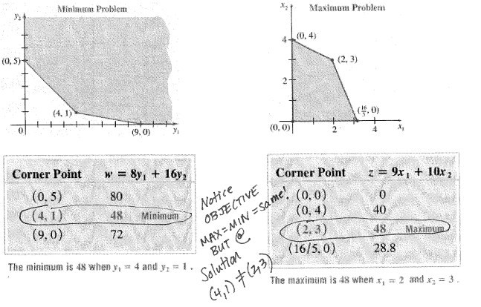
Graphical Description

Slide 13
Solution

Slide 17
Summary

Slide 18
Thank You

