Slide 1
MTH374: Optimization
For
Master of Mathematics
By
Dr. M. Fazeel Anwar
Assistant Professor
Department of Mathematics, CIIT Islamabad

Slide 2
Lecture 23

Slide 3
Recap
Simplex method

Slide 4
Today’s Topics
More examples of Simplex method

Slide 5
Notes on the Simplex tableau
1. In any simplex tableau, the objective function row (Z row) is always in terms of the nonbasic variables. This means that under any basic variable (in any tableau) there is a zero in the Z row. For the non basic there is no condition ( it can take any value in this row).
2. If there is a zero under one or more nonbasic variables in the last tableau (optimal solution tableau), then there is a multiple optimal solution.
3. When determining the leaving variable of any tableau, if there is no positive ratio (all the entries in the pivot column are negative and zeroes), then the solution is unbounded.
4. If there is a tie (more than one variables have the same most negative or positive) in determining the entering variable, choose any variable to be the entering one.
5. If there is a tie in determining the leaving variable, choose any one to be the leaving variable. In this case a zero will appear in RHS column; therefore, a “cycle” will occur, this means that the value of the objective function will be the same for several iterations.
6. A Solution that has a basic variable with zero value is called a “degenerate solution”.

Slide 6
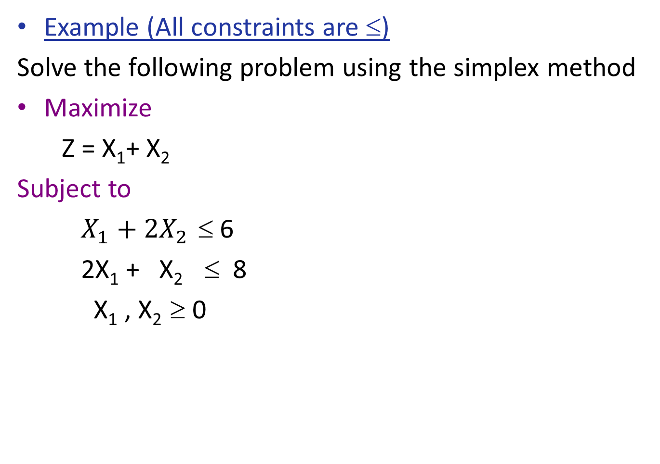
Example
Example (All constraints are ≤)
Solve the following problem using the simplex method
Maximize
Z = X₁+ X₂
Subject to
$X_{1}+2X_{2}$ ≤ 6
2X₁ + X₂ ≤ 8
X₁ , X₂ ≥ 0

Slide 12
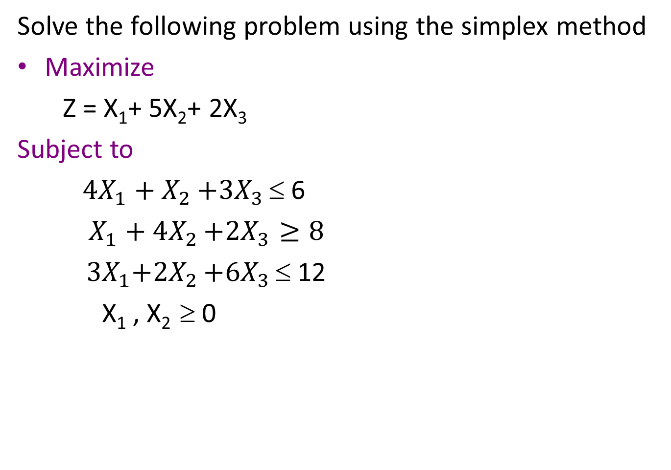
Example
Solve the following problem using the simplex method
Maximize
Z = X₁+ 5X₂+ 2X₃
Subject to
${4X}_{1}+X_{2}$ $+{3X}_{3}$ ≤ 6
$X_{1}+4X_{2}$ $+{2X}_{3}≥8$
${ 3X}_{1}+{2X}_{2}$ $+{6X}_{3}$ ≤ 12
X₁ , X₂ ≥ 0

Slide 19
Summary

Slide 20
Thank You

