Slide 1
MTH374: Optimization
For
Master of Mathematics
By
Dr. M. Fazeel Anwar
Assistant Professor
Department of Mathematics, CIIT Islamabad

Slide 2
Lecture 22

Slide 3
Recap
Graphical method
Corner point method

Slide 4
Today’s Topics
Simplex method

Slide 5
Simplex Method
Simplex: a linear-programming algorithm that can solve problems having more than two decision variables.
The simplex technique involves generating a series of solutions in tabular form, called tableaus. By inspecting the bottom row of each tableau, one can immediately tell if it represents the optimal solution. Each tableau corresponds to a corner point of the feasible solution space. The first tableau corresponds to the origin. Subsequent tableaus are developed by shifting to an adjacent corner point in the direction that yields the highest (smallest) rate of profit (cost). This process continues as long as a positive (negative) rate of profit (cost) exists.

Slide 6
Simplex Algorithm
The key solution concepts
Solution Concept 1: the simplex method focuses on CPF solutions.
Solution concept 2: the simplex method is an iterative algorithm (a systematic solution procedure that keeps repeating a fixed series of steps, called, an iteration, until a desired result has been obtained) with the following structure:

Slide 7
Simplex algorithm
Initialization: setup to start iterations, including finding an initial CPF solution
Optimality test: is the current CPF solution optimal?
if no if yes stop
Iteration: Perform an iteration to find a better CFP solution

Slide 8
Simplex algorithm
Solution concept 3: whenever possible, the initialization of the simplex method chooses the origin point (all decision variables equal zero) to be the initial CPF solution.
Solution concept 4: given a CPF solution, it is much quicker computationally to gather information about its adjacent CPF solutions than about other CPF solutions. Therefore, each time the simplex method performs an iteration to move from the current CPF solution to a better one, it always chooses a CPF solution that is adjacent to the current one.

Slide 9
Simplex algorithm
Solution concept 5: After the current CPF solution is identified, the simplex method examines each of the edges of the feasible region that emanate from this CPF solution. Each of these edges leads to an adjacent CPF solution at the other end, but the simplex method doesn’t even take the time to solve for the adjacent CPF solution. Instead it simply identifies the rate of improvement in Z that would be obtained by moving along the edge. And then chooses to move along the one with largest positive rate of improvement.

Slide 10
Simplex algorithm
Solution concept 6: A positive rate of improvement in Z implies that the adjacent CPF solution is better than the current one, whereas a negative rate of improvement in Z implies that the adjacent CPF solution is worse. Therefore, the optimality test consists simply of checking whether any of the edges give a positive rate of improvement in Z. if none do, then the current CPF solution is optimal.

Slide 11
The simplex method in tabular form
Steps:
1. Initialization:
a. transform all the constraints to equality by introducing slack, surplus, and artificial variables as follows:
Constraint type | Variable to be added
≥ | + slack (s)
≤ | - Surplus (s)

Slide 12
Simplex method in tabular form
b. Construct the initial simplex tableau
Basic variable | X₁ | … | X_{n} | S₁ | …... | S_{n} | RHS
S | Coefficient of the constraints |  |  |  |  |  | b₁
Z | Objective function coefficient In different signs |  |  |  |  |  | Z value

Slide 13
Simplex method in tabular form
2. Test for optimality:
Case 1: Maximization problem
the current BF solution is optimal if every coefficient in the objective function row is nonnegative
Case 2: Minimization problem
the current BF solution is optimal if every coefficient in the objective function row is nonpositive

Slide 14
Simplex method in tabular form
3. Iteration
Step 1: determine the entering basic variable by selecting the variable (automatically a nonbasic variable) with the most negative value (in case of maximization) or with the most positive (in case of minimization) in the last row (Z-row). Put a box around the column below this variable, and call it the “pivot column”

Slide 15
Simplex method in tabular form
Step 2: Determine the leaving basic variable by applying the minimum ratio test as following:
1. Pick out each coefficient in the pivot column that is strictly positive (>0)
2. Divide each of these coefficients into the right hand side entry for the same row
3. Identify the row that has the smallest of these ratios
4. The basic variable for that row is the leaving variable, so replace that variable by the entering variable in the basic variable column of the next simplex tableau. Put a box around this row and call it the “pivot row”

Slide 16
Simplex method in tabular form
Step 3: Solve for the new BF solution by using elementary row operations (multiply or divide a row by a nonzero constant; add or subtract a multiple of one row to another row) to construct a new simplex tableau, and then return to the optimality test. The specific elementary row operations are:
Divide the pivot row by the “pivot number” (the number in the intersection of the pivot row and pivot column)
For each other row that has a negative coefficient in the pivot column, add to this row the product of the absolute value of this coefficient and the new pivot row.
For each other row that has a positive coefficient in the pivot column, subtract from this row the product of the absolute value of this coefficient and the new pivot row.

Slide 17
Simplex method
Example (All constraints are ≤)
Solve the following problem using the simplex method
Maximize
Z = 3X₁+ 5X₂
Subject to
X₁ ≤ 4
2 X₂ ≤ 12
3X₁ +2X₂ ≤ 18
X₁ , X₂ ≥ 0

Slide 18
Simplex method
Solution
Initialization
Standard form
Maximize Z,
Subject to
  Z - 3X₁- 5X₂ = 0
  X₁ + S₁ = 4
  2 X₂ + S₂ = 12
  3X₁ +2X₂ + S₃ = 18
  X₁ , X₂, S₁, S₂, S₃ ≥ 0
Sometimes it is called the augmented form of the problem because the original form has been augmented by some supplementary variables needed to apply the simplex method

Slide 23
Definitions
A basic solution is an augmented corner point solution.
A basic solution has the following properties:
Each variable is designated as either a nonbasic variable or a basic variable.
The number of basic variables equals the number of functional constraints. Therefore, the number of nonbasic variables equals the total number of variables minus the number of functional constraints.
The nonbasic variables are set equal to zero.
The values of the basic variables are obtained as simultaneous solution of the system of equations (functional constraints in augmented form). The set of basic variables are called “basis”
If the basic variables satisfy the nonnegativity constraints, the basic solution is a Basic Feasible (BF) solution.

Slide 24
Initial tableau
Entering variable
2. Initial tableau
Basic variable | X₁ | X₂ | S₁ | S₂ | S₃ | RHS
S₁ | 1 | 0 | 1 | 0 | 0 | 4
S₂ | 0 | 2 | 0 | 1 | 0 | 12
S₃ | 3 | 2 | 0 | 0 | 1 | 18
Z | -3 | -5 | 0 | 0 | 0 | 0
Leaving variable
Pivot row
Pivot column
Pivot number

Slide 25
Simplex tableau
Notes:
The basic feasible solution at the initial tableau is (0, 0, 4, 12, 18) where:
X₁ = 0, X₂ = 0, S₁ = 4, S₂ = 12, S₃ = 18, and Z = 0
Where S₁, S₂, and S₃ are basic variables
X₁ and X₂ are nonbasic variables
The solution at the initial tableau is associated to the origin point at which all the decision variables are zero.

Slide 26
Optimality test
By investigating the last row of the initial tableau, we find that there are some negative numbers. Therefore, the current solution is not optimal

Slide 27
Iteration
Step 1: Determine the entering variable by selecting the variable with the most negative in the last row.
From the initial tableau, in the last row (Z row), the coefficient of X₁ is -3 and the coefficient of X₂ is -5; therefore, the most negative is -5. consequently, X₂ is the entering variable.
X₂ is surrounded by a box and it is called the pivot column

Slide 28
Iteration
Step 2: Determining the leaving variable by using the minimum ratio test as following:
Basic variable | Entering variable X₂ (1) | RHS (2) | Ratio (2)÷(1)
S₁ | 0 | 4 | None
S₂ Leaving | 2 | 12 | 6 Smallest ratio
S3 | 2 | 18 | 9

Slide 29
Iteration
Step 3: solving for the new BF solution by using the eliminatory row operations as following:
New pivot row = old pivot row ÷ pivot number
Basic variable | X₁ | X₂ | S₁ | S₂ | S₃ | RHS
S₁
X₂ | 0 | 1 | 0 | 1/2 | 0 | 6
S₃
Z
Note that X₂ becomes in the basic variables list instead of S₂

Slide 30
iteration
2. Apply the Gauss-Jordan elimination on the pivot column
Substitute this values in the table

Slide 31
Iteration
This solution is not optimal, since there is a negative numbers in the last row
Basic variable | X₁ | X₂ | S₁ | S₂ | S₃ | RHS
S₁ | 1 | 0 | 1 | 0 | 0 | 4
X₂ | 0 | 1 | 0 | 1/2 | 0 | 6
S₃ | 3 | 0 | 0 | -1 | 1 | 6
Z | -3 | 0 | 0 | 5/2 | 0 | 30
The smallest ratio is 6/3 =2; therefore, S₃ is the leaving variable
The most negative value; therefore, X₁ is the entering variable

Slide 32
Iteration
Apply the same rules we will obtain this solution:
Basic variable | X₁ | X₂ | S₁ | S₂ | S₃ | RHS
S₁ | 0 | 0 | 1 | 1/3 | -1/3 | 2
X₂ | 0 | 1 | 0 | 1/2 | 0 | 6
X1 | 1 | 0 | 0 | -1/3 | 1/3 | 2
Z | 0 | 0 | 0 | 3/2 | 1 | 36
This solution is optimal; since there is no negative solution in the last row: basic variables are X₁ = 2, X₂ = 6 and S₁ = 2; the nonbasic variables are S₂ = S₃ = 0
Z = 36

Slide 33
Special cases of linear programming
Infeasible solution
Multiple solution (infinitely many solution)
Unbounded solution
Degenerated solution

Slide 34
Notes on the Simplex tableau
1. In any simplex tableau, the objective function row (Z row) is always in terms of the nonbasic variables. This means that under any basic variable (in any tableau) there is a zero in the Z row. For the non basic there is no condition ( it can take any value in this row).
2. If there is a zero under one or more nonbasic variables in the last tableau (optimal solution tableau), then there is a multiple optimal solution.
3. When determining the leaving variable of any tableau, if there is no positive ratio (all the entries in the pivot column are negative and zeroes), then the solution is unbounded.
4. If there is a tie (more than one variables have the same most negative or positive) in determining the entering variable, choose any variable to be the entering one.
5. If there is a tie in determining the leaving variable, choose any one to be the leaving variable. In this case a zero will appear in RHS column; therefore, a “cycle” will occur, this means that the value of the objective function will be the same for several iterations.
6. A Solution that has a basic variable with zero value is called a “degenerate solution”.

Slide 35
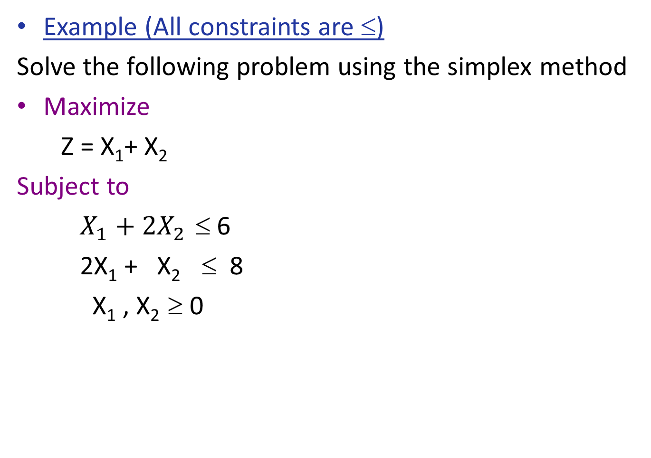
Example
Example (All constraints are ≤)
Solve the following problem using the simplex method
Maximize
Z = X₁+ X₂
Subject to
$X_{1}+2X_{2}$ ≤ 6
2X₁ + X₂ ≤ 8
X₁ , X₂ ≥ 0

Slide 40
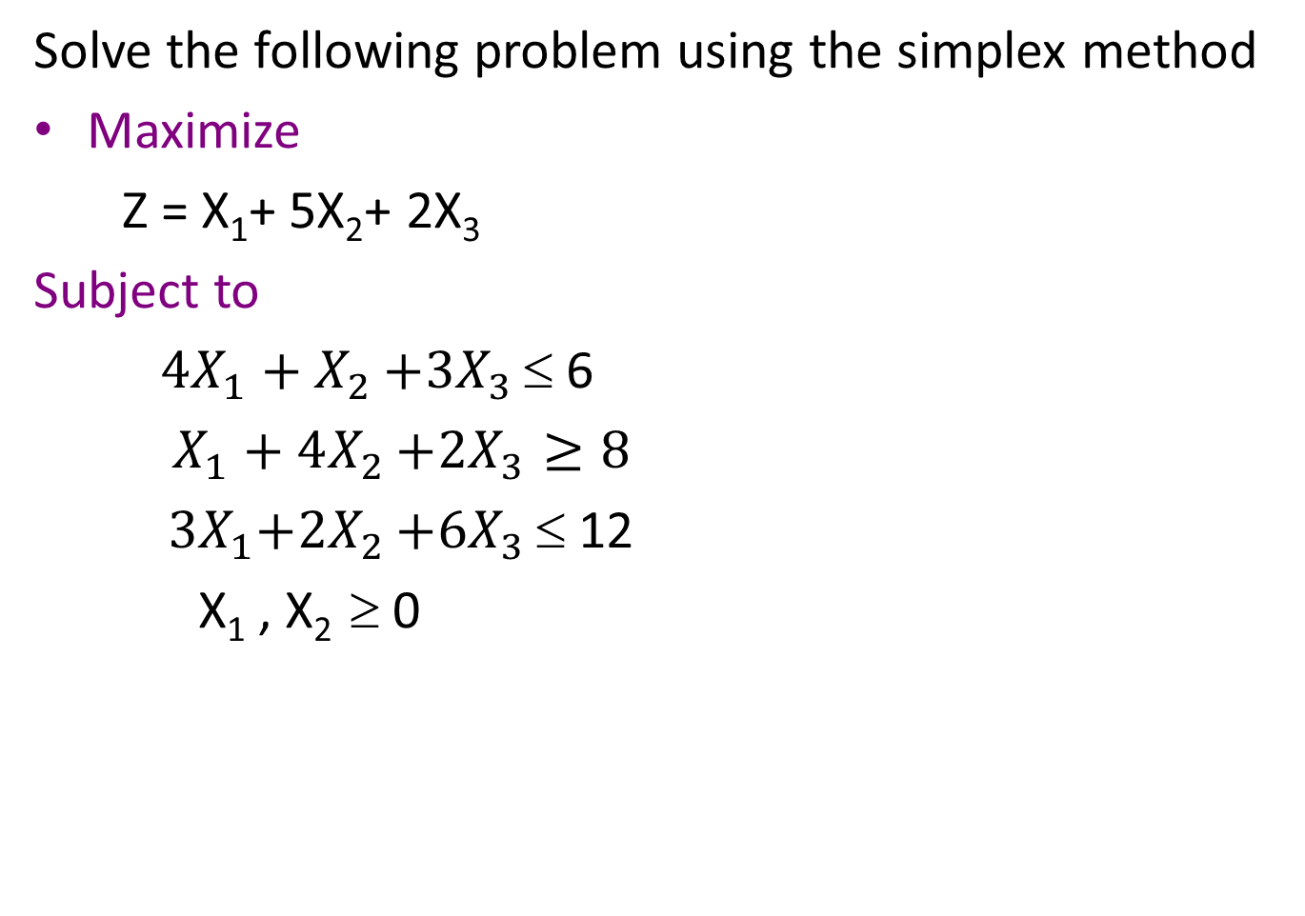
Example
Solve the following problem using the simplex method
Maximize
Z = X₁+ 5X₂+ 2X₃
Subject to
${4X}_{1}+X_{2}$ $+{3X}_{3}$ ≤ 6
$X_{1}+4X_{2}$ $+{2X}_{3}≥8$
${ 3X}_{1}+{2X}_{2}$ $+{6X}_{3}$ ≤ 12
X₁ , X₂ ≥ 0

Slide 45
Summary

Slide 46
Thank You

