Slide 1
MTH374: Optimization
For
Master of Mathematics
By
Dr. M. Fazeel Anwar
Assistant Professor
Department of Mathematics, CIIT Islamabad

Slide 2
Lecture 21

Slide 3
Recap
Linear programing
Convex set
Graphical method

Slide 4
Today’s Topics
Graphical method
Simplex method

Slide 5
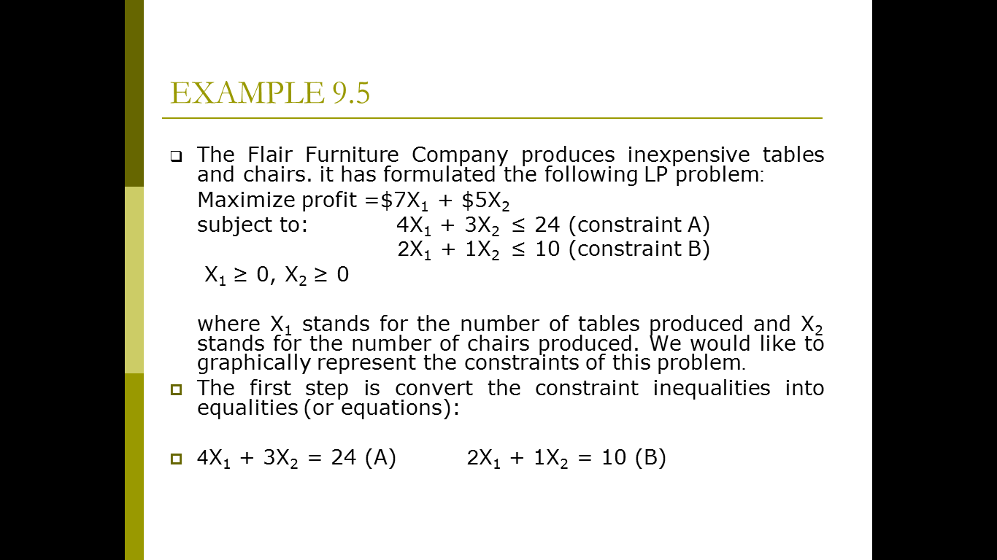
Graphical method-I

Slide 6
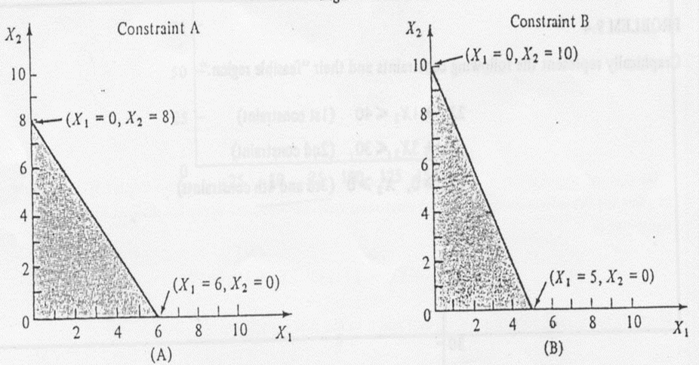

Slide 7
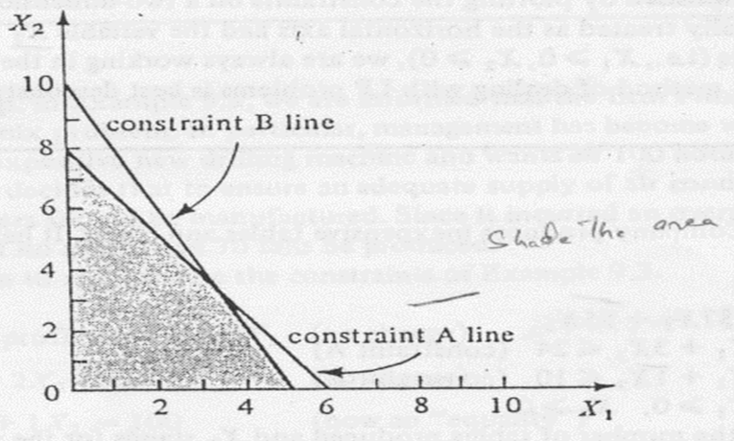

Slide 8
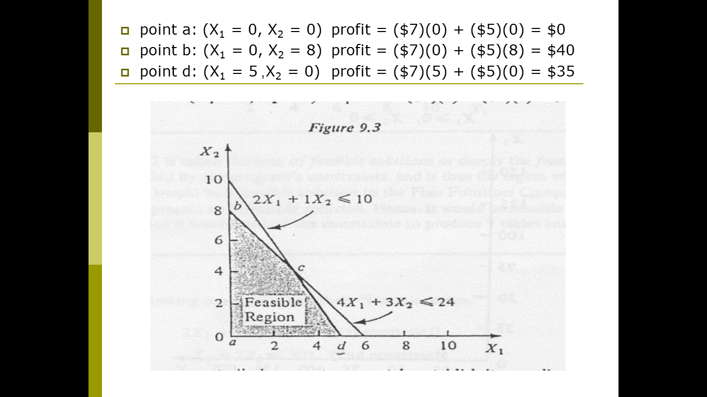

Slide 9
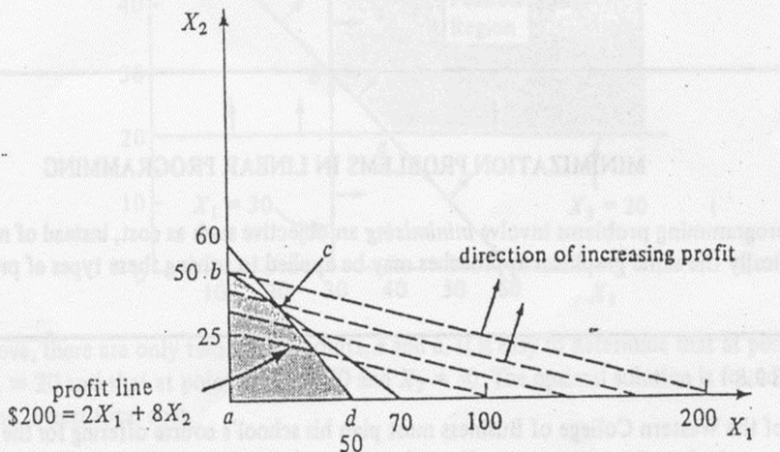

Slide 10
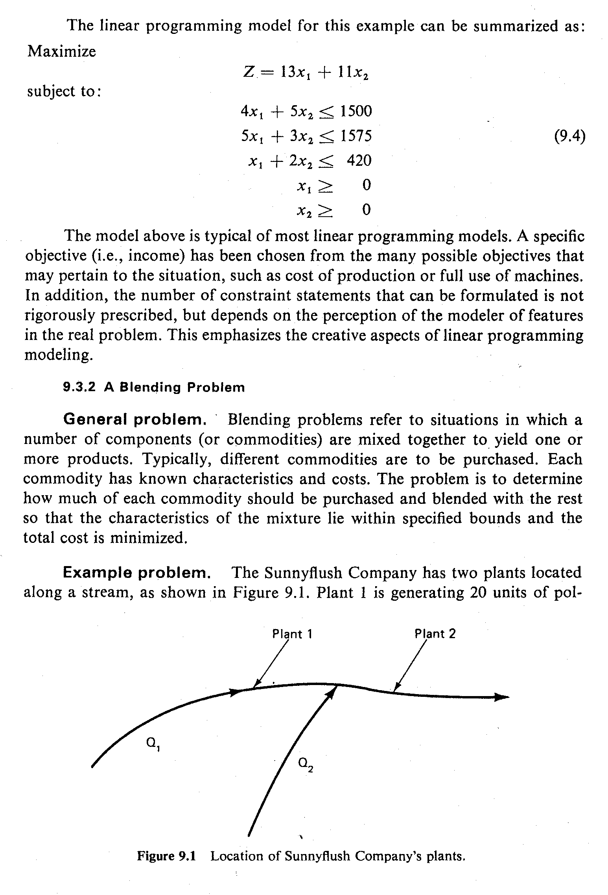
Graphical method-II

Slide 11
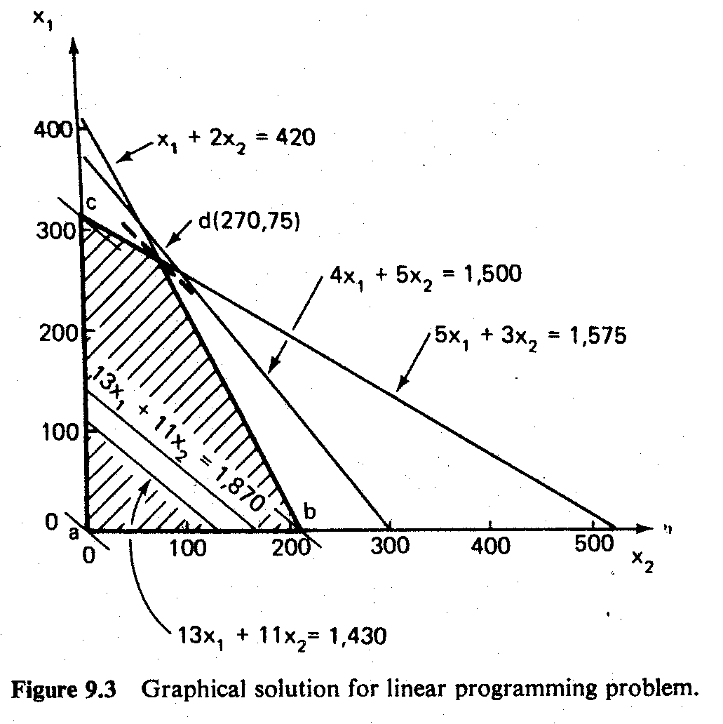

Slide 14
Graphical method-III

Slide 15
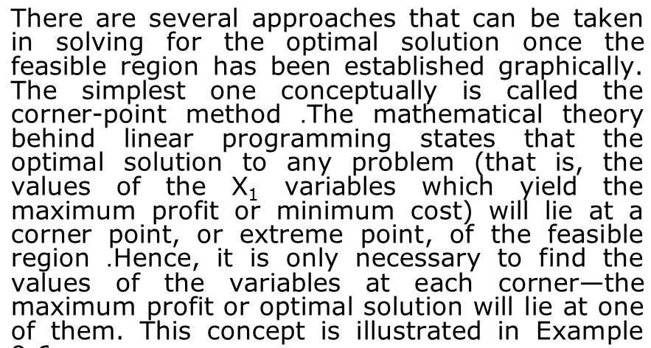
Corner point approach

Slide 18
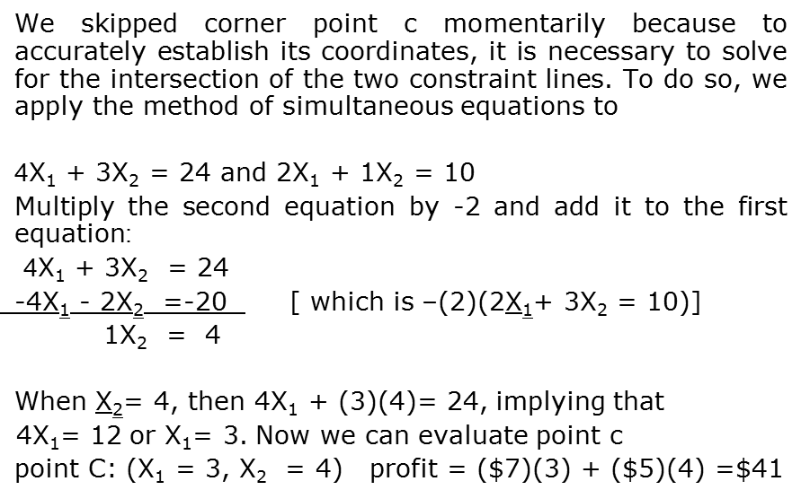

Slide 21
Example-II

Slide 25
Summary

Slide 26
Thank You

