Slide 1
MTH374: Optimization
For
Master of Mathematics
By
Dr. M. Fazeel Anwar
Assistant Professor
Department of Mathematics, CIIT Islamabad

Slide 2
Lecture 20

Slide 3
Recap
Constrained optimization
Linear programing

Slide 4
Today’s Topics
Linear programing
Introduction to solution
Convex sets
Graphical method

Slide 5
Linear programming problem
Linear objective and constraint functions:

Slide 6
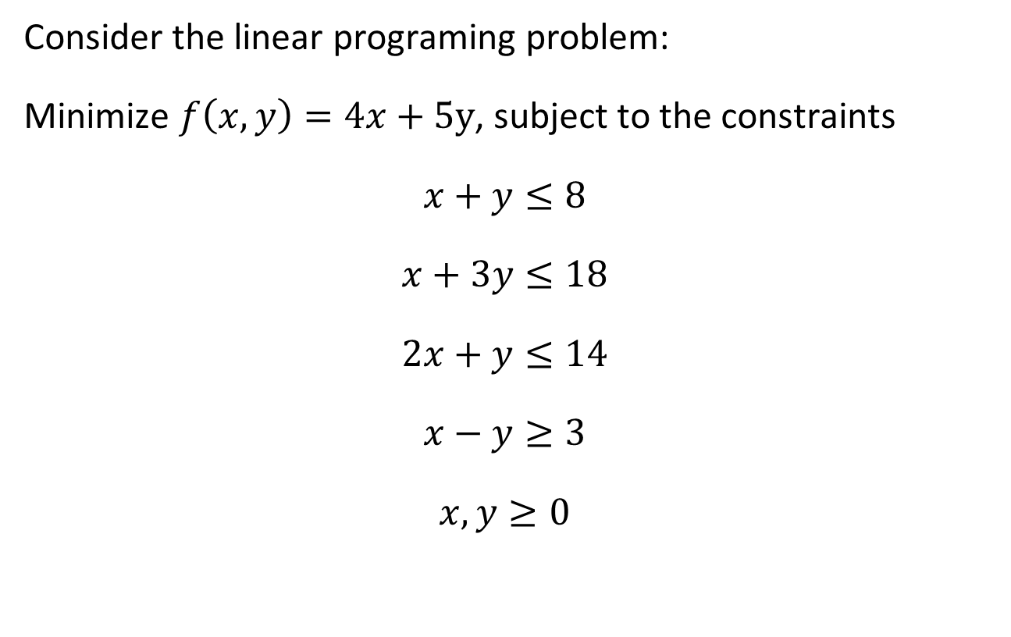
Slack and Surplus variables
Consider the linear programing problem:
Minimize $f\left(x,y\right)=4x+5y$, subject to the constraints
$$x+y≤8$$
$$x+3y≤18$$
$$2x+y≤14$$
$$x−y≥3$$
$$x,y≥0$$

Slide 7
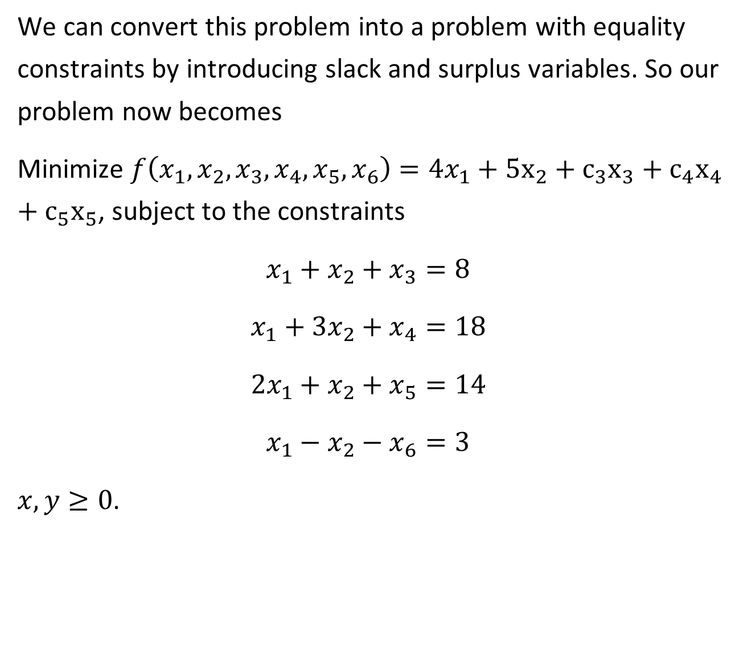
We can convert this problem into a problem with equality constraints by introducing slack and surplus variables. So our problem now becomes
Minimize $f\left(x_{1},x_{2},x_{3},x_{4},x_{5},x_{6}\right)=4x_{1}+5x_{2}+c_{3}x_{3}+c_{4}x_{4}+c_{5}x_{5}$, subject to the constraints
$$x_{1}+x_{2}+x_{3}=8$$
$$x_{1}+3x_{2}+x_{4}=18$$
$$2x_{1}+x_{2}+x_{5}=14$$
$$x_{1}−x_{2}−x_{6}=3$$
$x,y≥0$.

Slide 8
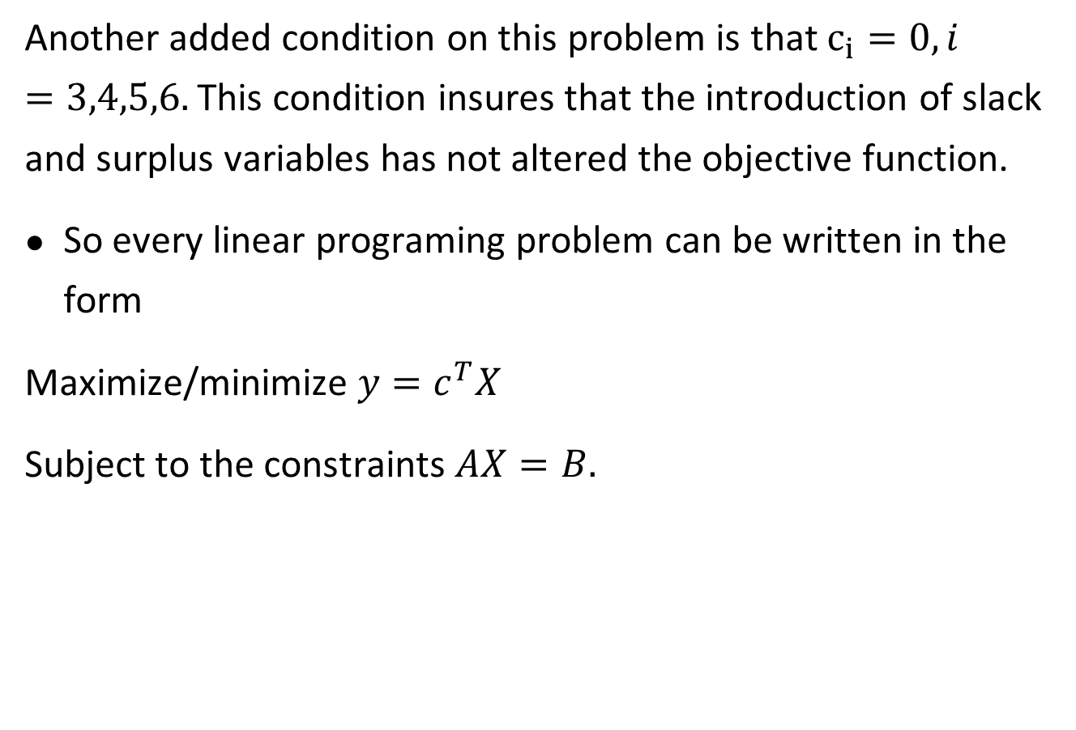
Another added condition on this problem is that $c_{i}=0, i=3,4,5,6.$ This condition insures that the introduction of slack and surplus variables has not altered the objective function.
So every linear programing problem can be written in the form
Maximize/minimize $y=c^{T}X$
Subject to the constraints $AX=B.$

Slide 11
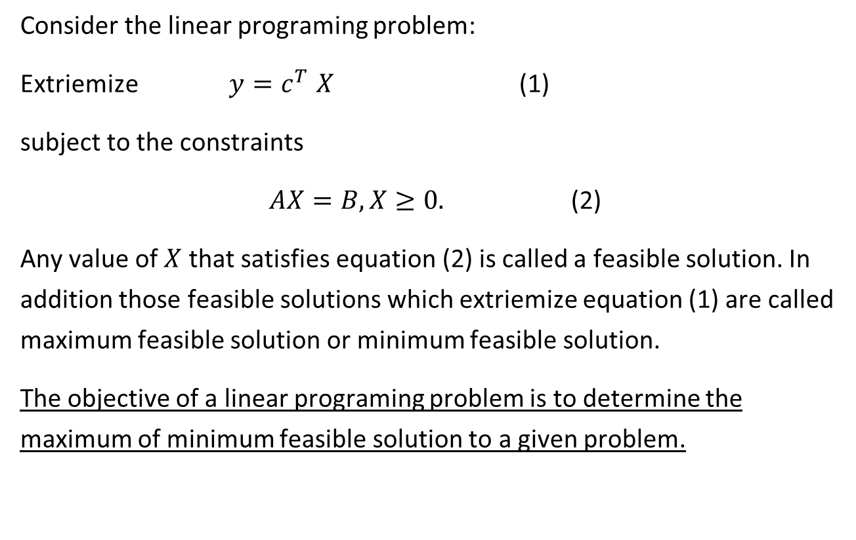
Feasible solution
Consider the linear programing problem:
Extriemize$y{=c}^{T}X$ (1)
subject to the constraints
$AX=B, X≥0.$ (2)
Any value of $X$ that satisfies equation (2) is called a feasible solution. In addition those feasible solutions which extriemize equation (1) are called maximum feasible solution or minimum feasible solution.
The objective of a linear programing problem is to determine the maximum of minimum feasible solution to a given problem.

Slide 12

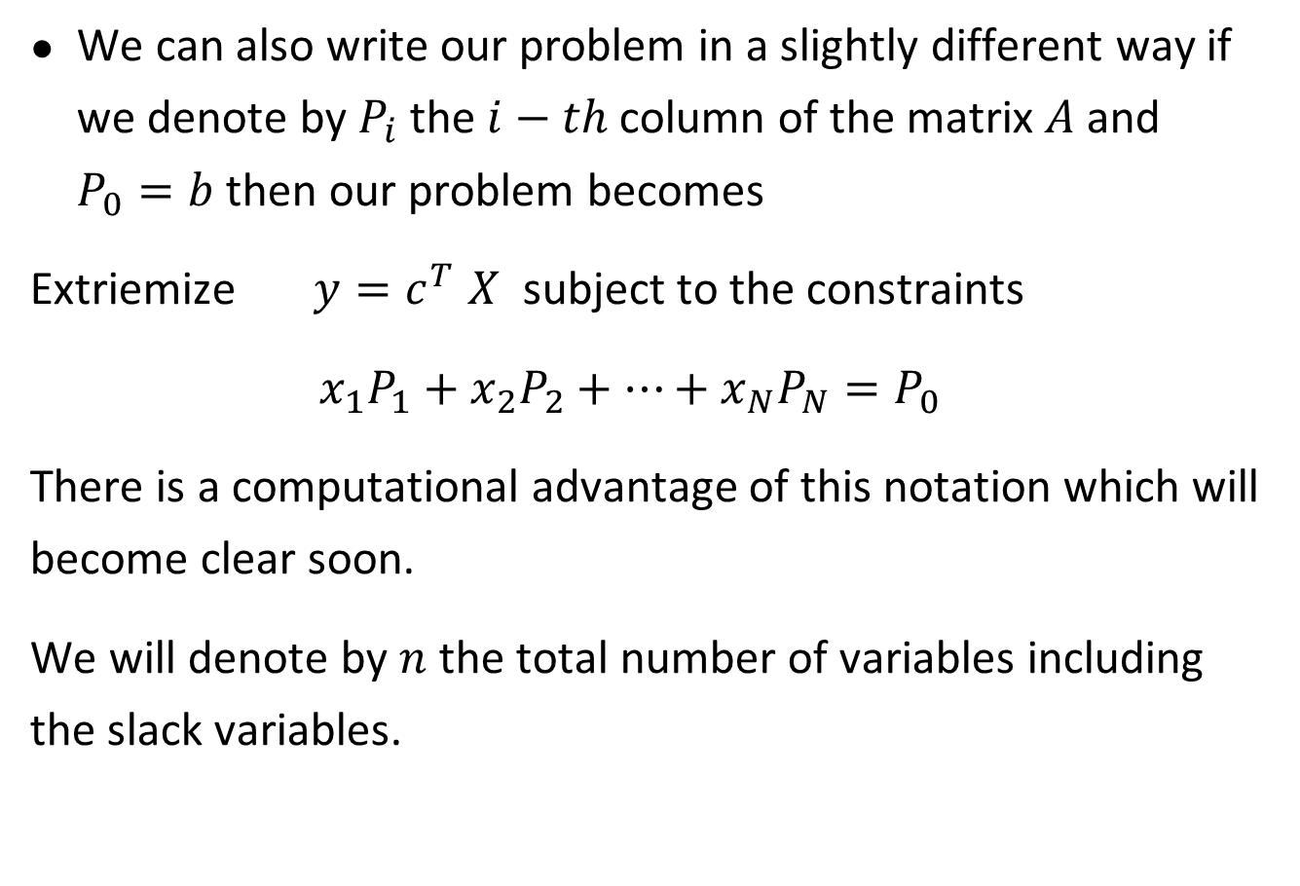
Decomposition of matrix $A$
We can also write our problem in a slightly different way if we denote by $P_{i}$ the $i−th$column of the matrix $A$and $P_{0}=b$ then our problem becomes
Extriemize$y{=c}^{T}X$ subject to the constraints
$$x_{1}P_{1}+x_{2}P_{2}+…+x_{N}P_{N}=P_{0}$$
There is a computational advantage of this notation which will become clear soon.
We will denote by $n$ the total number of variables including the slack variables.

Slide 13
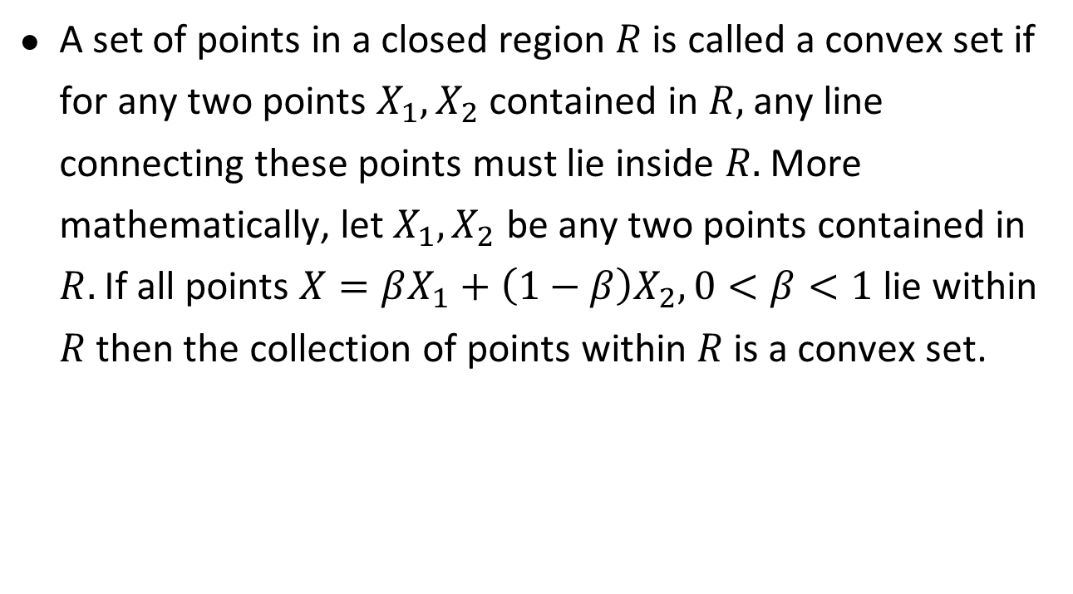
Convex set
A set of points in a closed region $R$ is called a convex set if for any two points $X_{1}, X_{2}$ contained in $R,$any line connecting these points must lie inside $R.$ More mathematically, let $X_{1},X_{2}$ be any two points contained in $R.$ If all points $X=βX_{1}+\left(1−β\right)X_{2}, 0<β<1$ lie within $R$then the collection of points within $R$ is a convex set.

Slide 15
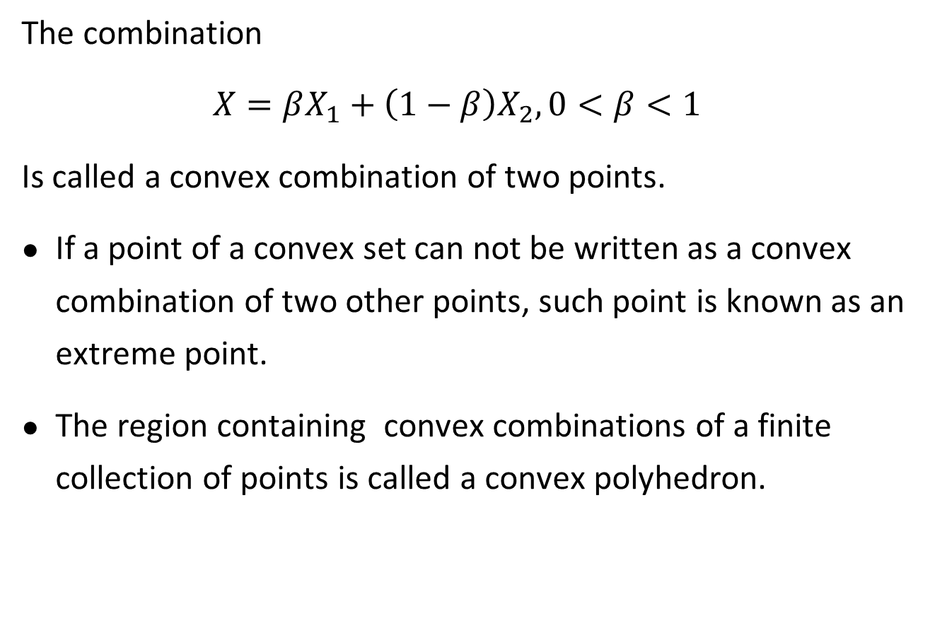
The combination
$$X=βX_{1}+\left(1−β\right)X_{2}, 0<β<1$$
Is called a convex combination of two points.
If a point of a convex set can not be written as a convex combination of two other points, such point is known as an extreme point.
The region containing convex combinations of a finite collection of points is called a convex polyhedron.

Slide 16
Graphical method-I

Slide 18
Graphical method-II

Slide 20
Graphical method-III

Slide 21
Summary

Slide 22
Thank You

