Slide 1
MTH374: Optimization
For
Master of Mathematics
By
Dr. M. Fazeel Anwar
Assistant Professor
Department of Mathematics, CIIT Islamabad

Slide 2
Lecture 02

Slide 3
Recap
Introduction
Why do we need optimization?
Some important optimization problems

Slide 4
Introduction
Optimization is the art of obtaining best policies to satisfy certain objectives while at the same time satisfying fixed requirements.
Effective decision making both in personal and professional capacity
Choosing the best possible option

Slide 5
Introduction (Cont…)
In this course we will learn how to transform certain practical problems into mathematics.
We will also study some mathematical techniques that will help us solve these problems
This course will show us how the concepts of calculus, linear algebra and other branches of mathematics can be applied in real life
In short we are trying to make the art of effective decision making into a science.

Slide 6
Optimization problems
Finding the shortest route
Finding the quickest route
Finding the best route under desired conditions
Making an investment decision
Maximizing profit
Minimizing risk
Maximizing stock
Designing an airplane with minimum weight and desired capacity.

Slide 7
More Optimization problems
Best possible utilization of resources
Optimize production within the constraints
Minimize labor while obtaining desired results
Deployment of army to minimize damage by an army attack

Slide 8
Today’s Topics
Mathematical models
Variables and objective functions
Some optimization from calculus

Slide 9
Mathematical Model
A mathematical model is an abstract model that uses mathematical language to describe the behaviour of a system.
Mathematical models are used particularly in the natural sciences and engineering disciplines. They are used in the social sciences (such as economics, sociology and political science); physicists, engineers, computer scientists, and economists use mathematical models most extensively.
Eykhoff (1974) defined a mathematical model as 'a representation of the essential aspects of an existing system (or a system to be constructed) which presents knowledge of that system in usable form'.

Slide 10
Example
A rectangular plot of land is to be fenced in using two kinds of fencing. Two opposite sides will use heavy duty fencing selling for $3 a foot, while the remaining two sides will use standard fencing selling for $2 a foot. What are the dimensions of the rectangular plot of greatest area that can be fenced in at a cost of $6000?

Slide 12
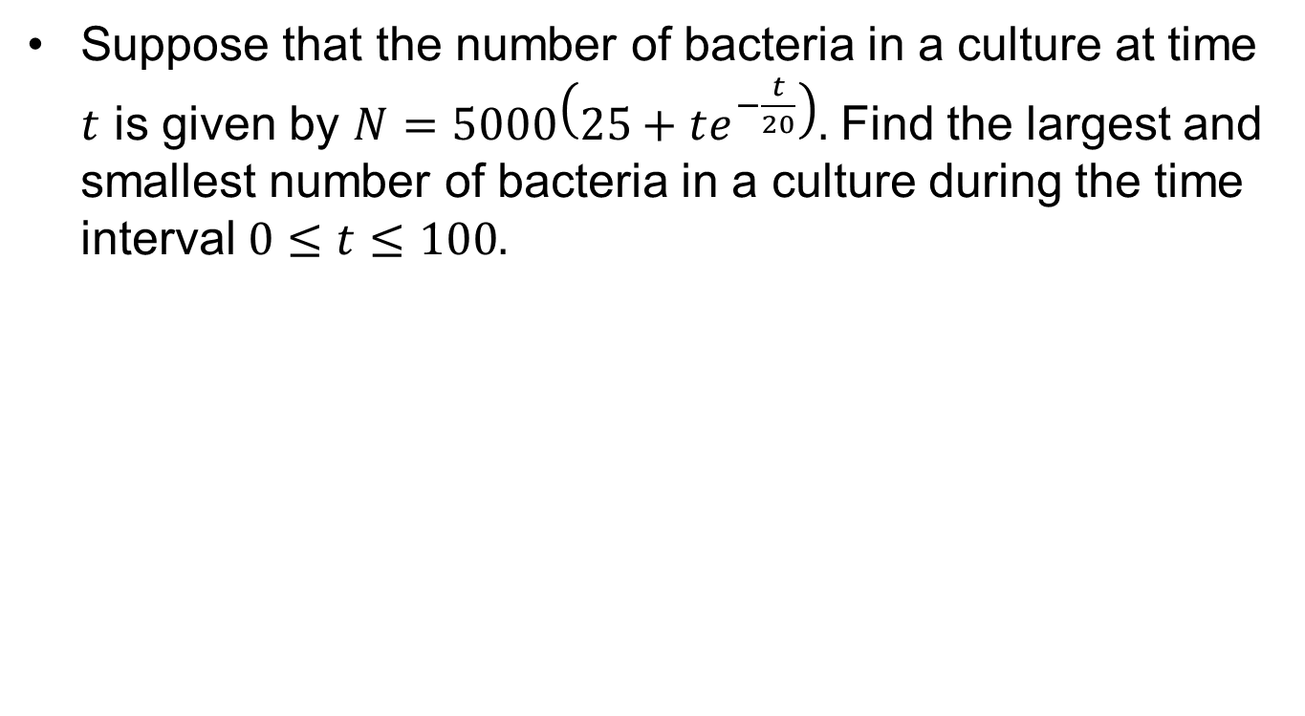
Example.
Suppose that the number of bacteria in a culture at time $t$ is given by $N=5000\left(25+te^{−\frac{t}{20}}\right).$ Find the largest and smallest number of bacteria in a culture during the time interval $0≤t≤100.$

Slide 13
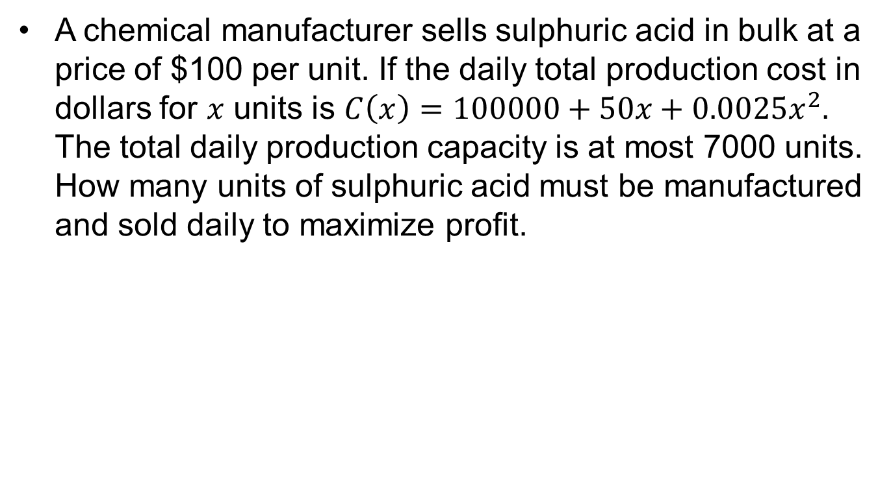
Example..
A chemical manufacturer sells sulphuric acid in bulk at a price of $100 per unit. If the daily total production cost in dollars for $x$ units is $C\left(x\right)=100000+50x+0.0025x^{2}.$ The total daily production capacity is at most 7000 units. How many units of sulphuric acid must be manufactured and sold daily to maximize profit.

Slide 15
Summary

Slide 16
Thank You

