Slide 1
MTH374: Optimization
For
Master of Mathematics
By
Dr. M. Fazeel Anwar
Assistant Professor
Department of Mathematics, CIIT Islamabad

Slide 2
Lecture 19

Slide 3
Recap
Steepest ascent/descent

Slide 4
Today’s Topics
Constrained optimization
Linear programing

Slide 5
Constrained optimization
Multivariable objective function with constraints
Both equality and inequality constraints
We will first focus on the problems where the objective function and the constraints are all linear
These problems are of very important practical significance
Some examples will be given in this lecture

Slide 6
Linear programming problem
Linear objective and constraint functions:

Slide 8
Practical linear programing problems

Slide 9
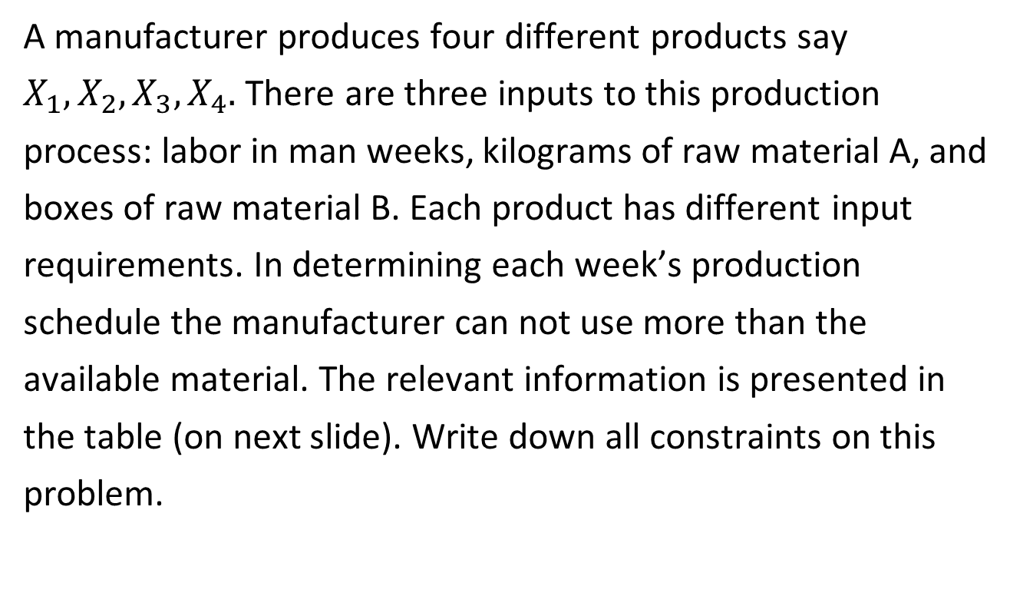
Manufacturing problem
A manufacturer produces four different products say $X_{1}, X_{2}, X_{3}, X_{4}.$ There are three inputs to this production process: labor in man weeks, kilograms of raw material A, and boxes of raw material B. Each product has different input requirements. In determining each week’s production schedule the manufacturer can not use more than the available material. The relevant information is presented in the table (on next slide). Write down all constraints on this problem.

Slide 10
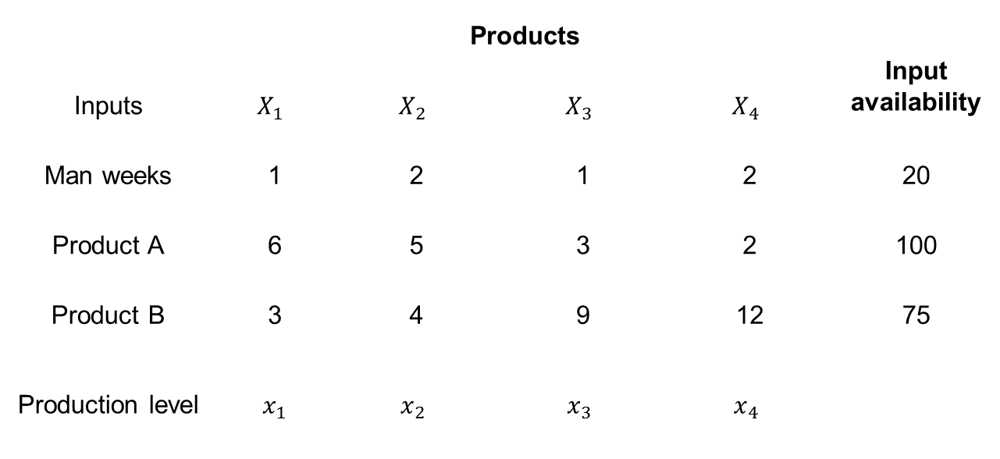
 | Products |  |  |  | Input availability
Inputs | $$X_{1}$$ | $$X_{2}$$ | $$X_{3}$$ | $$X_{4}$$
Man weeks | 1 | 2 | 1 | 2 | 20
Product A | 6 | 5 | 3 | 2 | 100
Product B | 3 | 4 | 9 | 12 | 75
Productionlevel | $x_{1}$ | $$x_{2}$$ | $$x_{3}$$ | $$x_{4}$$

Slide 12
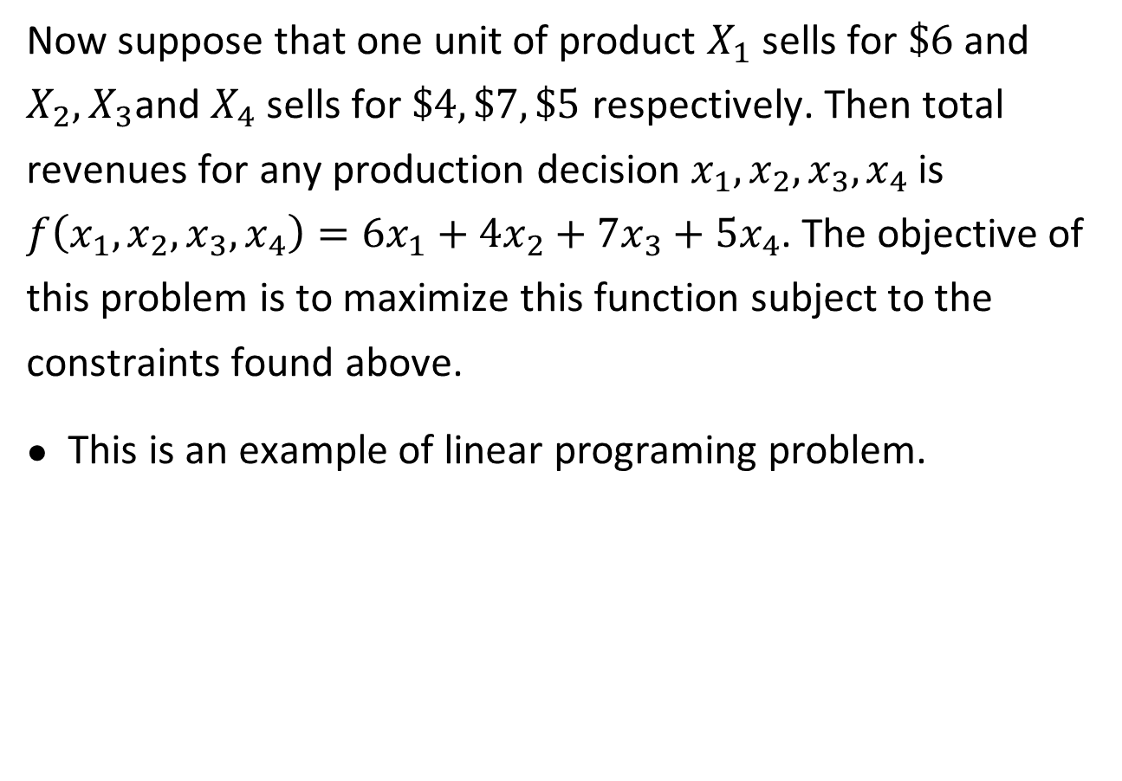
Now suppose that one unit of product $X_{1}$ sells for $\$6$ and $X_{2},X_{3}$and $X_{4}$ sells for $\$4, \$7, \$5$ respectively. Then total revenues for any production decision $x_{1},x_{2},x_{3},x_{4}$ is $f\left(x_{1},x_{2},x_{3},x_{4}\right)=6x_{1}+4x_{2}+7x_{3}+5x_{4}$. The objective of this problem is to maximize this function subject to the constraints found above.
This is an example of linear programing problem.

Slide 13
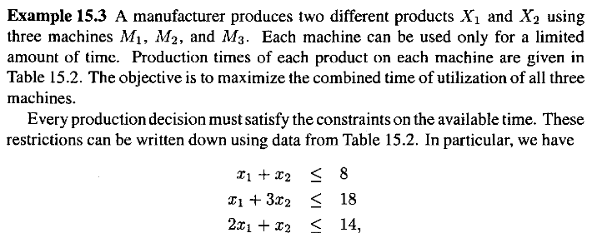
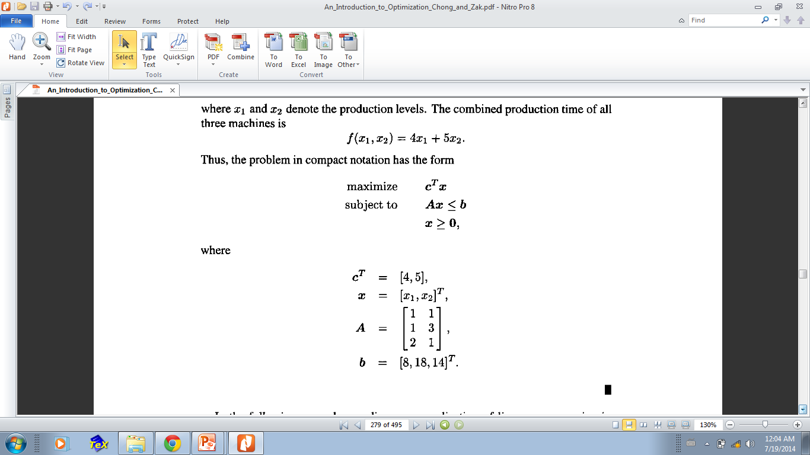

Slide 14
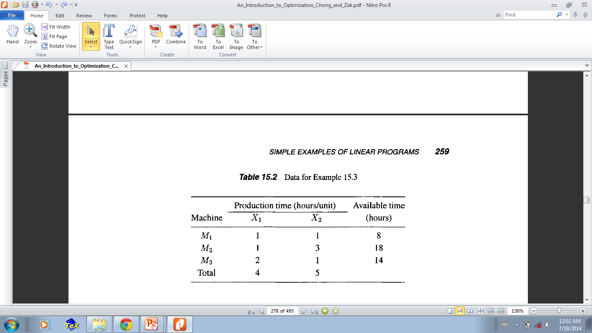

Slide 16
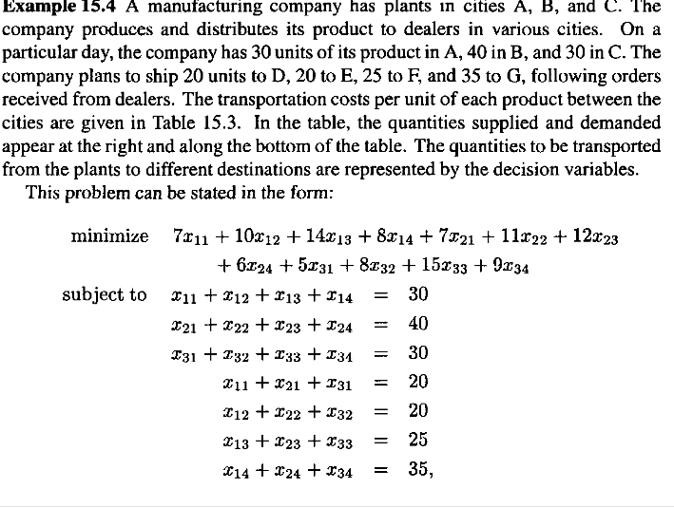

Slide 17
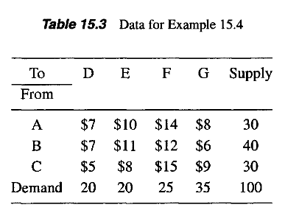

Slide 18
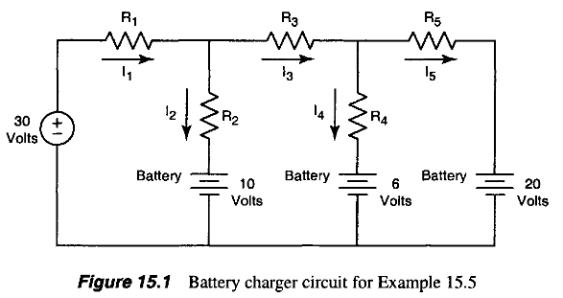

Slide 19
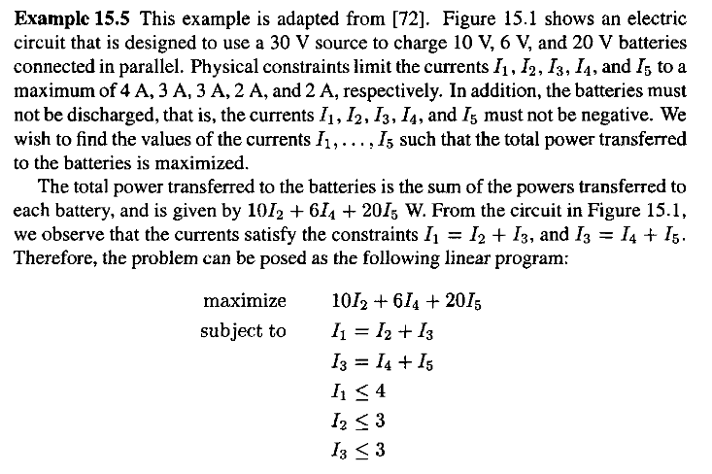

Slide 20
Summary

Slide 21
Thank You

