Slide 1
MTH374: Optimization
For
Master of Mathematics
By
Dr. M. Fazeel Anwar
Assistant Professor
Department of Mathematics, CIIT Islamabad

Slide 2
Lecture 18

Slide 3
Recap
Better version of Fibonacci search
Golden section search

Slide 4
Today’s Topics
Steepest ascent/descent

Slide 5
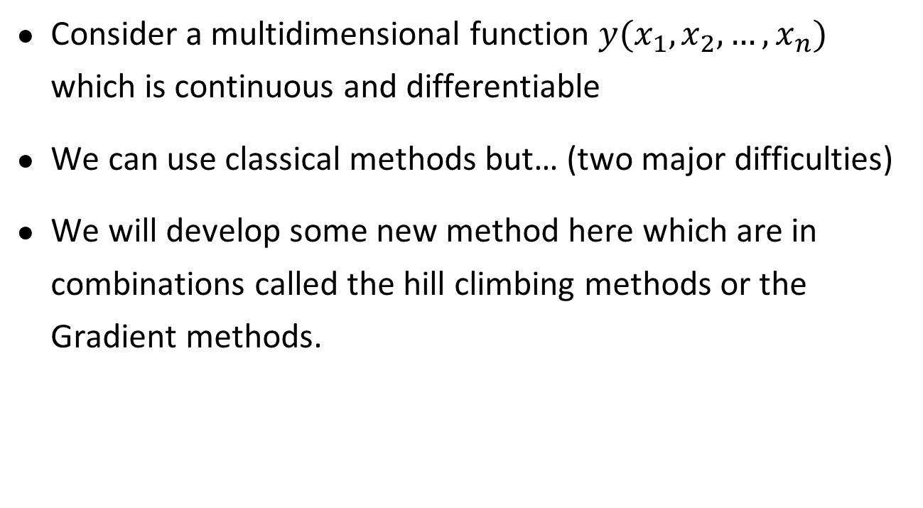
Multi-dimensional optimization by Gradient Methods
Consider a multidimensional function $y(x_{1}, x_{2}, …, x_{n})$ which is continuous and differentiable
We can use classical methods but… (two major difficulties)
We will develop some new method here which are in combinations called the hill climbing methods or the Gradient methods.

Slide 6
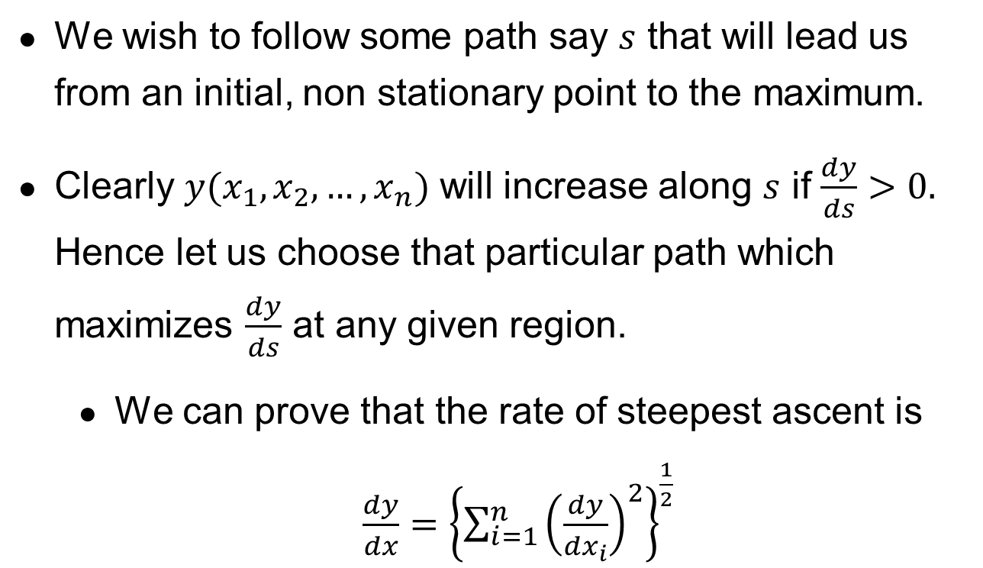
Steepest Ascent
We wish to follow some path say $s$ that will lead us from an initial, non stationary point to the maximum.
Clearly $y(x_{1},x_{2},…,x_{n})$ will increase along $s$ if $\frac{dy}{ds}>0.$ Hence let us choose that particular path which maximizes $\frac{dy}{ds}$ at any given region.
We can prove that the rate of steepest ascent is $\frac{dy}{dx}={\left\{\sum_{i=1}^{n}{{\left(\frac{dy}{dx_{i}}\right)}^{2}}\right\}}^{\frac{1}{2}}$

Slide 7
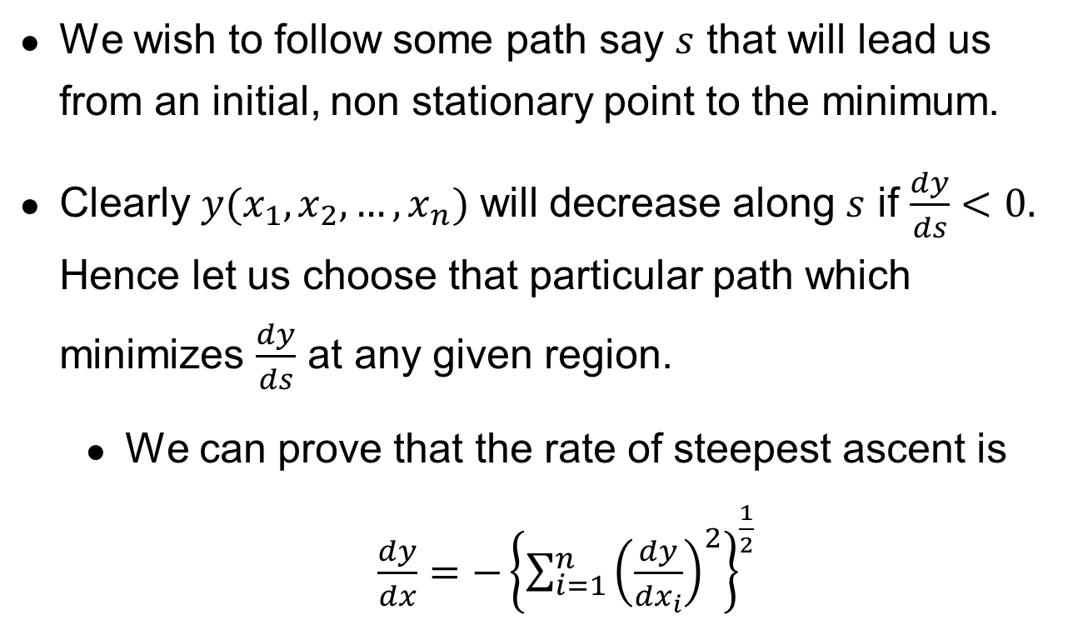
Steepest Descent
We wish to follow some path say $s$ that will lead us from an initial, non stationary point to the minimum.
Clearly $y(x_{1},x_{2},…,x_{n})$ will decrease along $s$ if $\frac{dy}{ds}<0.$ Hence let us choose that particular path which minimizes $\frac{dy}{ds}$ at any given region.
We can prove that the rate of steepest ascent is $\frac{dy}{dx}=−{\left\{\sum_{i=1}^{n}{{\left(\frac{dy}{dx_{i}}\right)}^{2}}\right\}}^{\frac{1}{2}}$

Slide 8
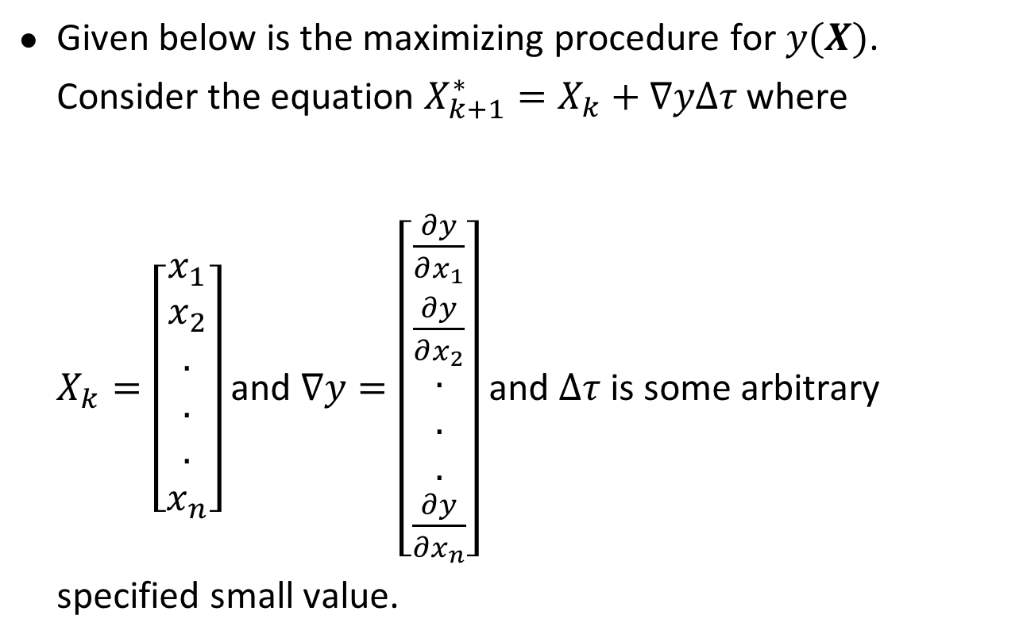
Numerical procedure for hill climbing
Given below is the maximizing procedure for $y(X)$. Consider the equation $X_{k+1}^{∗}=X_{k}+∇yΔτ$ where $X_{k}=\left[\begin{aligned}x_{1} \\ x_{2} \\ . \\ . \\ . \\ x_{n}\end{aligned}\right]$and $∇y=\left[\begin{aligned}\frac{∂y}{∂x_{1}} \\ \frac{∂y}{∂x_{2}} \\ . \\ . \\ . \\ \frac{∂y}{∂x_{n}}\end{aligned}\right]$and $Δτ$ is some arbitrary specified small value.

Slide 9
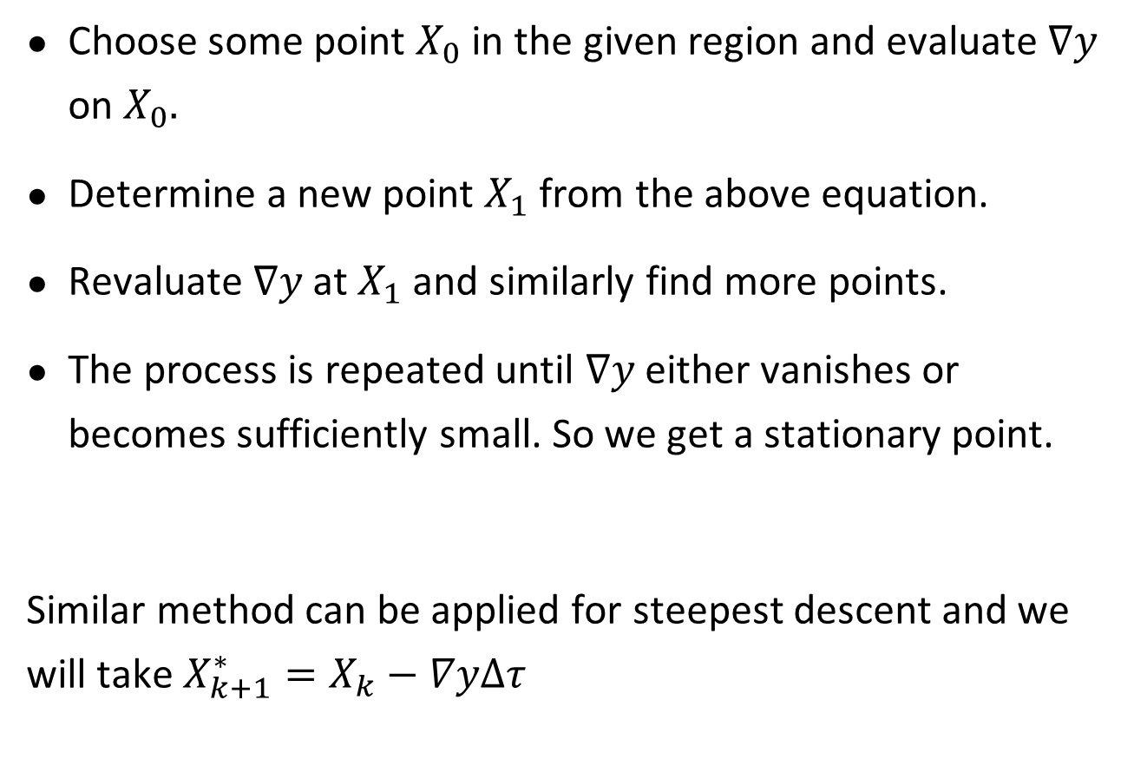
Choose some point $X_{0}$ in the given region and evaluate $∇y$ on $X_{0}.$
Determine a new point $X_{1}$ from the above equation.
Revaluate $∇y$ at $X_{1}$ and similarly find more points.
The process is repeated until $∇y$ either vanishes or becomes sufficiently small. So we get a stationary point.
Similar method can be applied for steepest descent and we will take $X_{k+1}^{∗}=X_{k}−∇yΔτ$

Slide 15
Summary

Slide 16
Thank You

