Slide 1
MTH374: Optimization
For
Master of Mathematics
By
Dr. M. Fazeel Anwar
Assistant Professor
Department of Mathematics, CIIT Islamabad

Slide 2
Lecture 17

Slide 3
Recap
Dichotomous search
Fibonacci search

Slide 4
Today’s Topics
Better version of Fibonacci search
Golden section search
Steepest ascent/descent

Slide 5
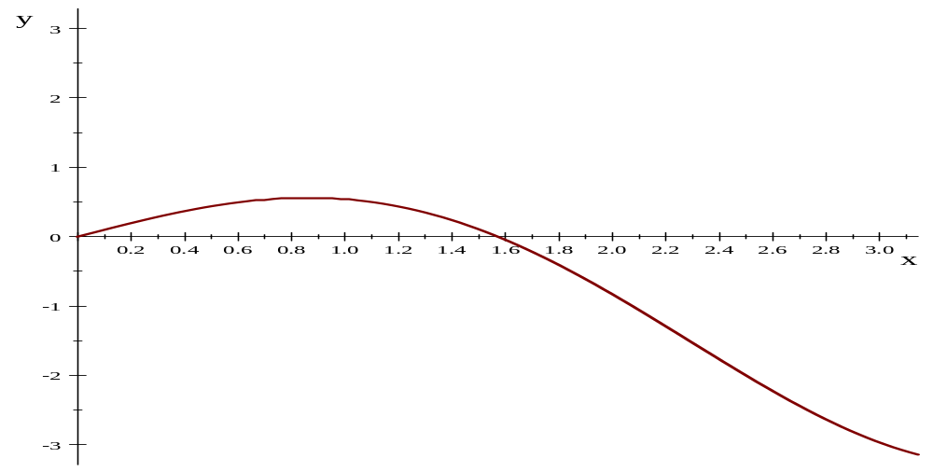
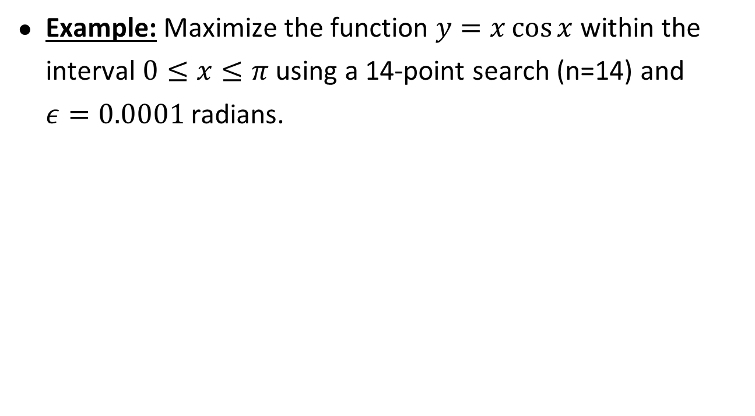
Fibonacci search-I
Example: Maximize the function $y=x\cos{x }$within the interval $0≤x≤π$ using a 14-point search (n=14) and $ε=0.0001$ radians.

Slide 6
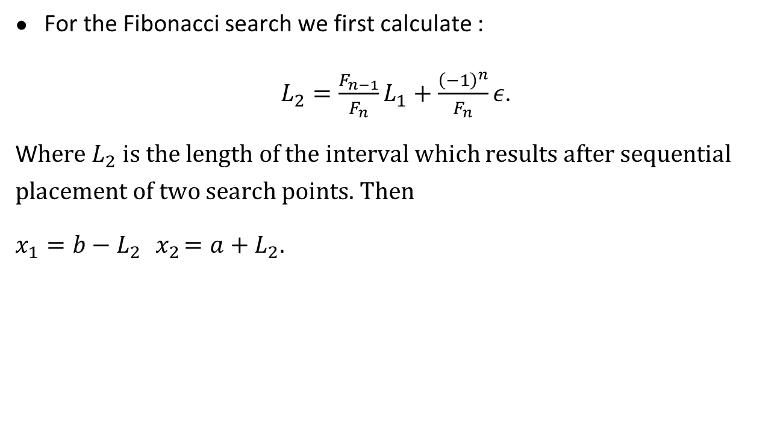
Fibonacci search-II
For the Fibonacci search we first calculate :
$L_{2}=\frac{F_{n−1}}{F_{n}}L_{1}+\frac{{\left(−1\right)}^{n}}{F_{n}}ε$.
W$here$ $L_{2}$ is the length of the interval which results after sequential placement of two search points. Then
$x_{1}=b−L_{2} { x}_{2}=a+L_{2}.$

Slide 11
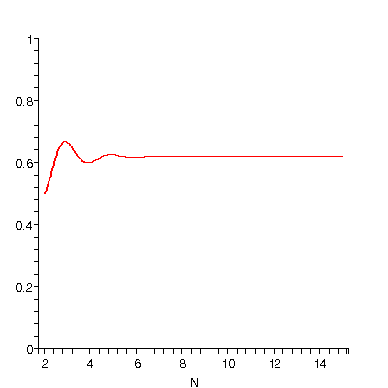
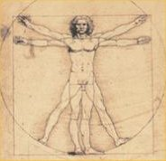
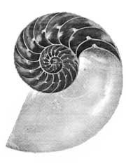
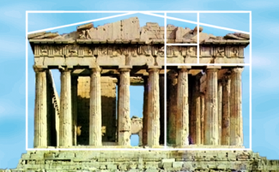
Sectioning – Golden Section
For large N, Fibonacci fraction β converges to golden section ratio φ (0.618034…):
Golden section method uses this constant interval reduction ratio φ
φ
1
1
φ

Slide 13
Golden section search-I
Example: Maximize the function $y=x\cos{x }$within the interval $0≤x≤π$ using a 14-point search (n=14) and $ε=0.0001$ radians.

Slide 14
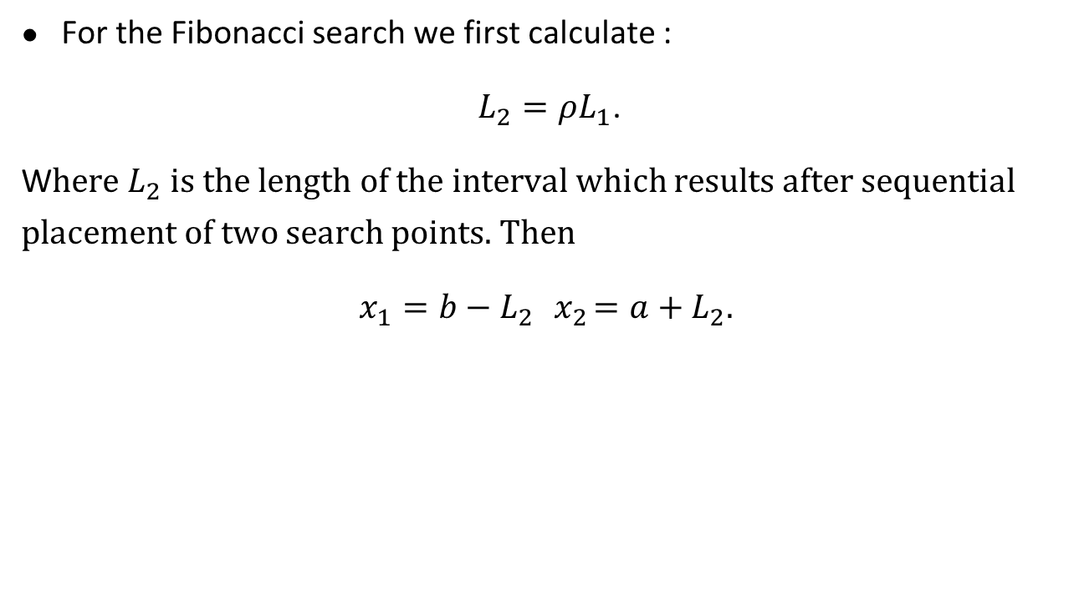
Golden section search-II
For the Fibonacci search we first calculate :
$L_{2}=ρL_{1}$.
W$here$ $L_{2}$ is the length of the interval which results after sequential placement of two search points. Then
$x_{1}=b−L_{2} { x}_{2}=a+L_{2}.$

Slide 16
Sectioning - Golden Section
Origin of golden section:
I₁
I₂ = φI₁
I₂ = φI₁
I₃ = φI₂
Final interval:

Slide 17
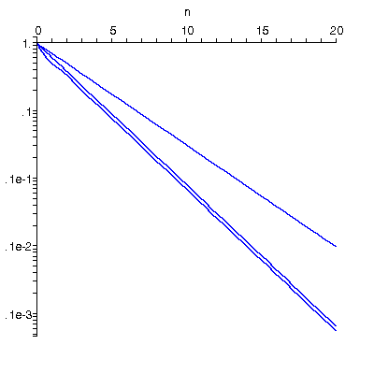
Comparison sectioning methods
Evaluations
Example: reduction to 2% of original interval:
Ideal dichotomous
interval reduction
N
Dichotomous 12
Golden section 9
Fibonacci 8
(Exhaustive 99)
Golden
section
Fibonacci
Conclusion: Golden section simple and near-optimal

Slide 18
Summary

Slide 19
Thank You

