Slide 1
MTH374: Optimization
For
Master of Mathematics
By
Dr. M. Fazeel Anwar
Assistant Professor
Department of Mathematics, CIIT Islamabad

Slide 2
Lecture 16

Slide 3
Recap
Search methods
Dichotomous search

Slide 4
Today’s Topics
Dichotomous search
Fibonacci Search

Slide 5
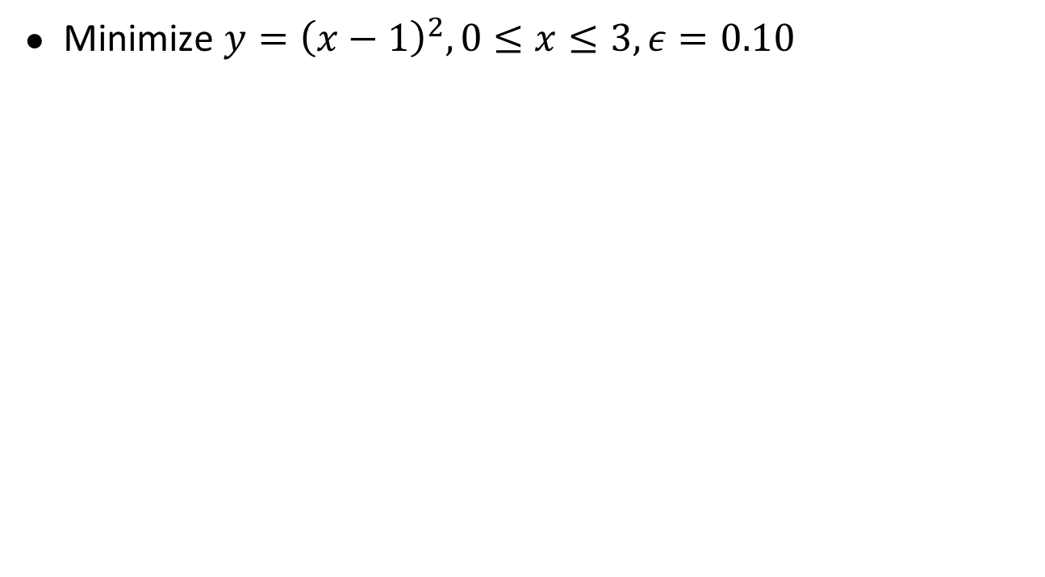
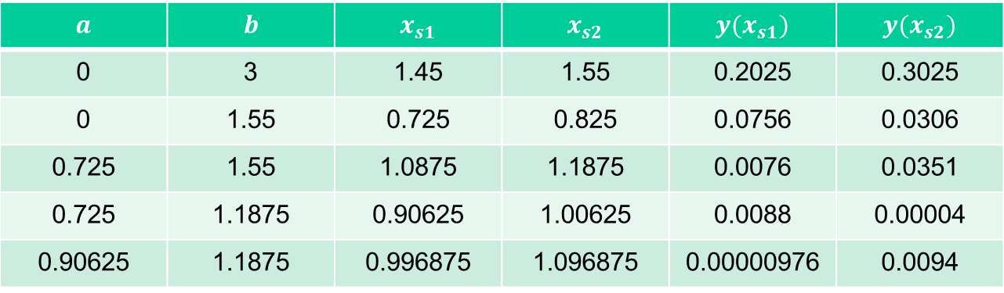
Example-II
Minimize $y={\left(x−1\right)}^{2}, 0≤x≤3, ε=0.10$
$$a$$ | $$b$$ | $$x_{s1}$$ | $$x_{s2}$$ | $$y(x_{s1})$$ | $$y(x_{s2})$$
0 | 3 | 1.45 | 1.55 | 0.2025 | 0.3025
0 | 1.55 | 0.725 | 0.825 | 0.0756 | 0.0306
0.725 | 1.55 | 1.0875 | 1.1875 | 0.0076 | 0.0351
0.725 | 1.1875 | 0.90625 | 1.00625 | 0.0088 | 0.00004
0.90625 | 1.1875 | 0.996875 | 1.096875 | 0.00000976 | 0.0094

Slide 8
Dichotomous search-III
Main Entry: di·chot·o·mous
Pronunciation: dI-'kät-&-m&s also d&-
Function: adjective
: dividing into two parts
Conceptually simple
idea:
  Try to split interval in half in each step
L₀
a₀
L₀/2
ε << L₀
b₀

Slide 9
Dichotomous search-IV
Interval size after 1 step (2 evaluations):
L₀
Interval size after m steps (2m evaluations):

Slide 10
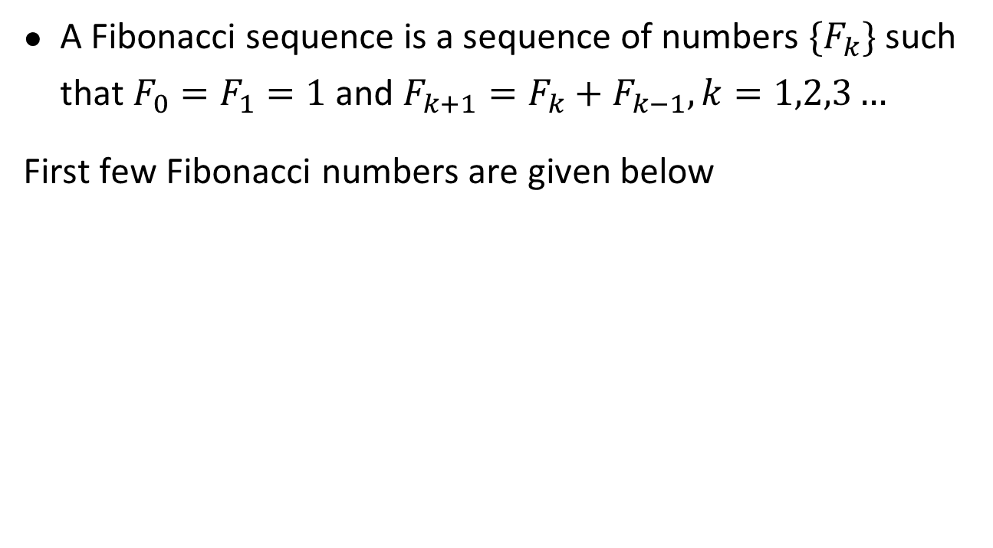
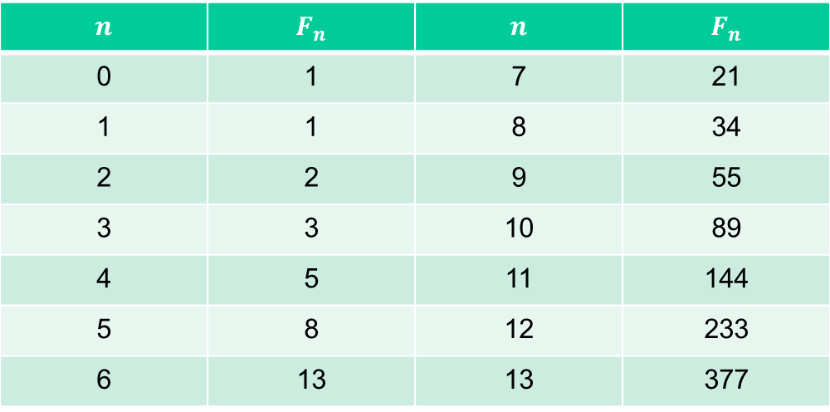
Fibonacci Sequence
A Fibonacci sequence is a sequence of numbers $\{F_{k}\}$ such that $F_{0}=F_{1}=1$ and $F_{k+1}=F_{k}+F_{k−1}, k=1,2,3…$
First few Fibonacci numbers are given below
$$n$$ | $$F_{n}$$ | $$n$$ | $$F_{n}$$
0 | 1 | 7 | 21
1 | 1 | 8 | 34
2 | 2 | 9 | 55
3 | 3 | 10 | 89
4 | 5 | 11 | 144
5 | 8 | 12 | 233
6 | 13 | 13 | 377

Slide 11
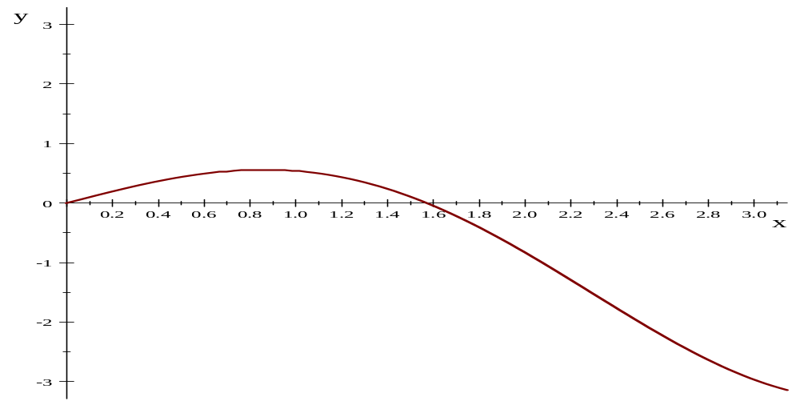
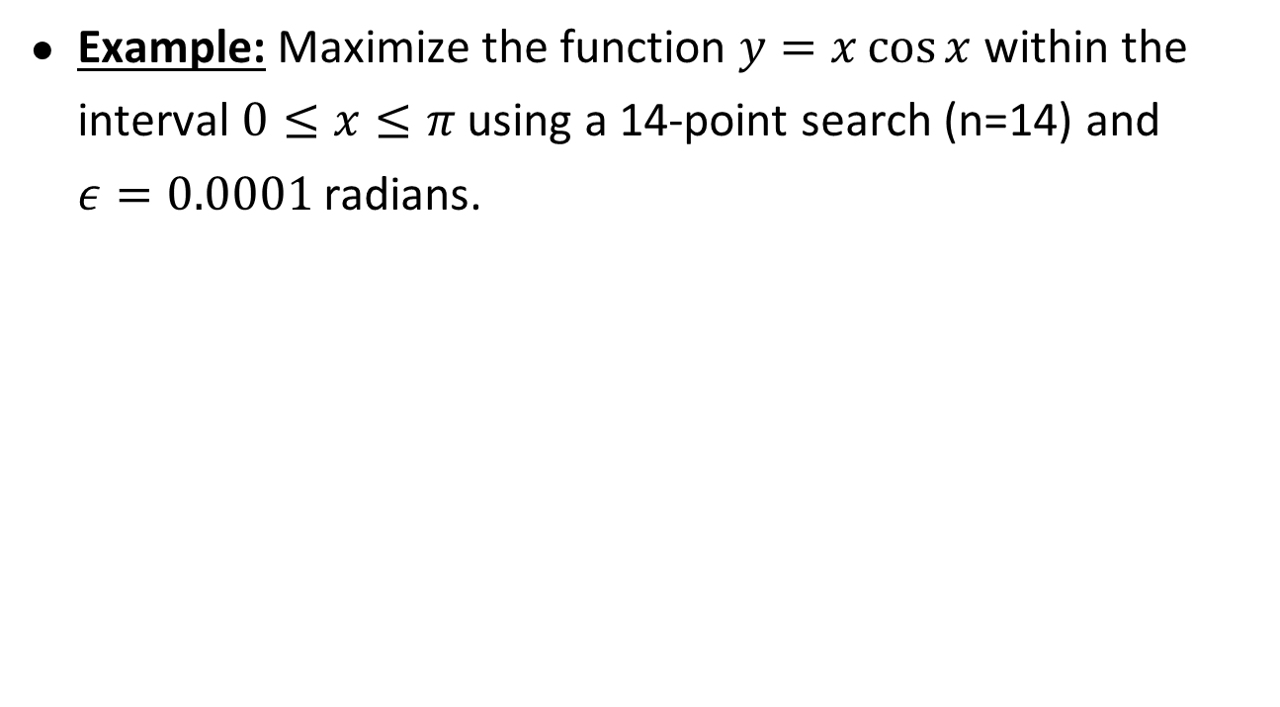
Fibonacci search-I
Example: Maximize the function $y=x\cos{x }$within the interval $0≤x≤π$ using a 14-point search (n=14) and $ε=0.0001$ radians.

Slide 12
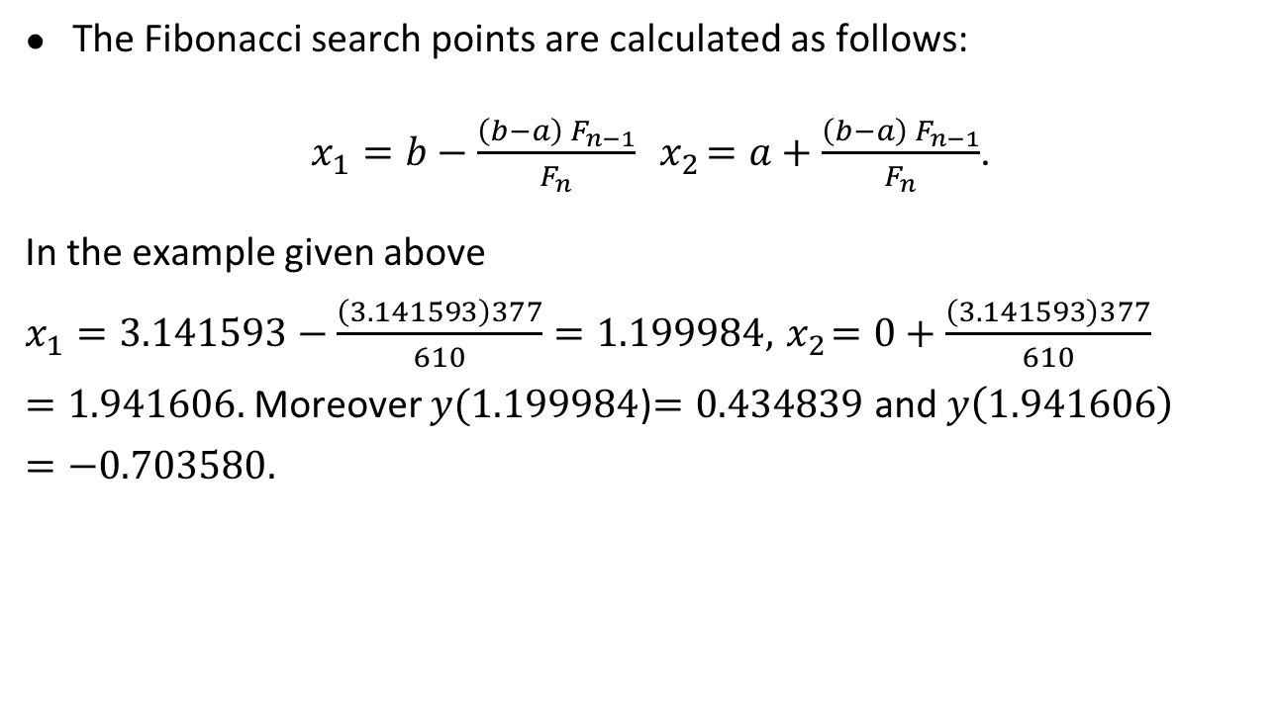
Fibonacci search-II
The Fibonacci search points are calculated as follows:
$x_{1}=b−\frac{\left(b−a\right){ F}_{n−1}}{F_{n}}{ x}_{2}=a+\frac{\left(b−a\right){ F}_{n−1}}{F_{n}}$.
In the example given above $x_{1}=3.141593−\frac{\left(3.141593\right)377}{610}=1.199984, { x}_{2}=0+\frac{\left(3.141593\right)377}{610}=1.941606.$Moreover $y(1.199984$)$=0.434839$ and $y\left(1.941606\right)=−0.703580.$

Slide 13
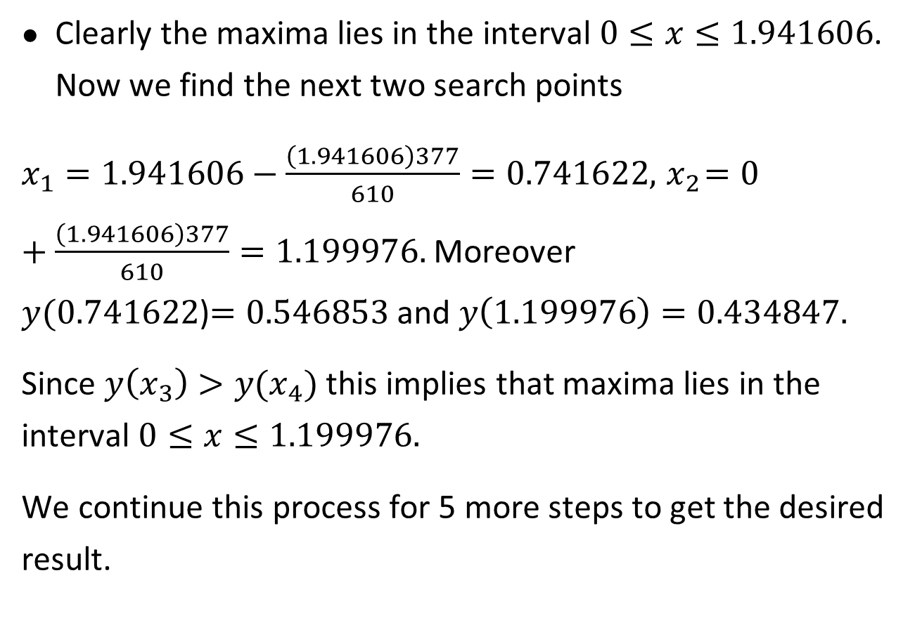
Clearly the maxima lies in the interval $0≤x≤1.941606$. Now we find the next two search points
$x_{1}=1.941606−\frac{\left(1.941606\right)377}{610}=0.741622, { x}_{2}=0+\frac{\left(1.941606\right)377}{610}=1.199976.$Moreover $y(0.741622$)$=0.546853$ and $y\left(1.199976\right)=0.434847.$
Since $y\left(x_{3}\right)>y(x_{4})$ this implies that maxima lies in the interval $0≤x≤1.199976.$
We continue this process for 5 more steps to get the desired result.

Slide 17
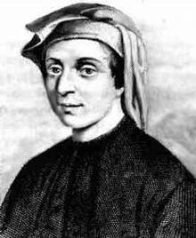
Sectioning - Fibonacci
Situation: minimum bracketed between x₁ and x₃ :
Fibonacci,
1180-1250
x₁
x₂
x₄
x₃
x₄
Test new points and reduce interval
Optimal point placement?

Slide 18

Optimal sectioning
Fibonacci method: optimal sectioning method
Given:
  Initial interval [a₀, b₀]
  Predefined total number of evaluations N

Slide 21
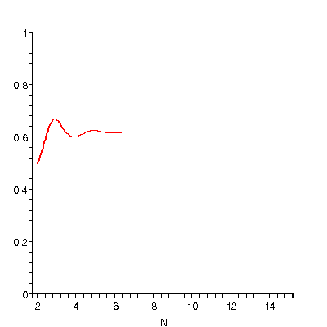
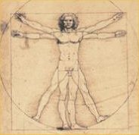
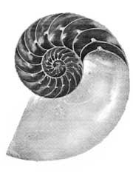
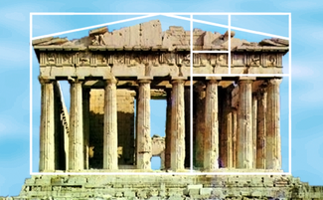
Sectioning – Golden Section
For large N, Fibonacci fraction β converges to golden section ratio φ (0.618034…):
Golden section method uses this constant interval reduction ratio φ
φ
1
1
φ

Slide 22
Sectioning - Golden Section
Origin of golden section:
I₁
I₂ = φI₁
I₂ = φI₁
I₃ = φI₂
Final interval:

Slide 23
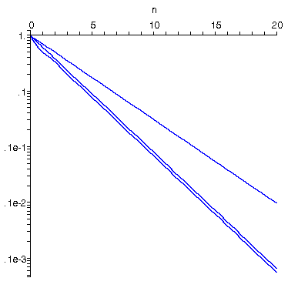
Comparison sectioning methods
Evaluations
Example: reduction to 2% of original interval:
Ideal dichotomous
interval reduction
N
Dichotomous 12
Golden section 9
Fibonacci 8
(Exhaustive 99)
Golden
section
Fibonacci
Conclusion: Golden section simple and near-optimal

Slide 24
Summary

Slide 25
Thank You

