Slide 1
MTH374: Optimization
For
Master of Mathematics
By
Dr. M. Fazeel Anwar
Assistant Professor
Department of Mathematics, CIIT Islamabad

Slide 2
Lecture 15

Slide 3
Recap
One dimensional unconstrained optimization
Search methods

Slide 4
Today’s Topics
Search methods
Dichotomous search

Slide 5
Brute-force approach
Simple approach: exhaustive search
Disadvantage: rather inefficient
L₀
f
n points:
Final interval size =
L_{n}
x

Slide 6
Basic strategy of 0th order methods for single-variable case
Find interval [a₀, b₀] that contains the minimum (bracketing)
Iteratively reduce the size of the interval [a_{k}, b_{k}] (sectioning)
Sectioning methods:
  Dichotomous search
  Fibonacci method
  Golden section method

Slide 7
Bracketing the minimum
f
[a₀, b₀]
x
x₁
x₂ = x₁+Δ
x₃ = x₂+γΔ
x₄ = x₃+γ²Δ
Starting point x₁, stepsize Δ, expansion parameter γ: user-defined

Slide 8
Unimodality
Bracketing and sectioning methods work best for unimodal functions:
“An unimodal function consists of exactly one monotonically increasing and decreasing part”

Slide 9
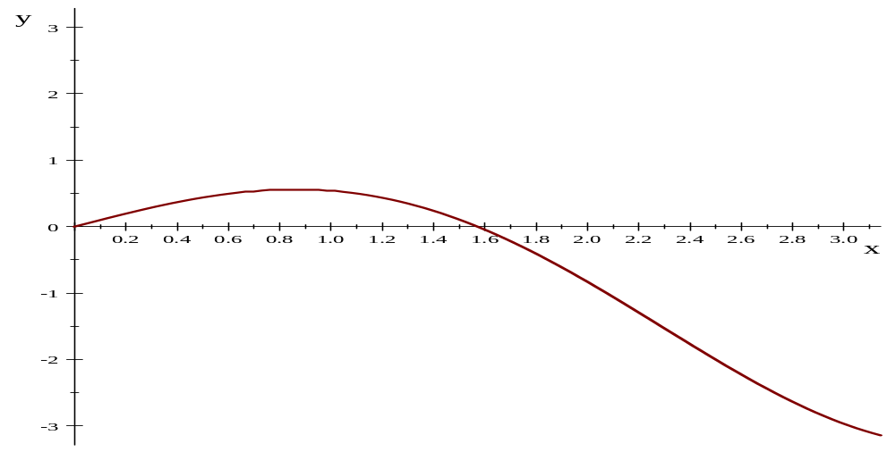
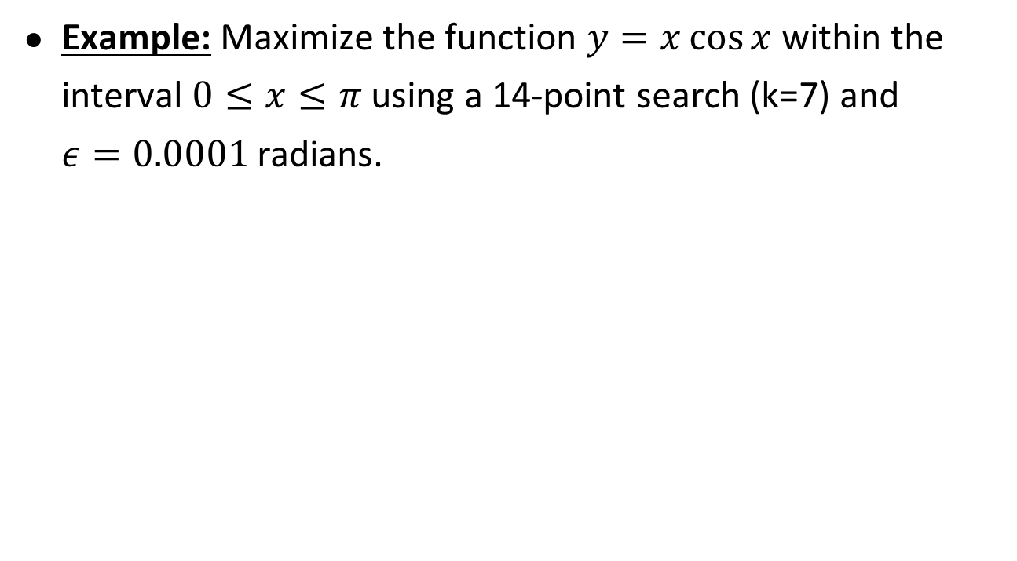
Dichotomous search
Example: Maximize the function $y=x\cos{x }$within the interval $0≤x≤π$ using a 14-point search (k=7) and $ε=0.0001$ radians.

Slide 10
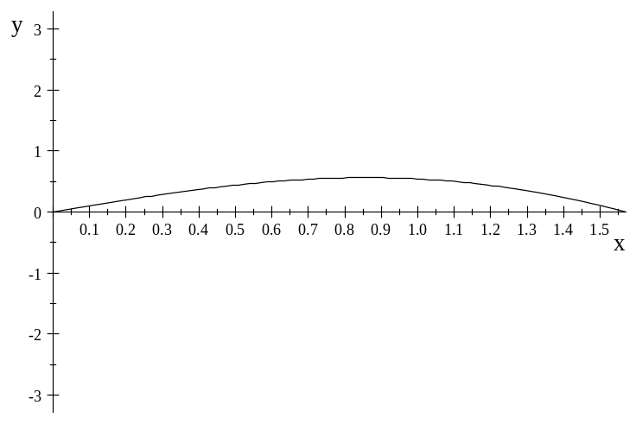
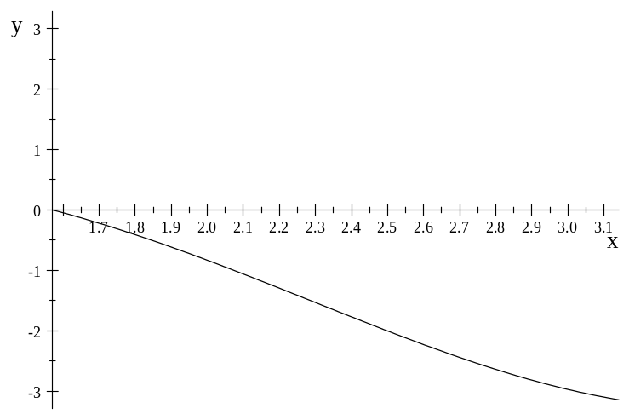
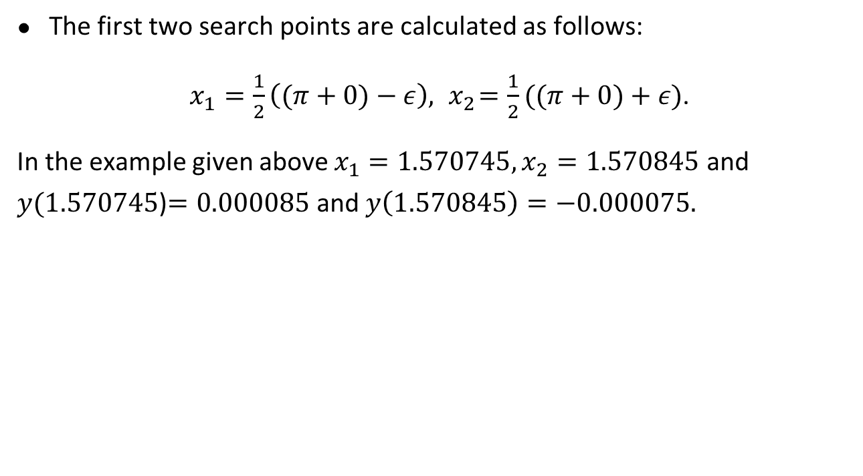
Dichotomous search-II
The first two search points are calculated as follows:
$x_{1}=\frac{1}{2}\left((π+0)−ε\right), { x}_{2}=\frac{1}{2}((π+0)+ε)$.
In the example given above $x_{1}=1.570745, x_{2}=1.570845$ and $y(1.570745$)$=0.000085$ and $y\left(1.570845\right)=−0.000075.$

Slide 11
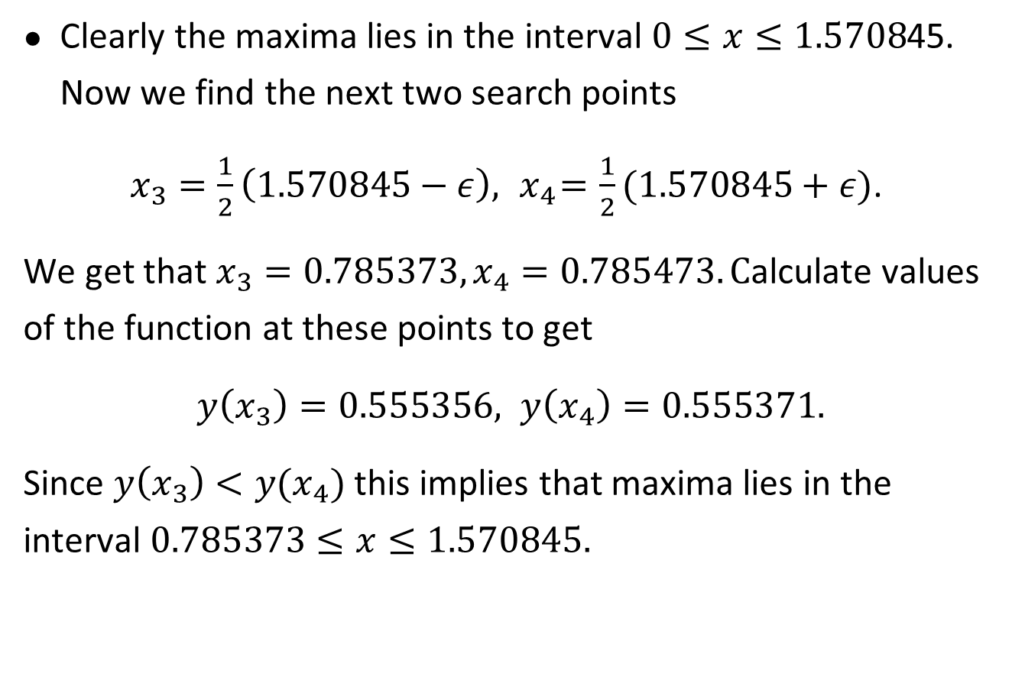
Clearly the maxima lies in the interval $0≤x≤1.5708$45. Now we find the next two search points
$x_{3}=\frac{1}{2}\left(1.570845−ε\right), { x}_{4}=\frac{1}{2}(1.570845+ε)$.
We get that $x_{3}=0.785373, x_{4}=0.785473. C$alculate values of the function at these points to get
$y\left(x_{3}\right)=0.555356, y\left(x_{4}\right)=0.555371.$
Since $y\left(x_{3}\right)<y(x_{4})$ this implies that maxima lies in the interval $0.785373≤x≤1.570845.$

Slide 12
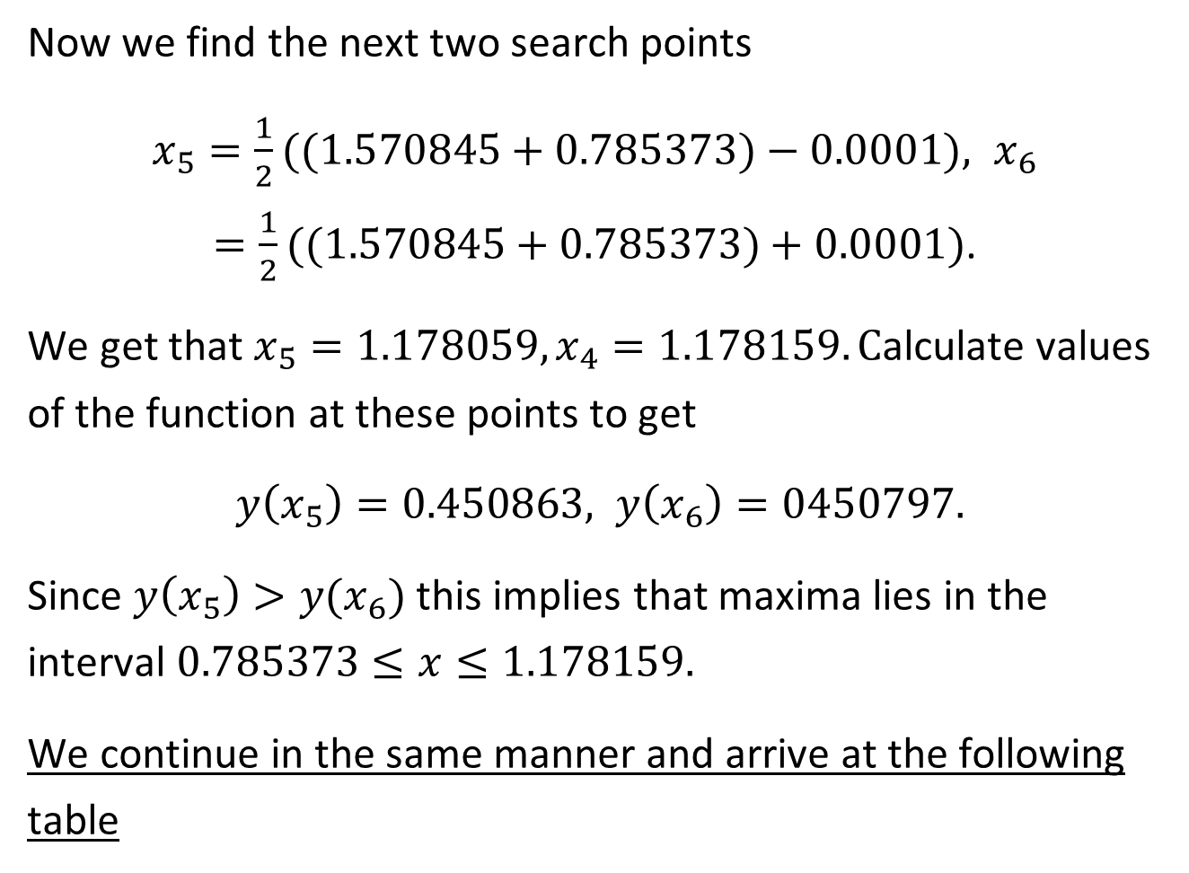
Now we find the next two search points
$x_{5}=\frac{1}{2}((1.570845+0.785373)−0.0001), { x}_{6}=\frac{1}{2}((1.570845+0.785373)+0.0001)$.
We get that $x_{5}=1.178059, x_{4}=1.178159. C$alculate values of the function at these points to get
$y\left(x_{5}\right)=0.450863, y\left(x_{6}\right)=0450797.$
Since $y\left(x_{5}\right)>y(x_{6})$ this implies that maxima lies in the interval $0.785373≤x≤1.178159.$
We continue in the same manner and arrive at the following table

Slide 13
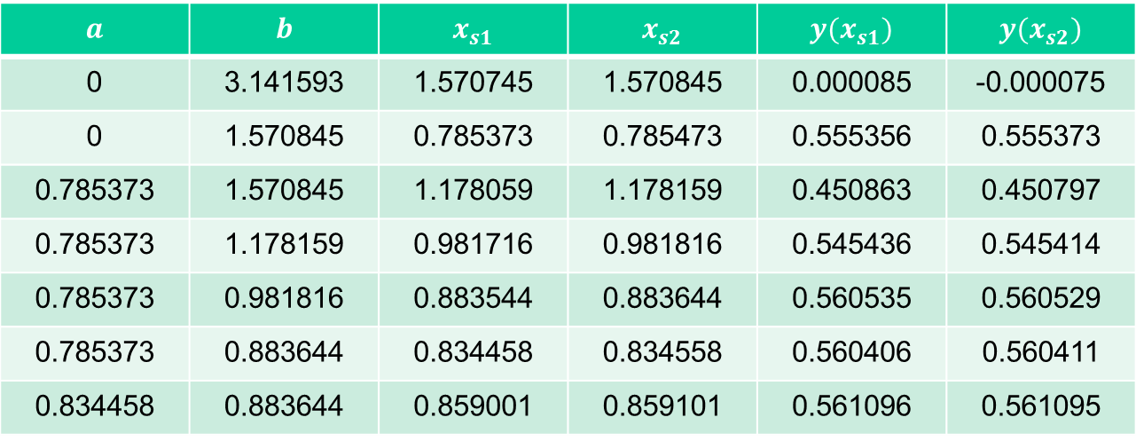
$$a$$ | $$b$$ | $$x_{s1}$$ | $$x_{s2}$$ | $$y(x_{s1})$$ | $$y(x_{s2})$$
0 | 3.141593 | 1.570745 | 1.570845 | 0.000085 | -0.000075
0 | 1.570845 | 0.785373 | 0.785473 | 0.555356 | 0.555373
0.785373 | 1.570845 | 1.178059 | 1.178159 | 0.450863 | 0.450797
0.785373 | 1.178159 | 0.981716 | 0.981816 | 0.545436 | 0.545414
0.785373 | 0.981816 | 0.883544 | 0.883644 | 0.560535 | 0.560529
0.785373 | 0.883644 | 0.834458 | 0.834558 | 0.560406 | 0.560411
0.834458 | 0.883644 | 0.859001 | 0.859101 | 0.561096 | 0.561095

Slide 15
Summary

Slide 16
Thank You

