Slide 1
MTH374: Optimization
For
Master of Mathematics
By
Dr. M. Fazeel Anwar
Assistant Professor
Department of Mathematics, CIIT Islamabad

Slide 2
Lecture 14

Slide 3
Recap
Lagrange multiplier with inequality constraints
Examples

Slide 4
Today’s Topics
One dimensional unconstrained optimization
Search methods
Dichotomous search

Slide 5
One dimensional unconstrained optimization
Find maxima/minima for a one variable function
We already know how to do this! Or do we?
Why develop new methods?
Every method has its own pros and cons

Slide 7
Unconstrained optimization algorithms
Single-variable methods
  0th order (involving only f )
  1st order (involving f and f ’ )
  2nd order (involving f, f ’ and f ” )
Multiple variable methods

Slide 8
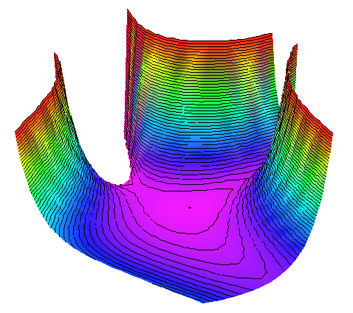
Why optimization algorithms?
Optimality conditions often cannot be used:
  Function not explicitly known (e.g. simulation)
  Conditions cannot be solved analytically
Example:
Stationary points:

Slide 9


0th order methods: pro/con
Strengths:
No derivatives needed
  Work also for discontinuous / non-differentiable functions
  Easy to program
  Robust
Weaknesses:
  (Usually) less efficient than higher order methods (many function evaluations)

Slide 10
Minimization with one variable
Why?
  Simplest case: good starting point
  Used in multi-variable methods during line search
Setting:
Iterative process:
f
Model
Optimizer
x

Slide 11

Termination criteria
Stop optimization iterations when:
  Solution is sufficiently accurate (check optimality criteria)
  Progress becomes too slow:
  Maximum resources have been spent
  The solution diverges
  Cycling occurs
x_{b}
x_{a}

Slide 12
Brute-force approach
Simple approach: exhaustive search
Disadvantage: rather inefficient
L₀
f
n points:
Final interval size =
L_{n}
x

Slide 15
Summary

Slide 16
Thank You

