Slide 1
MTH374: Optimization
For
Master of Mathematics
By
Dr. M. Fazeel Anwar
Assistant Professor
Department of Mathematics, CIIT Islamabad

Slide 2
Lecture 13

Slide 3
Recap
Lagrange multiplier with two equality constraints
Lagrange multiplier with inequality constraints

Slide 4
Today’s Topics
Lagrange multiplier with inequality constraints
One dimensional unconstrained optimization
Search methods
Dichotomous search

Slide 5
Lagrange Multipliers-IV
Constrained Extremum principle for one objective function and inequality constraints

Slide 7
Algorithm for LM with inequality constraints
First ignore the inequality constraints and proceed to extremize the objective function subject to the equality constraints, using the Lagrange-multiplier technique.
If the solution obtained above also satisfies the inequality constraints then the extremum lies within the boundaries of the constrained region and the problem is solved.
If one or more inequality constraint is violated then the solution will fall on a region boundary.
We then allow one of the inequality constraint to become an equality and repeat the procedure.
The above step is repeated until we obtained a desired solution. We may have to go through all combinations.

Slide 8
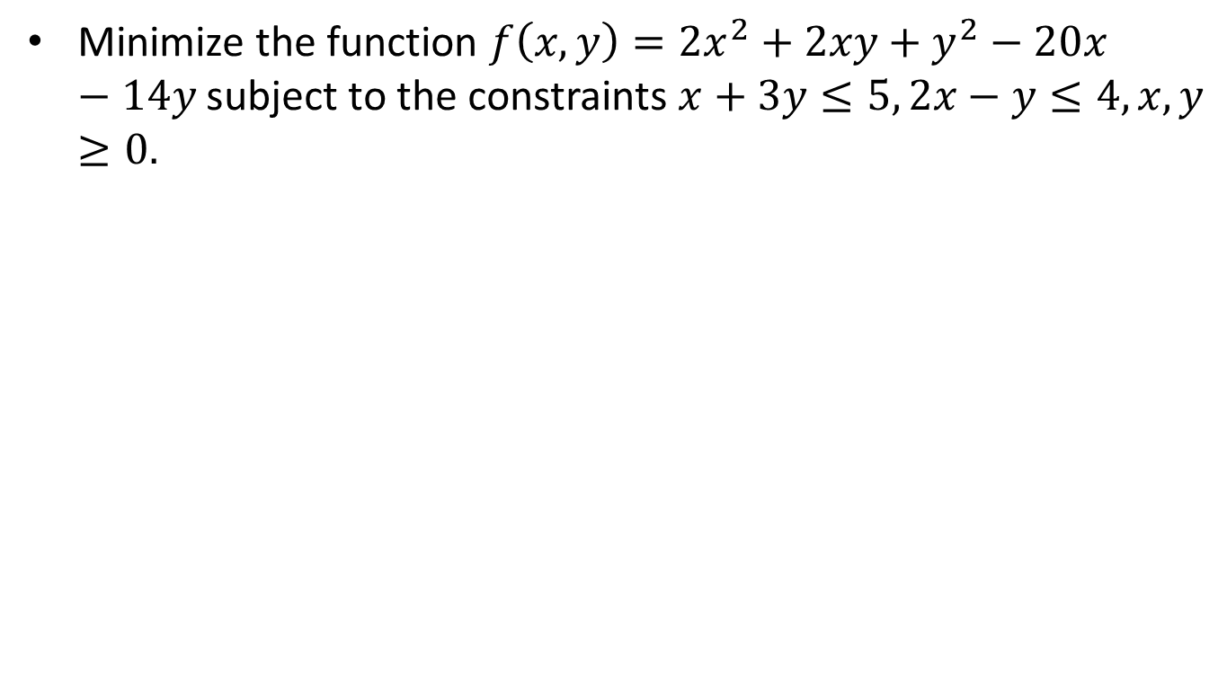
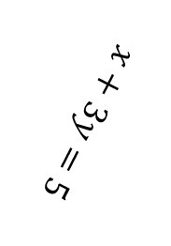
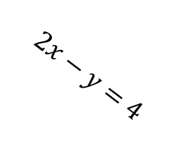
Example-X
Minimize the function $f\left(x,y\right)=2x^{2}+2xy+y^{2}−20x −14y$subject to the constraints $x+3y≤5, 2x−y≤4, x,y≥0.$
C
0
A
$$x+3y=5$$
B
$$2x−y=4$$

Slide 14
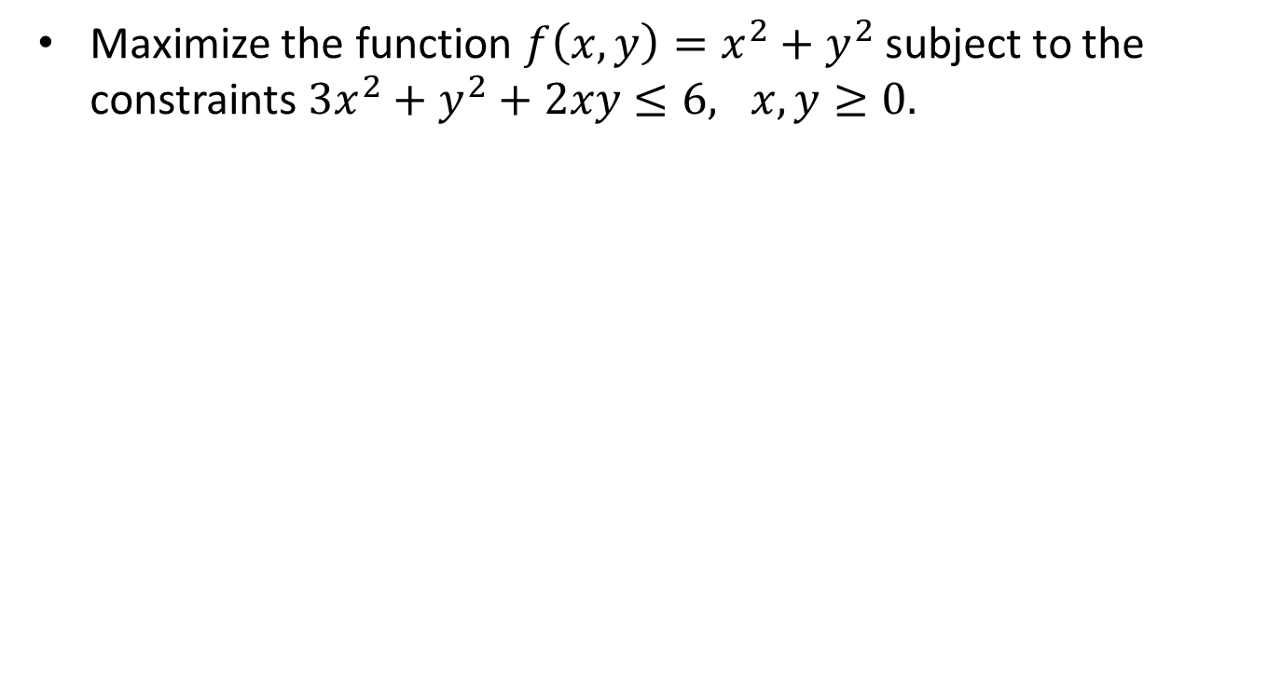
Example-XI
Maximize the function $f\left(x,y\right)=x^{2}+y^{2}$subject to the constraints $3x^{2}+y^{2}+2xy≤6, x,y≥0.$

Slide 19
One dimensional unconstrained optimization
Find maxima/minima for a one variable function
We already know how to do this! Or do we?
Why develop new methods?
Every method has its own pros and cons

Slide 21
Unconstrained optimization algorithms
Single-variable methods
  0th order (involving only f )
  1st order (involving f and f ’ )
  2nd order (involving f, f ’ and f ” )
Multiple variable methods

Slide 22
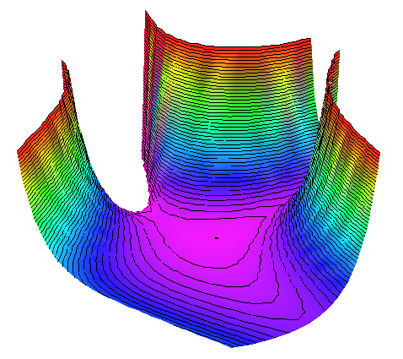
Why optimization algorithms?
Optimality conditions often cannot be used:
  Function not explicitly known (e.g. simulation)
  Conditions cannot be solved analytically
Example:
Stationary points:

Slide 23


0th order methods: pro/con
Strengths:
No derivatives needed
  Work also for discontinuous / non-differentiable functions
  Easy to program
  Robust
Weaknesses:
  (Usually) less efficient than higher order methods (many function evaluations)

Slide 24
Minimization with one variable
Why?
  Simplest case: good starting point
  Used in multi-variable methods during line search
Setting:
Iterative process:
f
Model
Optimizer
x

Slide 25

Termination criteria
Stop optimization iterations when:
  Solution is sufficiently accurate (check optimality criteria)
  Progress becomes too slow:
  Maximum resources have been spent
  The solution diverges
  Cycling occurs
x_{b}
x_{a}

Slide 26
Brute-force approach
Simple approach: exhaustive search
Disadvantage: rather inefficient
L₀
f
n points:
Final interval size =
L_{n}
x

Slide 27
Basic strategy of 0th order methods for single-variable case
Find interval [a₀, b₀] that contains the minimum (bracketing)
Iteratively reduce the size of the interval [a_{k}, b_{k}] (sectioning)
Approximate the minimum by the minimum of a simple interpolation function over the interval [a_{N}, b_{N}]
Sectioning methods:
  Dichotomous search
  Fibonacci method
  Golden section method

Slide 28
Bracketing the minimum
f
[a₀, b₀]
x
x₁
x₂ = x₁+Δ
x₃ = x₂+γΔ
x₄ = x₃+γ²Δ
Starting point x₁, stepsize Δ, expansion parameter γ: user-defined

Slide 29
Unimodality
Bracketing and sectioning methods work best for unimodal functions:
“An unimodal function consists of exactly one monotonically increasing and decreasing part”

Slide 30
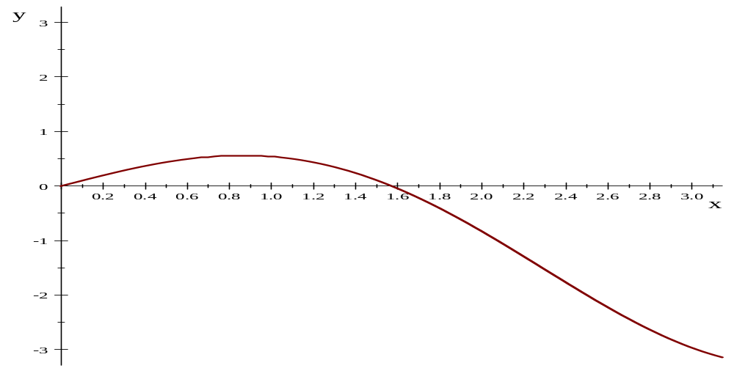
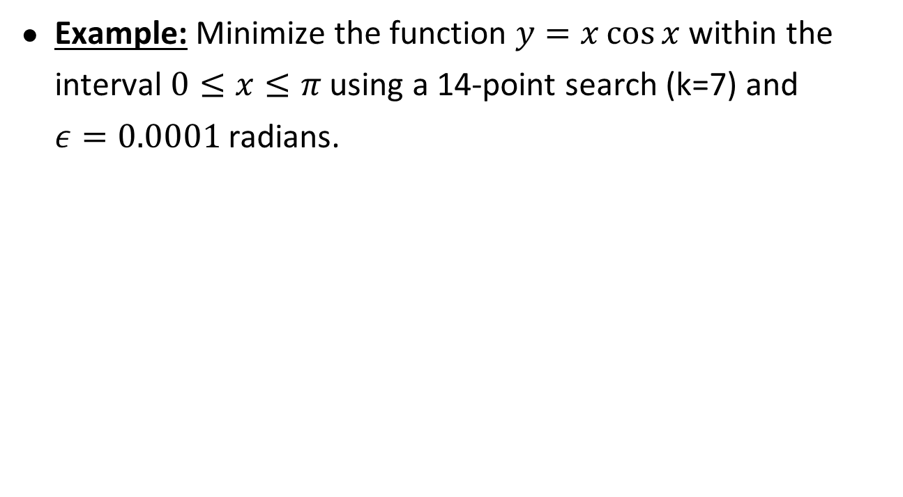
Dichotomous search
Example: Minimize the function $y=x\cos{x }$within the interval $0≤x≤π$ using a 14-point search (k=7) and $ε=0.0001$ radians.

Slide 31
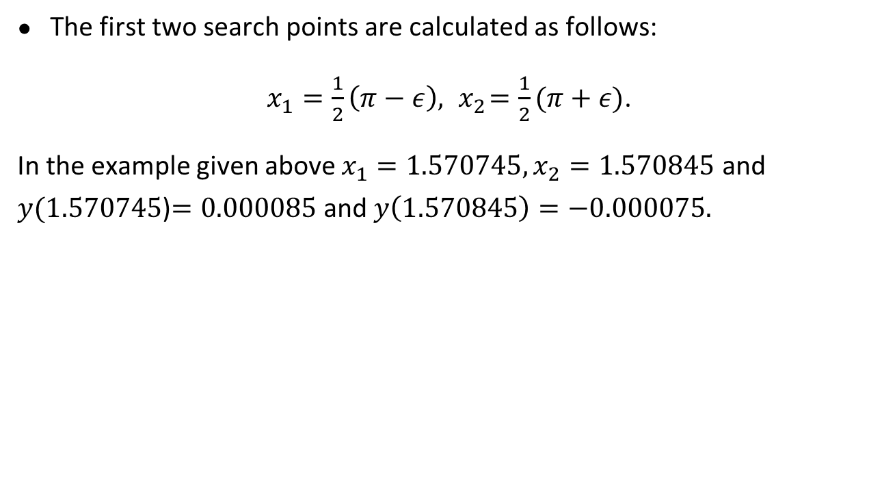
Dichotomous search-II
The first two search points are calculated as follows:
$x_{1}=\frac{1}{2}\left(π−ε\right), { x}_{2}=\frac{1}{2}(π+ε)$.
In the example given above $x_{1}=1.570745, x_{2}=1.570845$ and $y(1.570745$)$=0.000085$ and $y\left(1.570845\right)=−0.000075.$

Slide 32
Dichotomous search
Main Entry: di·chot·o·mous
Pronunciation: dI-'kät-&-m&s also d&-
Function: adjective
: dividing into two parts
Conceptually simple
idea:
  Try to split interval in half in each step
L₀
a₀
L₀/2
δ << L₀
b₀

Slide 33
Dichotomous search II
Interval size after 1 step (2 evaluations):
L₀
Interval size after m steps (2m evaluations):
Proper choice for δ :

Slide 34
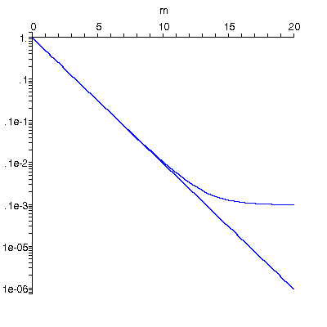
Dichotomous search III
Example: m = 10
m
Ideal
interval
reduction

Slide 35
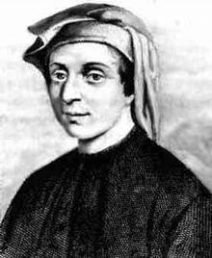
Sectioning - Fibonacci
Situation: minimum bracketed between x₁ and x₃ :
Fibonacci,
1180?-1250?
x₁
x₂
x₄
x₃
x₄
Test new points and reduce interval
Optimal point placement?

Slide 36

Optimal sectioning
Fibonacci method: optimal sectioning method
Given:
  Initial interval [a₀, b₀]
  Predefined total number of evaluations N, or:
  Desired final interval size ε

Slide 37
Fibonacci sectioning - basic idea
Start at final interval and use symmetry and maximum interval reduction:
I_{N}
I_{N-1} = 2I_{N}
I_{N-2} = 3I_{N}
δ << I_{N}
I_{N-3} = 5I_{N}
I_{N-4} = 8I_{N}
I_{N-5} = 13I_{N}
Fibonacci number
Notes:
Yellow point is point that has been added in the previous iteration.

Slide 38
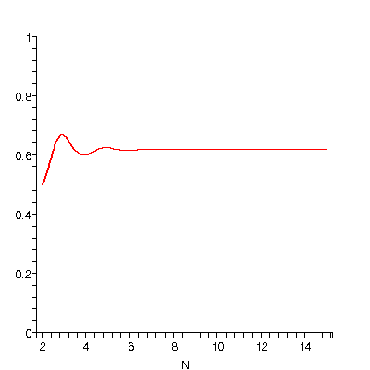
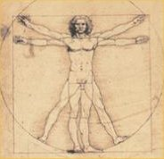
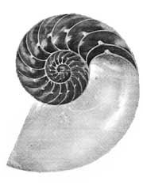
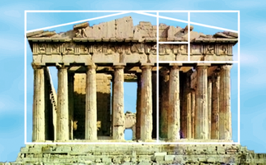
Sectioning – Golden Section
For large N, Fibonacci fraction β converges to golden section ratio φ (0.618034…):
Golden section method uses this constant interval reduction ratio φ
φ
1
1
φ

Slide 39
Sectioning - Golden Section
Origin of golden section:
I₁
I₂ = φI₁
I₂ = φI₁
I₃ = φI₂
Final interval:

Slide 40
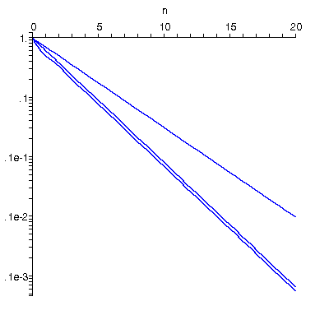
Comparison sectioning methods
Evaluations
Example: reduction to 2% of original interval:
Ideal dichotomous
interval reduction
N
Dichotomous 12
Golden section 9
Fibonacci 8
(Exhaustive 99)
Golden
section
Fibonacci
Conclusion: Golden section simple and near-optimal

Slide 41
Summary

Slide 42
Thank You

