Slide 1
MTH374: Optimization
For
Master of Mathematics
By
Dr. M. Fazeel Anwar
Assistant Professor
Department of Mathematics, CIIT Islamabad

Slide 2
Lecture 12

Slide 3
Recap
Lagrange multiplier with two equality constraints
Examples

Slide 4
Today’s Topics
Lagrange multiplier with two equality constraints
Lagrange multiplier with inequality constraints

Slide 5
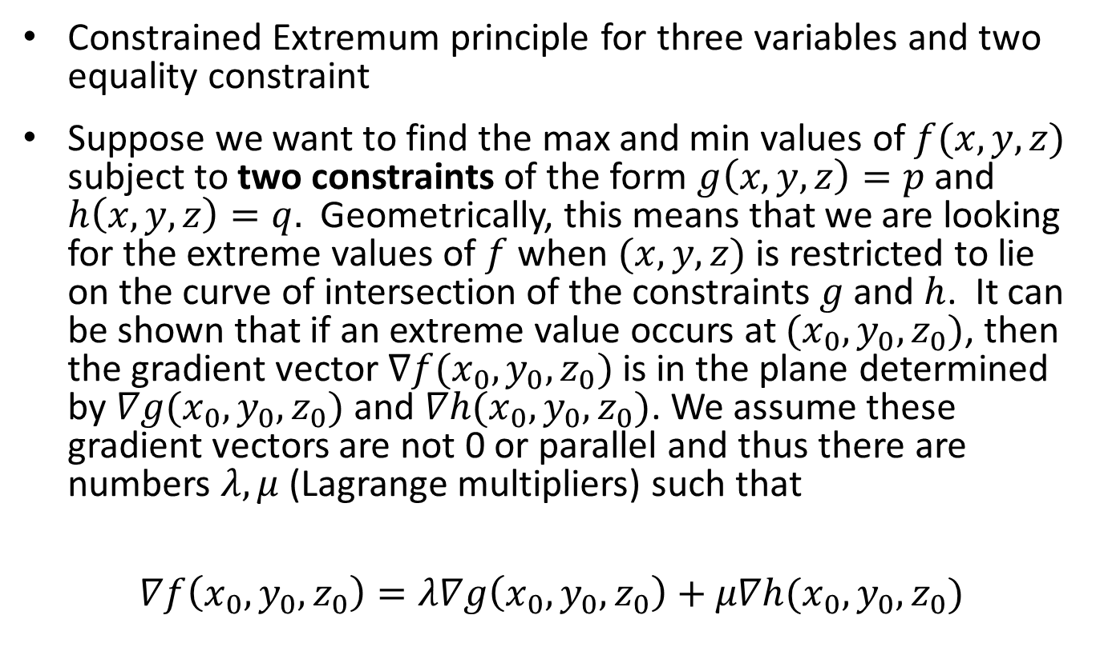
Lagrange Multipliers-III
Constrained Extremum principle for three variables and two equality constraint
Suppose we want to find the max and min values of $f(x,y,z)$subject to two constraints of the form $g\left(x,y,z\right)=p$and $h\left(x,y,z\right)=q.$Geometrically, this means that we are looking for the extreme values of $f$when $(x,y,z)$is restricted to lie on the curve of intersection of the constraints $g$and $h$. It can be shown that if an extreme value occurs at $(x_{0},y_{0},z_{0})$, then the gradient vector $∇f(x_{0},y_{0},z_{0})$is in the plane determined by $∇g(x_{0},y_{0},z_{0})$and $∇h(x_{0},y_{0},z_{0})$. We assume these gradient vectors are not 0 or parallel and thus there are numbers $λ,μ$(Lagrange multipliers) such that
$$∇f\left(x_{0},y_{0},z_{0}\right)=λ∇g\left(x_{0},y_{0},z_{0}\right)+μ∇h(x_{0},y_{0},z_{0})$$

Slide 6
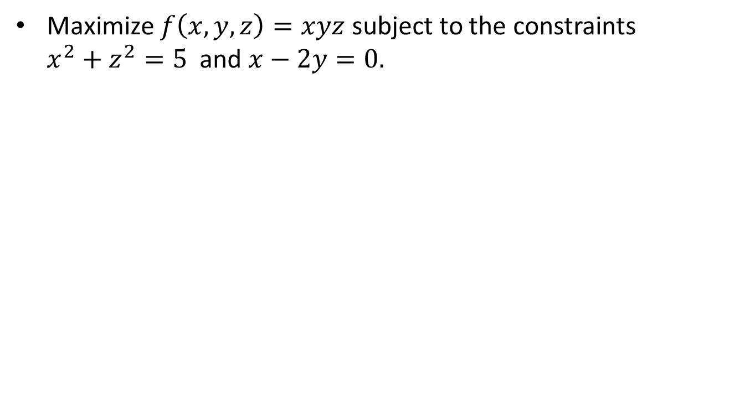
Example-VII
Maximize $f\left(x,y,z\right)=xyz$ subject to the constraints $x^{2}+z^{2}=5$ and $x−2y=0.$

Slide 13
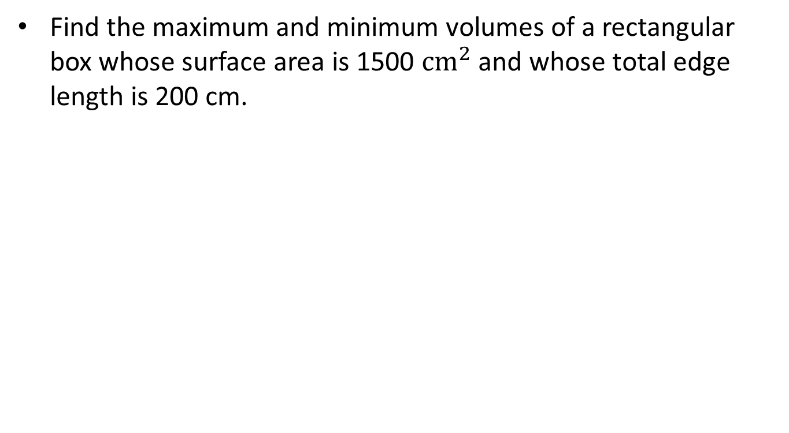
Example-VIII
Find the maximum and minimum volumes of a rectangular box whose surface area is 1500 $cm^{2}$and whose total edge length is 200 cm.

Slide 14
Lagrange Multipliers-IV
Constrained Extremum principle for one objective function and inequality constraints

Slide 15
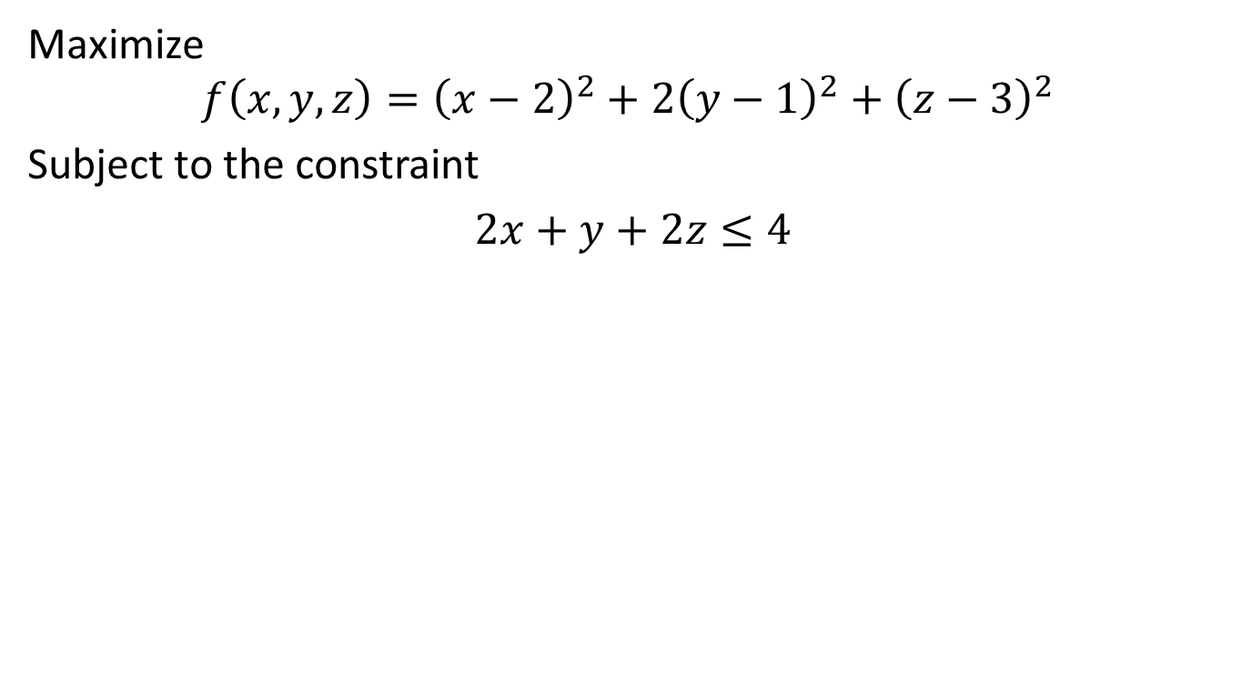
Example-IX
Maximize
$$f\left(x,y,z\right)={\left(x−2\right)}^{2}+2{\left(y−1\right)}^{2}+{\left(z−3\right)}^{2}$$
Subject to the constraint
$2x+y+2z≤4$

Slide 17
Summary

Slide 18
Thank You

